Slide 1
Pricing 101
Pricing Basics
How it works
Quick Tips & Things to Know

Slide 2
Intro to Pricing
Setting pricing…the beginning
Step 1
Product & Sourcing sources the product and determines final cost of product (including cost or product plus taxes, duty and freight.
Step 2
Product & Sourcing works with Division VP to determine List Price
Step 3
Divisional VP determines customer and tiered pricing considering a number of additional factors including customer programs/fees, royalties, etc.

Slide 3
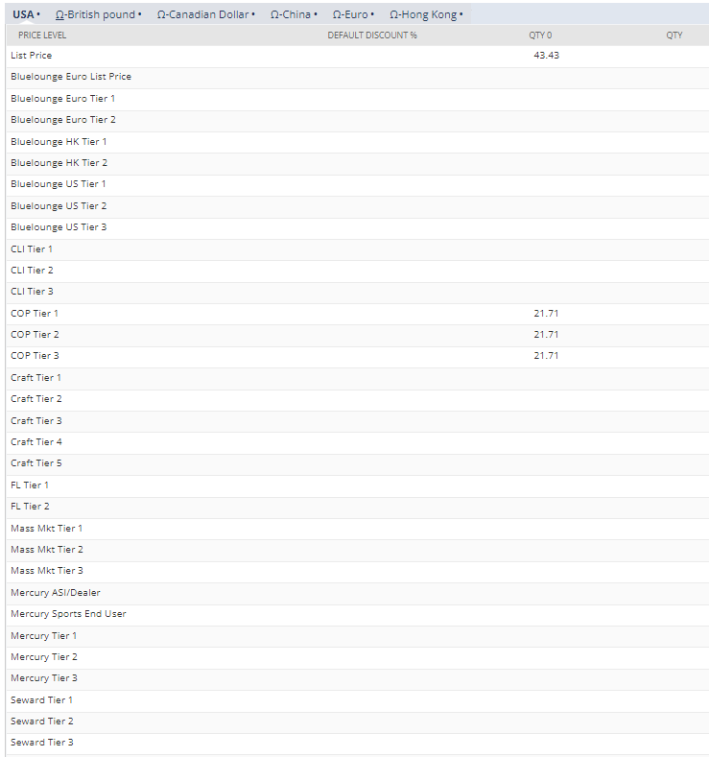
Pricing tab: types of pricing
LIST PRICE: Suggested retail price.
PRICE LEVELS (TIERS): Grouping customers into a level (by division) to all receive the same pricing structure (i.e. 50% off list, etc.).

Slide 4
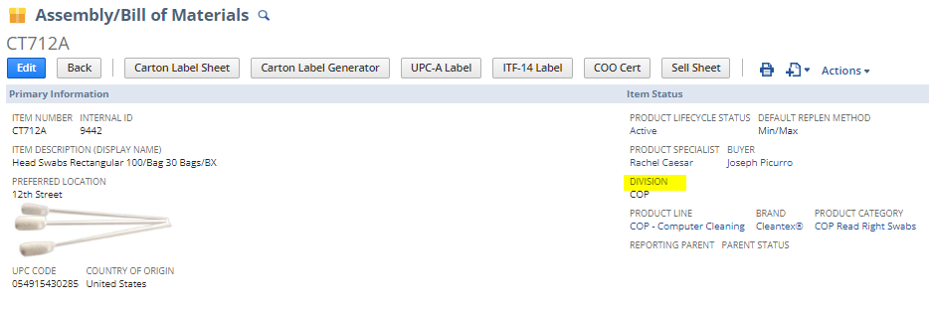
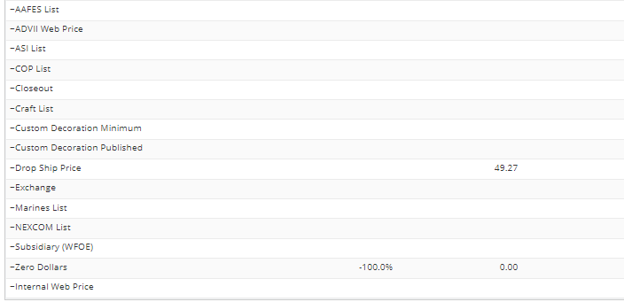
Pricing tab: types of pricing
CUSTOMER OR DIVISION LIST PRICE: Retail or selling price for specific divisions or customer.
CLOSEOUT PRICE: Price for liquidate or closeout products no matter the customer.
DROP SHIP PRICE: Price for select group of products that we will ship direct to the consumer.
WEB PRICE: Price displayed on Advantus owned websites. If nothing is entered, the list price will display.
CUSTOMER SPECIFIC (CUSTOM PRICING): Unique pricing specific to that customer & product combination. Pricing can be located under that customer number
Notes:
Pause for questions after this slide

Slide 5
Types of pricing
Customer Specific
Price Level
Quantity Break

Slide 6
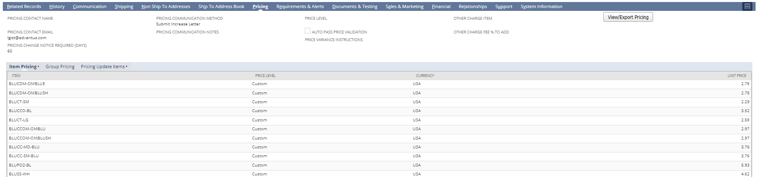
Types of pricing
Customer Specific
Used to record pricing that is specific to that customer only
Maintained on the customer record-pricing subtab
Each item or product is assigned a custom price

Slide 7
Types of pricing
Price Level
Used to record pricing that follows a specific structure for a group/category of accounts
Maintained on the item record-pricing subtab
Generally each level or “tier” is a specific percentage off list price (ex. 50% off)
Quantity Break
Used to record pricing equated to a specific quantity “break” or level that a customer must order
Maintained on the item record-pricing subtab
Very rare occurrence; generally this is for accounts that purchase larger pallet quantities or purchase warehouse items
Notes:
Any questions?

Slide 8
Adding customer specific pricing to customer record
Same Day
Not often used
Edit the Customer Record and add the item with either price level, list price, or a custom price
Future Date, Manual
Used for a set of 1-10 items
Must be entered by EOB the day before pricing needs to take effect
Use for:
Item Price Add/Update or Removal
Customer Price Add/Update or Removal
Future Date, Bulk
Used for a set of 10+ items
Must be entered by EOB the day before pricing needs to take effect
Use for:
Item Price Add/Update or Removal
Customer Price Add/Update or Removal

Slide 9
Combinations of pricing
Customers can have a combination of pricing
Each division sets their own pricing for customers
Example: McMaster Carr
Price Level: all items will default to this price tier for this account; COP Tier 2
Item Pricing: if the account purchases an item at a price that is different than the Price Level (COP Tier 2), then it needs to be listed here
This can be a tier or an alternative list price OR a custom price

Slide 10
Combinations of pricing

Slide 11
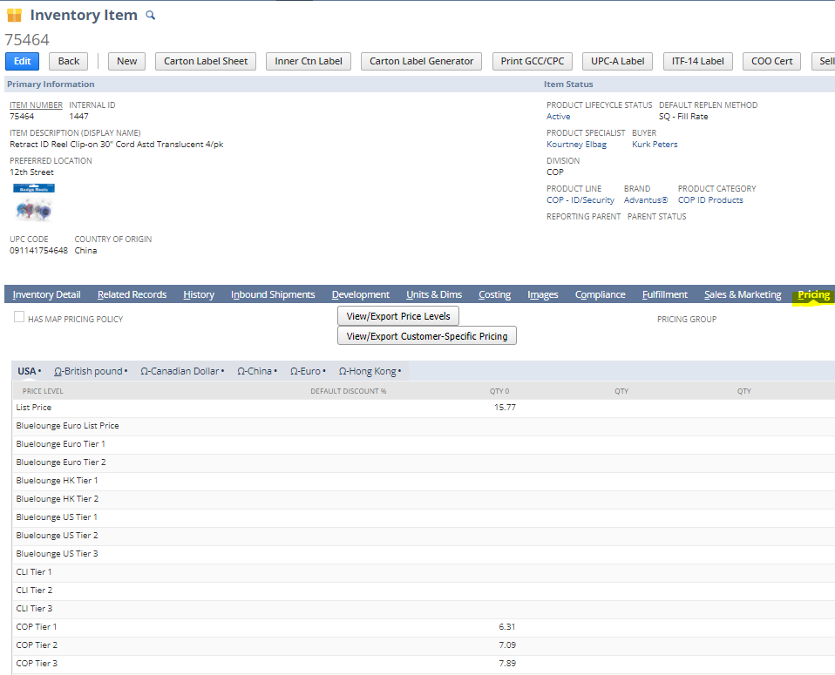
How to look up pricing
By Item
Open the Item record
Click on the Pricing tab
Look for the tier and note the price

Slide 12
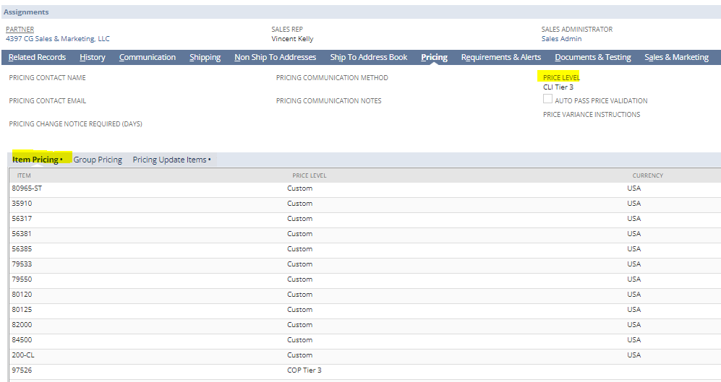
How to look up pricing
By Customer
Open the Customer record
Click on the Pricing tab
Look for the item number under the Item Pricing
If the item is not listed here, refer to the Price Level
If Unsure:
Reach out to the Sales Administrator on the Customer Record

Slide 13
Pricing hierarchy
When a PO is placed, pricing is pulled in the below order:
First, the order looks to see if there is a special price code on the customer record.
If no pricing is found on the customer record, the next level that is searched is the item price level that is associated with the customer number.
If there is no custom pricing or a price level assigned to the customer, then the system will pull list price.
Note: this is most likely going to trigger a price variance
Notes:
Note: this is why it’s important to have a Price Level for every customer
Note: this is most likely going to trigger a price variance

Slide 14
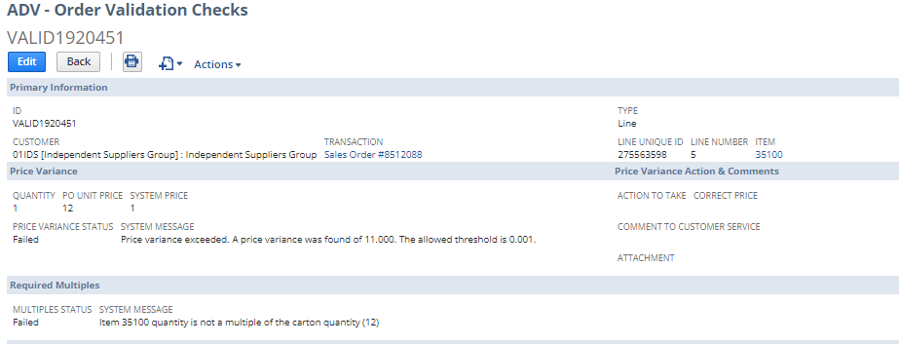
Price Validation & Variances
Process through which the system compares the order pricing with the pricing we have for that item/customer in NetSuite
If the pricing matches, the order validates and can go through
If the pricing does not match, the order fails validation and a price variance is created
Sales Admin must investigate and advise on action to take
Customer Service Rep takes advised action and order is sent through validation again
Notes:
**Important** Validation occurs at the item level and an order CANNOT be released with any validation failures

Slide 15
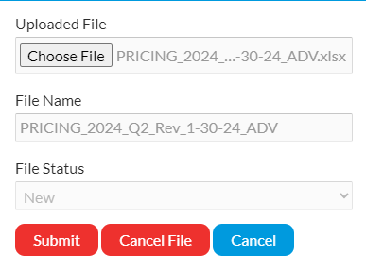
Pricing Outside of Advantus
In addition to maintaining all pricing internally (in NetSuite), Sales Ops is also responsible for maintaining pricing in customer portals
Each customer has their own process, and many key accounts have their own portal where we have to submit and/or update new pricing any time there is a price change
Example: Essendant has a price file that we have to request, update, and return with 120 days notice before we want the pricing to be effective
Other accounts require 180 days notice
Notes:
Customers we do this for: Office Depot, SP Richards, Staples, Essendant, Global Industrial, Wayfair,

Slide 16
Managing Price Changes
Price increases can happen for a variety of reasons: labor, freight, raw materials, packaging, supply chain, etc.
Every time a price increase happens, we have to:
Calculate new list price – both overall and divisional
Calculate new tiered pricing within item division
Calculate new tiered pricing for cross-sold divisions
Create notification letters for all accounts who currently purchase the item(s) and have purchased in the last 12-24 months
Create updated price lists for tiered pricing and any special pricing accounts
Send notification letters and respective price list to each customer who shows sales history
Complete cost justification forms and/or process for specific accounts
Enter new tiered price, list price, and custom price codes into Netsuite with the correct effective date for each account
Submit pricing in customer portals
Notes:
Example: MCG1 is increasing 4/1 and we have to make sure that all pricing is
Example: this was a 1/1 increase but Staples and SPR won’t take it until 4/1 so the price codes are entered differently

