Slide 1
DBIDS ENROLLMENT AND REGISTRATION
NAS JACKSONVILLE

Slide 2
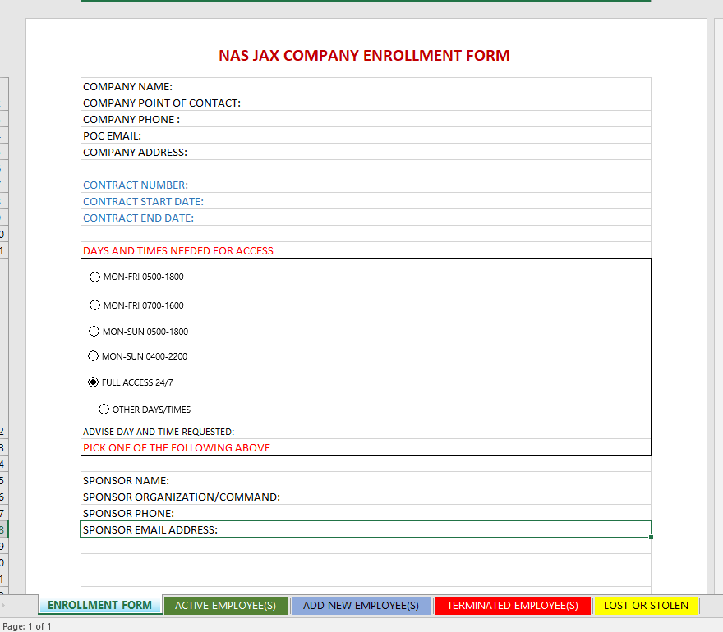
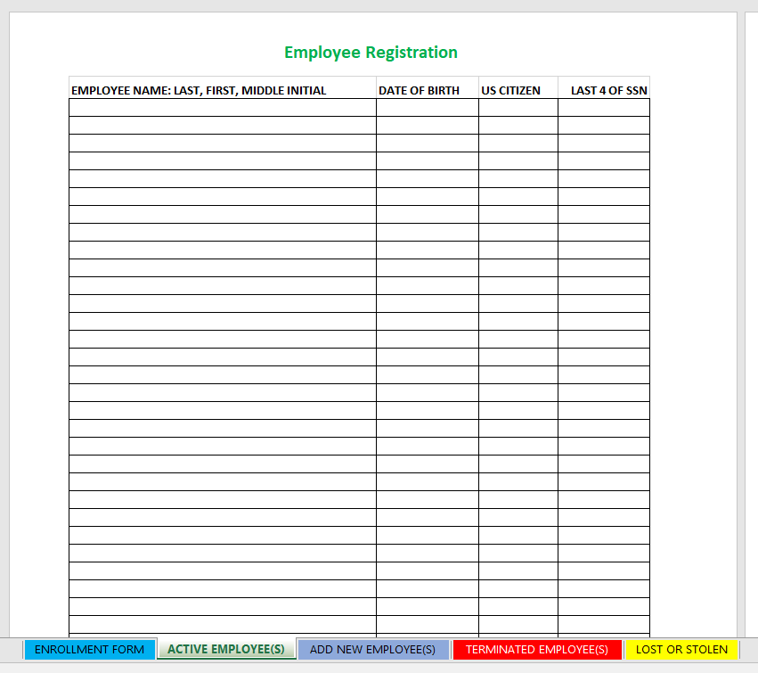
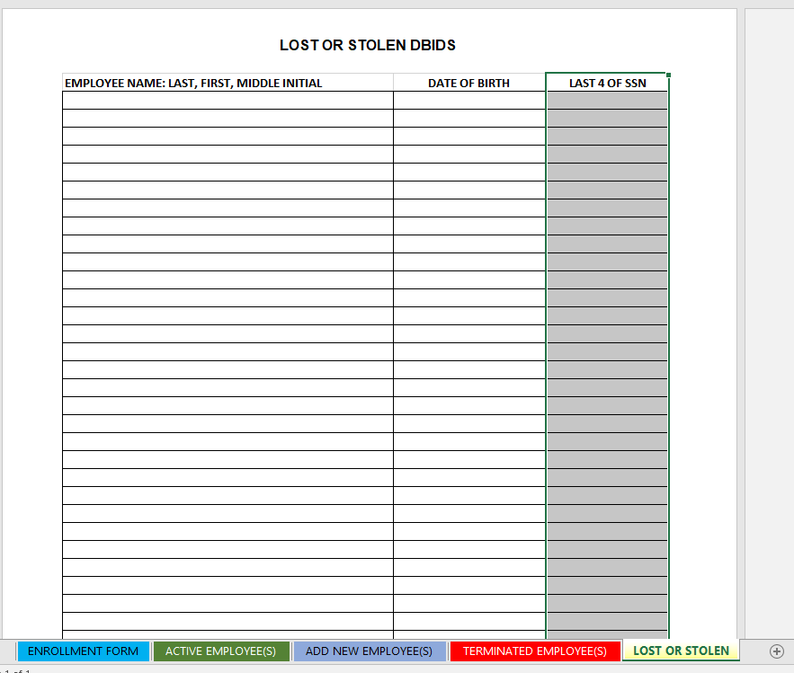
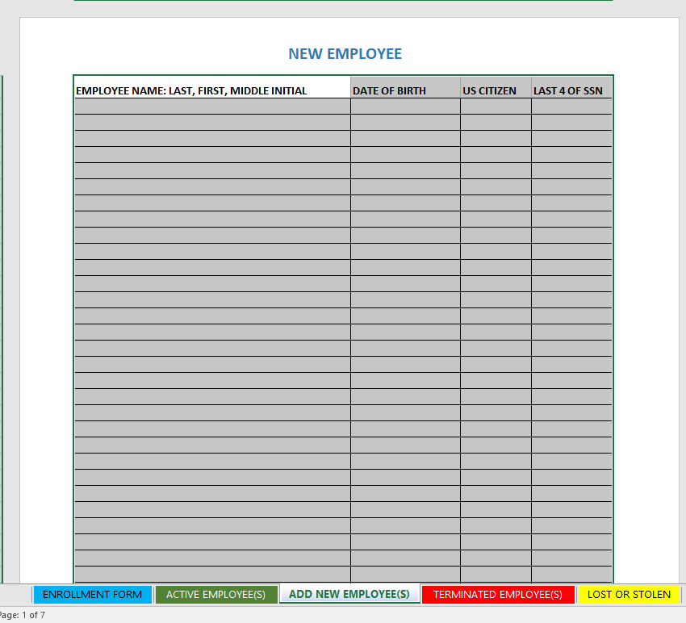
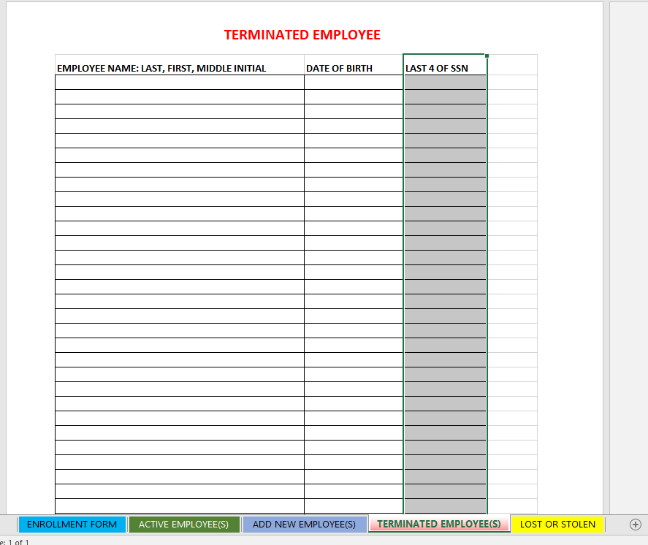
DBIDS COMPANY ENROLLMENT FORM
NAS Jacksonville requires all information to be filled out completely and correctly
DBIDS Company Enrollment form is a working “spreadsheet” that is auditable
Company information
Contract information
Days and times of access
Sponsor information
Employee information
SECNAV Form 5512/1

Slide 3
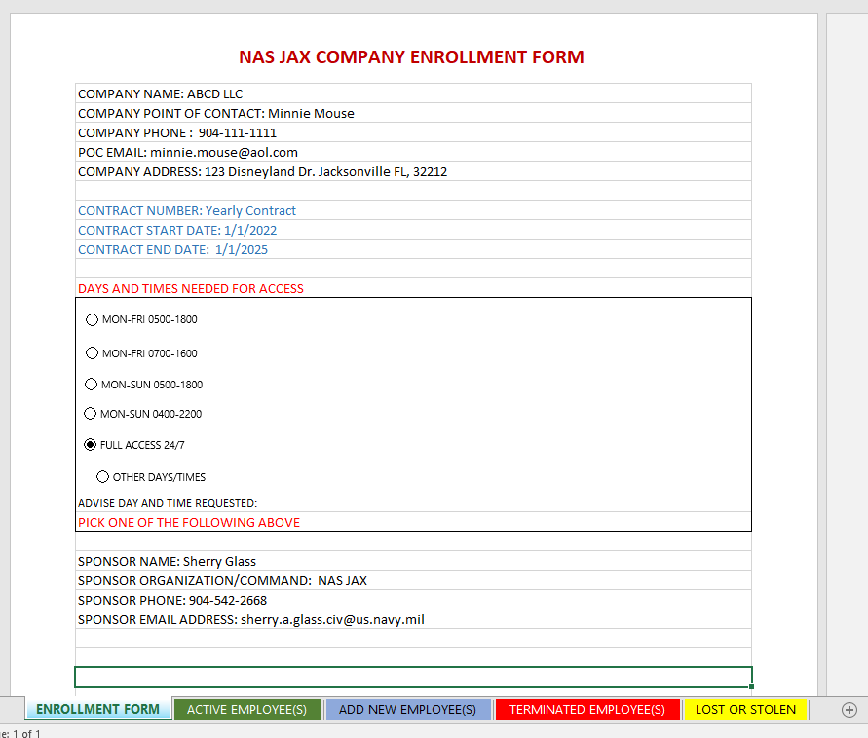
DBIDS Company Information
Company information filled out with all information is required. If there is no contract “Yearly Contract” will be sufficient.

Slide 4
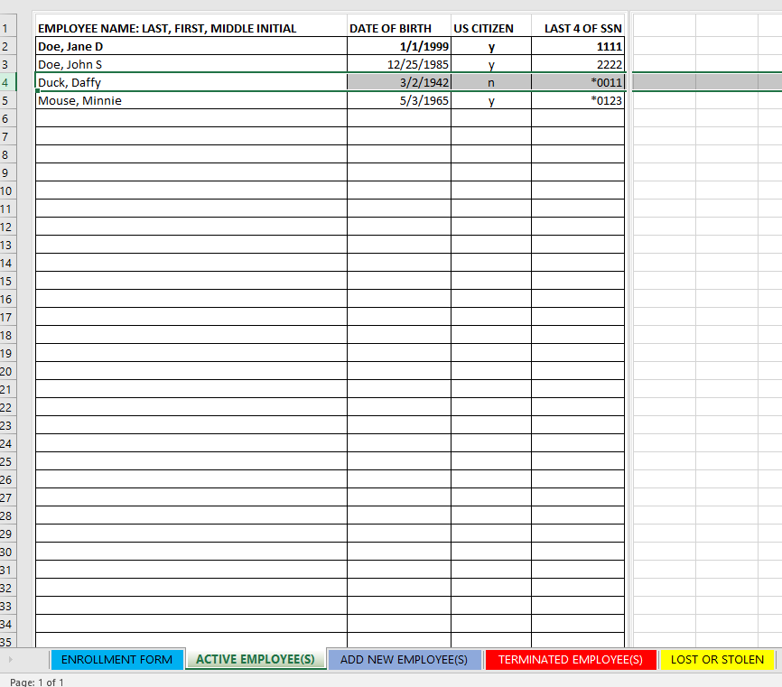
DBIDS Employee Information
All employee’s must be placed on this page or they will be terminated from access to NAS Jacksonville. The company will be required to reenroll if an employee has been taken off of the active employee tab. New registration will require SECNAV Form 5512/1 from all employees.

Slide 5
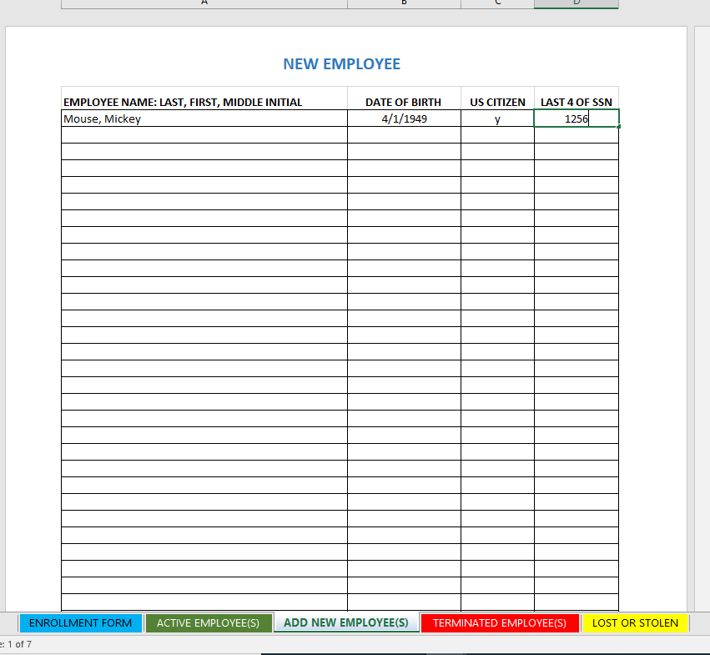
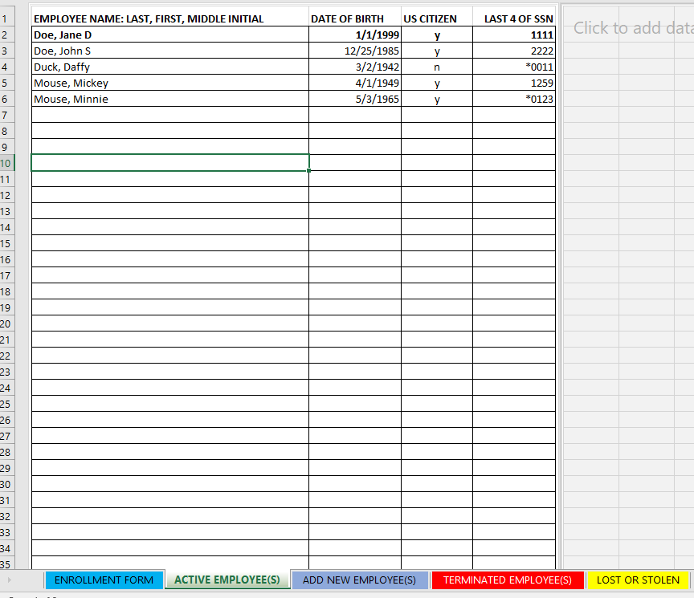
DBIDS Adding New Employee
When adding new employee make sure you send a SECNAV Form 5512/1 filled out by the new employee along with the DBIDS company enrollment form to your Command Sponsorship Liaison(CSL). When registration has been completed the new employee shall be moved to the active employee tab.
Blank new employee tab
New Employees
Moved to active employee

Slide 6
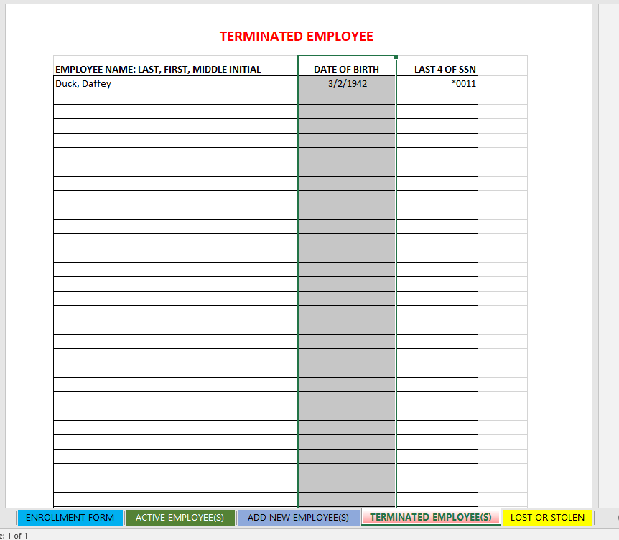
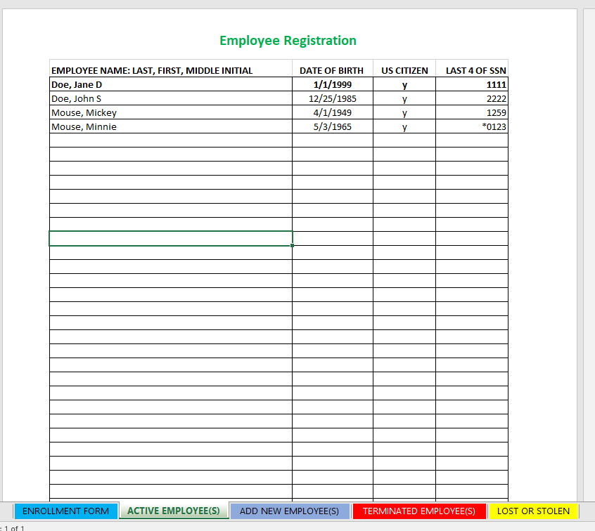
DBIDS Terminated Employee
DBIDS credential must be taken by the employee who no longer requires access to NAS Jacksonville. Remove the individual from the active tab and place on the terminated tab. Send to DBIDS company enrollment form to CSL as soon as possible.
Blank terminated employee tab
Terminated Employee
Delete from active employee tab

Slide 7
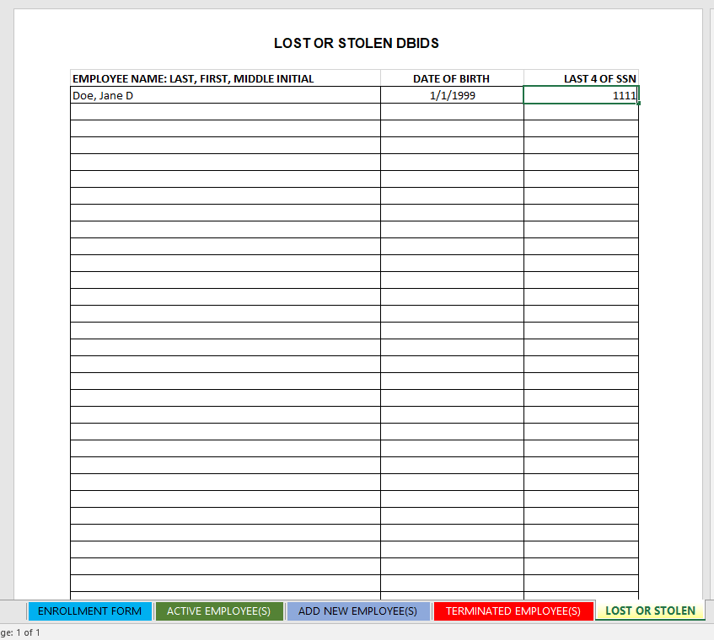
DBIDS Lost or Stolen
DBIDS credentials are to be reported lost or stolen as soon as possible, so Security can terminate the credential. If an contactor/vendor/or long term visitor looses or has their DBIDS credential stolen they require a lost or stolen form to have their DBIDS card replaced

Slide 8
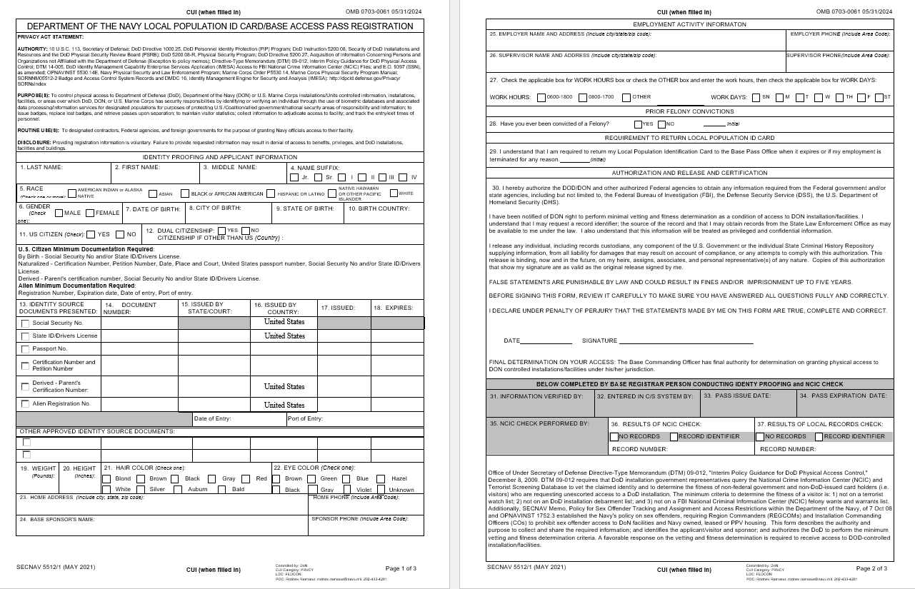
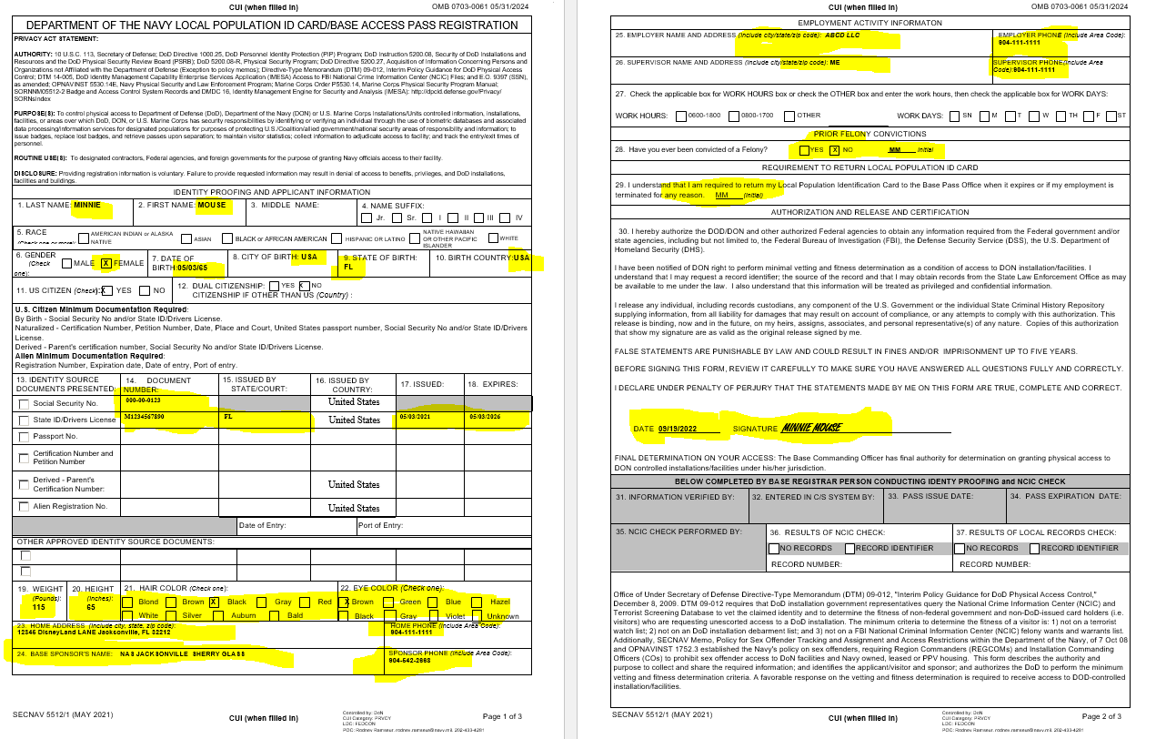
SECNAV Form 5512/1(May 2021)
The SECNAV Form 5512/1 will be completed prior to the enrollment of an employee in the DBIDS. This form will be filled out completely.
Not filled out
Filled out

Slide 9
Any Questions?
Please contact Tim Smalley at 904-542-4532 or Sherry Glass at 904-542-2668.

