Slide 1
Pricing Process Awareness

Slide 2
Objectives

Slide 3
Terminology
List Price
Divisional Tier Prices
~COP List
~Closeout
~Craft List
~Drop Ship
~Internal Web Price

Slide 4
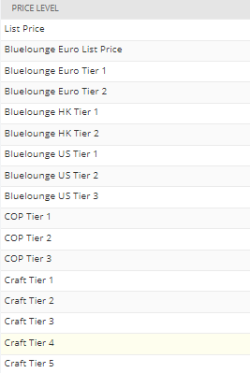
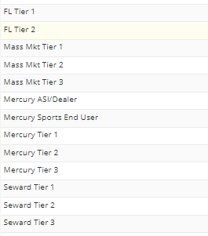
Divisional Tier Prices
Bluelounge
  Euro
  HK
  US
COP
Craft
FL (Floating Luxuries)
Mass Market
Mercury
Seward

Slide 5
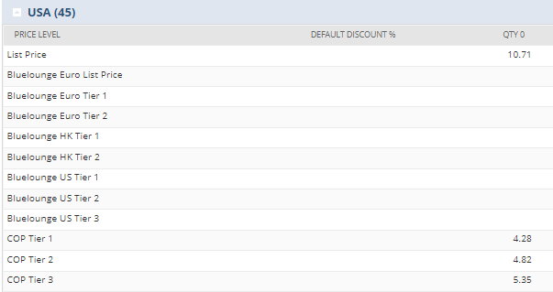
Intro to Pricing
Product & Sourcing (P&S) first works with divisional VP to determine product list price
P&S initially adds list price to item record in NS
  Marketing maintains all pricing after that
Divisional VP also determines tiered price levels and customer specific pricing
Marketing enters in tiered and customer specific pricing on the item record in NS and maintains it

Slide 6
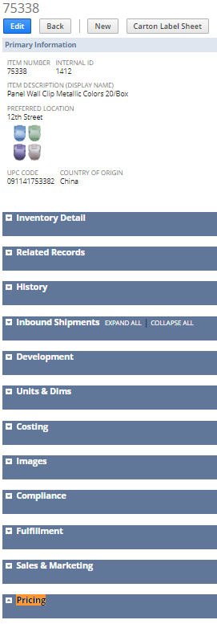
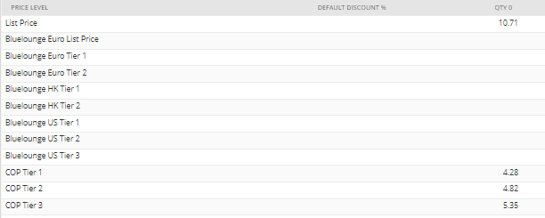
Item Record - Pricing
Navigate to the item record
Pricing tab/section will show all the pricing for that item
Notes:
Not all items will have all tiers. Many will just have one division.
Items that are cross-sold have

Slide 7
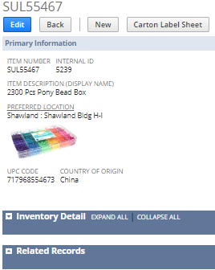
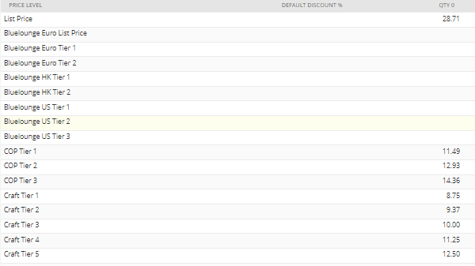
Item Record - Pricing
This is an example of an item cross-sold into multiple divisions and how that pricing looks
Notes:
This is an example of an item cross-sold into multiple divisions and how that pricing looks

Slide 8
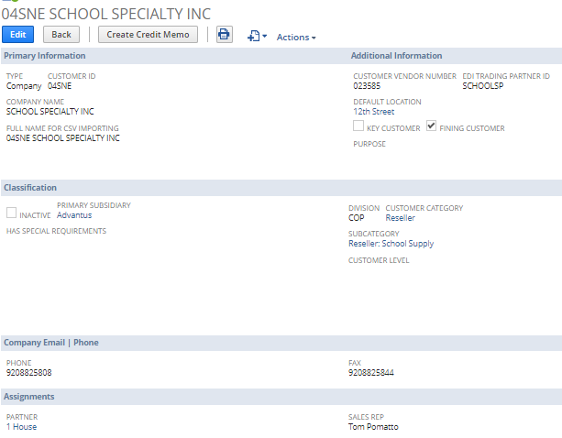
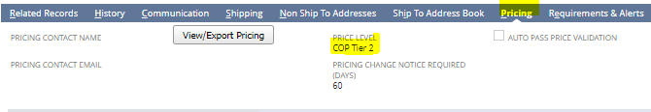
Customer Pricing
Most customers will be assigned tiered pricing
This can be found on the customer record under the Pricing tab

Slide 9
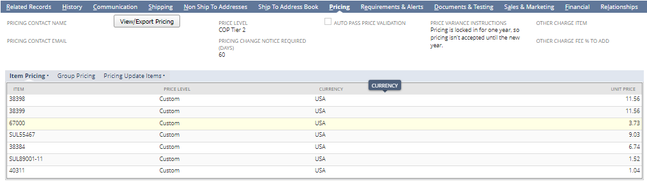
Customer Record - Pricing
Some customers receive special pricing outside of tiered pricing
This pricing is also found on the customer record under the Pricing tab, under Item Pricing
Example – 04SNE

Slide 10
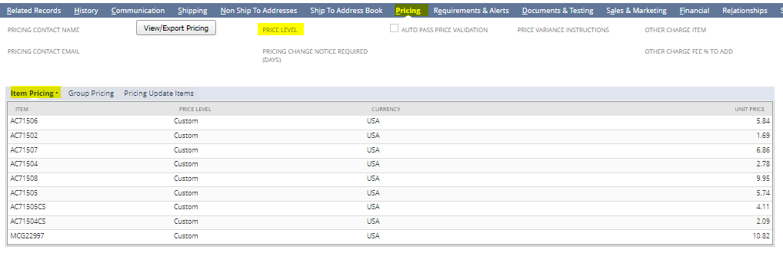
Customer Record - Pricing
Exclusive items
Some items are sold exclusively to one customer so their pricing is found on the customer record
Example: Acco
Notes:
Exclusive items
Some items are sold exclusively to one customer so their pricing is found on the customer record
Example: Acco

Slide 11

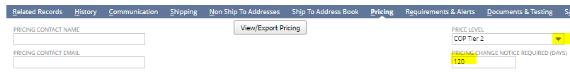
Assigning Tiered Pricing to Customer Record
A customer’s pricing tier should be given to you by VP
Open customer record, select edit
Click Pricing tab
Select appropriate Price Level from drop-down
Also enter the Pricing Change Notice Required time in terms of days; standard is 60 days unless otherwise noted
If available, include Pricing Contact Email
Notes:
A customer’s pricing tier should be given to you by VP
Open customer record, select edit
Click Pricing tab
Select appropriate Price Level from drop-down
Also enter the Pricing Change Notice Required time in terms of days; standard is 60 days unless otherwise noted
If available, include Pricing Contact Email

Slide 12
Assigning Custom Pricing to Customer Record
This pricing will be given to you by VP
Open customer record, select edit
Click Pricing tab
Manually enter in item number and pricing; select Custom from Price Level
Click OK
This can also be done through an import tool: http://wiki2.advantus.com/knowledge-base/netsuite-loading-customer-specific-pricing/

Slide 13
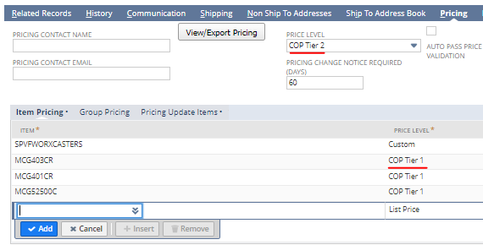
Assigning Pricing to Customer Record
In some cases, a customer will receive tiered pricing for majority of items, but might receive a separate tier for one product line
Click Pricing tab
Manually enter in item number and pricing; select the correct Tier from Price Level drop-down menu for that item
Example: 09MMC receives COP Tier 1 pricing for McGill Punch products

Slide 14
Tiered Pricing
A customer’s pricing tier should be given to you by VP
COP Tier 1 – 50/20 off list
COP Tier 2 – 50/10 off list
COP Tier 3 – 50 off list
Craft Tier 1 – 50/30
Craft Tier 2 – 50/25
Craft Tier 3 – 50/20
Craft Tier 4 – 50/10
Craft Tier 5 – 50
Notes:
COP Tier 1 – 50/20 off list
COP Tier 2 – 50/10 off list
COP Tier 3 – 50 off list
Craft Tier 1 – 50/30
Craft Tier 2 – 50/25
Craft Tier 3 – 50/20
Craft Tier 4 – 50/10
Craft Tier 5 – 50

Slide 15
Saved Searches for Pricing
Customer Price Levels – tells you the tier level a customer receives (if assigned)
Item Price Levels – allows you to export all pricing for items (on item record)
Customer Specific Item Pricing – allows you to export pricing for a specific customer
Future Price Level Prices – Marketing will use for creating price lists for customers that require a longer lead time
Future Customer Prices – not sure if this is something others will use, but this is what Marketing will use
Notes:
Do I need pictures/screenshots of each?

Slide 16
Pricing Hierarchy
When the system is trying to locate the correct price for an item on an order, it will search for pricing in this order:
Customer specific pricing (on customer record)
Tiered Price Level (on item record)
List Price

Slide 17
Price Validation Process
This is the process through which the system compares the pricing on an order with the pricing we have for that specific item/customer in NS
If pricing matches, the order validates and can go through
If pricing does not match, the order fails validation for that item and a price variance is created in marketing dashboard and Sales Admin must investigate and advise on action to take
CS rep then takes action advised by Sales Admin and order is sent through validation again
**Important** Validation occurs at the item level and an order CANNOT be released with any validation failures
Link to PV resolution process - http://wiki2.advantus.com/knowledge-base/price-variance-process/

Slide 18
Pricing Changes
Price increases more frequent due to factors such as supply chain, raw materials, etc.
  Price change submission process varies by customer- may involve communication from sales as well as compliance with notification lead times
In many cases, pricing must be updated directly in customer portal as well as in NS
This is where the Price Change Notification Lead field comes in handy to make sure Marketing notifies the customer in time

