Slide 1

Inventory Allocations & Reservations
Making sure the right inventory gets committed to the right Sales Orders

Slide 2

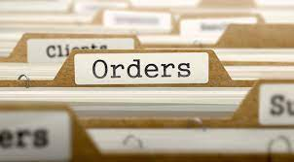

Agenda
How Did We Get Here Anyway?
Reservation Use Going Forward
Review of Inventory Allocation
Inventory Allocation/Re-Allocation Settings
Next Steps

Slide 3

How Did
We Get Here?
The 1.0 concept for reservations is not compatible with the 2.0 concept for Sales Order allocation
We have more levers available to control which SO lines get inventory allocated before other SO lines
Too many use cases that make a systematic solution not scalable
Only 220 out of 1371 Sales Order lines (16%) have needed inventory from their reservation
Monitoring and manually doing the work (since March 2022) has shown how complex the ask would be to make a customization that meets all the asks

Slide 4
Reservations will only be used to reserve inventory that is needed for
W o r k O r d e r s
Reservation Uses Going Forward

Slide 5


Inventory Allocation
Review

Slide 6
Inventory Allocation Schedule
Used to allocate SOs, TOs & WOs
Runs every 15 min
Controlled by Saved Searches
Will Re-Allocate Until Firmed

Slide 7
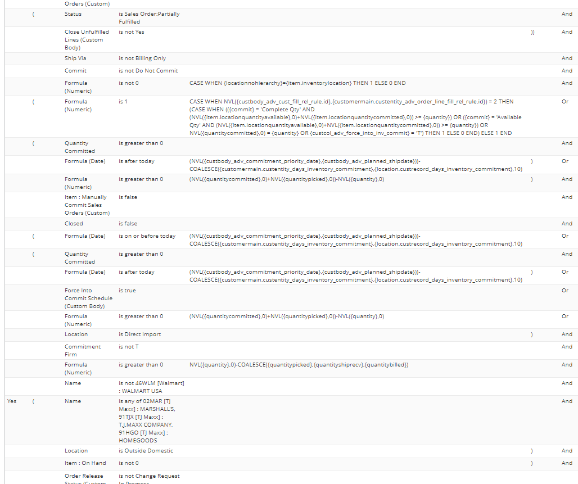
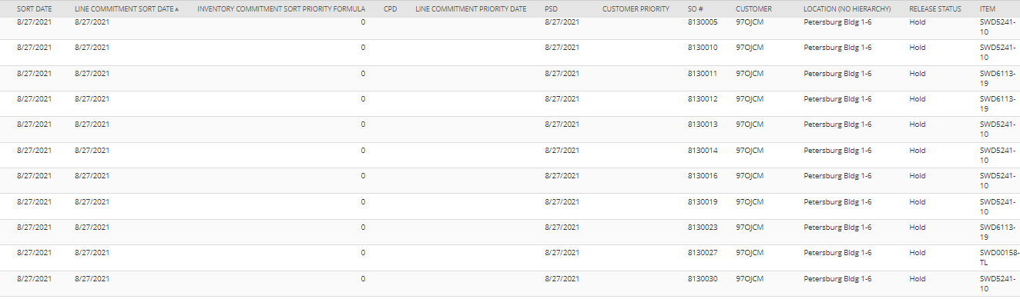
Saved Search Example

Slide 8
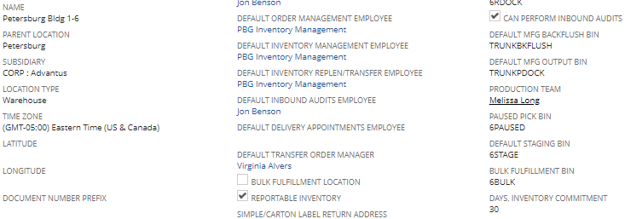
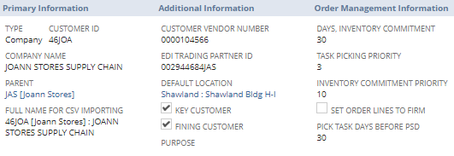
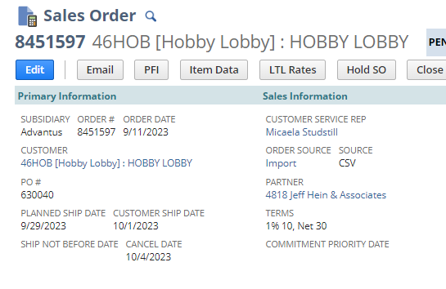
Getting SO Lines in the Allocation Pool
Location Record
Customer Record

Slide 9
Allocation Pool
Sales
Order
Sales
Order
Sales
Order
Sales
Order
Sales
Order
Sales
Order
Sales
Order
Sales
Order
Sales
Order
Sales
Order
Sales
Order
Sales
Order
Sales
Order
Sales
Order
Sales
Order
Sales
Order
Sales
Order
Sales
Order
Sales
Order
Sales
Order
Sales
Order
Sales
Order
Sales
Order
Sales
Order
Sales
Order
Sales
Order
Sales
Order
Sales
Order
Sales
Order
Sales
Order
Sales
Order
Sales
Order
Sales
Order
Sales
Order
Sales
Order
Sales
Order
Sales
Order
Sales
Order
Sales
Order
Sales
Order
Sales
Order

Slide 10
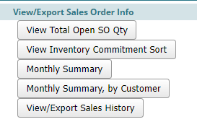
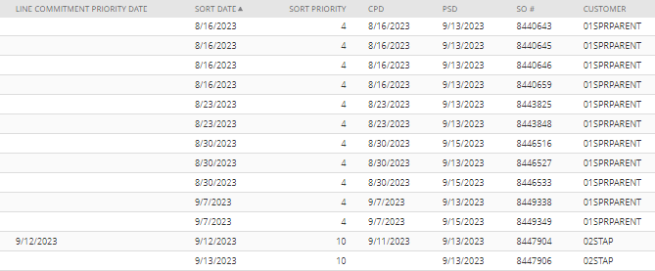
Sorting
Sales
Order
Sales
Order
Sales
Order
Sales
Order
Sales
Order
Sales
Order
Sales
Order

Slide 11
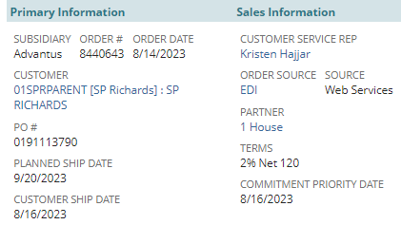
What Determines Sort Date?
Line Commitment Priority Date
Commitment Priority Date
Planned Ship Date
Date assigned by a user at the line level to influence the sort order of that item
Can be blank
Date assigned by a user at the header level to influence the sort order of all items
Can be blank
If PSD passes and SO is on hold, PSD value gets set as CPD
Default sort date
Required field on Sales Orders

Slide 12
Tie Breakers if
Sort Date is the same
Inventory Commitment Priority
From customer record
If Sort Date is the same
Internal ID
From Sales Order
If Sort Date & Inventory Commitment Priority are the same

Slide 13
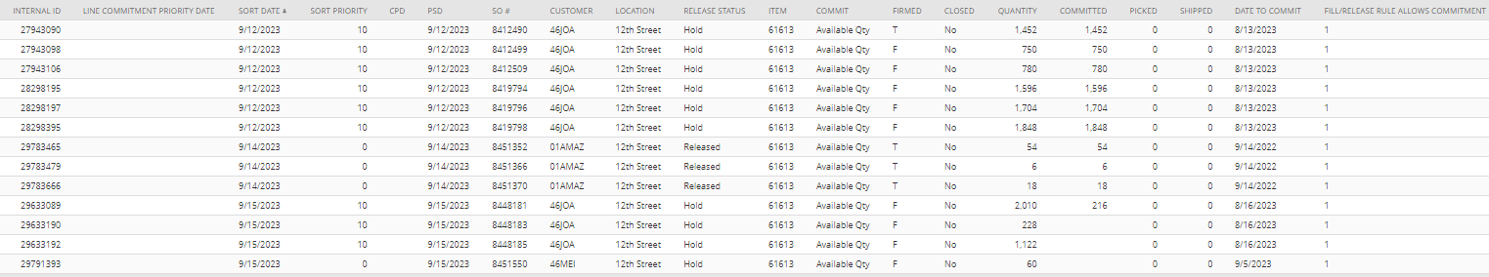
Example
Subtitle
Subtitle
These 4 SOs all have the same sort date. 46JOA wins over 46MEI because of the Inventory Commitment Priority Sort. Then SO 8448181 wins over the other two 46JOA SOs because it has the lowest Internal ID (it was created first)

Slide 14
Example
Subtitle
Subtitle
01AMAZ wins over 46JOA because it has a more near Sort Date; even though 46JOA has a higher Inventory Commitment Sort Priority- that field is only a tie breaker!

Slide 15
RE-ALLOCATION
Open the Design Ideas pane for instant slide makeovers. ​
When we have design ideas, we’ll show them to you right there.
Only the lines in the yellow boxes are eligible to take inventory from and re-allocate. The other lines are FIRMED

Slide 16
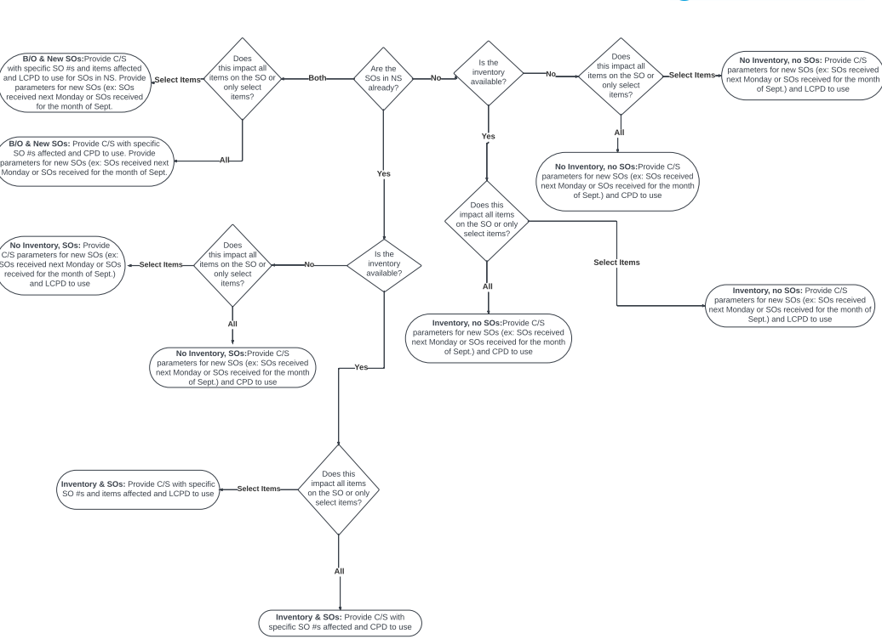
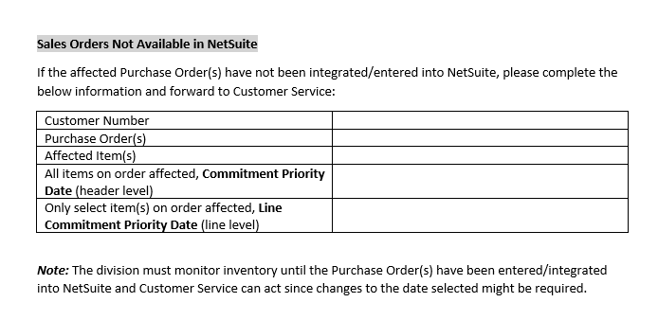
Who do I tell if I need to modify the sort? How?
Decision Tree and request templates will be provided after this training

Slide 17

Next Steps
Review Inventory Commitment Priority setting on Customer Record
Review Days, Inventory Commit setting on Customer Record
All existing searches for manually maintaining reservations will be turned off on 9/29/2023. New process must be followed effective 10/2/2023.

Slide 18

Questions?

