Slide 1
PRICING TASK
INSTRUCTIONS
Notes:
A pricing task should be entered in Netsuite for any request to add new pricing or update pricing due to a price increase or promotion, etc.

Slide 2
Notes:
A pricing task should be entered in Netsuite for any request to add new pricing or update pricing due to a price increase or promotion, etc.

Slide 3
In Netsuite, hover over the New Bar icon and select Task.

Slide 4
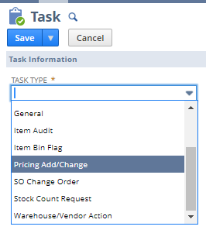
Under Task Type, choose Pricing Add/Change.

Slide 5
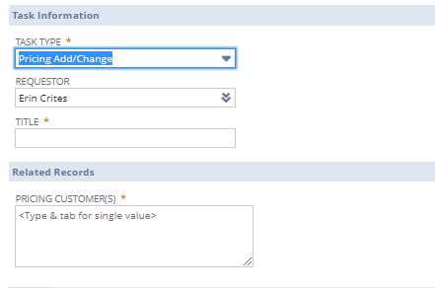
Under Title, list “{customer name/number} pricing update” or “{item number} pricing update” if not customer specific

Slide 6
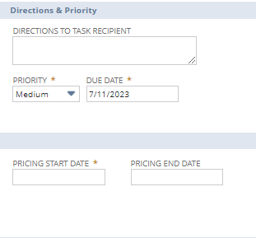
Under Directions to Task Recipient, provide details about what to do (ex. Update 04SNE pricing).
If this is a general price increase for all tiers/customers, please note this here. Example: “Update all pricing (list/tiers/customers) for 34365.”
If this is anything other than an increase, please list the reasons here.

Slide 7
Set your priority. You must manually put the date you need the pricing completed in the Due Date field. It will not automatically adjust based on the Priority you select.
High – need within 24-48 hours
Medium – need within 5 days
Low – due date is more than 5+ days in future

Slide 8
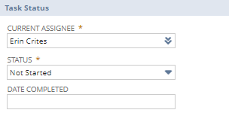
Assign to the correct sales admin/specialist that needs to complete.
Office Products division – Erin Crites
Craft & Hobby division – Jill Mariani
Wyla division – Jill Mariani
SWD/MRC/FL divisions – Brittani Underwood
ADVII division – Maureen Sandoval
Leave the Status as “Not Started”.

Slide 9
Under Related Records section, complete the Pricing Customers. To do this, start typing the customer name or number and it should populate. Add multiple if needed (ex. 01STA and 01STL). NOTE: If this is a general increase for all customers who buy the item please type in 19PRICE which is a default customer that signifies it affects all customers who purchase the item.
NOTE: It is the responsibility of the requestor to provide all customers that need to be updated. If this is not filled out correctly, the task will be assigned back to you to correct and re-submit.
Notes:
If there are customers missing, this needs to be completed via the task, not by email.
If Sales Operations knows there are customer missing, they will change the assignee back to the requestor’s name, edit the directions to the requester to ask that they fill in any missing customers or information.
The requestor will then need to update and assign it back to the Sales Ops Specialist.

Slide 10
Make sure to fill in the Pricing Start Date. Pricing End Date is optional and only should be used if it’s a time period pricing (ex. price increase delay to an account or promo pricing.

Slide 11
If this is a price increase, list the reason here. This will be what is given to the customer in the pricing increase notification emails/letters.
NOTE: This is not a required field but if it this is an increase and the customer must be notified, the information needs to be provided here. If this is not filled out correctly, the task will be assigned back to you to correct and re-submit.
Notes:
Note it is not a required field but if this is a price increase where the customer must be notified, this information will be required to create the letter/notification. If this is not complete, it will be assigned back to you to complete & resubmit.

Slide 12
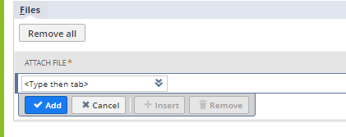
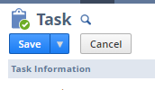
You can upload any spreadsheet or file via the drag/drop feature in top right corner.
Files will appear here.
Click Save at the top and you’re all set.

Slide 13
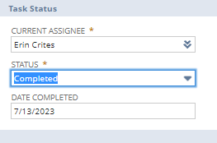
To Complete a Pricing Task – Sales Admin
When a pricing task is assigned to the Sales Support Specialist, it will appear at the top of their Marketing dashboard in NetSuite under Action Needed: My/Team Open Pricing Task.
Click on the task title and complete as directed.
When finished, click “Edit” and mark “Completed”. The date will automatically populate.
Click Save.

