Slide 1


Work Order Process
Overview

Slide 2
Work Order: transaction record in NetSuite used to schedule production of an item (POP order term replacement)
Assembly/Bill of Materials Item: finished item in NetSuite that is produced record includes components needed for the build
Assembly Build record: transaction record in NetSuite used to record quantity built in production (Note: can be based off a work order or used outside of a work order for subassembly builds such as laminating or cutting wood.)
Assembly Unbuild: transaction in NetSuite to undo all or part of an Assembly Build
2.0 Production Terminology

Slide 3
Broad Production Process Overview (With Work Order)
Assembly/Bill of Materials Item Record entered
Work Order entered to produce item
Production physically builds item
Assembly Build record is created
System adjusts inventory for components and finished item
Assembly Unbuild can be created if necessary

Slide 4
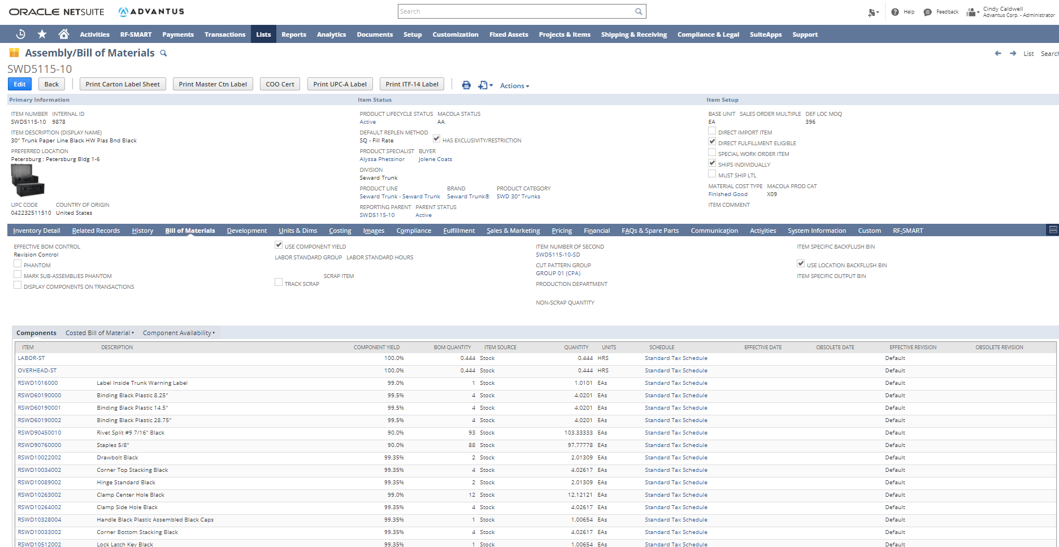
Assembly/Bill of Materials Item Record

Slide 5
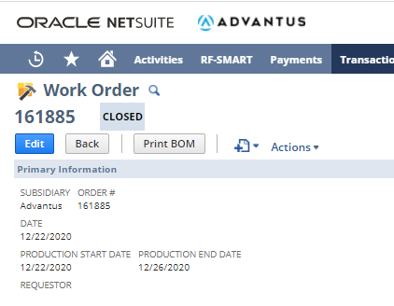
Work Order Status
Status | Description | (Components) Committed? | (Finished Item) On Order Quantity?
Planned | Scheduled, but no production can be made against it | N | N
Released | Components will be committed to it and production can be made against it up to available component quantity | Y | Y
In Process | Some production has been built against it, but not fully built | Y (remaining to be built) | Y (remaining to be built)
Built | Full quantity of work order was built | N | N
Closed | No more production will be made against it | N | N

Slide 6
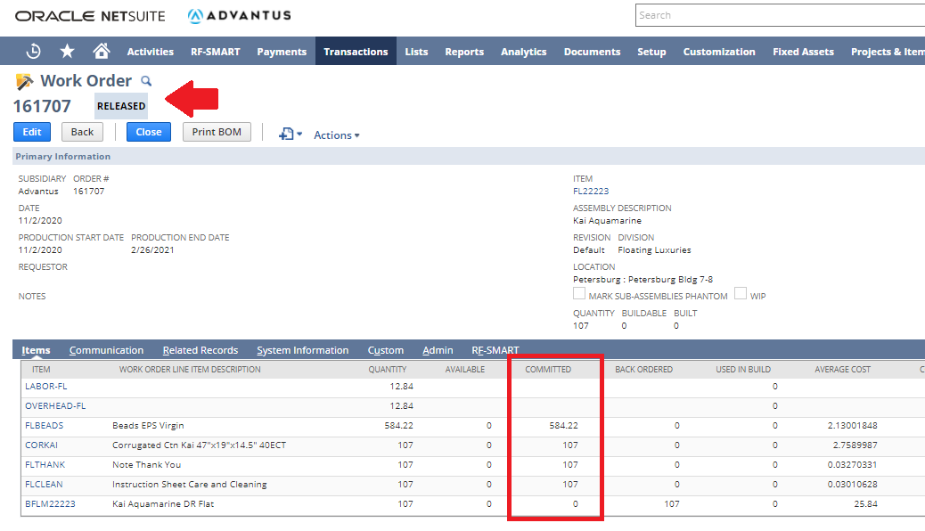
Work Order Status-Committed Quantity

Slide 7
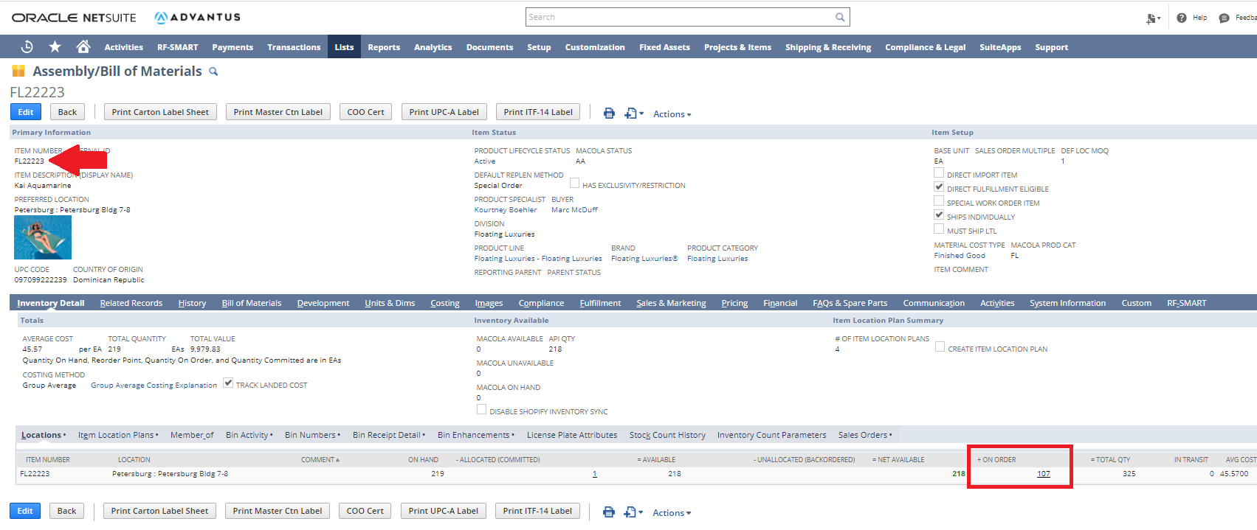
Work Order Status-On Order Quantity

Slide 8
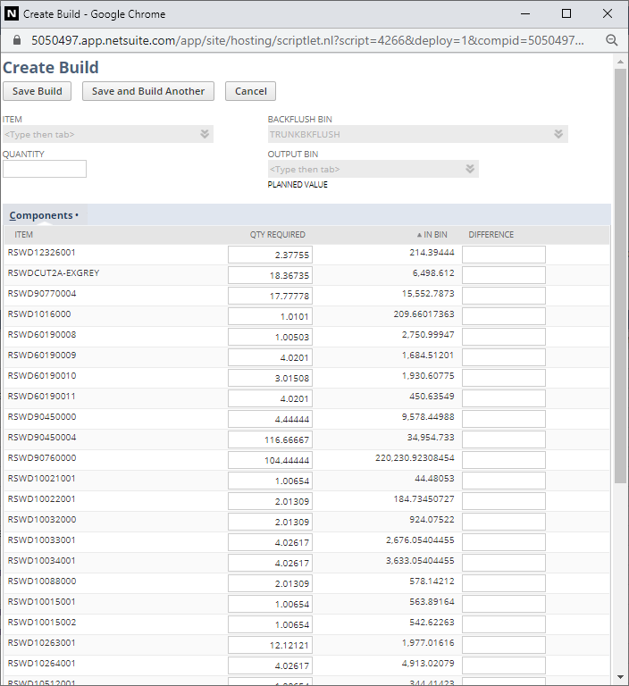
Assembly Build

Slide 9
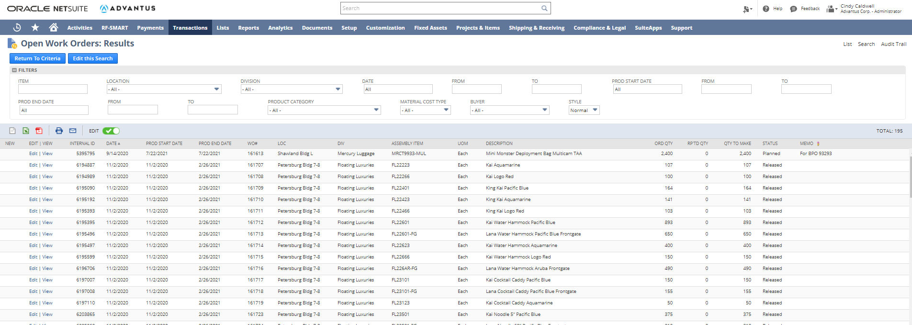
Research Tip: Open Work Order Saved Search

Slide 10
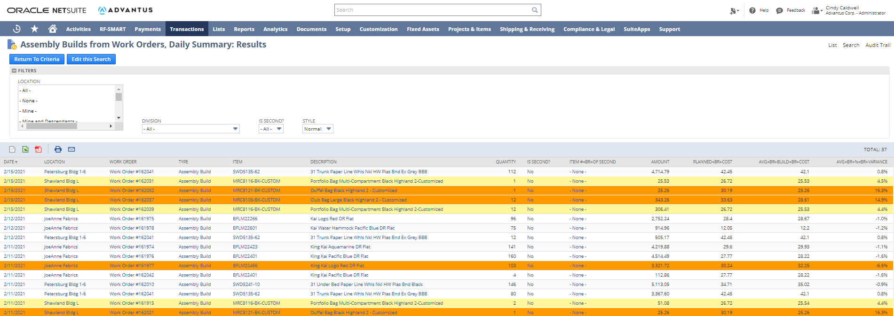
Research Tip: Assembly Builds from Work Orders, Daily Summary

Slide 11
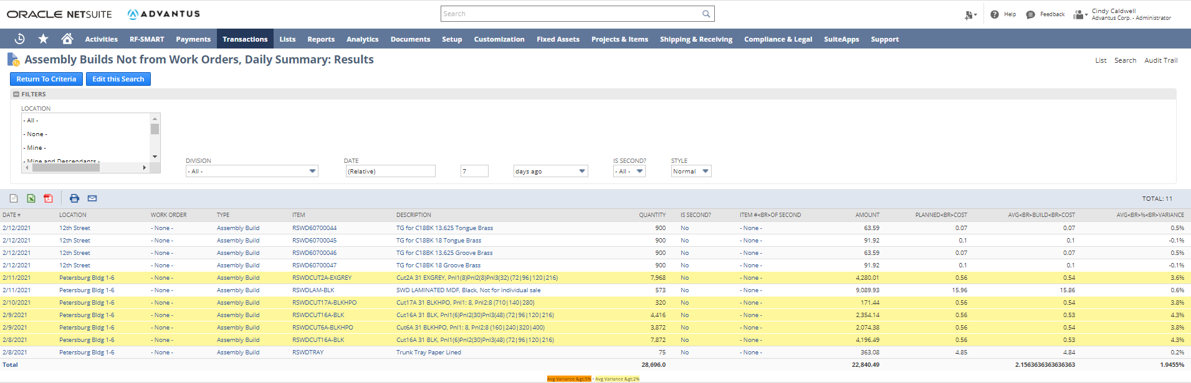
Research Tip: Assembly Builds Not from Work Orders, Daily Summary

Slide 12

Questions?

