Slide 1
Valogix Demand Planning

Slide 2
Agenda
What is Valogix?
Valogix Connections
Item Location Plans (ILP)
Supply and Demand
Forecasting
Replenishments
Common Terms

Slide 3
Valogix
Demand Planning Solution
Connected to NetSuite
Forecasts Demand
Recommends Inventory Replenishments
‘Push’ Replenishment orders to NetSuite

Slide 4
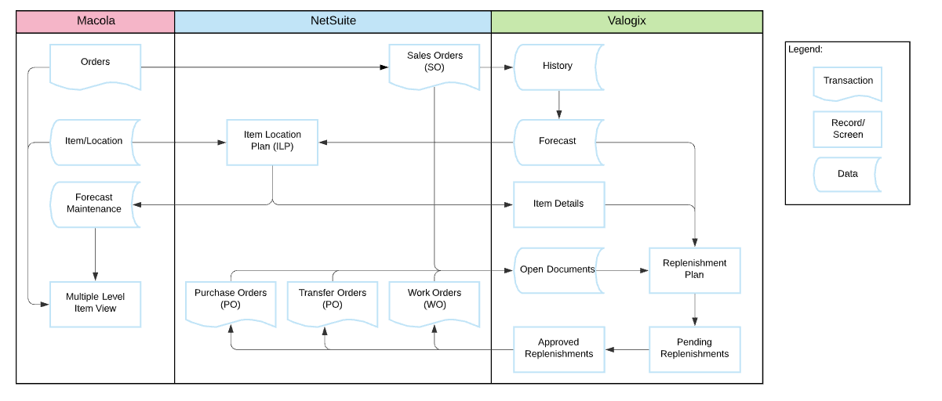
Supply and Demand Data Flow
Job Aid on Wiki Pending

Slide 5
NS (and Macola) to Valogix
The NetSuite to Valogix sync runs once a day (at night)
  Picks up NetSuite and Macola data as part of daily calculation
  Picks up Inventory values, Demand documents, Supply documents, Item information
    Inventory values and Item information based on Item Location Plans in NS
    Item information includes Item Lifecycle Status, Lead Time, Replenishment Method, Review Frequency, Vendor/Supply Location

Slide 6
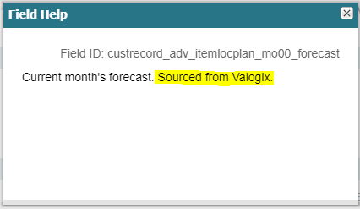
Valogix to NS
In order to facilitate several reporting needs, after Valogix runs daily calculation, a CSV is generated which is imported back into NS
  Data available on Item Location Plan
    Only certain fields are maintained this way- indicated by Sourced from Valogix in Field Help)
  Includes Critical Alerts, Forecasts, SQ Buffer Quantity (or Months of Supply Quantity)

Slide 7
Item Location Plan
Item Location Plan (ILP) must exist for Valogix to see Item information
  For default location, P&S sets up initial ILP and SCM adds the Replenishment Method and Review Frequency
  For any additional locations, SCM sets up the ILP
  Reminder on SCM dashboard to advise of new item ILPs
  The Replenishment Location and Supply Location on the ILP drive the type of inventory transaction Valogix will suggest
    Replenishment Location and Supplier = Purchase Order (Buy)
    Replenishment Location and different Supply Location = Transfer Order (Transfer)
    Replenishment Location and matching Supply Location = Work Order (Make)

Slide 8
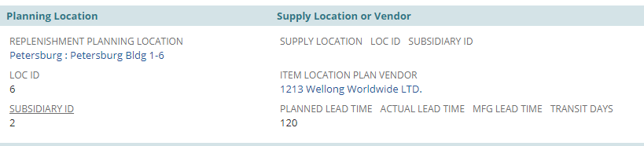
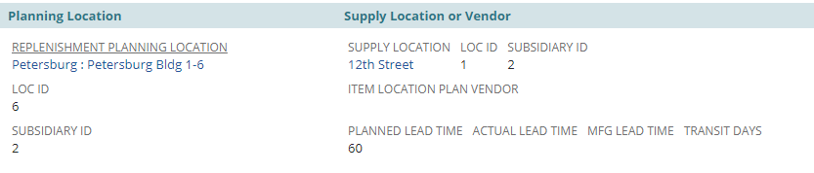
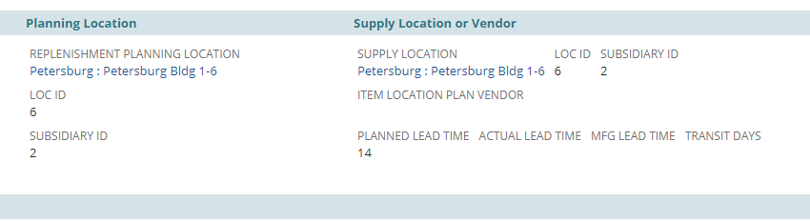
Item Location Plan- Examples
Purchased Seward Component Item
Tongue & Groove item- made at 12th Street and Transferred to PBG
Manufactured Seward Item

Slide 9
Supply and Demand Documents
Transaction | Supply | Demand
Sales Order |  | Historical and Open
Purchase Order | Open
Work Order | Open (parent) | Open (components)
Transfer Order | Open (receiving location) | Open (supplying location)

Slide 10

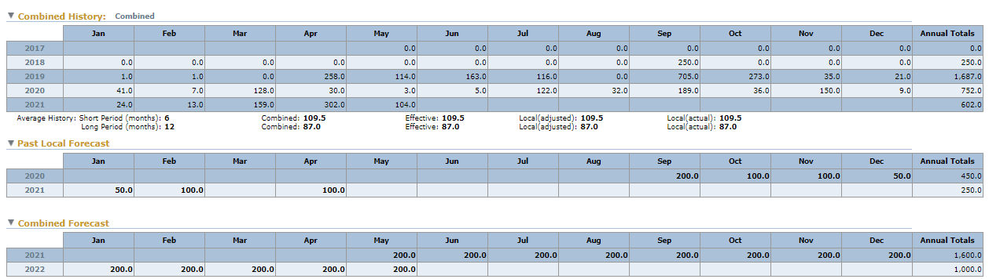
Forecasting
Valogix forecasts demand for an item based on historical demand (usage and sales)
  If we receive additional insight (customer forecasts, division VP instruction, etc.), we can override the forecast
  There is a checkbox on the ILP which indicates a forecast is overridden. In Valogix, overridden forecasts are bold)

Slide 11
Distributed v. Dependent
Valogix takes into account distributed and dependent demand and forecasts
  Distributed: demand from other locations for inventory at the replenishment location – usually filled via Transfer Order, Inventory Transfer
    Examples: E-Com supplied by 12th Street, instances where Tigers Rotterdam supplied by Tigers Hong Kong
  Dependent: demand for usage to make one or more parent items
    Examples: Forecasted demand for an MRC item flows down to the BMRC and MRCMULTICAM

Slide 12
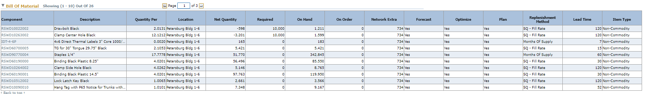
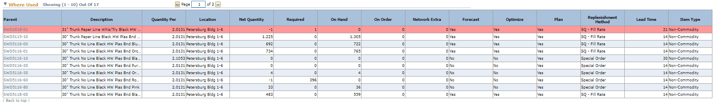
Parent/Component Example
Valogix picks up the BOM (shown as Where Used and Bill of Material)
Parent item forecasts roll down to the component items
Valogix will calculate component item needs based on lead time
  If the finished good has a 30 day lead time and the component has a lead time of 7 days, the replenishment will calculate off a total of 37 days

Slide 13
Replen Methods- SQ Fill Rate
Stocking Quantity (SQ) Fill Rate: calculates optimal quantity for on hand + on order over the planning horizon of an item/location
  Uses effective forecast, demand over the Planning Horizon and Stocking Quantity to Calculate recommended replenishments
    Stocking Quantity is calculated based on variances over the demand history and the SQ Service Level
    Service Level influences the Stocking Quantity
Suggests Replenishment to avoid going below Stocking Quantity
SQ Buffer Quantity (also called SQ Safety Stock Buffer): Amount of additional inventory beyond the forecasted demand needed to meet demand spikes (Reorder Point- Effective Forecast)

Slide 14
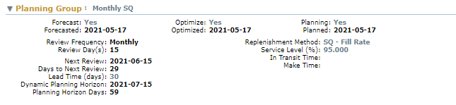
SQ Fill Rate Example
https://5050497.app.netsuite.com/app/common/custom/custrecordentry.nl?rectype=728&id=58
Item 36000

Slide 15
Replen Methods- Months of Supply
Months of Supply (MoS): calculates replenishments based on maintaining a stock buffer equivalent to a period of time
  Uses Months of Supply, Months of Supply Type, and forecast
    Months of Supply is the number of months we want to keep on hand
    Months of Supply Type is usually forecast
Suggests Replenishment to avoid going below Months of Supply Quantity
Will still show Service Level but is not used

Slide 16
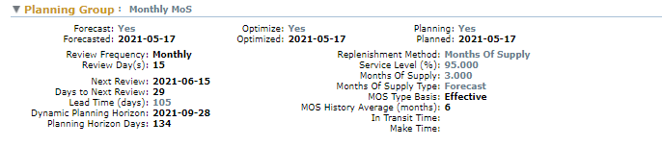
Months of Supply Example
https://5050497.app.netsuite.com/app/common/custom/custrecordentry.nl?rectype=728&id=19338
Item 38714

Slide 17
Replen Methods- Special Order
Special Order: replenishment method where replenishments are based on demand
  Under Special Order, inventory can go down to 0
Will still show Service Level and forecast but neither is used to calculate replenishment
  Demand Orders prompt replenishment
Non-Stock (Macola Status AN) are commonly Special Order

Slide 18
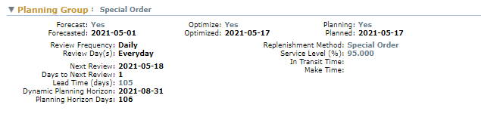
Special Order Example
https://5050497.app.netsuite.com/app/common/custom/custrecordentry.nl?rectype=728&id=38526
Item 39112

Slide 19
Review Frequency
How often to review for Replenishment
  Special Order items are Daily
  SQ Fill Rate and MoS can use both Weekly and Monthly
  The review frequency is set based on how often we plan to buy/make/transfer the item. If an item is set at Monthly, that doesn’t mean the item is ignored for a month
    Example: Review date for an item might be the 15th of the month, but Valogix does calculations and would prompt a replenishment on the 2nd of the month based on lead time and needing to order before the 15th to meet inventory

Slide 20
Replenishments
Based on the Replenishment Method and Review Frequency, Valogix will calculate and recommend replenishments
Supply Chain reviews these replenishments and then either defers or approves Replenishments to create Purchase Orders, Work Orders, and Transfer Orders
  Example of deferment: we have inventory in UA due to a country of origin transition. UA does not typically supply the main location and so Valogix might prompt a replenishment. Planner reviews quantities in UA and determines we have enough and so the Planner will defer the replenishment until the next review
If there is an exception for Replenishments (example: more commitments than anticipated, inventory is running lower against increasing forecast, backorders, potential backorders), Valogix provides alerts to notify buyers

Slide 21
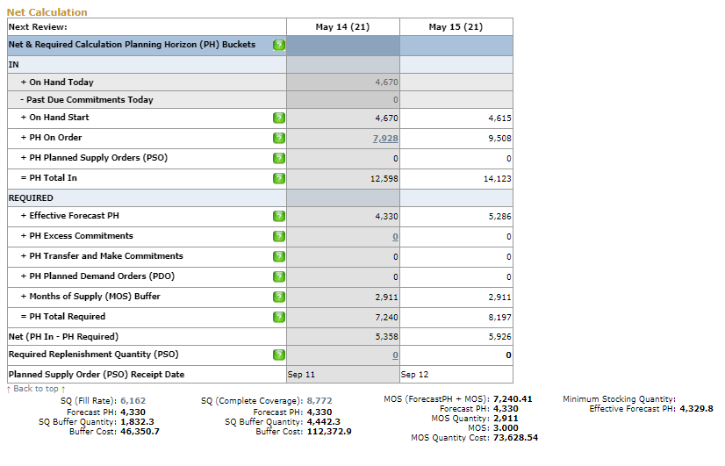
Net Calculation
Net Calculation is the breakout of some of the math Valogix runs through to calculate needs over the Planning Horizon
  Shows current replenishment review time frame and the next review
  Able to Review Inventory Flow for more detail

Slide 22
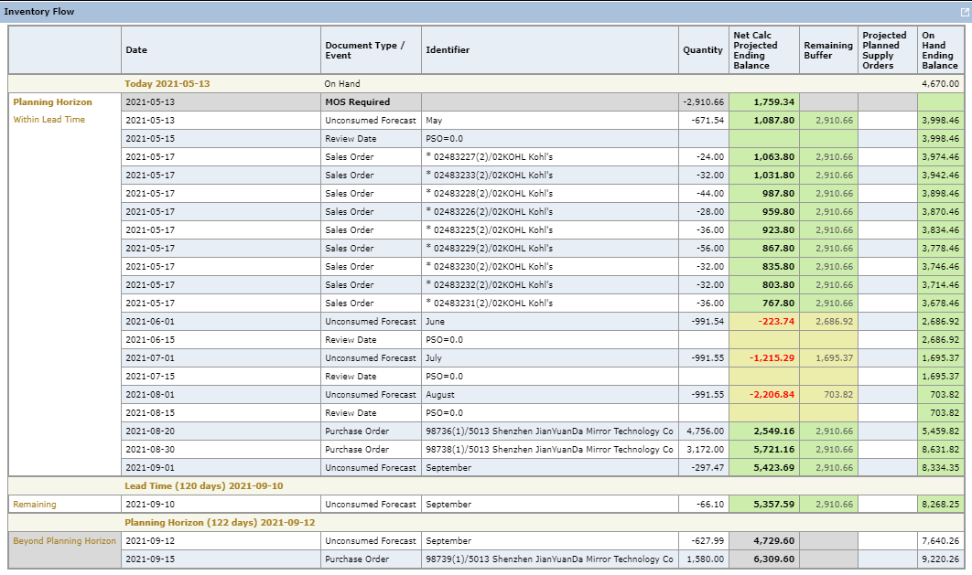
Inventory Flow Example
1
3
2
4
MOS Required is deducted to show this is how much we want to maintain
Unconsumed forecast is deducted to predict stock out
Existing Demand is deducted
Existing Supply is counted

Slide 23
Common Terms
Commitment: quantity on open demand documents
Lead Time: Manufacturing Lead Time + Transit Time
PDO: Planned Demand Order
PSO: Planned Supply Order
Planning Horizon: Lead Time + Days to Next Review. Abbreviated PH
  Inventory Flow shows Planning Horizon as well as Beyond Planning Horizon
PH Excess Commitments: Commitments that exceed the forecast for the Planning Horizon
Reorder Point: Inventory level where, if the total stock on hand plus on order falls to or below that point, action is taken to replenish the stock

Slide 24
Questions?

