Slide 1
NetSuite Shipments
Kevin Kazimir
May 4th, 2021

Slide 2
Agenda
What is the “ADV – Outbound Shipment” record
Outbound Shipment Manager
Shipping Parcel (aka “Smallpack”)
LTL Shipping
Shipping and EDI
Shipment Manipulation (Consolidation and Changing Shipment Structure)
Rollbacks

Slide 3
What is the “ADV – Outbound Shipment” Record
Custom Advantus “shipment” record
Commonly abbreviated as “OBS” or “Shipment”
Group of Item Fulfillments going to the same Customer, Same Ship Date, Same Ship Via, Same Freight Pay Code
Item Fulfillment 1
Shipping on 5/6
Shipment 1
Sales Order 1
(For ABC Company)
Item Fulfillment 2
Shipping on 5/13
Shipment 2
Sales Order 2
(For ABC Company)
Item Fulfillment 3
Shipping on 5/13

Slide 4
More OBS Fun Facts
It’s the Analog to the Wisys Shipment Record (wsPkgShipment) in 1.0
Searchable via Global Search
Can be found in the “Related Records” tab of Sales Order and Customer records
Gets generated after the order is picked
Shipment Ship Via is not always the same as the Sales Order Ship Via

Slide 5
Shipment Statuses
Picking
Shipment Pending (LTL Only)
Booked
Shipped
Other Statuses
Rollback In Progress
Rollback Completed
Consolidation in Progress
Consolidated

Slide 6
OBS Tour
Onward to NetSuite…

Slide 7
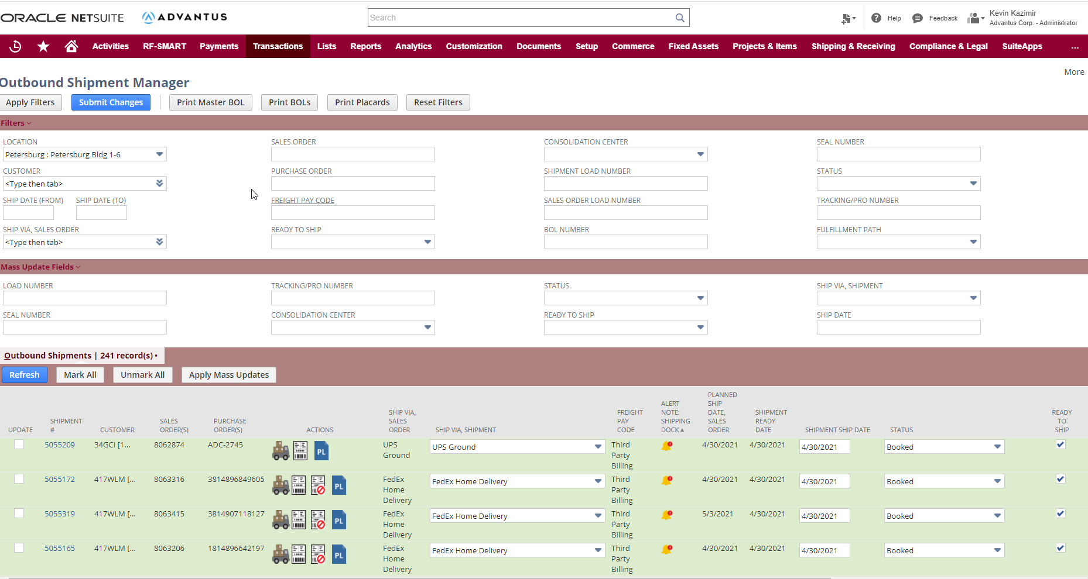
Outbound Shipment Manager
Successor to “AD PP4 Shipping” in Agility
Under “Shipping & Receiving” menu
Can filter and mass update
Has lots of validation
Cannot ship a “load” if all shipments on that load are not fully picked
Must enter dimensions on mixed cartons
Must specify an acct # for 3rd Party Billing
Cannot ship unless fully picked
Cannot ship if overpicked
Cannot ship if LTL and not rated
Color coding and informationally dense
Order alerts
Customers that do not allow banding
LTL/FTL Shipments Without Pallets

Slide 8
Shipping Parcel
Parcel shipping uses “ShipEngine” (the API that runs ShipStation)
Advantus has two distinct parcel shipping use-cases
PBG – Pick and ship “ships individually items” (aka PBG ships almost exclusively masters)
12th Ecom – Almost exclusively mixed cartons
Done from the Outbound Shipment Manager
Documents auto print the first time they are generated (using PrintNode)
Old documents are saved in the “Files” tab of the OBS record
We can audit how we made our shipping API requests – great for researching
We have a mobile friendly tool called “QuickShip” for use-case (1) above

Slide 9
Shipping LTL
We complete pick, use “Advantus Pack LP Shipment” to move the shipment to “Shipment Pending”
Advantus Pack LP Shipment – QC the pallets and account for them!
From Outbound Shipment Manager, user uses “OBS Lite” form to rate the Shipment
Can indicate accessorials on the OBS Lite form
If Advantus is paying for freight, you can rate the shipment
Can generate the BOL and Master BOL (if used)
Again - Old documents are saved in the “Files” tab of the OBS record

Slide 10
OBS Manager Tour
Back to NetSuite!

Slide 11
Shipping and EDI
OBS record is what drives our ASN transmission
We transmit an ASN when a shipment goes to SHIPPED (this is different from Macola!)
A custom record called “ADV – License Plate Register” (aka LPR) drives the ASNs
This record captures every scan on every license plate (LP)
Equivalent to a wsPkgLin record in 1.0
LPRs get Created
Every 2 Hours
Shipment is Booked
ASN Sent by Dell Boomi
Every 1-2 Hrs depending on Trading Partner
Shipment marked as “Shipped”
(Manually or at 10 PM ET)

Slide 12
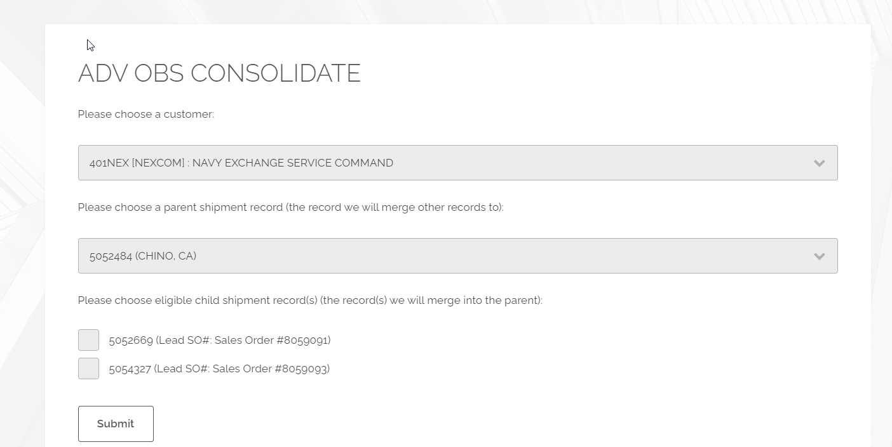
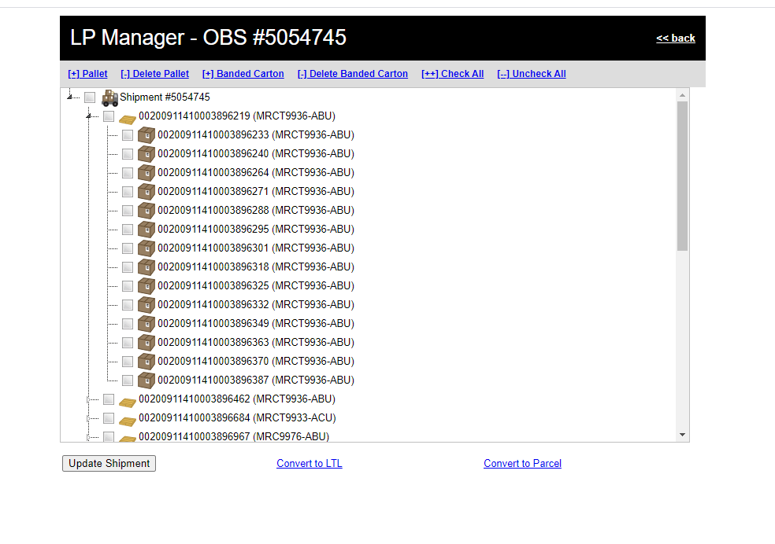
Shipment Manipulation
Shipment Consolidation
Two Use Cases
Consolidate Pre Pick – Done automatically if its allowed
Consolidate Post Pick – We release to the warehouse, and customer routes two orders together after we picked it
Use case (2) is done via the Shipment Consolidation tool
LP Manager
Used to manipulate packaging of a shipment
Convert LTL to Parcel (or Parcel to LTL)
Parcel - Band and unband
Pallet – Adjust palletization

Slide 13
Rollbacks
What is a “Rollback” and why
Supports “Customers First” Advantus Principle
NOT a magical “fix it” tool for a busted system!!!
Initiated from the Shipment record – Only Admins and Facilities, Lead roles
Breaks down LPs, undoes bin transfers, puts inventory back in preferred bin
Order goes back to a hold state (in essence)

Slide 14
Questions
Ask away!

