Slide 1
Saved Searches & Reports

Slide 2
Agenda
Saved Searches vs Reports
Navigating saved searches & reports
Filtering saved searches & reports
Basic updates to existing saved searches & reports
Advanced updates to existing saved searches
Process to request new or more advanced updates to saved searches & reports

Slide 3
Saved Searches
Reports
Display a lot of information about specific subset of records
In-line editable
Can handle complex formulas
Can incorporate NetSuite + Macola data, in some cases
Can be scheduled to send to users
Can show summary and detail data
Utilize filters to make scalable for many uses across divisions and depts
Display multiple levels of data through drill-down
Can only be built on transactional data ( ex: SOs, Invoices, GL activity) & therefore can only display NetSuite data
Limited scope of formulas
Group of standard reports or Sales and Financials prebuilt by NetSuite

Slide 4
Portlets Reminders Quick Links Shortcuts Reports on Center Tab
Saved Searches

Slide 5
Portlets Reminders Quick Links Shortcuts Reports on Center Tab
Saved Searches

Slide 6
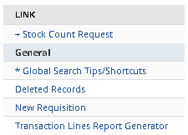
Portlets Reminders Quick Links Shortcuts Reports on Center Tab
Saved Searches

Slide 7
Portlets Reminders Quick Links Shortcuts Reports on Center Tab
Saved Searches
Pre-filtered saved searches can be saved as a shortcut

Slide 8
Portlets Reminders Quick Links Shortcuts Reports on Center Tab
Saved Searches

Slide 9
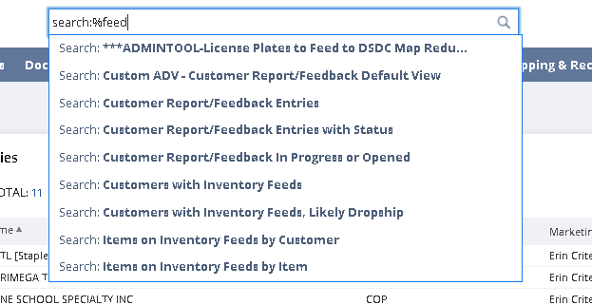
Saved Searches: Locating Using Global Search
% acts as a wildcard
Useful to find searches if you know a word in the title

Slide 10
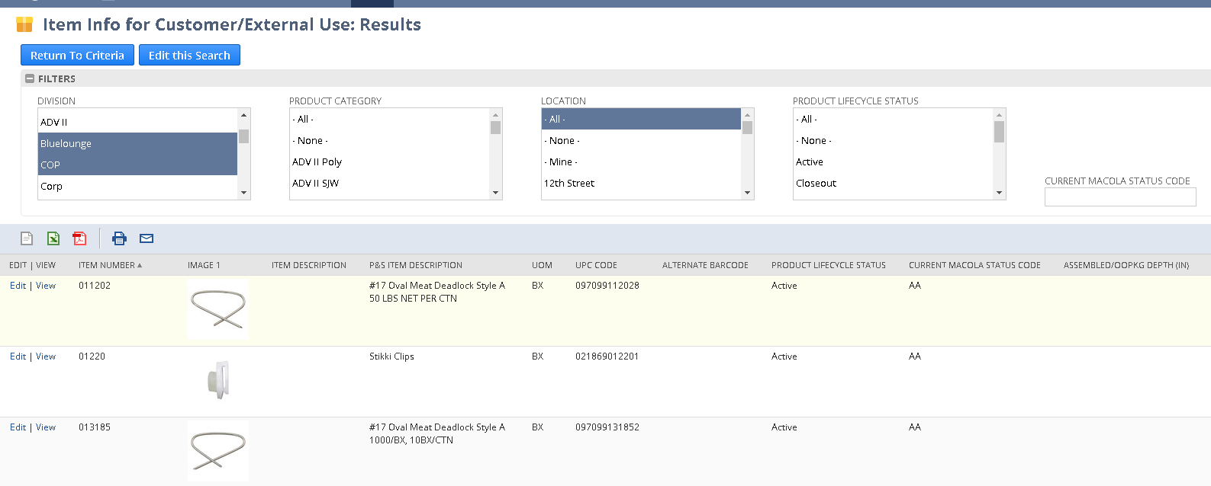
Saved Searches: Using Available Filters
Ctrl to multi select in drop down
Tab to display results in free text box
Selecting criteria in filters automatically refreshes the results

Slide 11
Saved Searches: Important Fields to Know
Document Number
SO, PO, WO, Inv #, depends on transaction type
Name
Depends on the transaction (ex. vendor on PO/vendor bill, customer on SO/invoice, employee on Requisitions/expense reports)
Type
Refers to Document type- example: SO, Bill, Credit Memo, Invoice

Slide 12
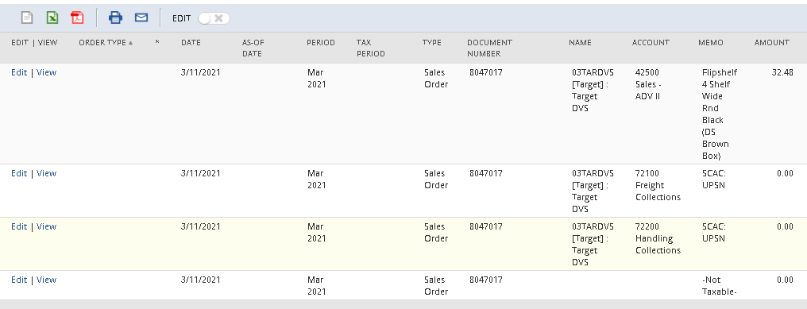
Saved Searches: Important Fields to Know
Main Line
By setting the Main Line filter to True in our search criteria, we are essentially saying "Only show me body-level data for the transactions in my results“
By setting Main Line filter to False, we are saying "Show me only the data from sublists in my results"

Slide 13
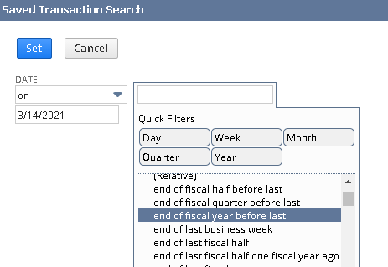
Saved Searches: Important Fields to Know
Created From
Allows users to pull in data from transactions that occurred before the subject transaction was created.
Example: a saved search with the criteria of Type=Invoice, the invoice was created from a Sales Order
Example
Date Phrases
Yesterday, today, last week, etc.
Example

Slide 14
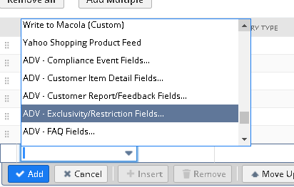
Saved Searches: Important Concepts to Know
Linked Records
Links multiple records together by a shared data point
Three trailing dots at the end of the text
Example

Slide 15
Saved Searches: Editing Criteria
Editing Criteria
Editing Results
Adding Filters

Slide 16
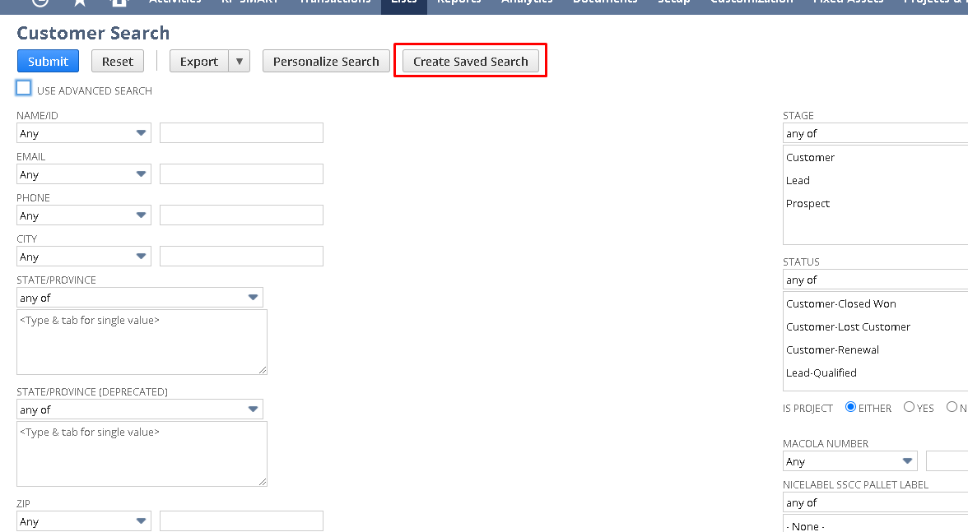
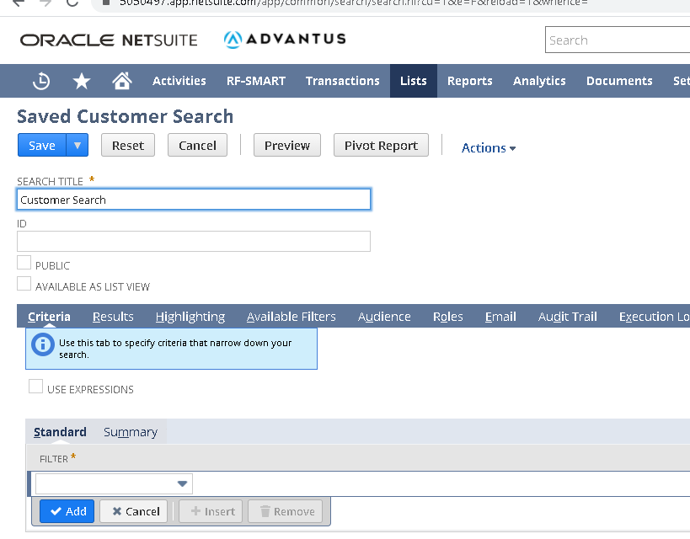
Saved Searches: Ad hoc

Slide 17
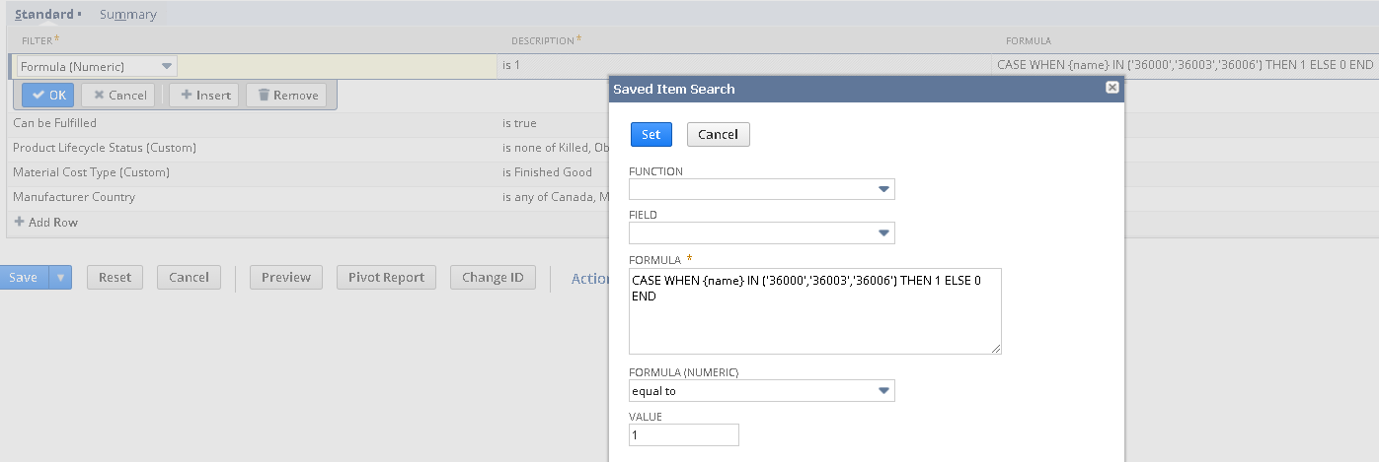
Saved Searches: ”Any of” Formula
Provides functionality like in SQL, as we see in Crystal
Field label from record
Example

Slide 18
Saved Searches: And, Or & Parentheses
Provides a way to build in “formulas” using expressions
Example

Slide 19
Saved Searches: Summaries
Group: Defines the data point(s) by which results are grouped when calculating other summary values (i.e. grouping by document number when counting items per sales order, grouping by customer when summing the total order value by customer). Note: Group is only available in the Results subtab.
Count: The number of qualifying results (i.e. number of sales orders per customer, number of line items on a sales order, number of item records belonging to a particular class)
Sum: The total of all qualifying values (i.e. total of all sales orders places by a specific customer, total quantity of all line items on a sales order, total quantity sold by item)
Minimum: The lowest qualifying result (i.e. the earliest sales order date by customer, the earliest order date for an item)
Maximum: The highest qualifying result (i.e. the most recent sales order date by customer, the most recent order date for an item)
Average: The average of all qualifying values (i.e. the average sales order amount by customer, the average order quantity by item)
Ex: Unresolved Price Variances

Slide 20
Saved Searches: Highlighting

Slide 21
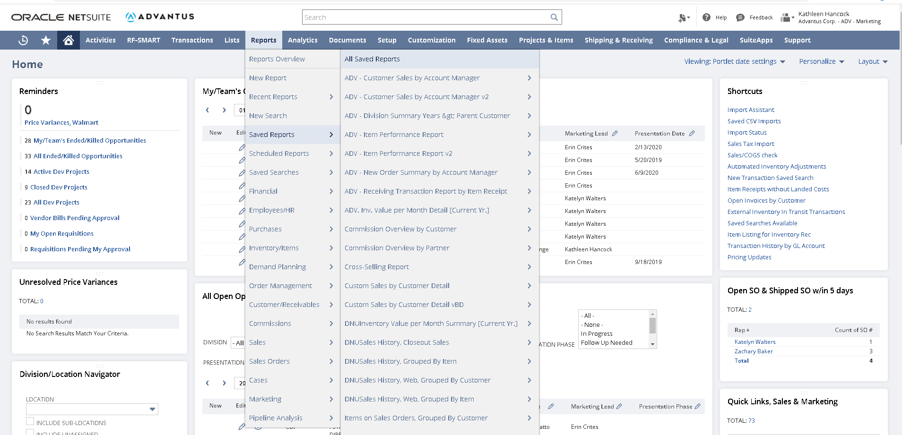
Quick Links Shortcuts Reports on Center Tab
Reports

Slide 22
Quick Links Shortcuts Reports on Center Tab
Reports

Slide 23
Quick Links Shortcuts Reports on Center Tab
Reports

Slide 24
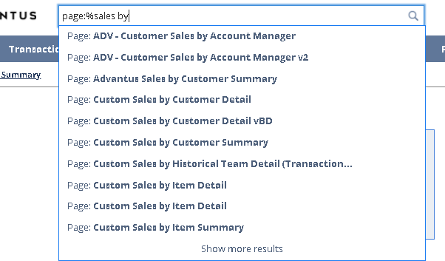
Reports: Locating Using Global Search
% acts as a wildcard
Useful to find searches if you know a word in the title

Slide 25
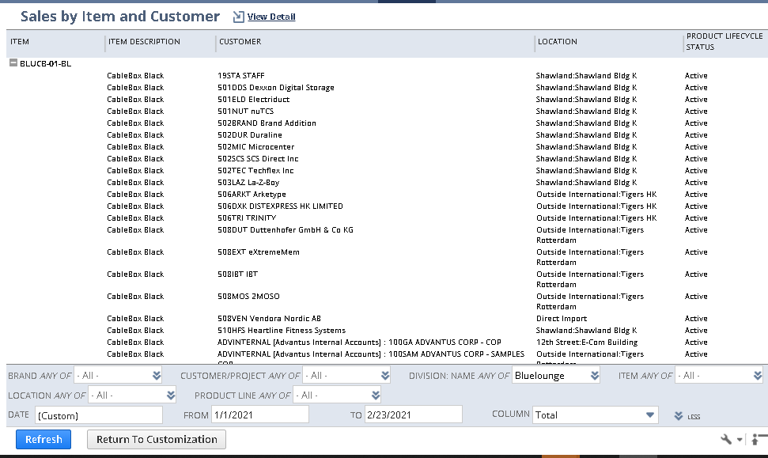
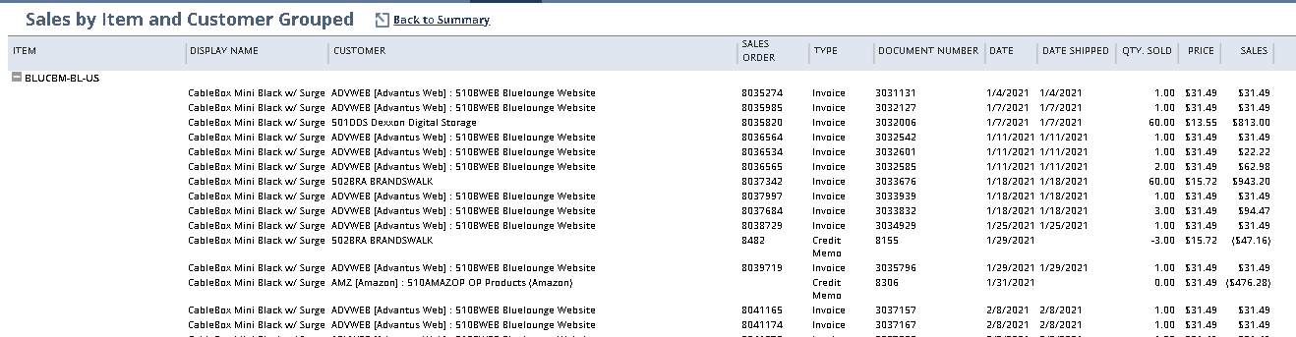
Reports: Using Available Filters, Summary & Detail Reports
Must click Refresh to display filtered results
Use Ctrl key to multi-select in a filter

Slide 26
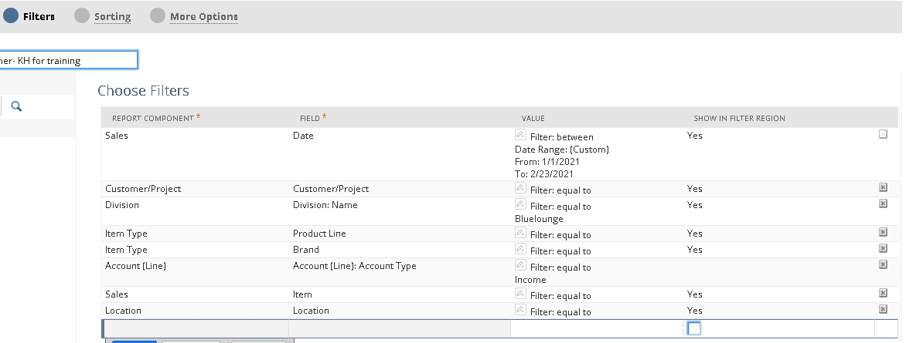
Reports: Adding Filters and Results

Slide 27
Reports: Viewing Details
From Summary Report
From Detail Report

Slide 28
Can’t find a report or saved search that works for you?
Need additional criteria/filters added?
Contact owner of saved search or report
Need a new report or saved search?
Contact 2.0 Response Team Member

