Slide 1
Sales Order Process
Overview & Troubleshooting

Slide 2
Broad Sales Order Process Overview
Sales Order Entered
Order Fulfilled
Item Fulfillment Created
Outbound Shipment Created
Invoice Created
Order Shipped

Slide 3
Sales Order
Sales Order Status

Slide 4
Sales Order
Sales Order Status

Slide 5
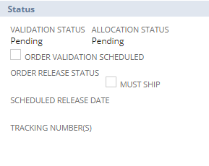
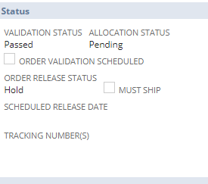
Validation Process Checks:
Address (general P.O. box)
Pricing
Required Multiples
Exclusivity/Restriction
Sales Order
Validation Status

Slide 6
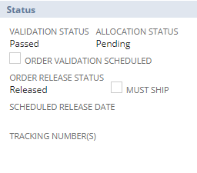
Sales Order
Order Release Status

Slide 7
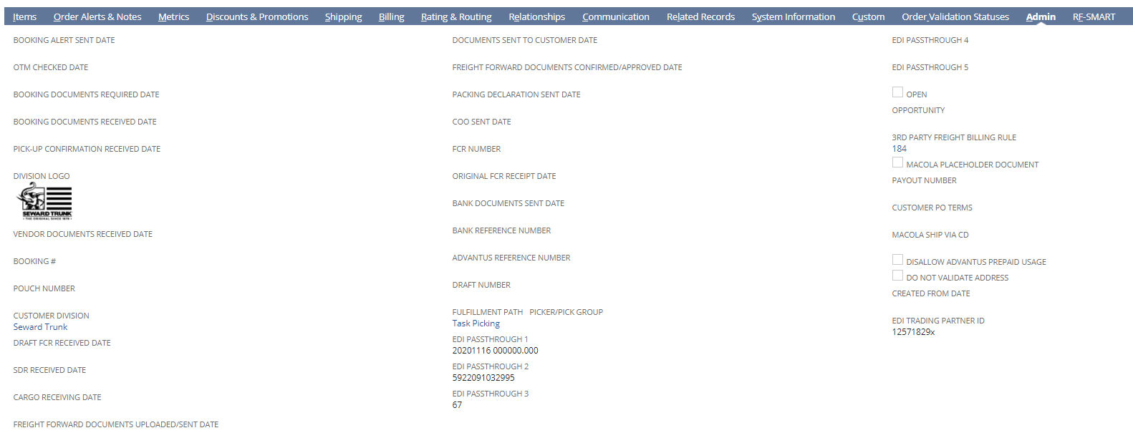
Fulfillment Paths:
Advantus Task Picking
DSDC
Bulk Fulfillment
Native Fulfillment
Pick/Pack/Ship*
Fulfillment

Slide 8
Fulfillment

Slide 9
Item Fulfillment
Record
Sales Order

Slide 10
Item Fulfillment
Record

Slide 11
Sales Order
Outbound Shipment
Record

Slide 12
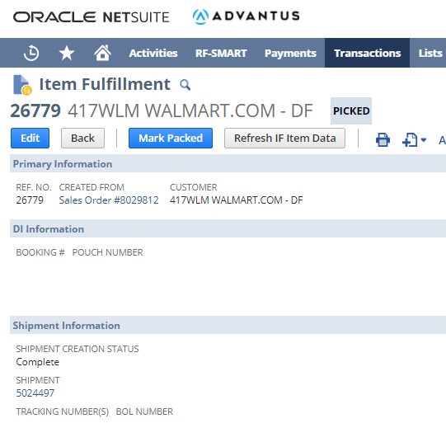
Item Fulfillment Record
Outbound Shipment
Record

Slide 13
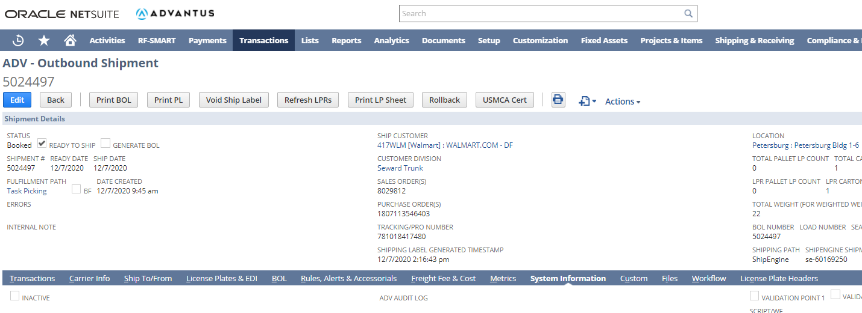
Outbound Shipment
Record

Slide 14
Sales Order
Invoice

Slide 15
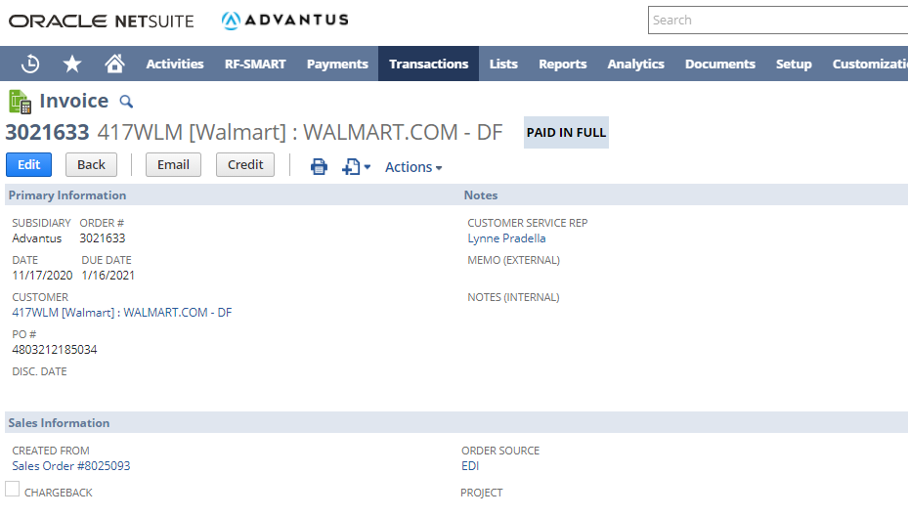
Invoice

Slide 16
Research Tip: System Information
Sales Order
Outbound Shipment
Pick Task
Item Fulfillment
Sales Order
*Access the Sales Order through various ways including Master Order Tracker, ShipEngine or global search.
System Information: Subtab on Sales Order is System Information. It will show activity from time of data entry of the order through billing (including release date/time)
Pick Task
*Access the Pick Task through RFSmart subtab on the Sales Order.
System Information: Subtab on pick task is Notes then select System Notes. This will show activity from time of task creation until it is submitted by the picker.
Item Fulfillment
*Access through Sales Order subtab Related Records
System Information: Subtab on Item Fulfillment is System Information. It will show activity from time of task being submitted through data being pushed to Outbound Shipment record.
Note: Probably will not use this record in research often.
Outbound Shipment
*Access through Sales Order subtab of Related Records or from Item Fulfillment link
System Information: Subtab on Outbound Shipment is System Information. It will show activity from time of creation from Item Fulfillment record to being marked as shipped.

Slide 17
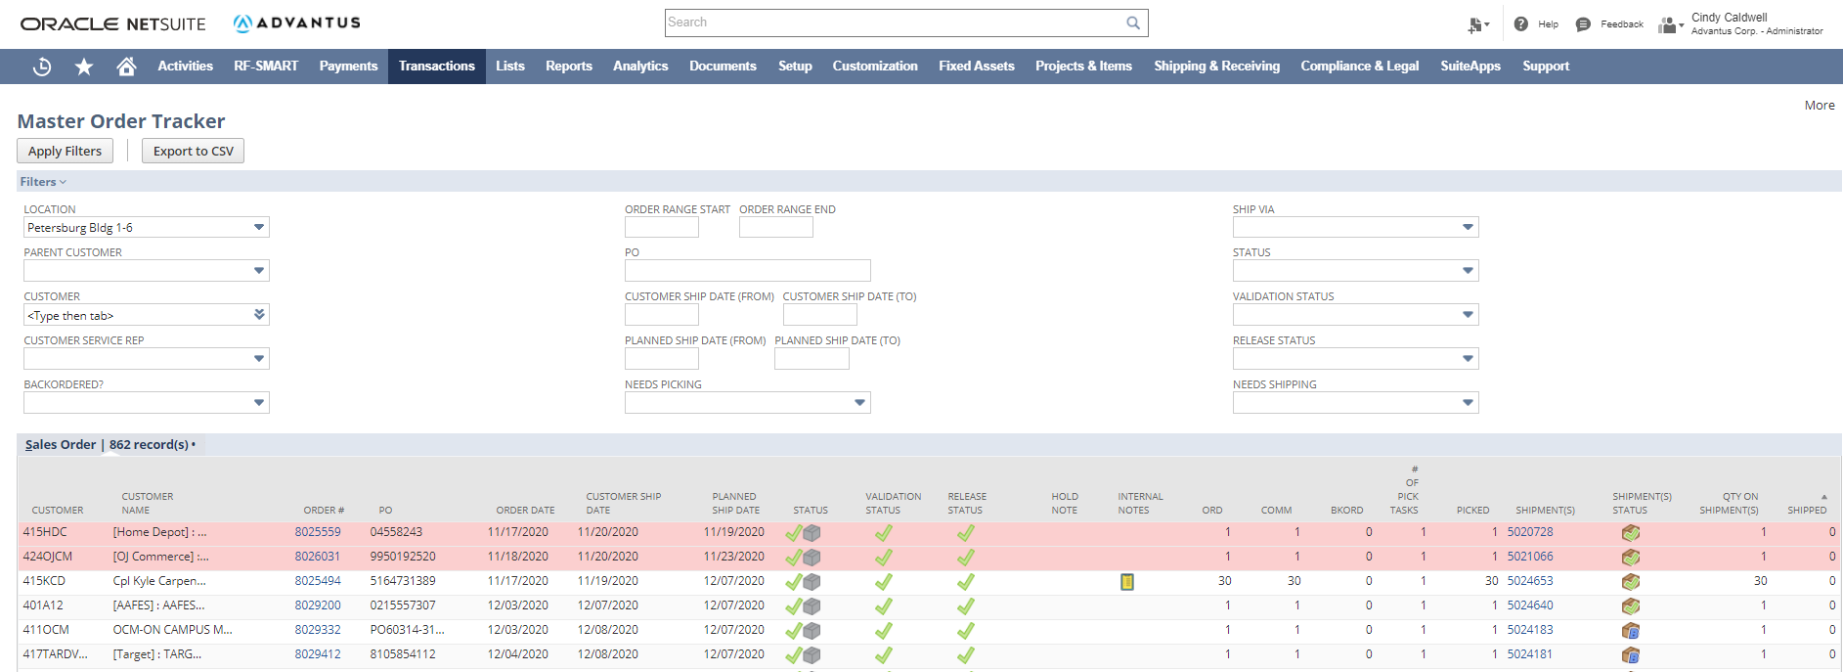
Research Tip: Master Order Tracker

Slide 18
Research Tip: Master Order Tracker

Slide 19
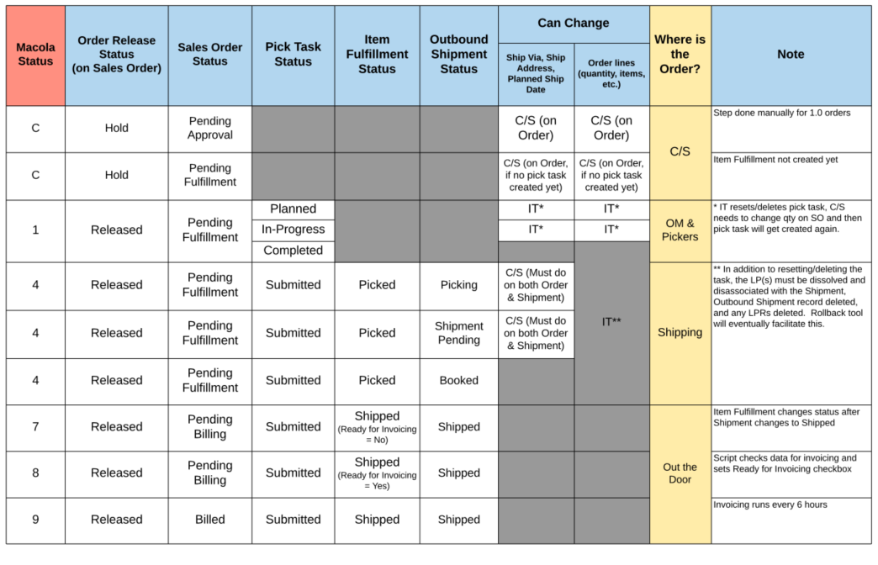
Research Tip: Macola versus NetSuite Order Status

Slide 20
Questions?

