Slide 1

Sales Order: Entry to Release
June 29, 2021

Slide 2
Agenda
Customer Rules
Flowchart
Entry
Approval
Commit
Allocation Status
Validation Status
Release
Post-fulfillment
Exceptions

Slide 3
Agenda
Customer Rules
Flowchart
Entry
Approval
Commit
Allocation Status
Validation Status
Release
Post-fulfillment
Exceptions

Slide 4
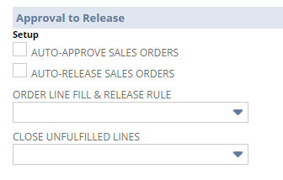
Customer Rules
Auto-Approve Sales Orders: customer’s orders are approved automatically
Auto-Release Sales Orders: customer’s orders are released automatically
Close Unfulfilled Lines: indicates whether the remaining lines on the customer’s orders should be closed after the first fulfillment
Customer record: Requirements & Alerts subtab

Slide 5
Customer Rules
Order Line Fill & Release Rule: how lines should be filled and released based on inventory commitment
  Partial Lines: Fill available quantity; release when committed
  Line in Full: Commit entire line or not at all; release when committed
  Order in Full: Commit lines; release when fully committed
  Lines on All Orders in Full: Commit all orders complete for each line; release when committed
    Orders handled manually
Customer record: Requirements & Alerts subtab

Slide 6
Agenda
Customer Rules
Flowchart
Entry
Approval
Commit
Allocation Status
Validation Status
Release
Post-fulfillment
Exceptions

Slide 7
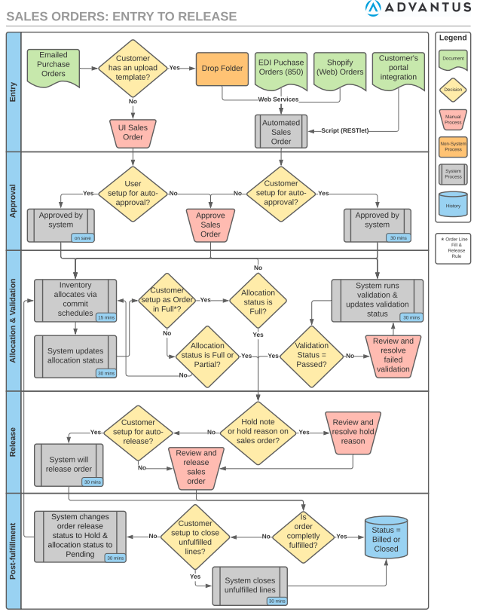
Flowchart
A flowchart illustrating the process from sales order entry to release is available on the wiki
  Job Aids
  NetSuite Training Sessions

Slide 8
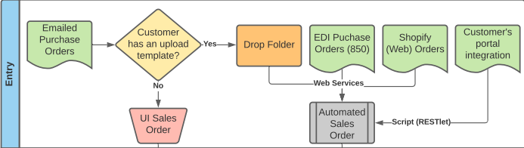
Agenda
Customer Rules
Flowchart
Entry
Approval
Commit
Allocation Status
Validation Status
Release
Post-fulfillment
Exceptions

Slide 9
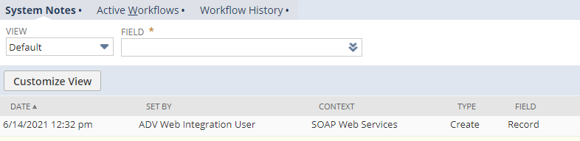
Sales Order Entry
Several ways a sales order can be created
  UI (user interface): manually entered
  Automated
    Web Services
      EDI
      Shopify integration
      Drop folder
    Script (RESTlet): integration for customer’s portal (ex. Amazon Seller Central)
Type of entry can be found under System Notes (context)
  Will be first entry in log

Slide 10
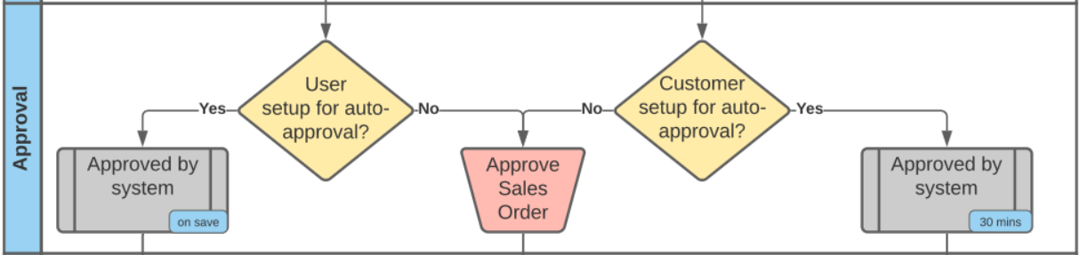
Agenda
Customer Rules
Flowchart
Entry
Approval
Commit
Allocation Status
Validation Status
Release
Post-fulfillment
Exceptions

Slide 11
Approval: Auto
UI sales orders: if the user entering the order is selected for auto-approval, the sales order will approve once saved
  Checkbox on employee record (Approvals subtab)
  Eligibility is determined by C/S Manager
Automated sales orders: if the customer is selected for auto-approval, the order will be approved via workflow every 30 mins
  Checkbox on customer record (Requirements & Alerts subtab)
Customer record: Requirements & Alerts subtab

Slide 12

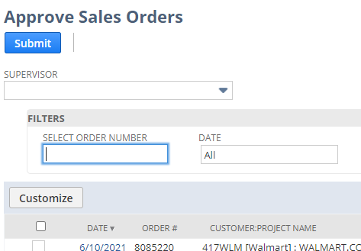
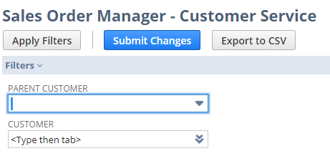
Approval: Manual
Multiple ways to approve
  Approve button on sales order
  Approve Sales Orders suitelet
    Transactions -> Sales -> Approve Sales Orders
  Sales Order Manager suitelet
    Transactions -> Custom -> Sales Order Manager - CS

Slide 13
Agenda
Customer Rules
Flowchart
Entry
Approval
Commit
Allocation Status
Validation Status
Release
Post-fulfillment
Exceptions

Slide 14


Commit
There are 3 ways to inventory to be committed/allocated
  Commit Orders: Manual
  Commit Orders: Schedules
  Reallocate Items
Quantity available to be allocated includes only NetSuite quantity
Icons on sales order lines indicate commitment
  Backordered line:
  Committed and not fulfilled line:
  No icon for fulfilled lines
Full training: Inventory Allocation/Commitment

Slide 15
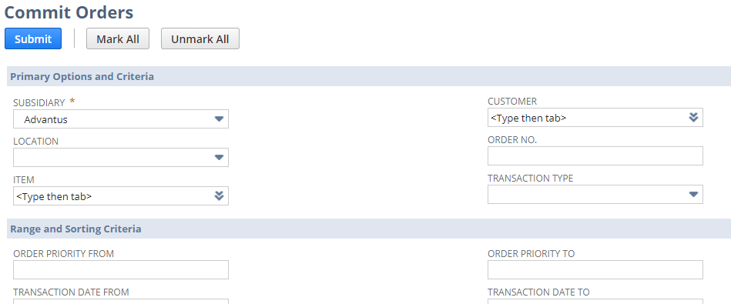
Commit: Manually
Transactions -> Inventory -> Commit Orders
Native suitelet
Expected to be used occasionally

Slide 16
Commit: Schedules
Transactions -> Inventory -> Commit Orders -> Schedule
Fill Backorders replacement
Majority of the orders will be allocated using schedules
Based on saved searches
  One for sales orders
  Reservation schedule is separate
Schedules are set up to run every 15 minutes

Slide 17
Commit Inventory: Reallocate Items
Transactions -> Inventory -> Reallocate Items
Native suitelet
Choose Item and Location
  Once selected, adjustments can be done as needed
Be aware: if you are trying to unallocate but the quantity is still available and there are not other orders for the items, the inventory will re-commit when the schedule runs again
  To prevent, the Commit field on the sales order line needs to be changed to Do Not Commit

Slide 18
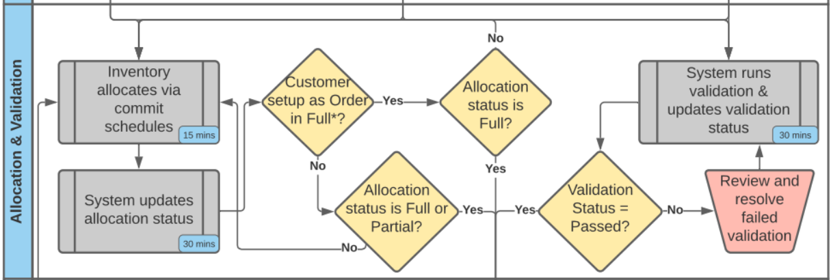
Agenda
Customer Rules
Flowchart
Entry
Approval
Commit
Allocation Status
Validation Status
Release
Post-fulfillment
Exceptions

Slide 19
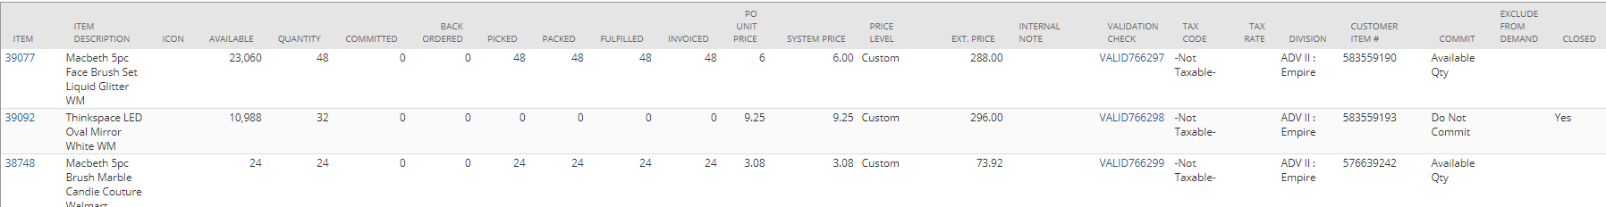
Allocation Status
Every 30 minutes, a workflow runs to determine if inventory has been committed to the sales order lines
Eligible items: Lines that are not closed or fulfilled
Statuses:
  Pending: no inventory has been committed for eligible lines
  Partial: at least one line has been committed, but not all for eligible lines
  Full: all lines are committed fully for eligible lines
Orders will stay in Pending status until at least one line is allocated
If an order doesn’t ship in full, a workflow resets to allocation status to Pending

Slide 20
Allocation Status: Pending
No inventory has been committed
No inventory has been committed for lines not fulfilled

Slide 21
Allocation Status: Partial
At least one line has been committed, but not all
At least one line has been committed or lines not fulfilled, but not all

Slide 22
Allocation Status: Full
All lines are committed fully
Remaining lines committed for lines not fulfilled

Slide 23
Agenda
Customer Rules
Flowchart
Entry
Approval
Commit
Allocation Status
Validation Status
Release
Post-fulfillment
Exceptions

Slide 24
Validation Status
Script runs every 30 minutes
  Validation can be run on demand by hitting the Validate Order button on sales order
4 tests
  Required Multiples
  Address Validation
  Item Exclusivity/Restrictions
  Price Variance
Statuses:
  Pending: validation has not run
  Passed: all tests passed
  Failed: 1 or more test failed
  Processing: validation is currently running
Detail of results can be found on the Validation subtab on the sales order
Full training: Sales Order Validation & Price Engine/Hierarchy

Slide 25
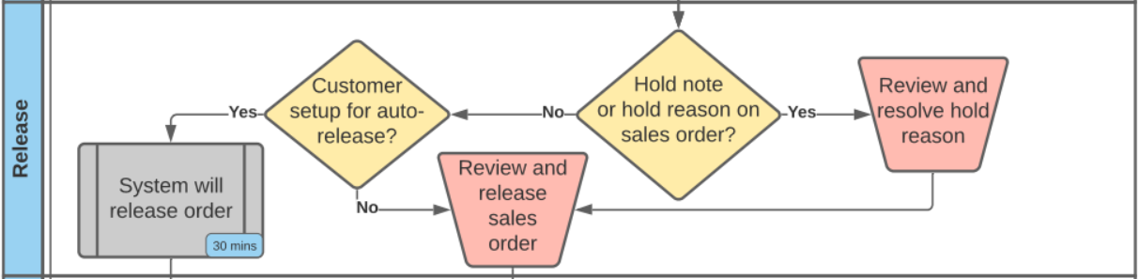
Agenda
Customer Rules
Flowchart
Entry
Approval
Commit
Allocation Status
Validation Status
Release
Post-fulfillment
Exceptions

Slide 26
Release: Overview
Requirements:
  Order needs to be approved
  Order need to be Pending Fulfillment or Partially Fulfilled
  Allocation Status needs to be Full or Partial
  Validation status needs to be Passed
  Hold Reason and Hold Note need to be blank
Statuses:
  Hold
  Released
  Rollback Completed
  Rollback Failed
  Rollback in Progress
  Scheduled

Slide 27
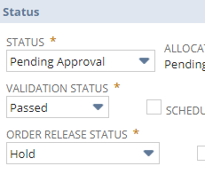
Release: Manual
Multiple ways to release
  Update Order Release status dropdown on sales order
  Sales Order Manager suitelet
    Transactions -> Custom -> Sales Order Manager - CS

Slide 28
Release: Auto
If the customer is selected for auto-approval, the order will be approved via workflow every 30 mins
  Checkbox on customer record (Requirements & Alerts subtab)
The sales order will not be released if the requirements are not meet
If the customer’s Order Line Fill & Release Rule is set to Order in Full, the sales order will not be released until the Allocation Status is Full
Customer record: Requirements & Alerts subtab

Slide 29
Release: Scheduled
Future Enhancement
C/S will have the ability to release sales orders on a future date
  Example: If an order is received on 6/15 and scheduled to ship on 9/15, C/S can schedule the order to be released on 9/10
C/S will change the Order Release Status to Scheduled and enter a date for the scheduled release
The system will release the order on that day
Benefit: reduce the number of times an order is touched

Slide 30
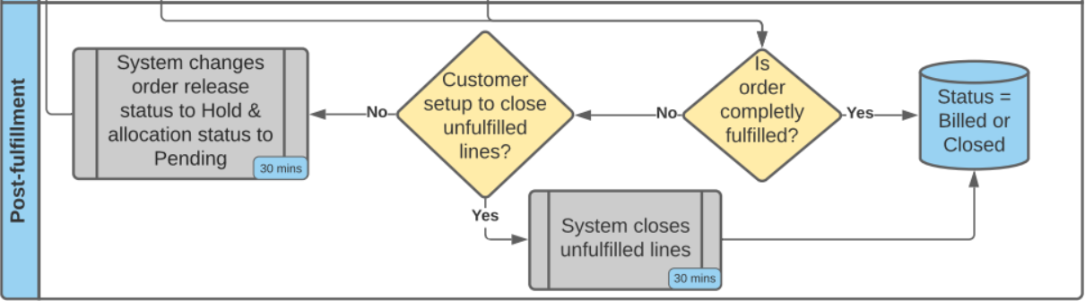
Agenda
Customer Rules
Flowchart
Entry
Approval
Commit
Allocation Status
Validation Status
Release
Post-fulfillment
Exceptions

Slide 31
Post Fulfillment: Statuses
Once billing schedule runs, the status will change to one of the following
  Partially Fulfilled: one or more lines still need to be fulfilled
  Billed: entire order has been fulfilled and billed
  Closed: one or more lines on the sales order have been closed
Allocation Status
  Once sales order is fulfilled, a workflow changes the allocation status back to Pending
Release Status
  Once sales order is fulfilled, a workflow changes the release status back to Hold

Slide 32
Post Fulfillment: Close Unfulfilled Lines
Customer record: Requirements & Alerts subtab
If the customer has the Close Unfulfilled Lines checkbox selected, a workflow will close the unfilled lines
Workflow runs once a day at night
If we receive more inventory, the orders that are partially fulfilled will not commit for customers with the close unfulfilled lines checkbox selected
Previous name: Close Backorders
Macola name: Delete Backorders

Slide 33
Agenda
Customer Rules
Flowchart
Entry
Approval
Commit
Allocation Status
Valuation Status
Release
Post-fulfillment
Exceptions

Slide 34
Exceptions
JoAnn Stores and Wyla samples customers are excluded from the commit schedules. They are committed manually by C/S.
Direct Import orders don’t use Allocation Status since they are linked to supply orders
Some orders don’t run through the standard validation process
  46WLM because of the size of the orders
    Price variances are checked separately
  Custom Decoration because of the order profile
    Addresses are validated
  Sample and Internal Orders because of the order profile
Orders for Advantus-staffed location use the order release status
  Examples: Not used for Direct Ship and Direct Import orders

Slide 35
Agenda
Customer Rules
Flowchart
Entry
Approval
Commit
Allocation Status
Valuation Status
Release
Post-fulfillment
Exceptions

Slide 36
Questions?

