Slide 1
From Receiving to Returns
NetSuite Inventory Flow
Process Overview

Slide 2
Process Overview
Inventory Flow job aid is available on Wiki Job Aids page.

Slide 3
Inbound Shipment Manager
Schedule appointments
Update shipment details
Review and manage scheduled deliveries in specified time period

Slide 4
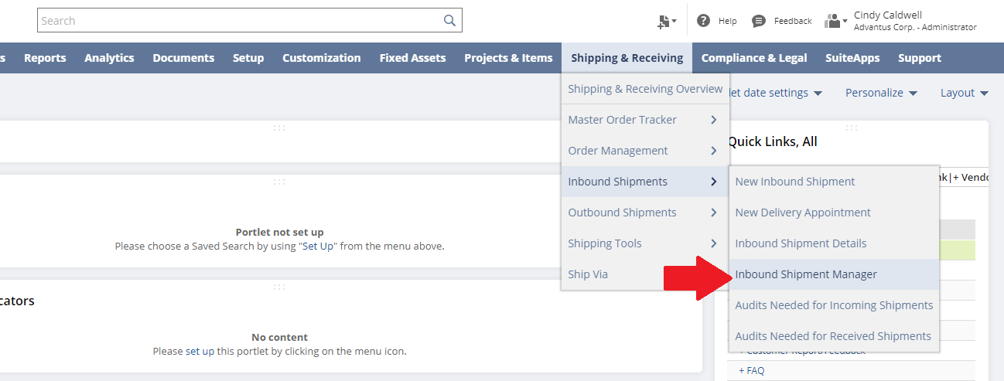
Inbound Shipment Manager

Slide 5
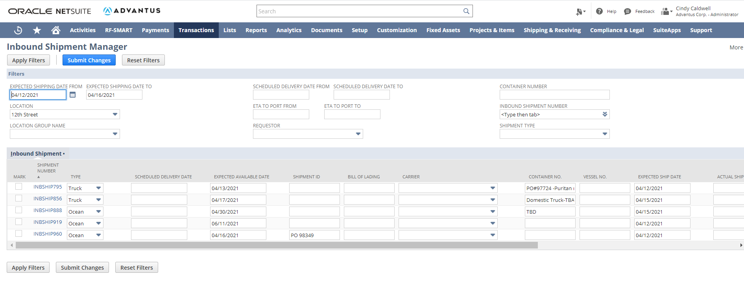
Inbound Shipment Manager

Slide 6
Inbound Shipment Details
Review upcoming inbound shipments
Palletization details
Scheduled audits on shipments
Access Inbound Shipment record

Slide 7
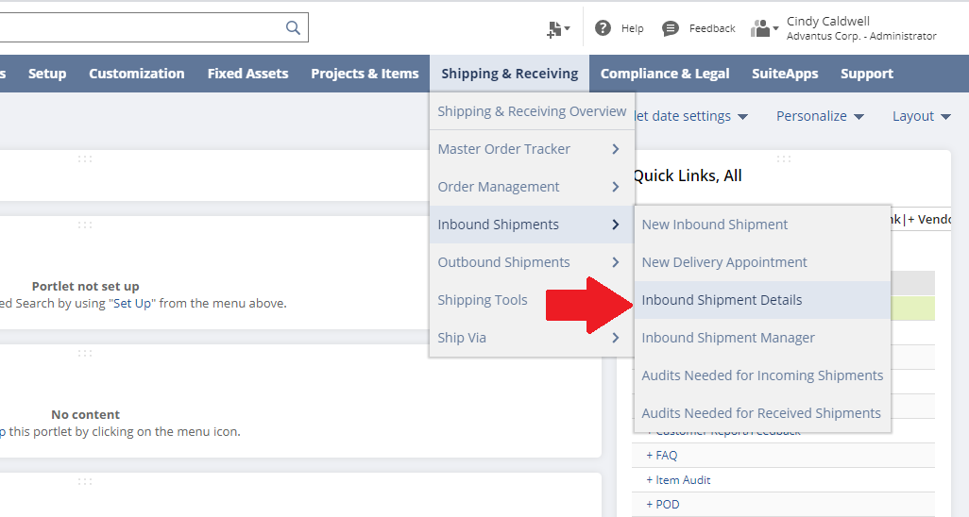
Inbound Shipment Details

Slide 8
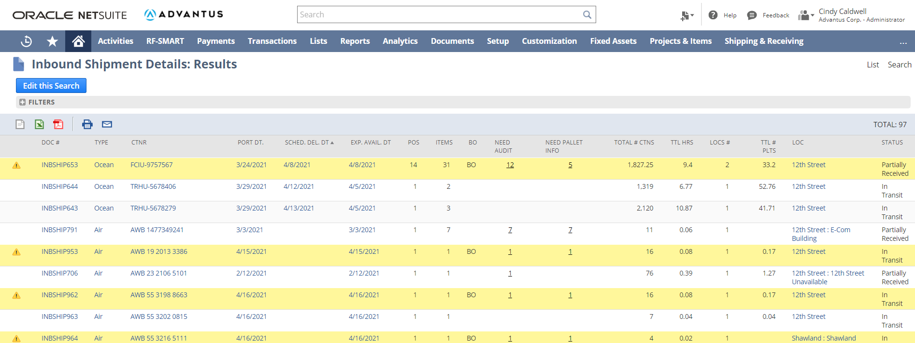
Inbound Shipment Details

Slide 9
Inbound Shipment Details-Audits

Slide 10
Inbound Shipment Details-Audits

Slide 11
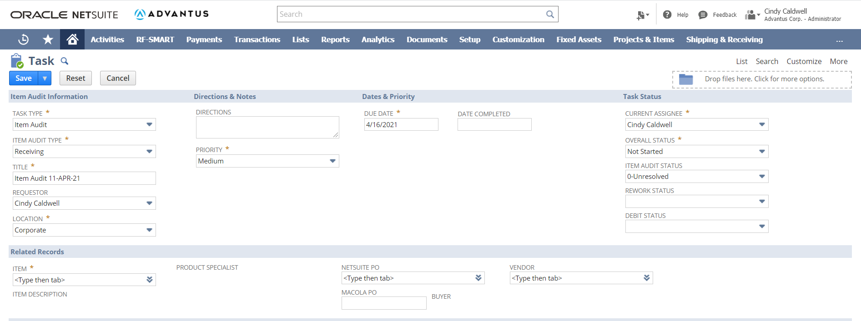
Inbound Shipment Details-Audits

Slide 12
Inbound Shipment Details-Inbound Shipment record

Slide 13
Inbound Shipment Details-Inbound Shipment record

Slide 14
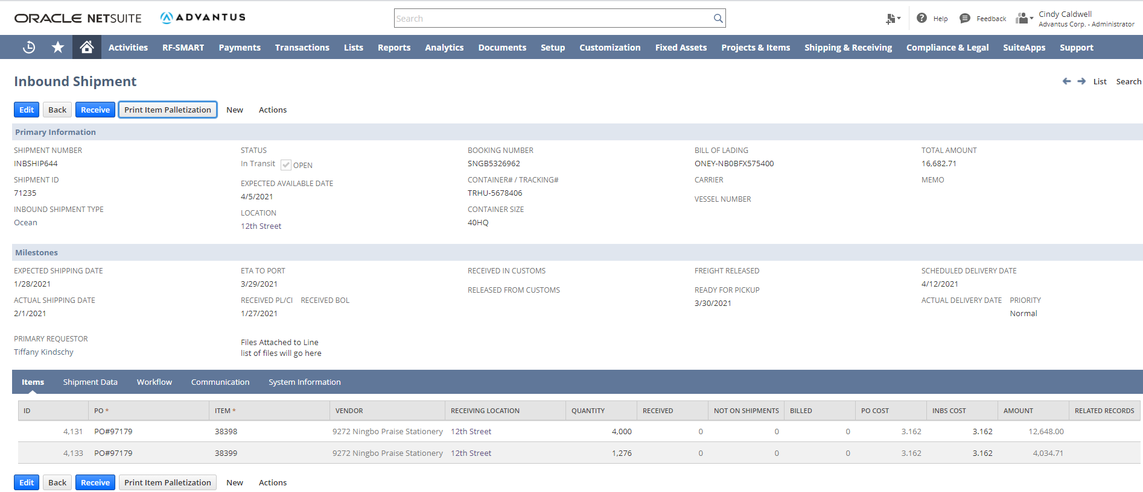
Inbound Shipment Details-Inbound Shipment record
Inbound Shipment Details-Inbound Shipment record

Slide 15
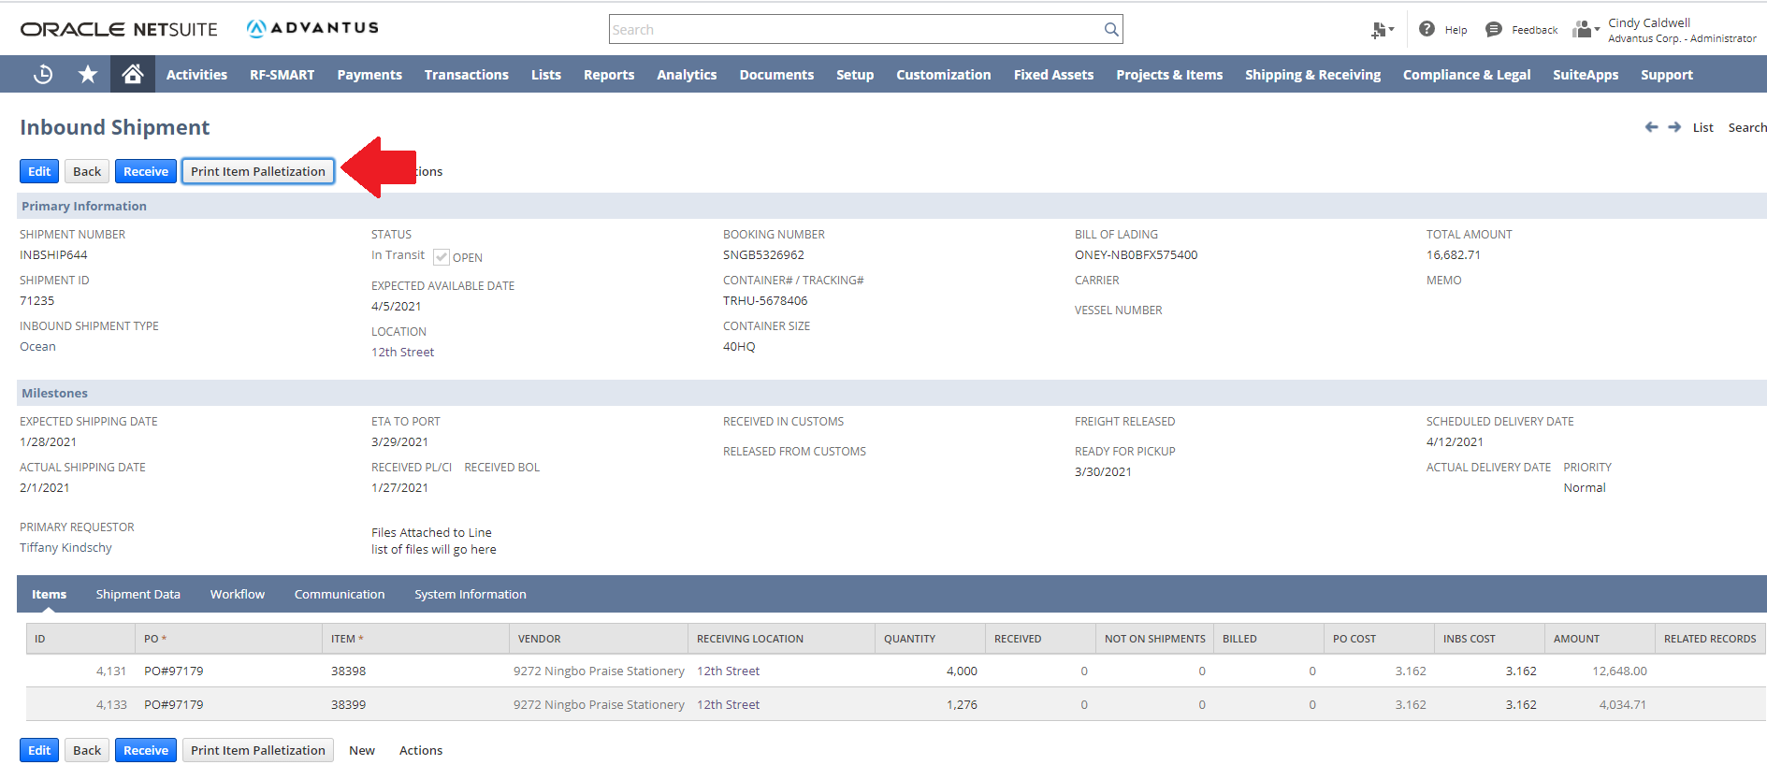
Inbound Shipment Details-Palletization
Inbound Shipment Details-Inbound Shipment record

Slide 16
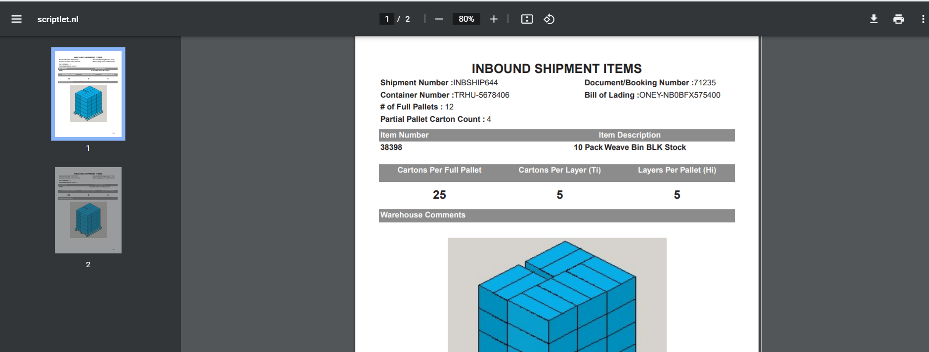
Inbound Shipment Details-Palletization
Inbound Shipment Details-Inbound Shipment record

Slide 17
Inbound Shipment Details-Receiving
Inbound Shipment Details-Inbound Shipment record

Slide 18
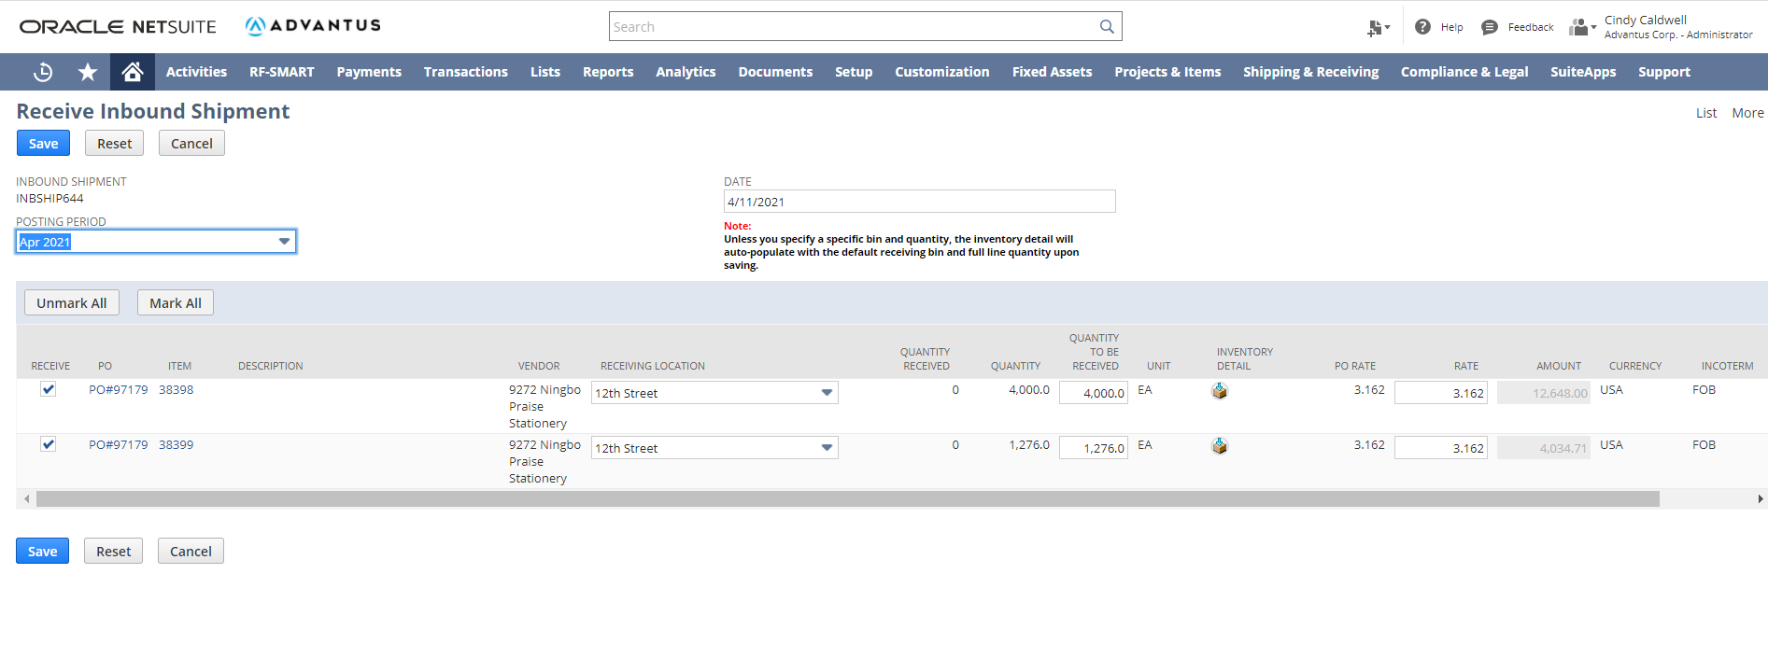
Inbound Shipment Details-Receiving
Inbound Shipment Details-Inbound Shipment record

Slide 19
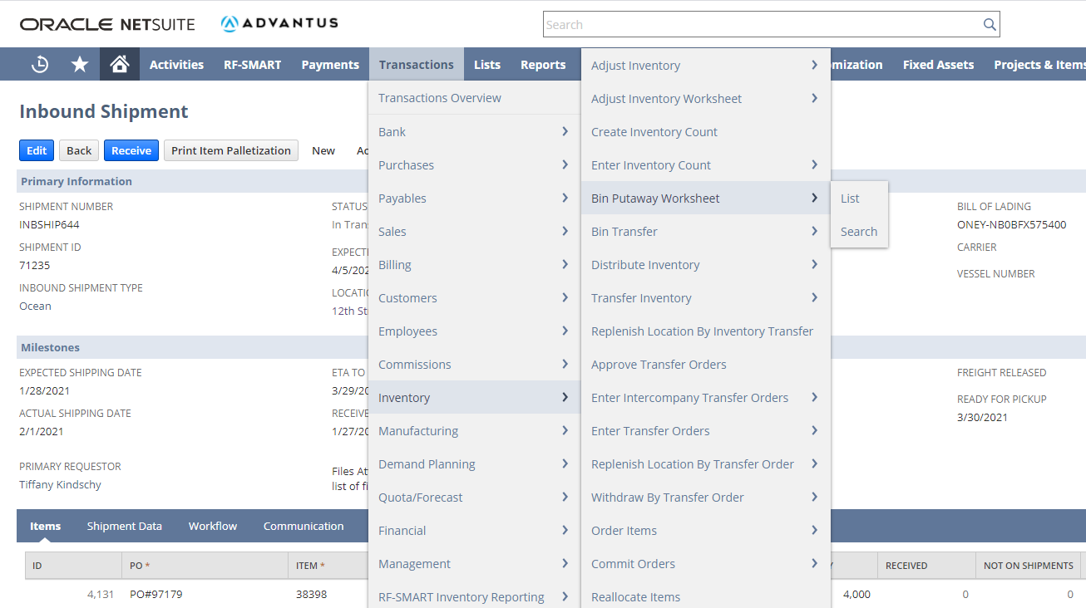
Bin Putaway Worksheet
Inbound Shipment Details-Inbound Shipment record

Slide 20
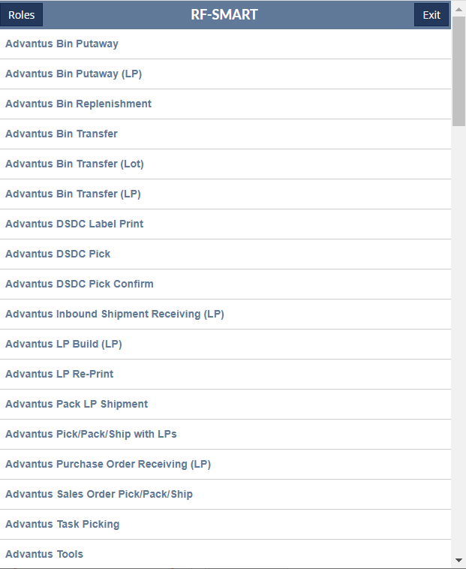
RF-Smart Bin Putaway
Inbound Shipment Details-Inbound Shipment record

Slide 21
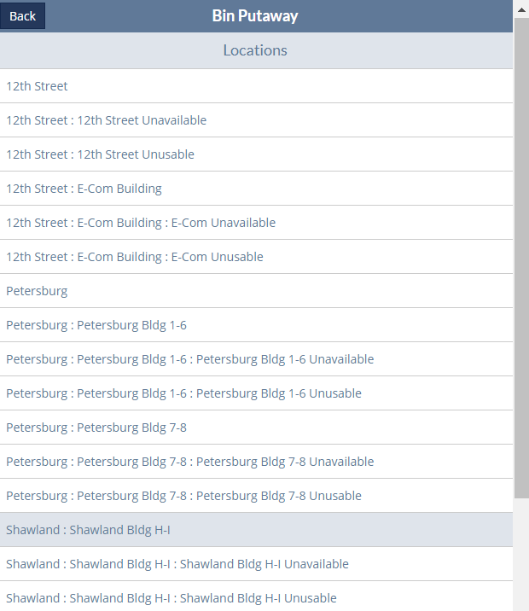
RF-Smart Bin Putaway
Inbound Shipment Details-Inbound Shipment record

Slide 22
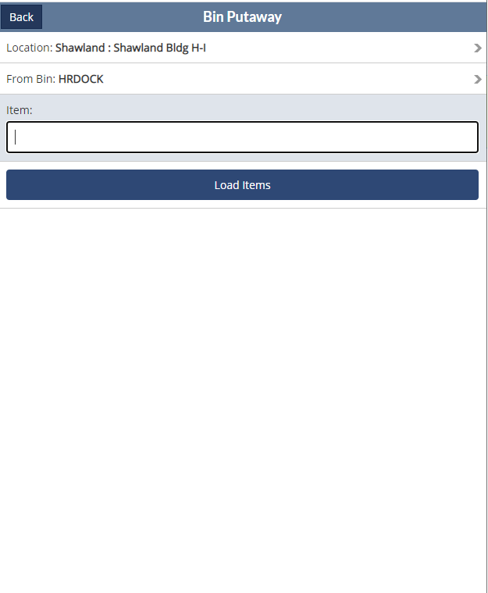
RF-Smart Bin Putaway
Inbound Shipment Details-Inbound Shipment record

Slide 23
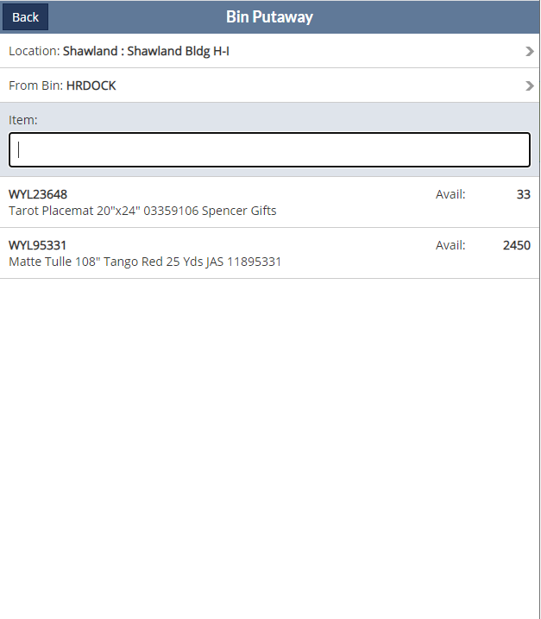
RF-Smart Bin Putaway
Inbound Shipment Details-Inbound Shipment record

Slide 24
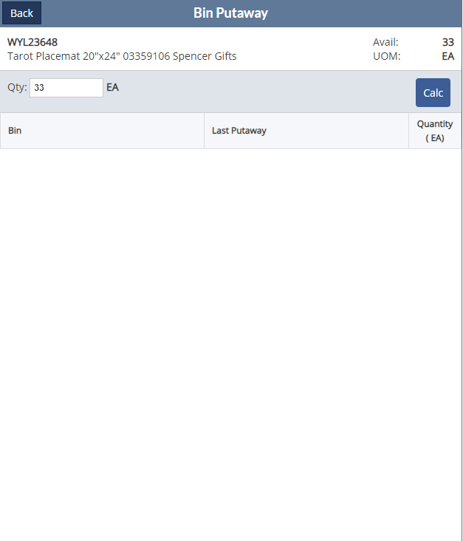
RF-Smart Bin Putaway
Inbound Shipment Details-Inbound Shipment record

Slide 25
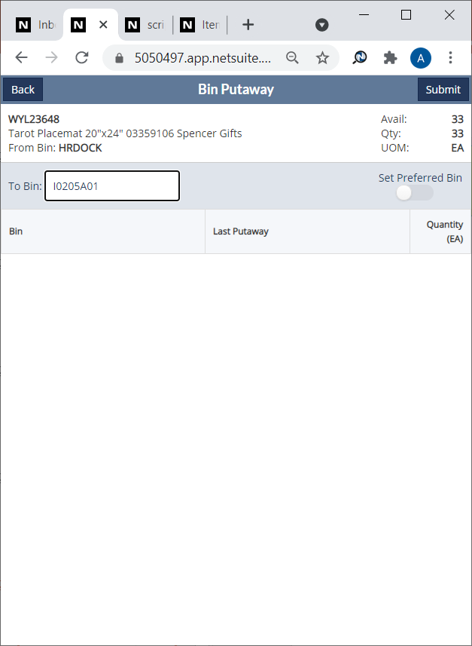
RF-Smart Bin Putaway
Inbound Shipment Details-Inbound Shipment record

Slide 26
Returns Process
Inbound Shipment Details-Inbound Shipment record
Authorized return
-item received back from the customer that already has a Return Authorization record in NetSuite, or
-item has identifiable information so that the sales order can be located for a Return Authorization to be added

Slide 27
Returns Process-Authorized Return
Inbound Shipment Details-Inbound Shipment record
Customer Service
Issues Return Authorization in NetSuite from the Sales Order
Approves Return Authorization in NetSuite (if necessary
Warehouse Operations
Confirms Return Authorization exists in NetSuite for approved returned item
If Return Authorization is not already in the system, contacts Customer Service to provide identifiable information so record can be added
Accounts Receivable
Issues financial refund in NetSuite
Updates Return Authorization in the system to either restock it or process it as unusable
Issues Credit Memo for return
If Ecommerce order, issues refund on Ecommerce purchase site

Slide 28
Returns Process
Inbound Shipment Details-Inbound Shipment record
Unauthorized return
-item received back from the customer that has no identifiable information

Slide 29
Returns Process-Unauthorized Return
Inbound Shipment Details-Inbound Shipment record
Warehouse Operations
Issues Return Authorization in NetSuite using the unauthorized return Customer Number for that location
Approves Return Authorization in NetSuite (if necessary
Customer Service
Researches unauthorized returns to identify sales order
Updates Return Authorization record to actual customer, purchase number and Credit Memo Reason code to CS - Authorized Return
Accounts Receivable
Issues financial refund in NetSuite
If not identified and resolved in 6 months, issues a $0.00 credit
Issues Credit Memo for return
If Ecommerce order, issues refund on Ecommerce purchase site
Updates all Return Authorization in the system to either restock it or process it as unusable

Slide 30
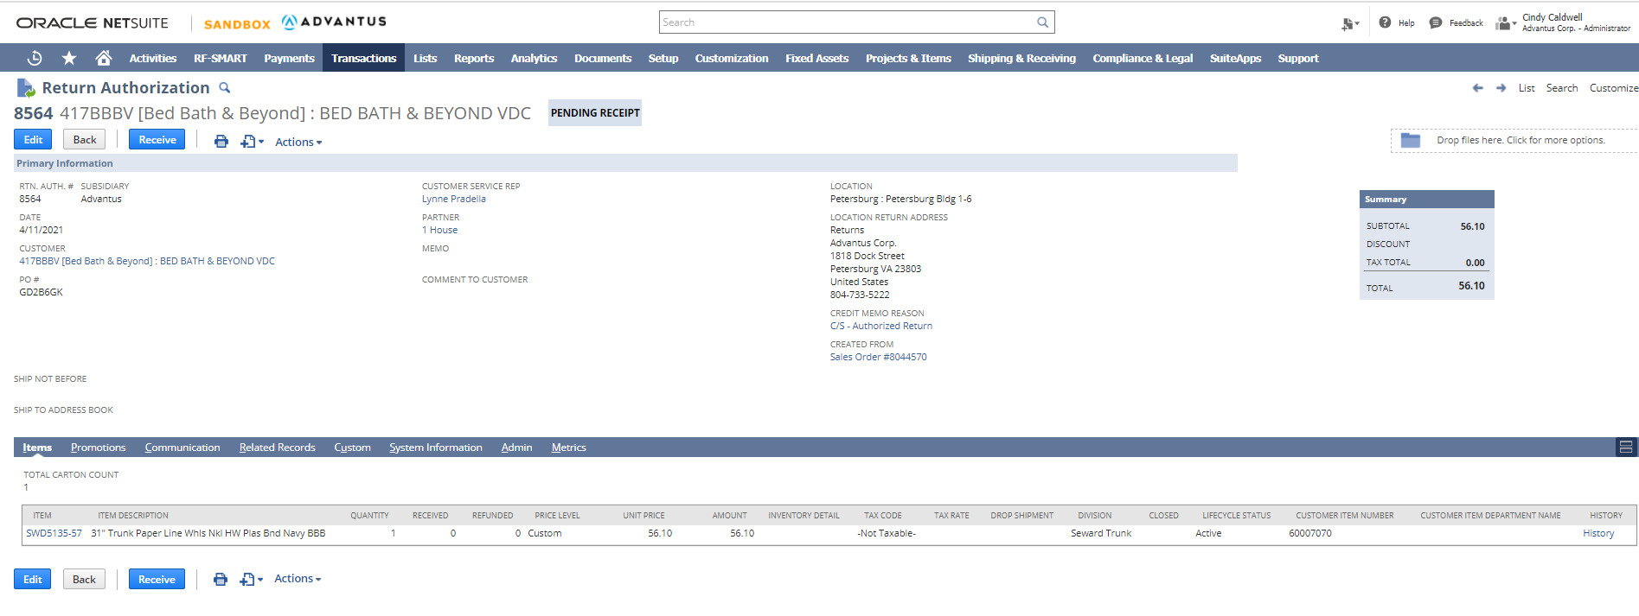
Returns
Inbound Shipment Details-Inbound Shipment record

Slide 31
Returns
Inbound Shipment Details-Inbound Shipment record

Slide 32
Questions?

