Slide 1
Purchase Order -> Inbound Shipment Flow

Slide 2
Agenda
Purchase Orders
Inbound Shipments
Connections between
Saved Searches
Item Level Info
Date Flow Review

Slide 3
Purchase Orders
All Purchase Orders are issued in NetSuite
PO reasons:
Inventory Replenishment/Acquisition – as forecasted or directed
Custom Decoration Orders- created off Sales Order
DI- created off Sales Order
Requisition- created off approved requisition

Slide 4
Purchase Orders
Purchase Order Statuses
Pending Supervisor Approval – either new POs or POs with $ changes (for SCM)
Pending Receipt – PO Issued to Vendor
Pending Billing/Partially Received – Partially received and that received quantity is pending billing
Pending Billing- fully quantity of PO received and pending billing
Fully Billed- Purchase Order lifecycle complete
Closed- one line to all lines on the PO were closed
The rest of the lines might have been billed normally but one Closed line makes the whole PO status Closed

Slide 5
PO Process
Demand for PO Exists
PO Submitted for approval
PO issued to vendor
PI Received within 48 hours and Requestor reconciles PO
Vendor gets to work, time passes
Vendor or Galaxy sends booking/shipping documents
SCM creates Inbound Shipment

Slide 6
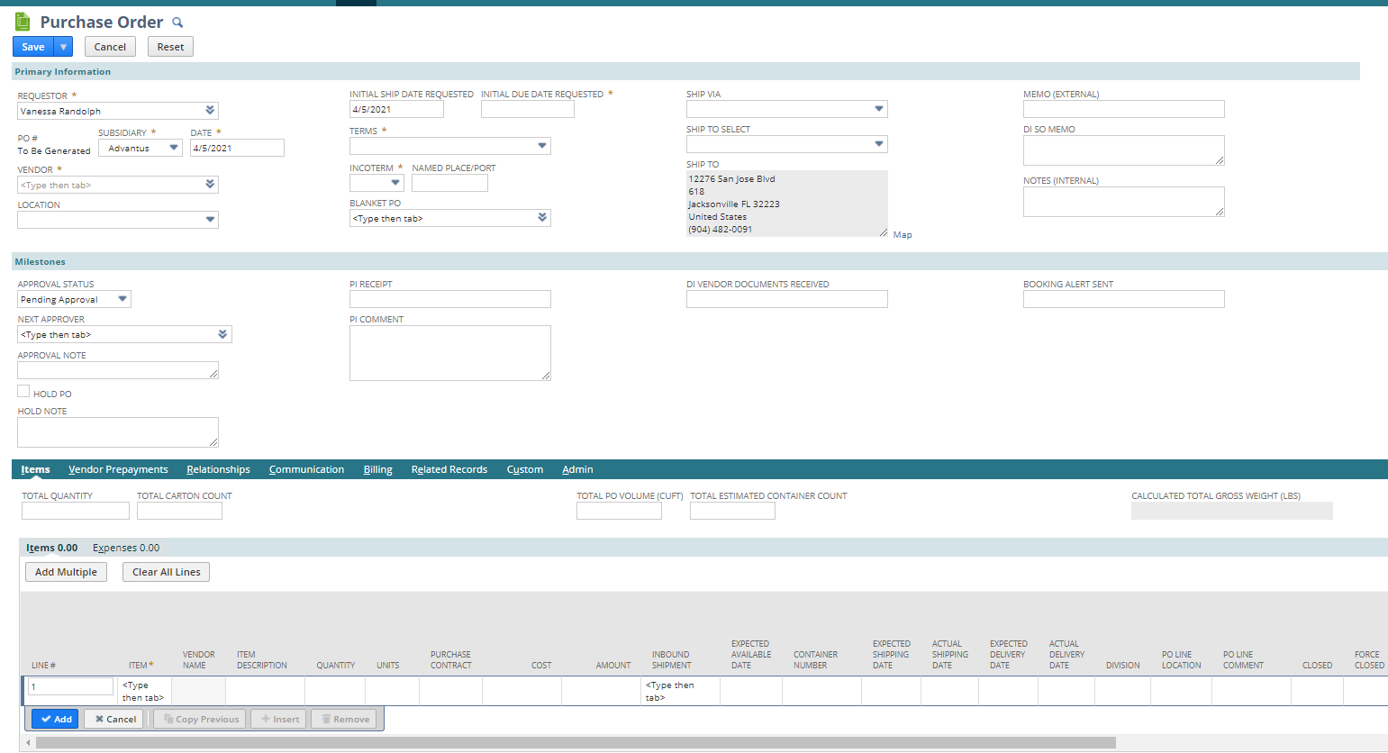
Purchase Orders

Slide 7
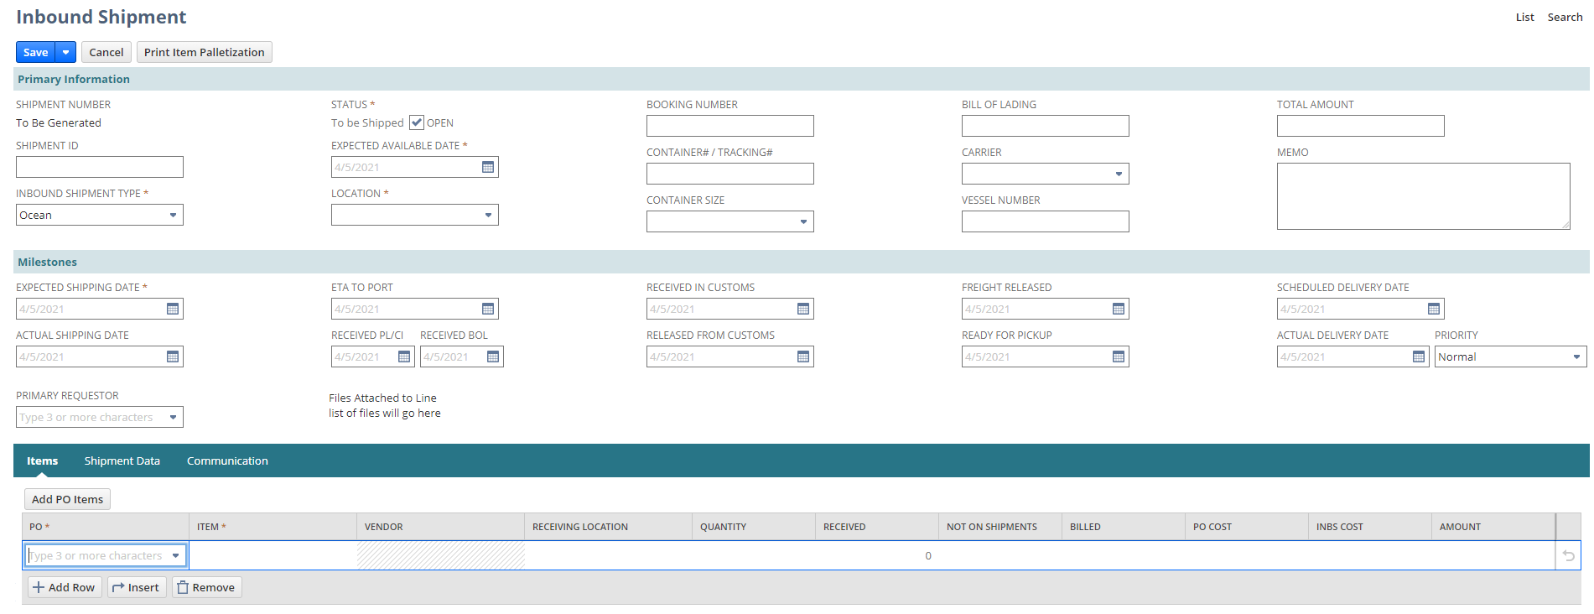
Inbound Shipments
Separate record created from lines on a Purchase Order
Could be lines from one PO or lines from multiple POs
Often abbreviated to INBS

Slide 8
Inbound Shipments
17
4
7
19
15
2
5
8
1
3
6
9
10
12
18
16
13
11
14
1) Three Types of Inbound: Ocean, Air, Truck
2) SCM enters the current Expected Available Date- after INBS creation, this date updates the field of the same name on the PO line
3) SCM enters the Header location where this shipment is to be received
4) SCM enters Booking Number if we have one (some shipments don’t have booking numbers)

Slide 9
Inbound Shipments
17
4
7
19
15
2
5
8
1
3
6
9
10
12
18
16
13
11
14
5) SCM enters the container number- tracking if Truck, Airway bill if Air
6) Container Size- set container size (provided at booking)
7) Bill of Lading number
8) Carrier- Carrier Company (provided on shipping documents)
9) Vessel- (provided on shipping documents)
Notes:
Carrier- Evergreen Shipping Agency; Vessel- Ever Given xxxxx

Slide 10
Inbound Shipments
17
4
7
19
15
2
5
8
1
3
6
9
10
12
18
16
13
11
14
10) SCM enters current Expected Shipping Date- after INBS creation, this date updates the field of the same name on the PO line
11) Primary Requestor populates on the INBS after save- sets based on the buyer for the goods listed
12) ETA to Port- provided on Galaxy documents, usually for Ocean Shipments

Slide 11
Inbound Shipments
17
4
7
19
15
2
5
8
1
3
6
9
10
12
18
16
13
11
14
13) Received PL/CI- Packing List and Commercial Invoice. Primary Requestor enters this date after confirming all values have been verified against these documents
Received BOL- Date we received the BOL

Slide 12
Inbound Shipments
17
4
7
19
15
2
5
8
1
3
6
9
10
12
18
16
13
11
14
14) SCM adds PO lines to the INBS. The receiving location, quantity and cost values pull from the PO on INBS creation
15) Shipment ID- this is the Galaxy shipment report ID
16) Actual Shipping Date- entered once goods ship

Slide 13
Inbound Shipments
17
4
7
19
15
2
5
8
1
3
6
9
10
12
18
16
13
11
14
17) Status:
To be Shipped- default status of entry- should remain in this status until there is an Actual Shipping Date
In Transit- Once a shipment ships, SCM marks In Transit– INBS cannot be received until marked In Transit
Partially Received
Received
Closed- Not commonly used

Slide 14
Inbound Shipments
17
4
7
19
15
2
5
8
1
3
6
9
10
12
18
16
13
11
14
18) Scheduled Delivery Date- Entered by the warehouse once Airvan contacts them to schedule delivery
19) Total Amount- sum of costs of items on the INBS

Slide 15
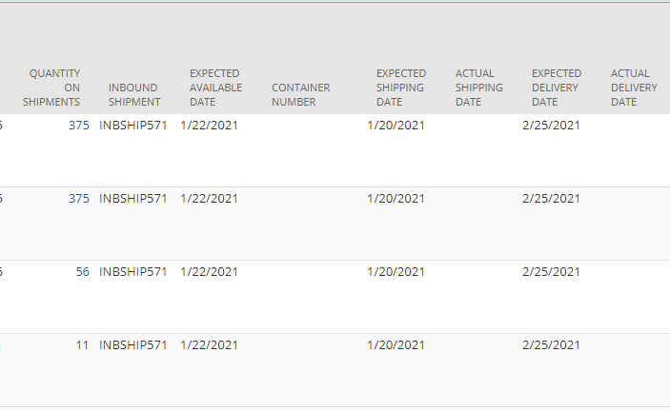
Inbound Shipment fields on PO
Once Dates are populated on INBS, they push from the INBS to the PO Line
INBS # and Container # will also populate on PO Line

Slide 16
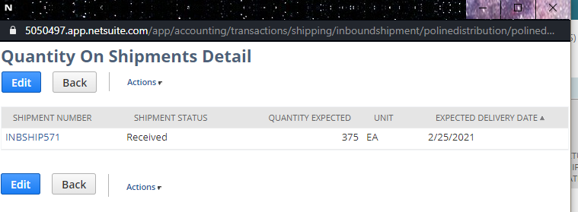
Inbound Shipment fields on PO
The number under Quantity on Shipments is a hyperlink which will open Quantity on Shipments Detail-
Clicking the hyperlink INBSHIP*** will take you to the INBS record

Slide 17
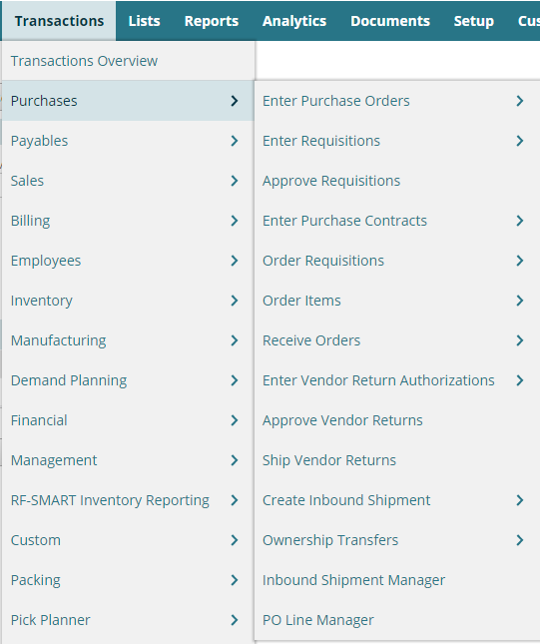
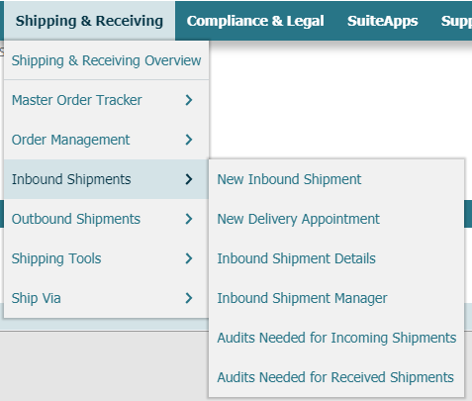
Inbound Shipment Manager
Shipping & Receiving -> Inbound Shipments -> Inbound Shipment Manager
Transactions -> Purchases -> Inbound Shipment Manager

Slide 18
Inbound Shipment Manager
Enter filter criteria, commonly an INBS #, Container #, or date criteria and select Apply Filter

Slide 19
Inbound Shipment Manager
Can be used to search for an INBS by Container number- clicking on the hyperlink under shipment number will open the INBS record
Can also be used to make changes to multiple INBS records
Warehouse also uses to update Scheduled Delivery Date

Slide 20
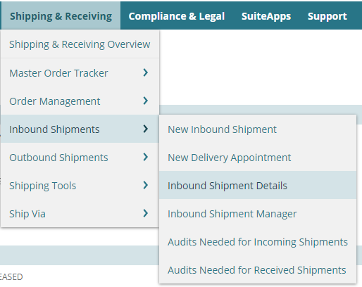
Inbound Shipment Details
Shipping & Receiving -> Inbound Shipments -> Inbound Shipment Details
Receiving report
Excludes Outside locations
Includes In Transit and Partially Received INBS

Slide 21
Inbound Shipment Details
Receiving uses to review
Summary of incoming shipments
Priority
BO Shipments
Item info (audits, missing fields, how much to unload)
Etc.

Slide 22
Information on Item Level
Under Inventory Detail -> Location, you can see On Order quantities. The On Order field is a hyperlink to the Open Supply Transactions by Item & Location saved search
This search is one way to see whether items are on shipments and the Expected Available Date

Slide 23
Information on Item Level
Related Records -> Next Supply
Shows Next PO or Work Order Date, Quantity and open quantity totals
These fields update daily

Slide 24
Information on Item Level
Related Records -> Purchase Orders
You can see Purchase Orders with their Expected Available Date, Qty on Shipments, and other fields

Slide 25
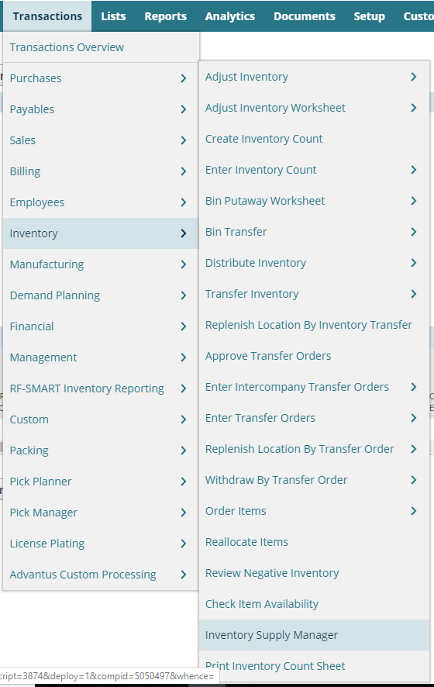
Inventory Supply Manager
Transactions -> Inventory -> Inventory Supply Manager
Review information for multiple items, a divisions items, etc.
Review supply documents across date ranges, locations, etc.

Slide 26
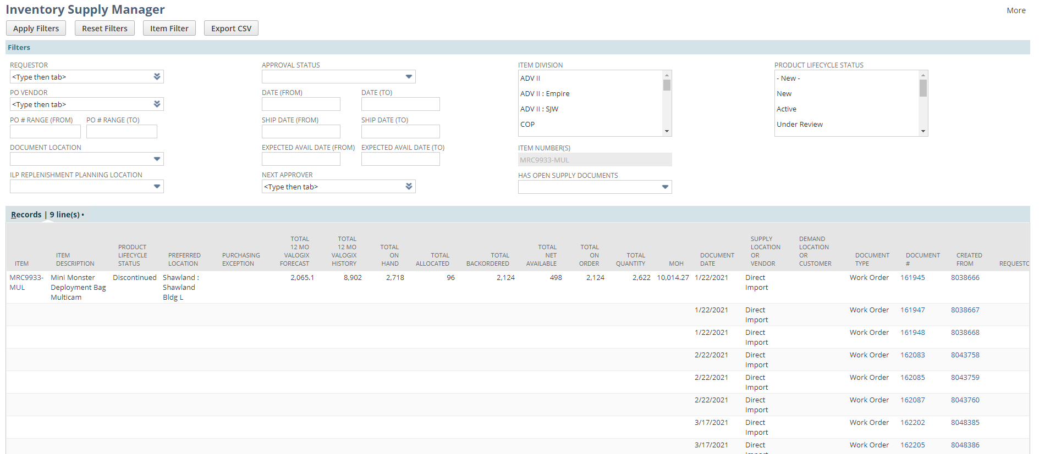
Inventory Supply Manager

Slide 27
Date Flow Summary
Field | Who Updates | Based on what | When | Where | Calculation?
Expected Shipping Date | PO Requestor, then SCM | Pulls to PO line from Initial Ship Date Requested, updated on the line based on PI or circumstances | At PO issuance and as it changes | Starts on PO, then from INBS | Order Date + Mfg LT
Actual Shipping Date | SCM | Shipping Docs, Galaxy | Once SCM receives shipping docs or updates | INBS
ETA to Port | SCM | Shipping Docs, Galaxy | Once SCM receives shipping docs or updates | INBS
Expected Available Date | PO Requestor, then SCM | Pulls to PO line from Initial Due Date Requested, updated based on PI, circumstances | Once SCM receives shipping docs or updates | Starts on PO, then from INBS | Expected Shipping + Transit + (7 for Ocean)
Scheduled Delivery Date | WH- Receiving | Airvan Delivery | Once Container Ports | INBS
Dates vary throughout the process based on updated information

