Slide 1


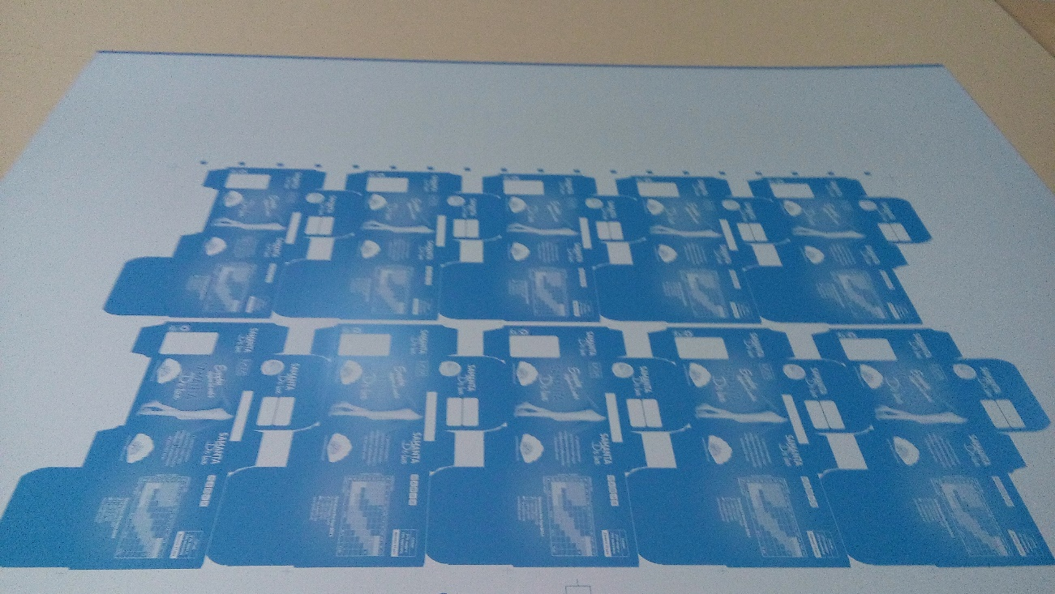
“Print Buying 101”

Slide 2
What this document will help you do
Understand what printed materials Advantus is buying.
Understand the concepts of incremental cost when buying printed goods.
Understand plate costs, set up charges, die costs.
Understand gang runs.
Understand the number of colors it takes to print something, CMYK, 4/4, 4/1, 4/0, 1/1 and 1/0 and the cost differences of all these methods.
Understanding giving art that is ready for the printer and that vendors count production time from when they have final, approved artwork.
Understanding that each printer has specific capabilities.
Understanding that local doesn’t always mean cheaper on printing
Understand Overage and Underage.
Understanding how to spec out a print job.
Review common paper stocks and common sheet sizes.
Understand UV Coatings and Lamination.

Slide 3
What we Print
Advantus purchases many types of printed materials
  These include packaging for our products that we make in the USA or overseas including blister cards, labels, and boxes
  Catalogs for our various product lines
  Collateral material for shows
  Mailing pieces
  Warning labels & tags
  Product info inserts
  Labor Law Posters and Motivational Posters
  Information labels
  Warranty cards

Slide 4
Incremental Printed Cost
When you buy printing there is a huge investment by the printer in setting up the print job.
  Key info: The first sheet that prints is the most expensive and they get progressively cheaper as the job continues.
  This means that once a job is running it is very easy to run more of the job at a much lower per piece price.
    Printers want to encourage you to take more than you might normally buy by giving you nominal pricing that decreases as quantities increase. This is a function of set-up time and cost versus run time and cost.
    Often you will see a situation where ordering twice the quantity only costs 20% more. For example, if you get a quote like the following:
      1000 $1200
      2000 $1600
      5000 $1800
    You are paying $1.20 each at 1000, $.80 each at 2000 and only $.36 each at 5000. If you only need 1000 or less the question should be will we possibly need 2000 or 5000? The incremental cost of the additional goods is almost nothing. Let’s say you find out you need 5000 or 10000 and the 10000 price is $1900, clearly you would order 10000 and pay only $100 for the additional 5000 pieces. The additional are almost free at only $.02 each for the last 5000 pieces.

Slide 5
Plate Costs, Set Up Charges, Die Costs
Typically there are plate costs when you do a print job (unless it is printed electronically—ink jet, etc.).
  Advantus always wants plate costs separated out of a print job—WHY?
    If a printer quotes you the plate cost in the cost of the printing, when you go to re-order you may use the same cost and therefore you will be re-buying the plates over and over. There is no free lunch, plates are not free.
  Set-up charges should also be separated from print jobs on domestic print jobs. We want to understand the true cost of the printed material versus the set up charge.
  Dies, which are tools used to cut shaped print jobs, should have their costs separated just like printing plates.
    Dies are needed when there are cutouts in printing or you are making a non-standard shape (circular catalog, triangular sign, new size of blister card).
    There are also charges when you set up new blister cards that are used for specific products, a good example is the blisters that are used when Tim Holtz items are packed on a card.

Slide 6
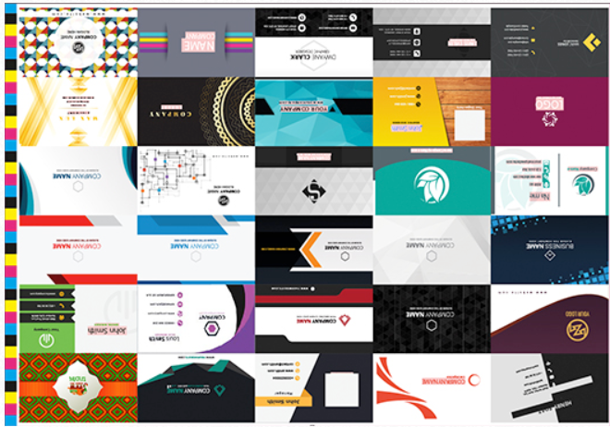
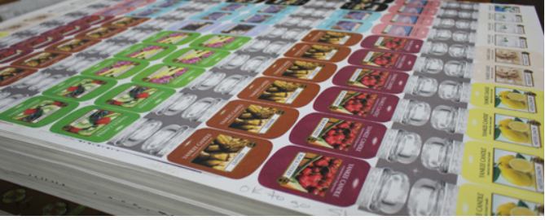
Gang Runs
A gang run is when jobs of similar characteristics are run at the same time on the same printing plates to lower the per unit cost.
  Let’s say you are printing a header card that is 4” x 6”, you may have 20 different sku’s that use 20 different versions of the header card, if you run them at the same time you can “gang” them up on a printing plate and get great economies of scale as you make the print run larger. The downside is that you have paid for plates with a very specific ratio of item to item. Meaning if your usage varies you may have to create a new set of plates to avoid over buying items you don’t need.
  You could also gang jobs that utilize very similar colors, for example, all Tim Holtz packaging. You have to realize that the cost may go up the next time you run if you can’t find jobs ready to run at the same time as you did the first time. Or if you are ganging jobs on one large plate you again might need new plates to avoid overbuying items that have usage that is different from their ratio in the ganged plate.
  You should always look to see if we have similar jobs to run when ordering printed packaging. If I have one header card running do I need any similar ones (or will I need them in the near future—could they be added to this order). They may be able to be added in the right proportion to what you need, not necessarily 1:1 ratio with current item.

Slide 7

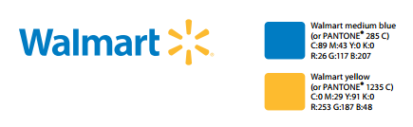
CMYK (Cyan, Magenta, Yellow, Black)
The most common method for color printing is called “Four Color Process.”
  It is commonly abbreviated “4/C.” The press you see at 12th Street can do 1 color only but we can run things through 2x or more to get more colors. This is very inefficient.
  It involves the 4 colors mentioned above and shown on the front page of this presentation.
  With those 4 colors you can create almost any color.
  If you need specific PMS match colors, or want even greater clarity, you must use a press that can print with even more colors, a 4 color press uses the CMYK colors, but there are presses all the way up to 16 specific colors. It is quite common to use presses that print in 5, 6, or more specific colors when you need these precise extra colors added to the final product.
    If you tried to get very specific PMS matched colors like Walmart’s logo, you would need either two PMS colors or a CMYK equivalent that comes close.

Slide 8
Printers Require Finished Artwork
It is critical that all the preparation for a print job be done before giving artwork to a printer.
  Printers will volunteer to fix your artwork but the cost is high. Fix the artwork at Advantus.
  Any changes made after you give art to a printer are added to the cost of a job and called AA’s (Author’s Alterations). These are very expensive.
When ordering products from a vendor overseas the time to ship the order starts when the vendor gets finished packaging or product artwork.
  Regardless of what the vendor may say, they won’t start ordering raw materials or start the real clock going until the artwork is 100% signed off on and approved. Do not think that just because Supply Chain Management or Product Development has cut a PO that your goods are being set in motion.

Slide 9
Printers’ Capabilities
Each printer has specific capabilities. No one printer can do it all competitively, regardless of what they say.
  Based on the equipment a particular printer has, it makes them better at different types of jobs. It is not based on printing quality or skill, it is based on equipment and the types of jobs the printer typically runs.
  Some printers specialize in catalogs, mailings, labels, short runs, long runs, packaging, etc.
  Some printers can print blister cards while others cannot. Packaging is usually very specialized and even though a printer may offer to print packaging items it is almost always better to go to a specialized printer.
You have to research the printer and see what they are doing in-house versus jobbing out and determine the right printer for each job.

Slide 10
Local vs. Cheaper
Just because a printer can do a job and is located close to where you are doesn’t make them the right printer for the job.
  Overseas printing can be a very economical alternative to local printing if you have the time.
  Going outside the Jacksonville area often gets much more competitive pricing as the printing market in Jacksonville is relatively small with limited choices.
    No company on earth prints more business cards than VistaPrint, their pricing typically can’t be beat because of that.
    The Midwest has some huge volume, low cost printers. Lancer Label is excellent at labels and they do huge volumes and have tremendous quantities of stock sizes which help avoid die charges.
    When you need a specific type of print job often you can save a fortune sourcing the job on the web.
  It is important to get 3 quotes on any print job to make sure that your costs are as low as possible. 3 quotes from all Jacksonville printers is not doing the job properly.

Slide 11
Overage/Underage
Just because you order a quantity does not mean you will get that exact quantity from a printer.
  Printers may legally give you 10% more (overage) or 10% less (underage) than you ordered and you have no right to complain. Meaning, you must pay for the 10% overage (at the same rate per sheet as the original quote) and you must accept a quantity that is 10% less than you ordered as complete.
  This 10% overage and underage is considered “trade custom” and has the force of law. You can only be charged for the quantity that they actually deliver.
  You can negotiate overage and underage up front if a specific quantity is critical, it must be spelled out.
  Typically we order what we need and accept the 10% overage or underage.
  Normally a printer will charge more if you are demanding a specific quantity not subject to overage/underage as they will have to print more to assure no underage and discard any overage they print.
  If, for example, you absolutely need 1000 copies of a catalog and cannot accept the possibility of 900, you must specify this to the printer—it will raise the price. In this case you would say, “we cannot accept any less than 1000.” Just understand that the printer will be factoring this in to your cost and it will likely raise the price per unit. If you need only 1000 and don’t want overage you should simply accept the possibility of overage because negotiating to eliminate overage usually means the printer just raises the price and discards the overage.
  Normally printers deliver 10% more than you order because they make more money selling more than less. A useful document on Printing Trade Customs can be found at http://printostat.com/docs/Printing-Trade-Customs.pdf

Slide 12
How to Write Good Print Specs
Here’s a list of the 12 basic specs every printer needs to know about your job.
Job name and description. This is for easy reference. Always make sure the contact person’s name, email, phone, etc., is provided.
Delivery date requested. The date you need it is key. You need to be sure a printer can deliver when you need it.
Quantity. How many do you need? If this job is tied to a mailing list, be careful about the final quantity. You don’t want to run short. Extras (“overs”) are standard on any print job, and normally are 10% more than you ordered. See description of overage and underage.
Flat size. What size is the piece before it’s finished or folded? Dimensions are given by width and then by height (think 8 1/2 x 11).
Finished size. These note the dimensions once a job is folded or bound.
Page count. This applies to magazines, bound newsletters, books, booklets, and some brochures.
Paper stock. This is a big one, as paper is the major cost of almost every print job. If you have a specific stock in mind, give the printer all of the details. If not, describe the paper in general and ask for help. For labels you must specify what type of adhesive (permanent, removable etc.) and what type of material the label is going to be attached to (be specific—not “plastic box” but rather “polypropylene box”.
Inks. Is this a 1-color, 2-color, or 4-color job, for example? Tell your printer everything. If it’s a 4-color job, are you requesting CMYK (the 4 process colors) or specific PMS colors? If your finished job will be run through laser printers, make sure you note this on the spec form. The inks must be compatible.
Finishing. This describes any finishing steps done to a job once it’s printed, including folding, perfect binding, spiral binding, perforating, scoring, embossing, and so on.
Job format. How will the printer get your job file – electronically? If so, what platform are you using (Mac or PC)? How about the design programs you’re using to build the job, including the specific versions.
Special concerns. Tell the printer anything about the job that you haven’t already. Does it need certain varnishes? Are there going to be a significant amount of solids on it? Will this piece need to match other projects that are already printed (or are printing elsewhere)? Give printer samples.
Shipping. Where will the finished job be shipped? Supply all details, including any special shipping or packing instructions.

Slide 13
How to Write Good Print Specs
Remember to ask the printer’s representative to comment on your requirements, they have more experience and may be able to make valuable suggestions.
  Printing salespeople are a great resource, use them to learn and to get a better result.
  Five minutes invested with a printing salesperson can save hours of anguish and save money.
Talk to people within our company with printing experience to find out how printers have performed previously and also see if anyone internally can guide you with more knowledge about printing.
Time invested on the front end spec’ing out a print job will pay off in a properly done job that comes in as needed and within budget.

Slide 14
Paper Stocks
  Paper is measured in the USA in terms of #’s. That’s “pounds”. It means how much a ream (500 sheets) of the stock in its uncut size would yield. However, this can be confusing since different papers come from different uncut sizes:
    Bond paper is cut from 17x22 inches. Cover paper is cut from 20x26 inches. So equal weights of bond and cover are quite different.
    Samples of paper give you the best idea of what you will get when you print your job and are critical to examine before you spec out your job.

Slide 15
Paper Stocks
24# Uncoated Text and 28# Uncoated Text
  The 28% is thicker and heavier than the 24#
  Standard uses: envelopes and letterhead, they are typically called “White Wove”
70# Uncoated Text (slightly thicker than copy paper)
  This is a premium uncoated (non-glossy) white stock and is safe for laser printing.
  This stock feels thick and substantial in your hands and is the best type of uncoated paper stock for full-color printing.
80# (thickness of a quality magazine page).
  80# Gloss Text—standard glossy paper provides and excellent opaque base for rich process color printing. Typically used on brochures, catalog inserts, flyers, and posters.
  80# Dull/Matte Text—satin finish (not shiny) that is finely coated, opaque base for easy to read, crisp printing. Typically used on brochures, information sheets (instructions/warrantees), and flyers
100# Coated Text (25% thicker than 80# Text)
  100# Gloss Text—similar to 80# Gloss Text but 25% heavier for a more substantial feeling printed piece. Used for brochures, information sheets, self-mailers, posters and door hangers.
  100# Dull/Matte Text—more substantial version of 80# Dull/Matte Text. Same uses as 100# Gloss.
80# Coated Cover (thickness of a postcard or a baseball card)
  80# Gloss Cover—Glossy finish for photographs and other images. Used on heavy weight brochures, catalog covers and packaging
  80# Dull/Matte Cover—is a thick cover stock with a smooth, non-shiny coating that is used on catalogs and booklets interior pages
100# Uncoated cover (thickness of a standard business card)
  Bright white uncoated smooth cover stock usually 14pt in thickness. 14 points means .014” (14/1000ths of an inch). It is easy to write on this stock and is a very strong stock to use for appointment or reminder cards and business cards.

Slide 16
Paper Stocks
120# Coated Cover (thickness of a standard business card)
  120# Gloss Cover— Very popular paper that is 14pt with a glossy, coated finish. Very good on photographs and other images. Not good if you want to be able to write on the stock. Used for business cards, hang tags, presentation folders.
  120# Dull/Matte Cover—Smooth non-shiny coating. 14pt thickness well suited for detailed, crisp printing without sacrificing the ability to write on the paper. Excellent choice for business cards, postcards and greeting cards.
200# Coated Cover (almost twice as thick as 120# cover)
  24pt it is a very thick and sturdy stock. Glossy smooth finish that produces vibrant colors and professional image quality. Works very well for die cuts and foil stamped items. Used for business cards, hang tags, table tents, POP Displays, rack cards(cards on the top of retail selling units).

Slide 17
Sheet Sizes
Letter Size 8.5” x 11”
  The most common paper size in the USA. The rest of the world(Europe/Asia etc.) uses A4 which is slightly different (8.3” x 11.7”).
  This cut sheet size is cut from 17” x 22” master sheets which means you get 4 sheets from each master sheet.
  If someone says that they have 20 lb. letter size copy paper that means that a ream (500 sheets) of 17”x22” of this paper weighs 20 lbs.
  Very common size to print catalogs. Each page would be 8.5” x 11” but the catalog itself would be printed on 11” x 17” paper and folded/stapled down the middle of the sheet.
Legal Size 8.5” x 14”
  Not a common size at all, common legal pads.
Many other sheet sizes are common and printers can order sizes to fit particular print jobs.
To have the most economical catalogs or other print jobs use 8.5” x 11” (Letter Size) or some derivative of that size. For example, 5.5” x 8.5” is easy to make from 8.5” x 11” paper.
Each different type of printing has its own standard sheet sizes and many printers have standard sizes based on their equipment. It is important to know where your job and requirements fit best and to also try to keep your size that you design within what is common size standards. Printing sales people are a great information resource in this regard. For example, blister cards are printed on specific sheet sizes of paper, you want to get your needs to fit on the standards rather than waste paper by having your job not utilize the paper efficiently.

Slide 18
UV Coatings and Laminations
There is a major enemy to anything you print. THE SUN!!!
  In the past UV Coatings were used to prevent fading of ink and paper.
  UV coatings are very harmful to the environment and hurt the ability of the paper to be recycled.
  Since about 2012/2013 ink quality and paper quality have been used to eliminate the need for most UV coatings. So it is important to make sure the printer is not quoting using cheap inks and papers that tend to fade (ink) or yellow (paper)
Lamination
  This is what we do for Labor Law posters to give them durability and strength so they will last and appear more substantial. This gives our posters the ability to have pushpins stuck in them and hang on a wall for years without being easily ripped.
  There are two types of common laminations. Liquid laminations are printed onto the paper and are cheap. Film laminations are applied to the paper and are more substantial and cost more, we use film lamination on our Labor Law posters.
  Lamination film comes in a variety of thicknesses. For example, we laminate our Labor Law Posters in 1.7 mil (.0017”) on each side, that means the lamination is actually 3.4 mils (.0034”) in total thickness.

