Slide 1
2.0 Training: Pick Plans & Pick Tasks
June 8, 2021

Slide 2
2.0 Training: Pick Plans & Pick Tasks
Pick Planner Overview
Pick Plan Record
Pick Task Record
Pick Plan Group, Schedule
Principles
Problem Solving

Slide 3
2.0 Training: Pick Plans & Pick Tasks
Pick Planner Overview
Pick Plan Record
Pick Task Record
Pick Plan Group, Schedule
Principles
Problem Solving

Slide 4
Pick Planner Overview

Slide 5
Pick Planner Overview
Airport analogy

Slide 6
Pick Planner Overview

Slide 7
Pick Planner Overview
Receive/Enter Orders

Slide 8
Pick Planner Overview
Review/Release

Slide 9
Pick Planner Overview
Fulfill

Slide 10
Pick Planner Overview
Order Fulfillment Paths (Recap of previous training)
Native Fulfillment
DSDC
Direct Import
Bulk Fulfillment
Billing Only
Task Picking

Slide 11
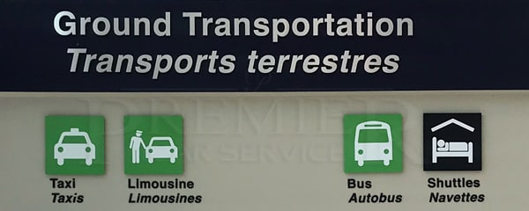
Pick Planner Overview
Order Fulfillment Paths (Recap of previous training)
Native Fulfillment
DSDC
Direct Import
Bulk Fulfillment
Billing Only
Task Picking

Slide 12
Pick Planner Overview
Order Fulfillment Paths (Recap of previous training)
Native Fulfillment
DSDC
Direct Import
Bulk Fulfillment
Billing Only
Task Picking

Slide 13
Pick Planner Overview
Order Fulfillment Paths (Recap of previous training)
Native Fulfillment
DSDC
Direct Import
Bulk Fulfillment
Billing Only
Task Picking

Slide 14
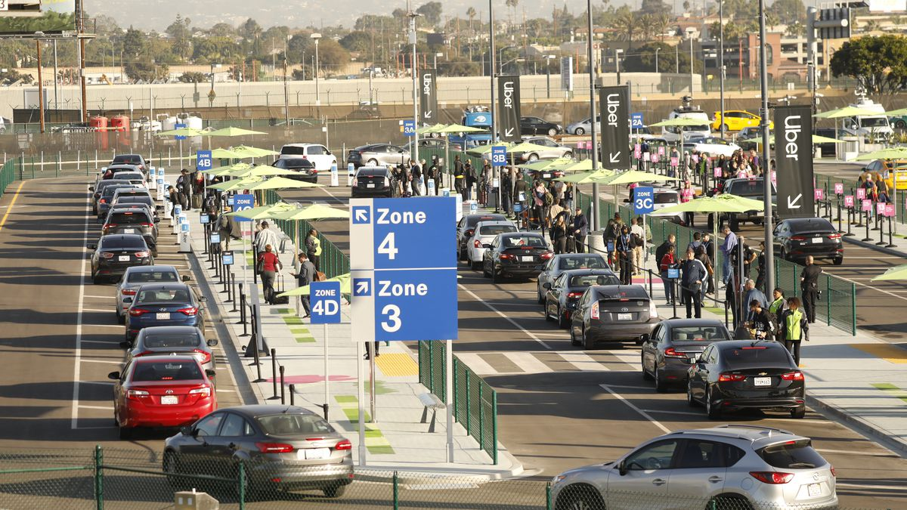
Pick Planner Overview

Slide 15
Pick Planner Overview
Pick Planner (dispatch) controls which orders (passengers) get assigned to which pick plans (taxi lanes) and assigns pick tasks (cars)

Slide 16
Pick Planner Overview
Pick Planner

Slide 17
Pick Planner Overview
Pick Plan

Slide 18
Pick Planner Overview
Pick Task

Slide 19
Pick Planner Overview
Order

Slide 20
Pick Planner Overview
Pick Plan
Pick Task
Order
Pick Planner

Slide 21
Pick Planner Overview
Pick Planner (dispatch) controls which orders (passengers) get assigned to which pick plans (taxi lanes) and assigns pick tasks (cars)
Dispatch Pick Planner
Taxi Lane Pick Plan
Taxi Pick Task
Passenger Order

Slide 22
2.0 Training: Pick Plans & Pick Tasks
Overview
Pick Plan Record
Pick Task Record
Pick Plan Group, Schedule
Principles
Problem Solving

Slide 23
2.0 Training: Pick Plans & Pick Tasks
Overview
Pick Plan Record
Pick Task Record
Pick Plan Group, Schedule
Principles
Problem Solving

Slide 24
Pick Plan Record

Slide 25
Pick Plan Record
Pick Plan

Slide 26
Pick Plan Record
Pick Plan = Taxi Lane

Slide 27
Pick Plan Record
Pick Plan = Taxi Lane
Currently have 27 Pick Plans
Airport has many taxi, rideshare lanes
Can create more over time as needed
Each have different criteria/reasons to exist

Slide 28
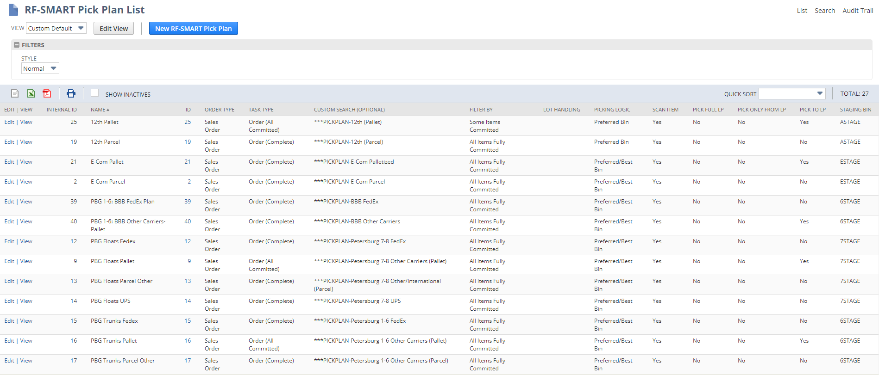
Pick Plan Record

Slide 29
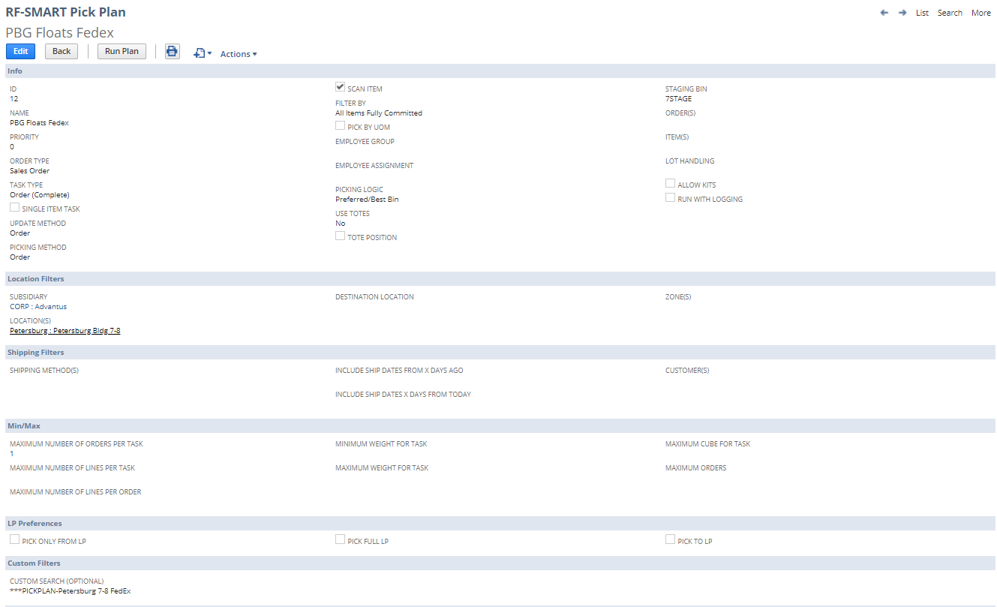
Pick Plan Record

Slide 30
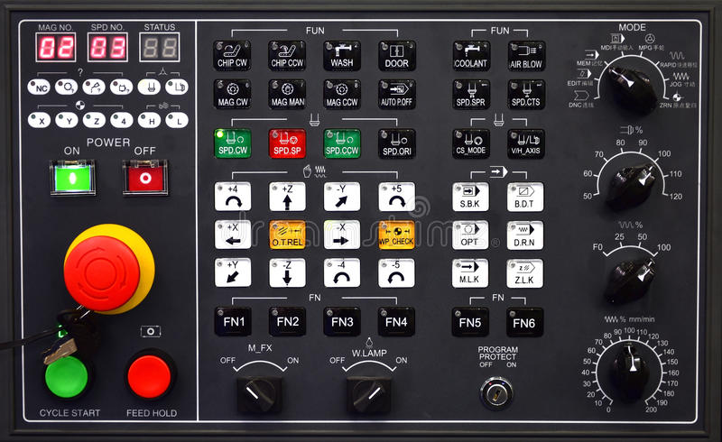
Pick Plan Record
Pick Plan record is like a control board
Has a series of settings on it
Determines which orders get assigned pick tasks, what kind of pick task, when, etc.

Slide 31
Pick Plan Record

Slide 32
Pick Plan Record
Why create multiple Pick Plans?
Examples

Slide 33
Pick Plan Record

Slide 34
Pick Plan Record

Slide 35
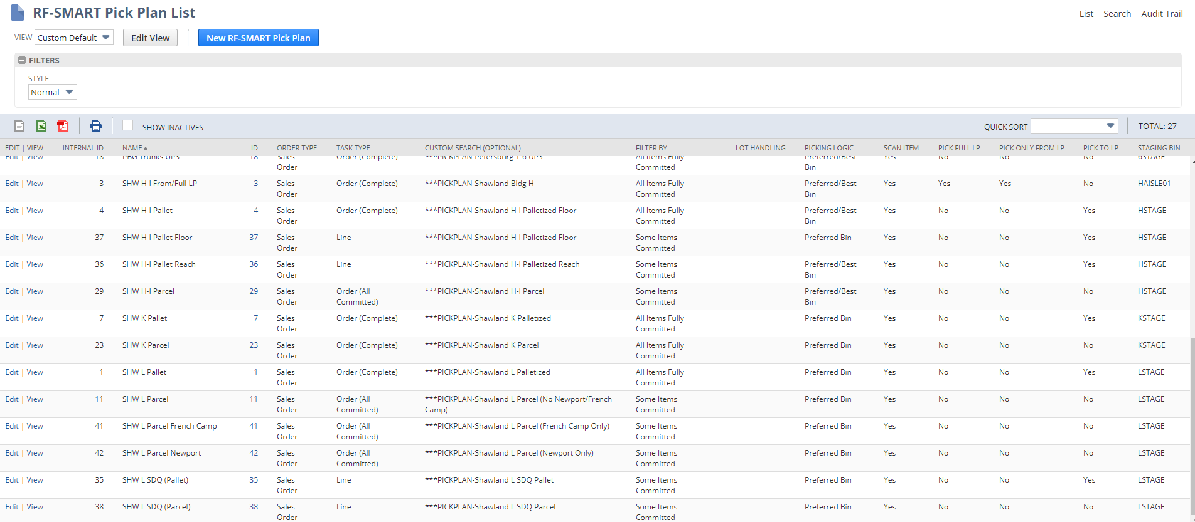
Pick Plan Record

Slide 36
Pick Plan Record

Slide 37
Pick Plan Record

Slide 38
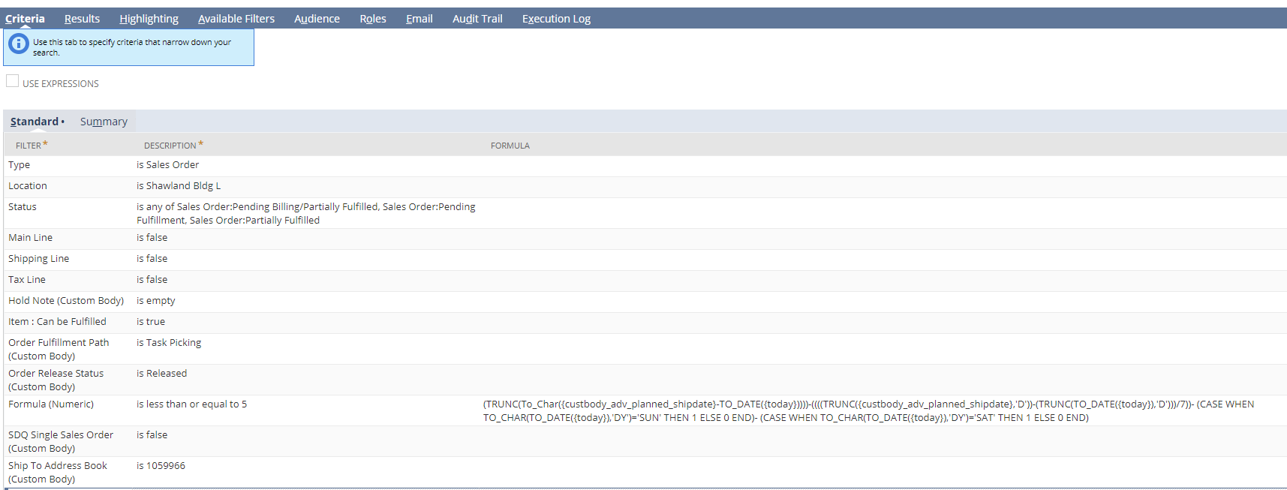
Pick Plan Record
Custom Search is the main way we divide orders into Pick Plans.
Example of very granular one:

Slide 39
2.0 Training: Pick Plans & Pick Tasks
Overview
Pick Plan Record
Pick Task Record
Pick Plan Group, Schedule
Principles
Problem Solving

Slide 40
2.0 Training: Pick Plans & Pick Tasks
Overview
Pick Plan Record
Pick Task Record
Pick Plan Group, Schedule
Principles
Problem Solving

Slide 41
Pick Task Record

Slide 42
Pick Task Record
Pick Task

Slide 43
Pick Task Record
Pick Task = Taxi

Slide 44
Pick Task Record
Pick Task = Taxi
Pick Tasks are created from and assigned to Pick Plans
An Order (and therefore a Pick Task) can have many lines on it
Think of family getting into a car; family = one order with many lines

Slide 45
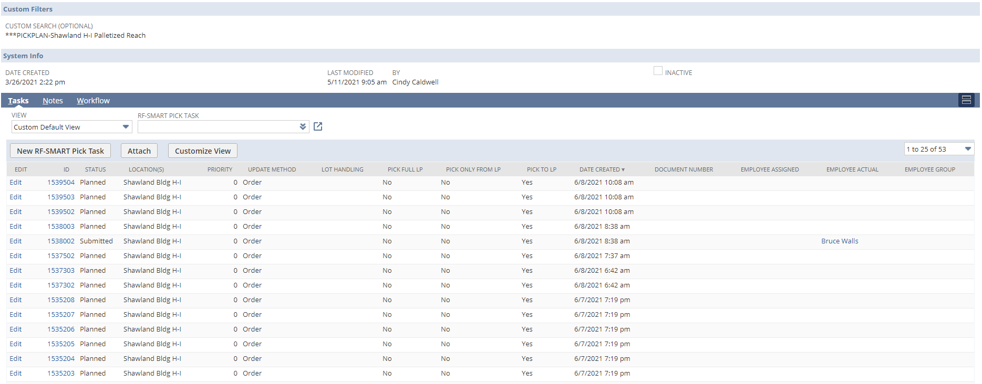
Pick Task Record
Since Pick Tasks are created from Pick Plans, they can be viewed in the Tasks sublist on the Pick Plan record

Slide 46
Pick Task Record
Pick Tasks inherit the settings from the Pick Plan they were created from
Can be simple, single-line pick tasks
Can be large, multi-line (>100) pick tasks
Examples

Slide 47
Pick Task Record

Slide 48
Pick Task Record
Inherited from
Pick Plan

Slide 49
Pick Task Record
Who picked it

Slide 50
Pick Task Record
Pick Task Lines (1)

Slide 51
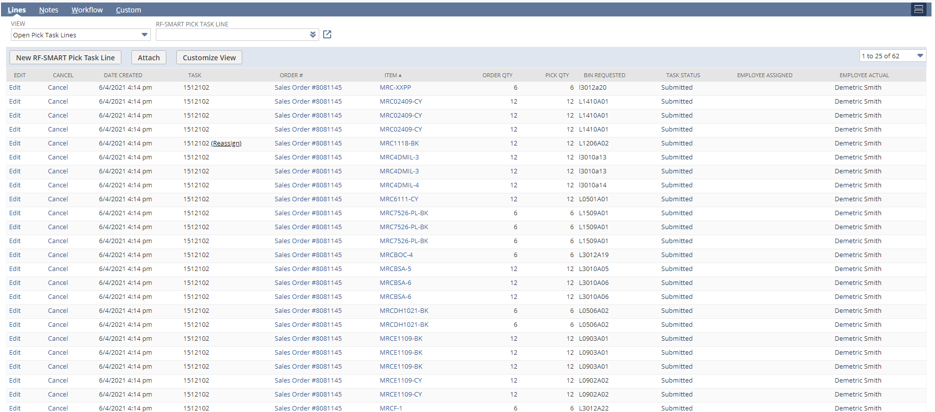
Pick Task Record
Can have many pick task lines, if there are many lines on the Sales Order
Pick Task Lines (62)

Slide 52
Pick Task Record
An Order (and therefore a Pick Task) can have many lines on it
Think of family getting into a car; family = one order with many lines
Pick Tasks are currently never assigned to more than one Order
Never more than one family in a car
Sometimes, an Order can get multiple Pick Tasks
Family decides to split between two taxis
Example: Wyla floor vs Wyla reach
Example: Back orders, multiple fulfillments

Slide 53
Pick Task Record
Can see the Pick Tasks associated with a Sales Order under the RF-SMART subtab on the Sales Order
Most of the time, one Pick Task per Sales Order
Example SO 8081088
Sometimes, depending on Pick Plan settings, will see multiple Pick Tasks per Sales Order
Example SO 8081145

Slide 54
Pick Task Record
Remember: the Pick Plan controls how Pick Tasks are created and what settings they inherit
This includes how/when Item Fulfillments are created
For example, this means we can control if we want an Item Fulfillment to be created every time a Pick Task is submitted for that order, or wait until all the Pick Tasks for that order are submitted.
Example SO 8072854: 4 Pick Tasks, 1 Item Fulfillment

Slide 55
Pick Task Record
As we conduct go-lives, we will create additional Pick Plans to meet the needs of the business.
This includes creating Pick Plans that accommodate the customer requirements on fulfilling backordered lines, fulfilling multiple times against a Sales Order, etc.
Will review those additional settings and controls in a future training

Slide 56
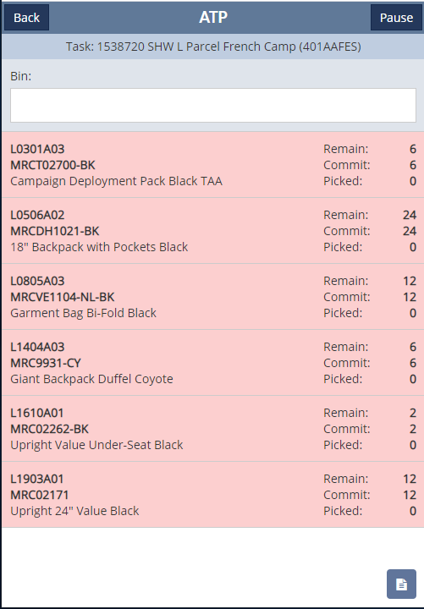
Pick Task Record
Pick Task Lines are what show up on the picker’s gun
Pick Task Lines are sorted by bin, in ascending order, on the picker’s gun

Slide 57
2.0 Training: Pick Plans & Pick Tasks
Overview
Pick Plan Record
Pick Task Record
Pick Plan Group, Schedule
Principles
Problem Solving

Slide 58
2.0 Training: Pick Plans & Pick Tasks
Overview
Pick Plan Record
Pick Task Record
Pick Plan Group, Schedule
Principles
Problem Solving

Slide 59
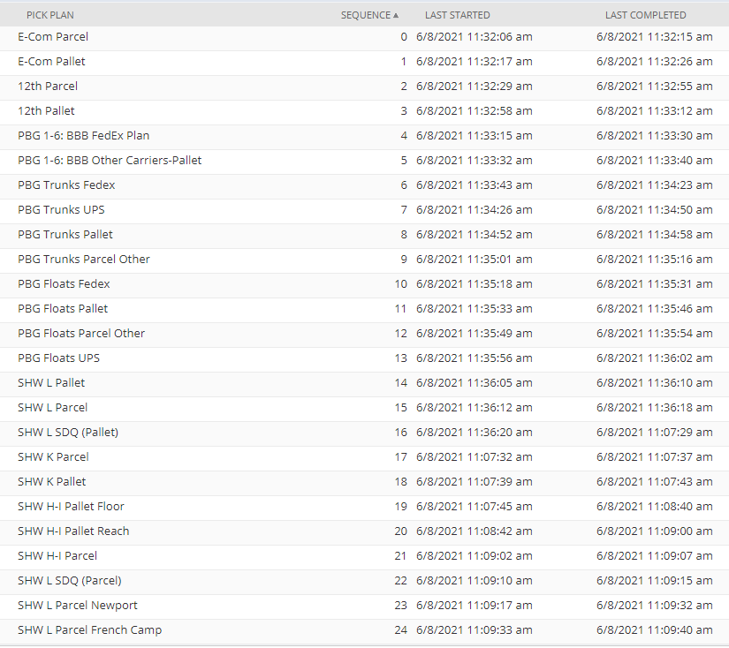
Pick Plan Group, Schedule
Pick Plans are assigned to run one after another, in a sequence that is defined in a record called Pick Plan Group
Of the 27 Pick Plans we have set up, 25 are scheduled (2 are on-demand, or for testing)
Currently runs every 30 minutes
Orders must meet Pick Plan criteria to get picked up and get a Pick Task < THIS IS KEY!

Slide 60
2.0 Training: Pick Plans & Pick Tasks
Overview
Pick Plan Record
Pick Task Record
Pick Plan Group, Schedule
Principles
Problem Solving

Slide 61
2.0 Training: Pick Plans & Pick Tasks
Overview
Pick Plan Record
Pick Task Record
Pick Plan Group, Schedule
Principles
Problem Solving

Slide 62
Principles
Goal is automatic Pick Task creation: set the Pick Plans up correctly and let them create the Pick Tasks; reduce human involvement
Need to keep the complexity and number of Pick Plans such that all can run within the 30 minute window (currently takes about 10 min to run through all 25 scheduled Pick Plans)
Do not want to create a Pick Task too soon before it will actually be picked. Ideal is day of or day before pick date.
Why? Because inventory is always changing, preferred bins change, etc. and then the Pick Task is out of date
Currently, some Pick Plans create pick tasks 5-10 days out. For most situations, this would be too far, but we do this to allow pickers to start earlier on large orders, etc.
Not really much benefit to create so far in advance for typical orders, just need to adjust our thinking about pick tasks

Slide 63
2.0 Training: Pick Plans & Pick Tasks
Overview
Pick Plan Record
Pick Task Record
Pick Plan Group, Schedule
Principles
Problem Solving

Slide 64
2.0 Training: Pick Plans & Pick Tasks
Overview
Pick Plan Record
Pick Task Record
Pick Plan Group, Schedule
Principles
Problem Solving

Slide 65
Problem Solving

Slide 66
Problem Solving
Pick Task?

Slide 67
Problem Solving
Sometimes an order doesn’t get a Pick Task when we expect it to. Users seem to notice this using the Master Order Tracker (MOT)

Slide 68
Problem Solving
Common Reasons for Pick Tasks not being created for an Order:
In between 30 min Pick Plan Group run
Order is not a Task Picking order
Order does not meet search criteria on Pick Plan:
Location
Sales Order isn’t Approved
Sales Order isn’t Released
Planned Ship Date is beyond date criteria
Ship via is not set correctly
Pick Plan is set to consider committed inventory, and line(s) are backordered on Sales Order
Resolution: Correct the order or wait for order to meet the criteria

Slide 69
Problem Solving
Less Common Reasons for Pick Tasks not being created for an Order:
Pick Plan search criteria is not correct
Resolution: Email 2.0 and go-live manager will fix
Pick Plan is set to use Preferred Bin and a Preferred Bin has not been set up for an item on the Sales Order
Resolution: Inventory Management to set Preferred Bin for item
Location on Sales Order got set incorrectly or someone accidentally changed
Resolution: C/S fix
Order Fulfillment Path did not get set correctly on Sales Order
Resolution: IT ticket
Issue with script
Resolution: IT ticket

Slide 70
2.0 Training: Pick Plans & Pick Tasks
Overview
Pick Plan Record
Pick Task Record
Pick Plan Group, Schedule
Principles
Problem Solving

Slide 71
2.0 Training: Pick Plans & Pick Tasks
Overview
Pick Plan Record
Pick Task Record
Pick Plan Group, Schedule
Principles
Problem Solving

