Slide 1
P&S Average Cost Training
9.28.2020

Slide 2
Macola Standard Cost vs. NetSuite Average Cost
Macola Standard Cost
NetSuite Average Cost
Requires us to set a standard for every item, unrelated to the location.
Transactions that vary from the standard cost are booked against variance accounts.
Required a great deal of maintenance.
Total inventory value divided by quantity on hand.
Cost fluctuates over time as transactions are entered.
Can calculate average cost for an item across multiple locations.

Slide 3
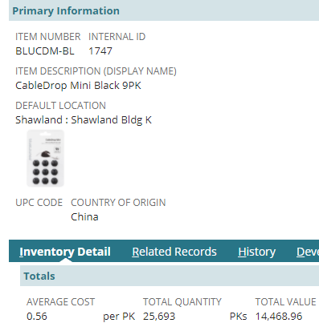
What is average cost?
Basic principle
  COGS divided by QOH
    COGS (Cost of Goods Sold) includes FOB cost + freight + duty
    QOH (Quantity on hand) includes any unavailable locations
  Using example from BLUCDM-BL
    $14,468.96 is our COGS
    25,693 is our QOH
    $14,468.96 / 25,693 = $.56
  Should be very easy to understand for inventory or purchased assembly items. It gets more complicated for true assembly items.

Slide 4
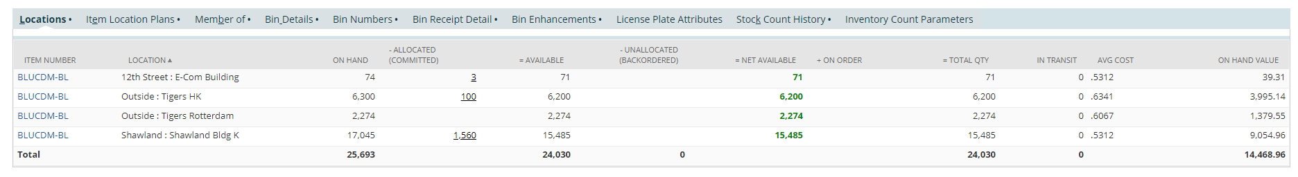
What is average cost?
COGS and QOH come from the locations sublist in NetSuite
  Macola COGS and QOH are not tracked in NS for brands or locations that have not gone live yet.
NetSuite has the ability to calculate average cost by location which we did not have in Macola. The ability comes from purchase orders cut to specific locations plus location specific landed cost templates.

Slide 5
What impacts average cost?
Every time a transaction impacting the cost is processed, the average cost is recalculated.
Transactions that impact average cost are called posting transactions.
  Item Receipt (PO receipt, Return Authorization)
  Assembly Builds/Unbuilds
  Inventory Adjustments
  Inventory Transfers
IF TRANSACTIONS ARE NOT CORRECT, IT WILL IMPACT THE COST ON FUTURE TRANSACTIONS!
  EX: If your carton dimensions are not updated before receipt and the freight is off, it cannot be corrected.
  If Accounting has closed the month, transactions in closed months cannot be corrected.

Slide 6
Examples
Inventory receipts
Average cost decreasing

Slide 7
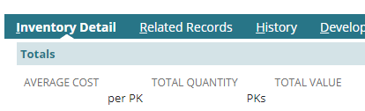
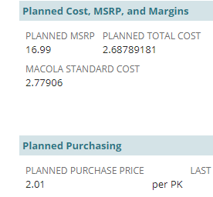
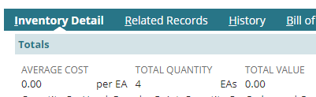
Average cost scenarios
When the COGS and QOH are both 0, the average cost disappears. 0/0=0
How will I know what my cost will be if the average cost is gone?
  You would reference the planned total cost to get an idea.
  This is why it is important to always keep the planned purchase price cost updated.
When the COGS are $0 but there is QOH, the average cost disappears and this means the inventory has been written off. 0/4 = 0

Slide 8

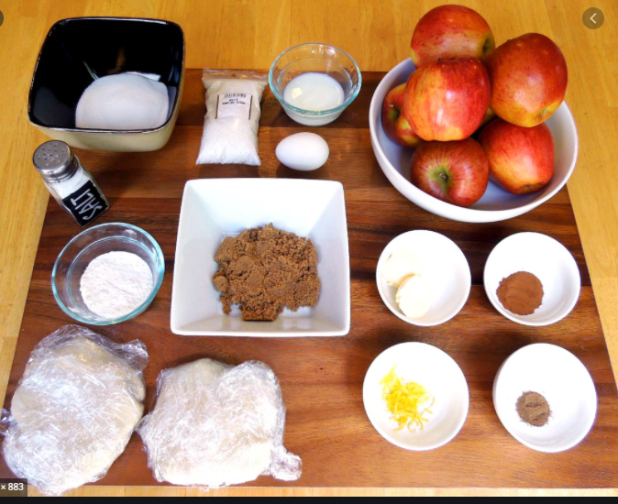
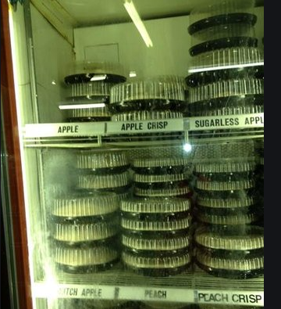
Average cost relating to true assembly items
The raw materials are in the pantry
$5 Apples, $1 Sugar, $3 for crust ingredients
  New cost to make the pie is $9
  Until you get $2 apples and $2 crust ingredients, the cost will be higher
  RAW MATERIALS/SUB-ASSEMBLIES drive the cost of assembly items, not what you “know it costs to make.”
The finished good is the pie
A baker know what it costs to make a pie on a normal day
Planned Cost $5
  ($2 for apples, $1 for sugar, $2 for crust ingredients)
The QOH is already made pies in the fridge.
          20 pies in fridge at $5 ($100 COGS / 20 QOH)
          Makes 10 new pies at $9 ($90 COGS / 10 QOH)
          Average cost of 30 pies is $6.33
            ($190 COGS / 30 pies on hand = $6.33)

Slide 9
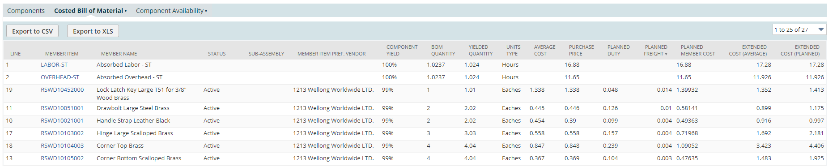
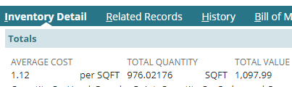
Seward Trunk example – SWDAF0001
The trunk planned cost is $89.291
(The Pie)
The trunk average cost is $93.742
(The Raw Materials in the Pantry)
RSWDCUT9A-NVYAF was “bought” at $1.125. Until the 976 SQFT on hand are depleted or lower cost inventory is added, the cost will be higher.
(The Raw Materials in the Pantry)

