Slide 1

POI & Customer
Compliance Fines in NetSuite
December 15, 2020

Slide 2
POI
POI Refresher
Tracking POI
Failure Causes and Notes
Updating Failure Causes and Notes
      POI Order Header Metrics
      POI Order Line Metrics
Reporting

Slide 3
POI Refresher
4 metrics:
  On-Time
  Complete
  Damage-Free
  Accurate Documentation
On-Time, Damage-Free, Accurate Documentation are header level failures
Complete is a line level failure but reported at the header level
  If one line fails, the order fails

Slide 4

Tracking POI
Metrics sub-tab on sales order
If an order fails one of the metrics, the checkbox will not be checked
On-Time and Complete are calculated via script each day at the end of each day
  Metric Calculations Completed checkbox on sales order indicated when the script has run
Damage-Free and Accurate Documentation are updated monthly by Compliance
  Checkboxes are checked by default and unchecked if there is a failure

Slide 5
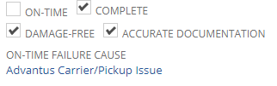
Failure Causes and Notes
Failure Causes: defined list of reasons for failure
  On-Time: header
  Complete: line sublist
Header Notes
  On-Time
  Damage-Free
  Accurate Documentation

Slide 6
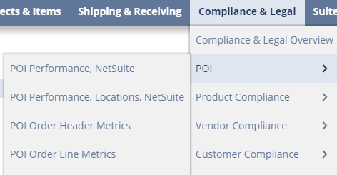
Updating Failure Causes and Notes
Sales Order Form
  Header fields can be updated directly on the form
  Line level fields can only be viewed on the form. Updates must be made via POI Order Line Metrics suitelet
POI Order Header Metrics
  Compliance & Legal -> POI -> POI Order Header Metrics
POI Order Line Metrics
  Compliance & Legal -> POI -> POI Order Line Metrics

Slide 7
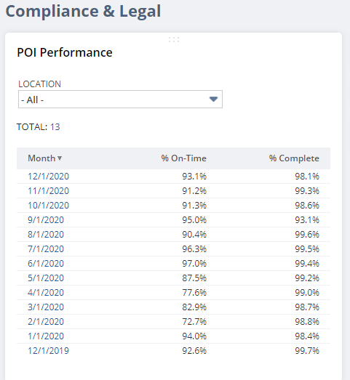
POI Reporting
On-Time and Complete percentages are available on the Compliance & Legal dashboard
  Rolling 13 months
POI Performance and POI Performance, Locations
  Provides totals for On-Time and Complete and links to details

Slide 8
Customer Compliance Fines
Compliance Fine Tracking Updates
Compliance Fine Amounts
Viewing Compliance Fine Data
      Compliance & Legal dashboard
Additional Reporting

Slide 9
Compliance Fine Tracking Updates
Compliance Fines are tracked in NetSuite for Macola and NetSuite orders
Replacement for Quickbase tracking
  Fines are no longer maintained in QB
Review, dispute and approval process will stay as is for now
Additional enhancements will be added
Violation Type grouping is the same
Department field is now Fine Responsibility in NetSuite

Slide 10
Compliance Fine Amounts
Maintained Fields
  Amount of Fine: amount from customer’s fine or chargeback
  Approved: amount determined to be our expense
  Disputed: amount currently in dispute but has not been reversed yet
  Reversed: amount of fine paid back by the customer
  Vendor Chargeback (aka Vendor Fine): amount deducted from the vendor for customer fine’s caused by the vendor
Calculated Fields
  In Review: Amount of Fine less Approved, Disputed and Reversed amounts
  Out-of-Pocket: Approved Amount less Vendor Fine Amount

Slide 11
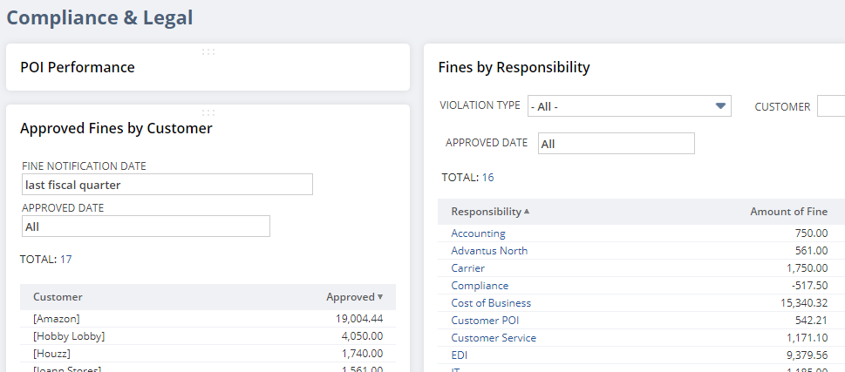
Viewing Compliance Fine Data
The monthly or quarterly spreadsheet has been replaced by the Compliance & Legal dashboard
  Default of searches will be the last fiscal quarter based on the fine notification date
Once filters are changed, the dashboard will keep the filters
Filters for charts cannot be updated

Slide 12
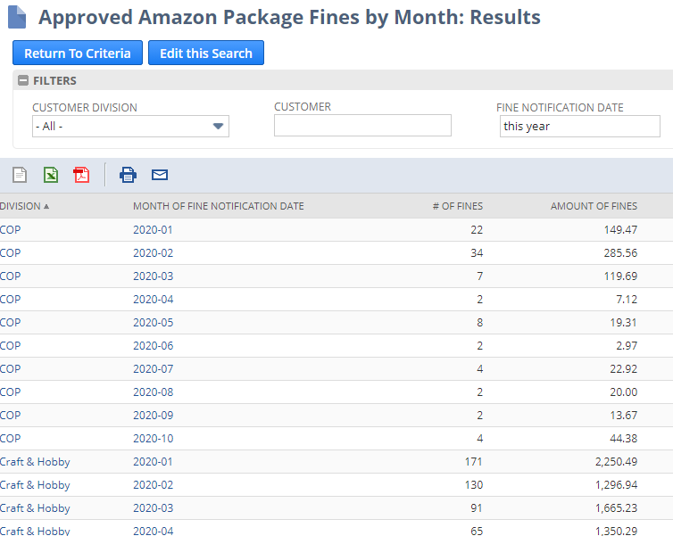
Additional Reporting
Additional Reporting is available in the Customer Compliance section of the Compliance & Legal tab
  Amazon Package Fines
    Spreadsheet normally sent out upon request is now available for everyone
    Saved search can be filtered as need
  Compliance Fine Summary YTD
    Summary grouped by month and Fine Responsibility
  Compliance Fine Department Summary YTD
    Summary grouped by Fine Responsibility only

Slide 13
Questions?

