Slide 1
Dashboards and Reporting
June 1, 2021

Slide 2
Agenda
Dashboards
Layout
Portlets
Changes
Reporting
Reporting Tab
Quick Reports
Helpful Saved Searches

Slide 3
Dashboards

Slide 4
Layout: Home
Home dashboard: 3 columns
Left: Reminders, Subsidiary/Division/Location (SDL) Navigator and Quick Search
Right: Shortcuts and Quick Links
Middle: Role-specific portlets
Portlets may be added to the left or right columns based on the need of the role
Example: if the role doesn’t need the SDL Navigator regularly, a portlet can be added to the left column above the navigator

Slide 5
Layout: Tabs
Dashboard on tabs: 2 columns
Portlets selected for the tab, not the role
Every role will access to the tab dashboards but they may vary slightly in appearance or access based on permissions

Slide 6
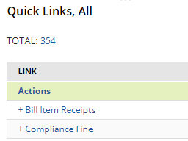
Portlets: Overview
Portlets available differs based on the type of page
Portlets can be collapsed or expanded by clicking the title
Portlets don’t refresh automatically when the entire page is refreshed
Refresh portlets by clicking the circle icon on the right of the portlet
Exception: Google Chrome has a extension that will refresh all portlets on the page when the page is refreshed

Slide 7
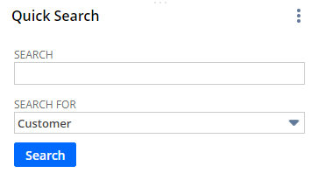
Portlets Available on Home Dashboard
Shortcuts
Limit: 1
Controlled by the user
External links and Pre-filtered saved searches can also be added
Hover over 3 dots and select New Shortcut
Quick Search
Limit: 1
Search for a specific type of record

Slide 8
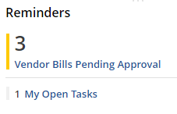
Portlets Available on Home Dashboard
Reminders
Limit: 1
Should be focused on action items
Option available to view reminders with zero results
Best practice: don’t show zero results so the focus what action should/can be taken
Can be displayed as large or small numbers
Can be highlighted based on the number of records
Example: 0-5 records should be yellow and 5+ records should be red

Slide 9
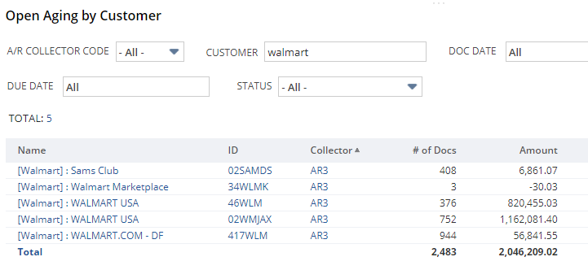
Portlets Available on Home Dashboard
Custom Search
Limit: 6
Saved searches displayed directly on the dashboard
Should be focused on data needed for the role on a daily basis
Quick Links portal is a custom search portlet

Slide 10
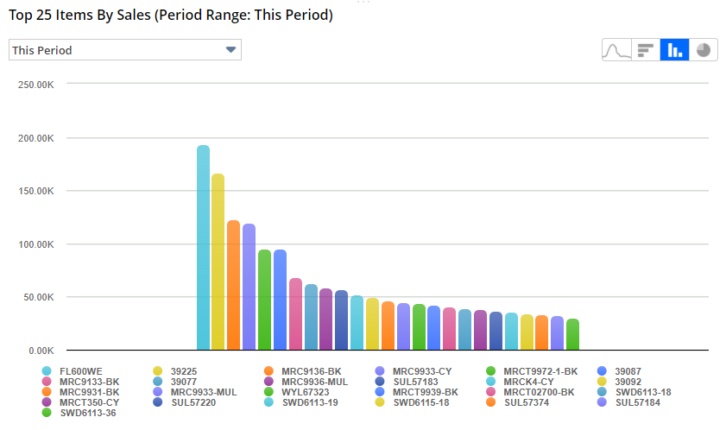
Portlets Available on Home Dashboard
Report Snapshots
Limit: 10
Charts and graphs using information from Reports
Information available to be displayed is very limited
Will be more useful once we have fully transitioned to NetSuite

Slide 11
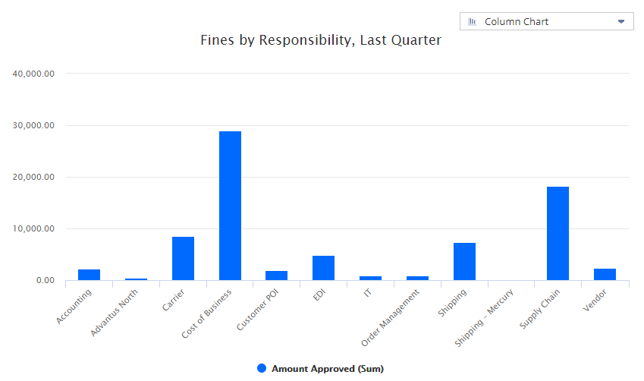
Portlets Available on Home Dashboard
Analytics
Limit: 10
New reporting option released by NetSuite a couple of years ago
Pivot tables and charts can be displayed
Does not currently have drill down capabilities

Slide 12
Portlets Available on Home Dashboard
List
Limit: 2
Displays simple version of records in a list
Refer to the Lists tab for which records are available to be displayed

Slide 13
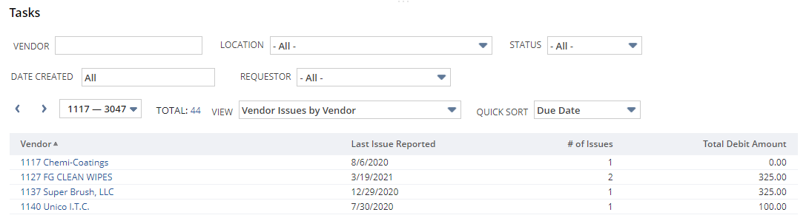
Portlets Available on Home Dashboard
Tasks
Limit: 1
Displays list of tasks
Any type of task list can be displayed. Not limited to your assigned tasks

Slide 14
Portlets Available on Home Dashboard
Calendar
Limit: 5
Can only display tasks
Provides link to task

Slide 15
Portlets Available on Home Dashboard
KPI Meter
Simple meter reporting total data against a quota or forecast
KPI Scorecard
Custom scorecards formatted to compare current totals with prior totals
Key Performance Indicators
Individual KPIs formatted to compare current totals with prior totals
Note: KPI Portlets will not be implemented until a future phase

Slide 16
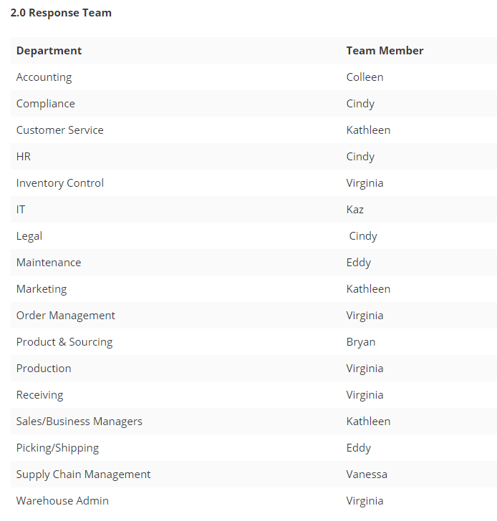
Requesting Changes
The home dashboard for each role is controlled by the 2.0 team member responsible for the area
List of assigned team members is available on the home page of the wiki

Slide 17
Reporting

Slide 18
Reporting Tab: Overview
Customized tab previously named Reports
Available for all roles
Listed reports and saved searches are primarily customized reports and saved searches
Reasons for the change
Directory similar to the P drive
Majority of the reports and saved searches being used are customized
Unless the global search is used or the report/saved search has been added to the dashboard, users may not be aware of helpful reports and saved searches
Quick links are becoming out of control
We will clean this up to be important links for that role instead of all the saved searches or reports available for that role

Slide 19
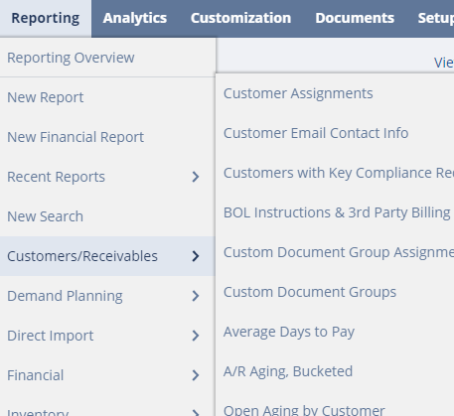
Reporting Tab: Dropdown
If you hover over the tab, you can see the new categories created. Within each category, there is the list of reports or saved searches
Categories are based on function, not department
More reports and saved searches will be added
If you have any reports or saved searches that should be added, please send in to 2.0

Slide 20
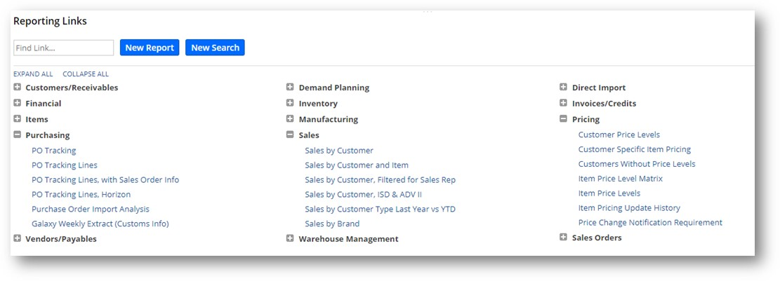
Reporting Tab: Dashboard
Reporting Links portlet has been added
Portlet is only available on this dashboard
Portlet allows you to expand or collapse the categories individually or all together

Slide 21
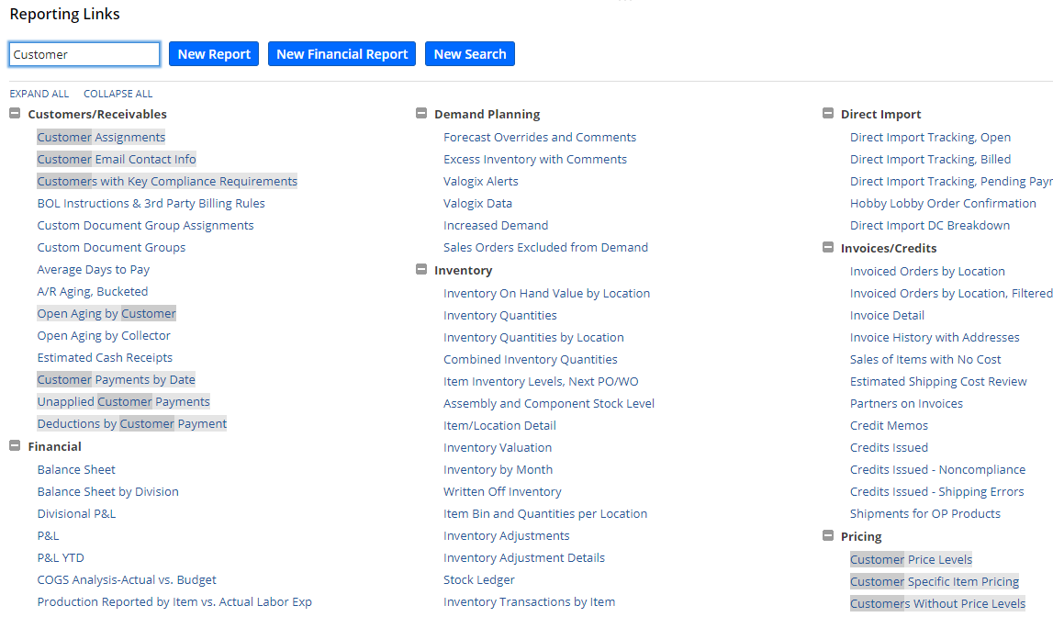
Reporting Tab: Dashboard
If you are looking for a particular report, you can type in the keyword into the Find Link… box and the portlet will expand the categories and highlight the possible matches

Slide 22
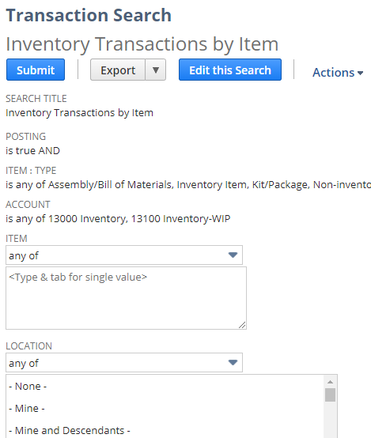
Reporting Tab: Dashboard
For the larger saved searches, the link will direct you to select filters before running
The information at the top of the screen is the criteria specific for that saved search
Click Submit to continue to the results

Slide 23
Quick Reports
New customization
Buttons similar to Quickbase buttons
Uses one saved search and passes pre-determined filters for the button
Used for common saved searches where multiple people are filtering to get specific data regularly

Slide 24
Helpful Saved Searches
Customer Assignments: employees, partners, and categories assigned to each customer
GL Accounts Typical Activity: descriptions of activity and department responsible for each GL account
Inventory Valuation: value and quantity of the inventory at any time
Inventory Transactions by Item: replacement for Macola’s native report by the same name
Item Details: general information about the items
Item Information: additional information about the items
Customer Item Numbers: list of items from the Customer Item Details
Including ability to search using the customer’s item information
Sales Orders (Open and History): all sales order from both systems
Open to Pick: replacement for Crystal report by the same name
My/My Team's Approved Vendor Bills: bills approved by you or your reports
Helpful for reaching expenses

Slide 25
Questions?

