Slide 1
2.0 Training: Tasks Stock Count Request Item Bin Flag Warehouse/Vendor Issue Item Audit
January 12, 2021

Slide 2
2.0 Training: Tasks
Task Record
Creating a Task
Task Types

Slide 3
2.0 Training: Tasks
Task Record
Creating a Task
Task Types

Slide 4
Task Record
Native NetSuite record
Can be used for managing tasks and project management, time tracking, milestones
We have customized
Will likely be used in the future in additional ways

Slide 5
Task Record
Native NetSuite record
Can be used for managing tasks and project management, time tracking, milestones
We have customized
Will likely be used in the future in additional ways
Not the same as a Pick Task

Slide 6
2.0 Training: Tasks
Task Record
Creating a Task
Task Types
Stock Count Request
Item Bin Flag
Warehouse/Vendor Issue
Item Audit

Slide 7
Creating a Task
Several different ways

Slide 8
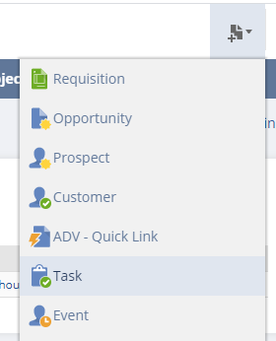
Creating a Task
Several different ways
New Bar Icon

Slide 9
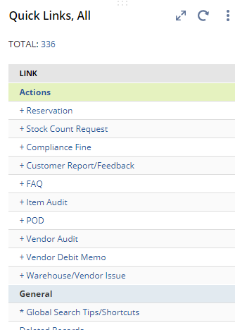
Creating a Task
Several different ways
New Bar Icon
Quick Link Action

Slide 10
Creating a Task
Several different ways
New Bar Icon
Global Search: type “New Tasks”
Quick Link Action

Slide 11
Creating a Task
Several different ways
New Bar Icon
Global Search: type “New Tasks”
From a Search (i.e. Item Audits)
Quick Link Action

Slide 12
Creating a Task
When a Task Type is selected, the form will change according to that type of task

Slide 13
Creating a Task
When a Task Type is selected, the form will change according to that type of task

Slide 14
Creating a Task
3 General Sections:

Slide 15
Creating a Task
3 General Sections: Overview information

Slide 16
Creating a Task
3 General Sections: Related records and additional fields, details

Slide 17
Creating a Task
3 General Sections: Task status

Slide 18
2.0 Training: Tasks
Task Record
Creating a Task
Task Types
Stock Count Request
Item Bin Flag
Warehouse/Vendor Issue
Item Audit

Slide 19
Task Types
Stock Count Request
Item Bin Flag
Warehouse/Vendor Issue
This was originally just Rework
Item Audit

Slide 20
1. Stock Count Request

Slide 21
1. Stock Count Request
Used to request Stock Counts (aka cycle counts)
Stock Count Request <> Stock Count
Does not create the Stock Count
Is not the Stock Count
Location controls default task Assignee
Location > Default Inventory Employee

Slide 22
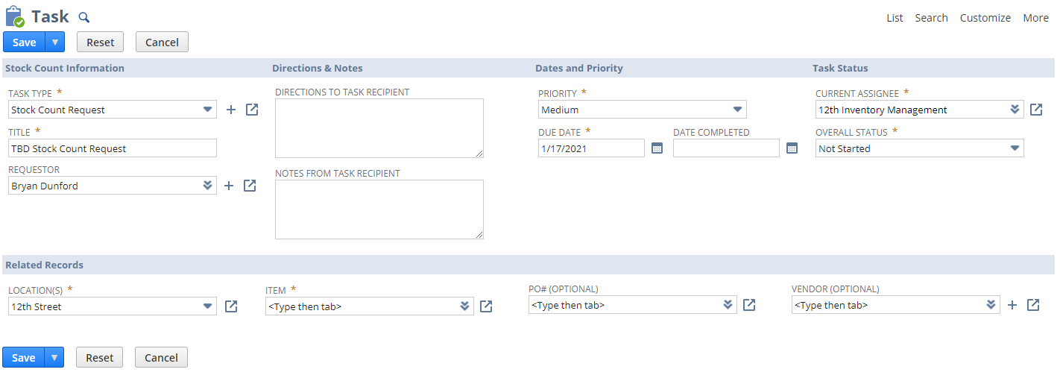
1. Stock Count Request

Slide 23
1. Stock Count Request
Searches
Open Stock Count Requests
Completed Stock Count Requests

Slide 24
Task Types
Stock Count Request
Item Bin Flag
Warehouse/Vendor Issue
This was originally just Rework
Item Audit

Slide 25
2. Item Bin Flag

Slide 26
2. Item Bin Flag
Replacement for skip table
Usually created during picking process
Indicates there was an issue during the pick
Directs inventory management to review issue
Will also direct creation of bin replenishments
Types of Item Bin Flags

Slide 27
2. Item Bin Flag
Replacement for skip table
Usually created during picking process
Indicates there was an issue during the pick
Directs inventory management to review issue
Will also direct creation of bin replenishments
Types of Item Bin Flags
Needs Replenishment
Incorrect Quantity
Damaged Product
Incorrect Product
Bin Inaccessible
Status Prevents Picking

Slide 28
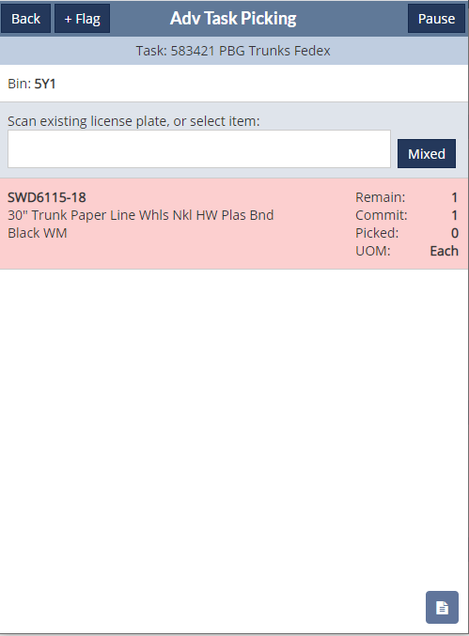
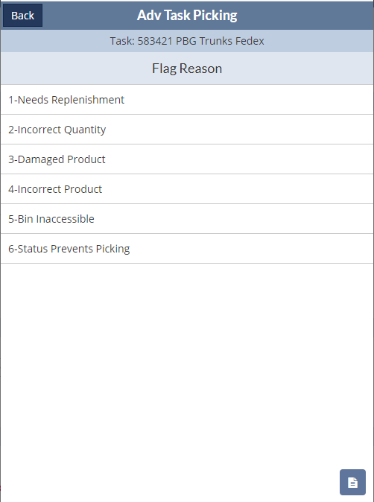
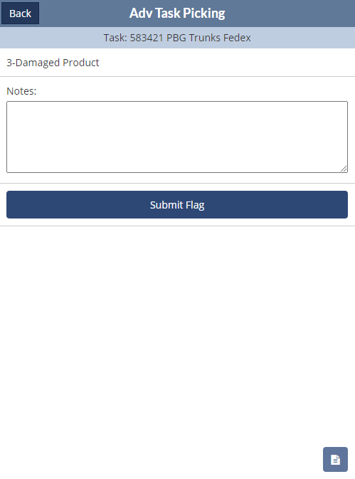
2. Item Bin Flag

Slide 29
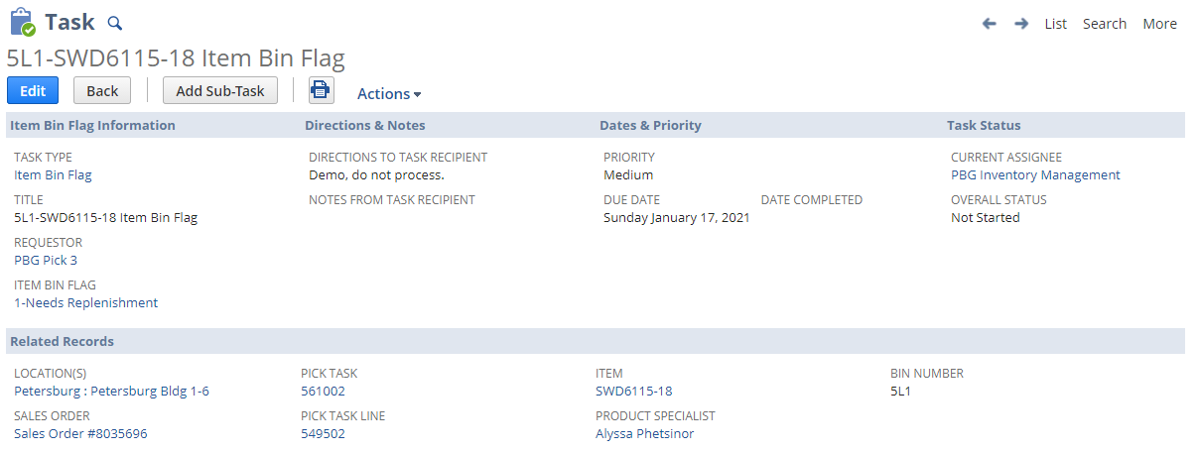
2. Item Bin Flag

Slide 30
2. Item Bin Flag
Searches
Open Item Bin Flags
Completed Item Bin Flags

Slide 31
Task Types
Stock Count Request
Item Bin Flag
Warehouse/Vendor Issue
This was originally just Rework
Item Audit

Slide 32
3. Warehouse/Vendor Issue

Slide 33
3. Warehouse/Vendor Issue
Used by multiple teams
Current Sub-types: Rework, Logistics
Allows for Reworks and Vendor Debit Memos
Also allows for files/attachments
Vendor Error Types

Slide 34
3. Warehouse/Vendor Issue
Used by both multiple teams
Current Sub-types: Rework, Logistics
Allows for Reworks and Vendor Debit Memos
Also allows for files/attachments
Vendor Error Types
Audit Failure
Carton < 90% capacity or > 1/2"
Carton dimensions/weight
Delayed Communication
Delays in receipt of product sample
Failure to return signed docs on time
Improper use of fragile markings or carton arrows
Incorrect Pack or Case Quantity
Late shipments and/or incomplete shipments
Mis-labeled Cartons
Mis-labeled Product
No Packing Slip
Other defects
Other requirements
Other-Production Delays
Paperwork Errors
Product Recalls and/or stop-sales
Product Testing Failure
Trilingual information missing
UPC on carton
UPC on item
Weights and Measures violations

Slide 35
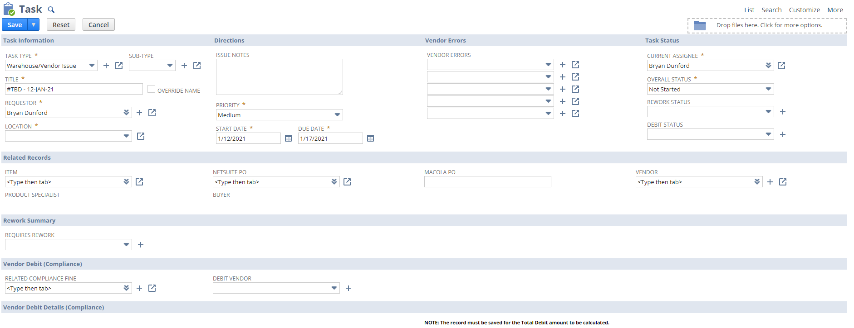
3. Warehouse/Vendor Issue

Slide 36
3. Warehouse/Vendor Issue

Slide 37
3. Warehouse/Vendor Issue

Slide 38
3. Warehouse/Vendor Issue
Examples in NetSuite
Damaged product/debit memo
https://5050497.app.netsuite.com/app/crm/calendar/task.nl?id=1508&scrollid=1508&whence=&cmid=1610470740241_8702
Rework
https://5050497.app.netsuite.com/app/crm/calendar/task.nl?id=2910&whence=&cmid=1610470938149_8861\

Slide 39
3. Warehouse/Vendor Issue
Searches
Open Warehouse/Vendor Issues
Completed Warehouse/Vendor Issues
All Reworks
My/Team Open Reworks
Open Reworks
Open Reworks, 12th
Open Reworks, PBG
Open Reworks, SHW

Slide 40
Task Types
Stock Count Request
Item Bin Flag
Warehouse/Vendor Issue
This was originally just Rework
Item Audit

Slide 41
4. Item Audit

Slide 42
4. Item Audit
Replacement for QB inbound audits
Current Sub-types: Receiving, Directed Audit
Allows for Reworks and Vendor Debit Memos

Slide 43
4. Item Audit
Replacement for QB inbound audits
Current Sub-types: Receiving, Directed Audit
Allows for Reworks and Vendor Debit Memos
Can be created directly by P&S or others (does not have to be related to an inbound shipment)
Can be generated by the receiving team from Inbound Shipment Details search
Uses item record fields and time logic (8 months currently) to determine if an item should be included for audit
After an item is audited, it will drop from future shipments on the inbound shipment details list, to mitigate over-auditing (unless P&S Specialist sets field requirements to audit)

Slide 44
4. Item Audit
Controls for Item Auditing (other than directed item audits)
Item Record > Activities
Item Level
Product Line Level
Product Category Level
Time Since Last Audit (currently 8 months)
Currently Open Item Audit

Slide 45
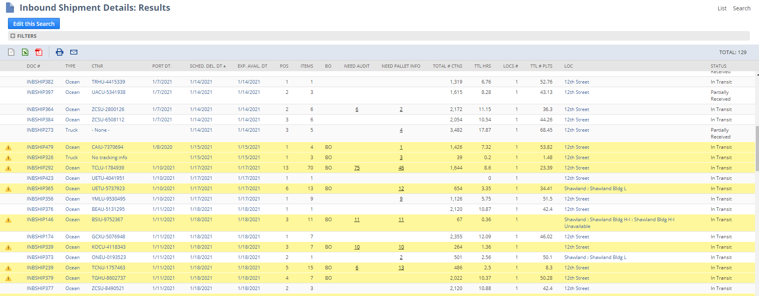
4. Item Audit
Inbound Shipment Details

Slide 46
4. Item Audit

Slide 47
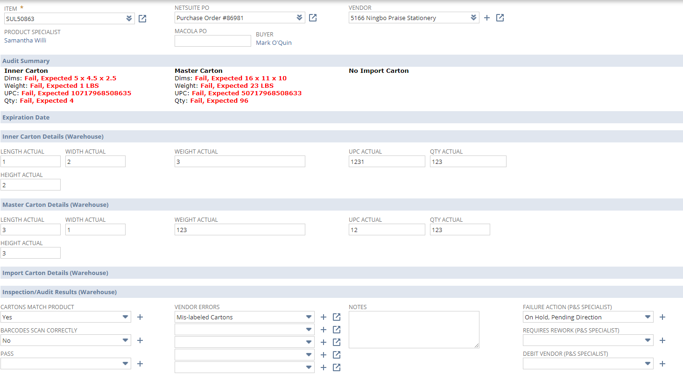
4. Item Audit

Slide 48
4. Item Audit

Slide 49
4. Item Audit

Slide 50
4. Item Audit

Slide 51
4. Item Audit

Slide 52
4. Item Audit

Slide 53
4. Item Audit

Slide 54
4. Item Audits
Searches
Open Item Audits
Completed Item Audits
My/Team Open Item Audits

Slide 55
2.0 Training: Tasks
Task Record
Creating a Task
Task Types

Slide 56
Questions?

