Slide 1

2.0 Training:
License Plates
July 13, 2021

Slide 2
2.0 Training: License Plates
What is a License Plate
Why are license plates used
What is the structure of a license plate

Slide 3
2.0 Training: License Plates
What is a License Plate
Why are license plates used
What is the structure of a license plate

Slide 4
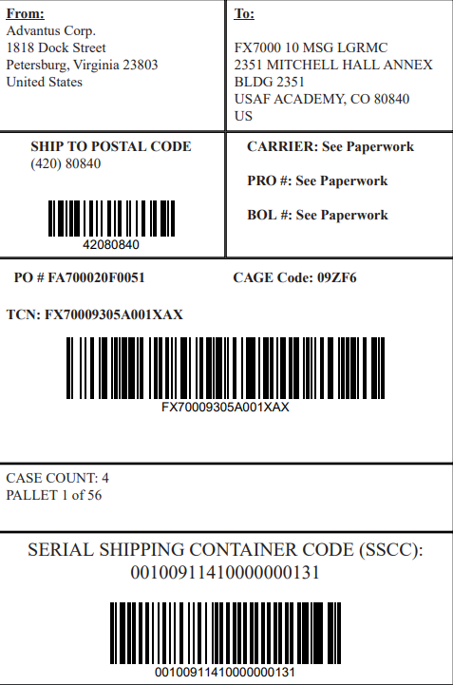
What is a License Plate
Often abbreviated to LP or LPN (License Plate Number)
Method of grouping inventory in a common container for easier management

Slide 5
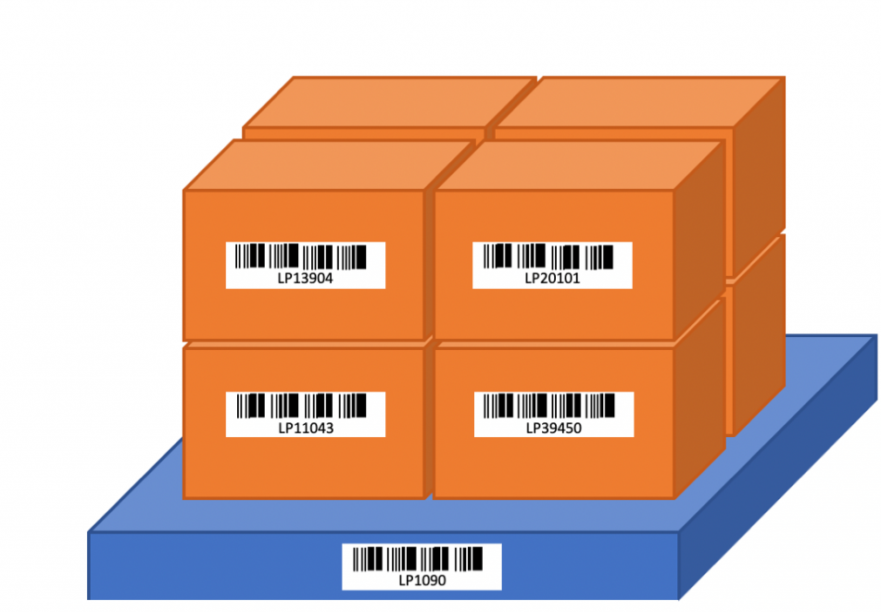
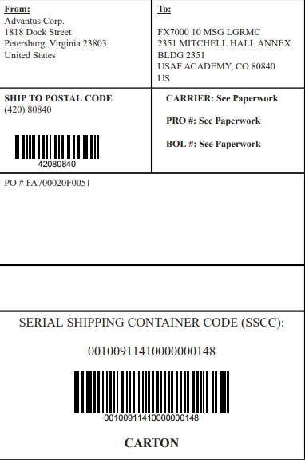
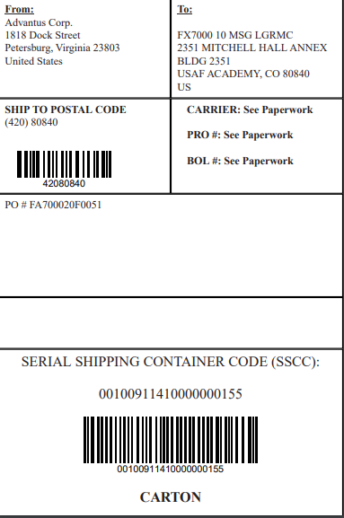
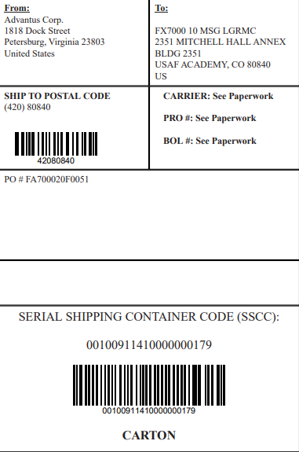

What is a License Plate
Can be created for any container of items
  Does not have to be physical container
  But in our world, it is typically a carton or pallet

Slide 6
What is a License Plate
Utilizes a unique 20-digit number that ties to a record that tracks many pieces of information
  Item, quantity, UOM, date, transaction number, etc.
20-digit number is referred to as Serial Shipping Container Code (SSCC)

Slide 7
What is a License Plate
Utilizes a unique 20-digit number that ties to a record that tracks many pieces of information
  Item, quantity, UOM, date, transaction number, etc.
20-digit number is referred to as Serial Shipping Container Code (SSCC)
8

Slide 8
What is a License Plate
Utilizes a unique 20-digit number that ties to a record that tracks many pieces of information
  Item, quantity, UOM, date, transaction number, etc.
20-digit number is referred to as Serial Shipping Container Code (SSCC)
8

Slide 9
What is a License Plate
8

Slide 10
What is a License Plate
  00: Application identifier
    Indicates this is a license plate/SSCC
8

Slide 11
What is a License Plate
  00: Application identifier (LP)
  1: Extension digit
    We can use 0-9
    Use different numbers for RFS, BF, etc.
8

Slide 12
What is a License Plate
  00: Application identifier (LP)
  1: Extension digit
  0091141: Advantus Prefix
    Assigned by international body, GS1
8

Slide 13
What is a License Plate
  00: Application identifier (LP)
  1: Extension digit
  0091141: Advantus Prefix
  000000013: Sequence number
    Allows for 999,999,999 LPs X 10 (ext digit)
8

Slide 14
What is a License Plate
  00: Application identifier (LP)
  1: Extension digit
  0091141: Advantus Prefix
  000000013: Sequence number
  1: Check digit
8

Slide 15
2.0 Training: License Plates
What is a License Plate
Why are license plates used
What is the structure of a license plate

Slide 16
2.0 Training: License Plates
What is a License Plate
Why are license plates used
What is the structure of a license plate

Slide 17
Why are license plates used
Allows for quick and accurate processing of inventory
  Receiving
  Transferring
  Shipping

Slide 18

Why are license plates used
Allows for quick and accurate processing of inventory
  Receiving
  Transferring
  Shipping
A single scan retrieves many levels of information at once, rather than scanning each carton or each item

Slide 19
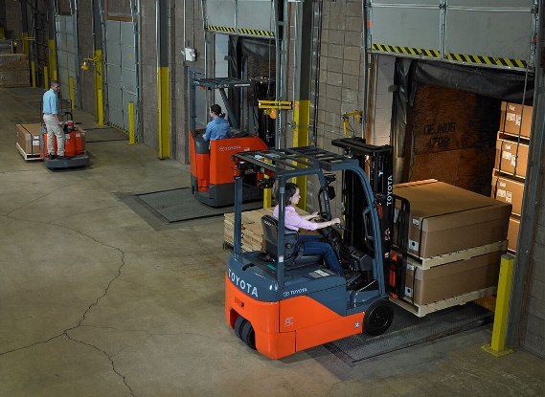

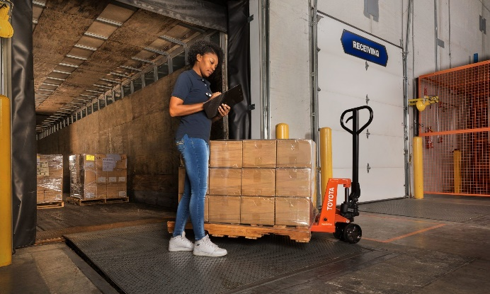
Why are license plates used
Used when a customer uses EDI and ASNs (Advanced Shipping Notices)
Data transmitted in ASN includes the LPs in the shipment
When the LP is received and scanned by the customer, the data is compared against the ASN to confirm we shipped and they received what we transmitted.

Slide 20
Why are license plates used
Currently, Advantus only uses LPs for internal inventory management and outbound order fulfillment processes
We do not currently utilize LPs for receiving inventory from vendors, but may in the future

Slide 21
2.0 Training: License Plates
What is a License Plate
Why are license plates used
What is the structure of a license plate

Slide 22
2.0 Training: License Plates
What is a License Plate
Why are license plates used
What is the structure of a license plate

Slide 23
What is the structure of a License Plate

Slide 24
What is the structure of a License Plate

Slide 25
What is the structure of a License Plate
In this image, there would be one pallet license plate (LP) and 8 carton license plate (LPs)
The carton LPs are nested as “children” within the pallet LP

Slide 26
What is the structure of a License Plate
Scanning the pallet LP will provide information about all items in the pallet
Scanning a carton LP will provide information about the items in the carton

Slide 27
What is the structure of a License Plate
Pallet LP label usually is not on the pallet itself but on the outside of the shrinkwrapped cartons

Slide 28
What is the structure of a License Plate
Structure:
    Carton License Plate Header

Slide 29
What is the structure of a License Plate
Structure:
    Carton License Plate Header
      License Plate Line

Slide 30
What is the structure of a License Plate
Structure:
    Carton License Plate Header
      License Plate Line
        License Plate Line Detail

Slide 31
What is the structure of a License Plate
Structure:
  Pallet License Plate Header (optional)
    Carton License Plate Header
      License Plate Line
        License Plate Line Detail

Slide 32
What is the structure of a License Plate
Structure:
  Pallet License Plate Header (optional)

Slide 33
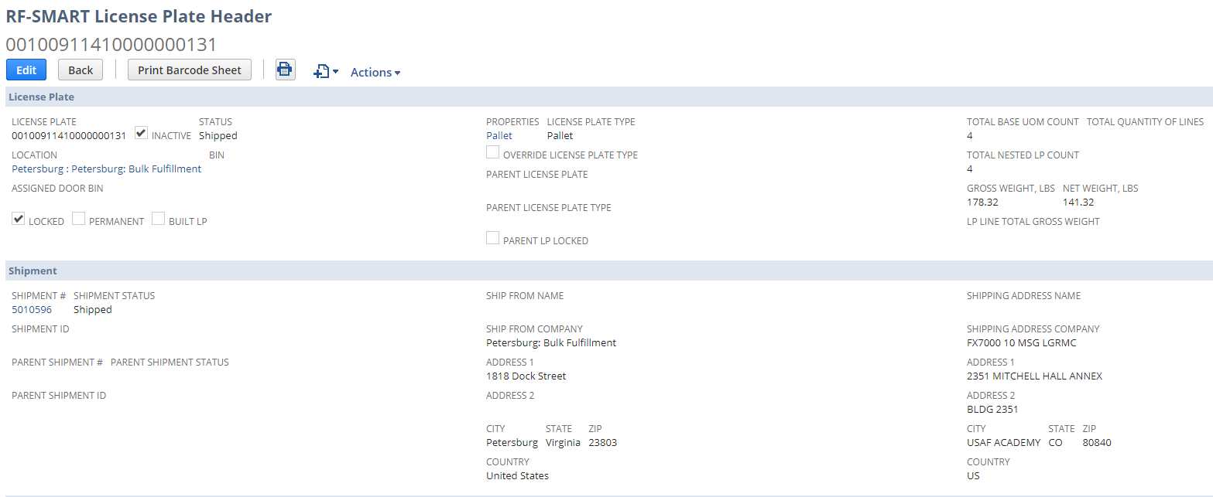
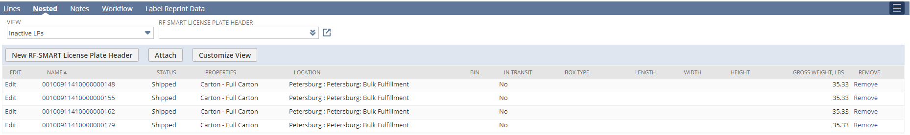
What is a License Plate

Slide 34
What is a License Plate
License Plate Number
(SSCC)

Slide 35
What is a License Plate
License Plate Number
(SSCC)
Type

Slide 36
What is a License Plate
License Plate Number
(SSCC)
Type
Parent LP (N/A because
this is a pallet LP)

Slide 37
What is a License Plate
License Plate Number
(SSCC)
Type
Parent LP (N/A because
this is a pallet LP)
Nested “children” carton LPs

Slide 38
What is the structure of a License Plate
Structure:
  Pallet License Plate Header (optional)

Slide 39
What is the structure of a License Plate
Structure:
  Pallet License Plate Header (optional)
    Carton License Plate Header

Slide 40
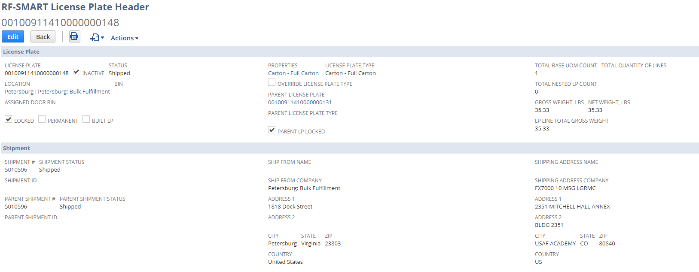
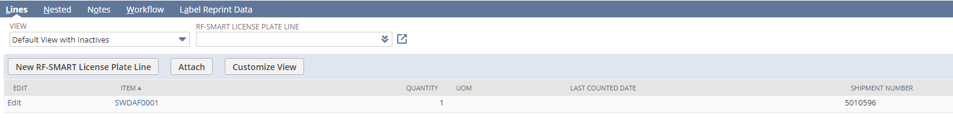
What is the structure of a License Plate

Slide 41
What is the structure of a License Plate
License Plate Number
(SSCC)

Slide 42
What is the structure of a License Plate
License Plate Number
(SSCC)
Type

Slide 43
What is the structure of a License Plate
License Plate Number
(SSCC)
Type
Parent LP

Slide 44
What is the structure of a License Plate
License Plate Number
(SSCC)
Type
Parent LP
LP Lines (1:1 for every different item inside)

Slide 45
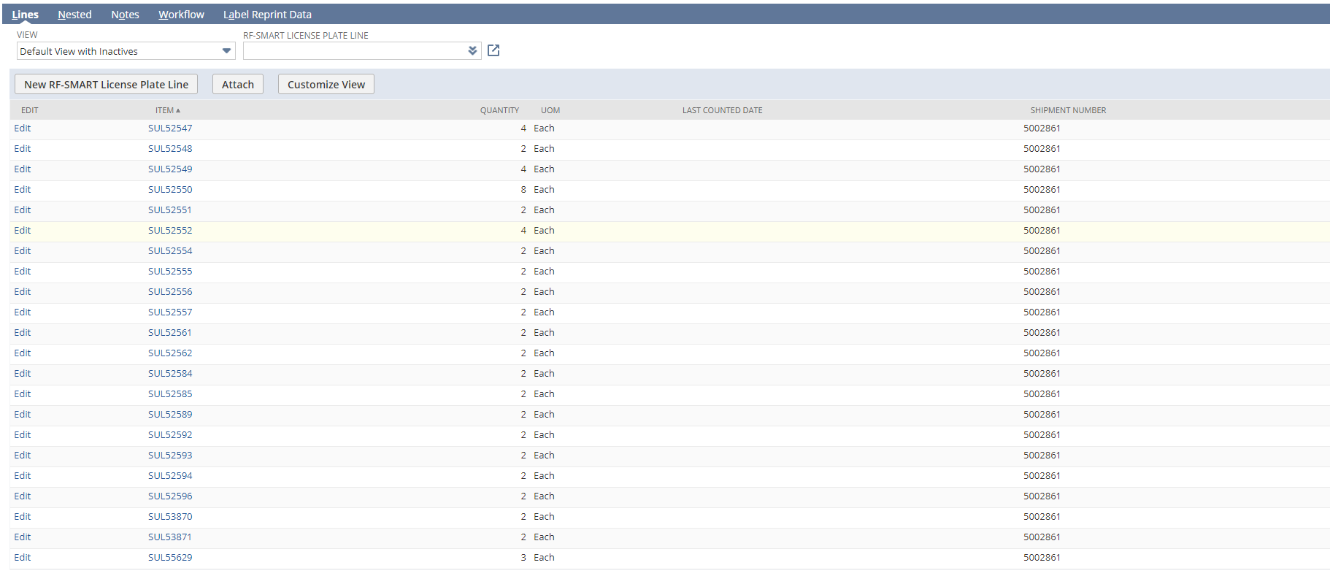
What is the structure of a License Plate
Example 46WLM mixed carton with 22 different items (Carton LP has 22 LP lines)

Slide 46
What is the structure of a License Plate
Structure:
  Pallet License Plate Header (optional)
    Carton License Plate Header

Slide 47
What is the structure of a License Plate
Structure:
  Pallet License Plate Header (optional)
    Carton License Plate Header
      License Plate Line

Slide 48
What is the structure of a License Plate
Structure:
  Pallet License Plate Header (optional)
    Carton License Plate Header
      License Plate Line (1:1 for every Item # in carton)

Slide 49
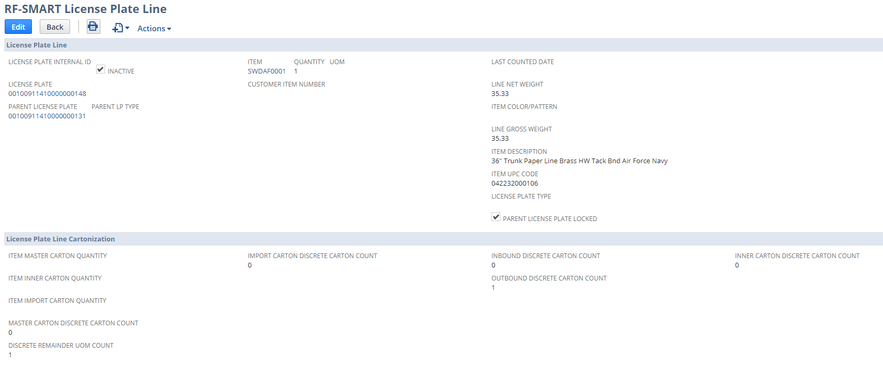
What is the structure of a License Plate

Slide 50
What is the structure of a License Plate
Carton LP
Pallet LP

Slide 51
What is the structure of a License Plate
Item info
Carton LP
Pallet LP

Slide 52
What is the structure of a License Plate
Structure:
  Pallet License Plate Header (optional)
    Carton License Plate Header
      License Plate Line

Slide 53
What is the structure of a License Plate
Structure:
  Pallet License Plate Header (optional)
    Carton License Plate Header
      License Plate Line
        License Plate Line Detail

Slide 54
What is the structure of a License Plate
Structure:
  Pallet License Plate Header (optional)
    Carton License Plate Header
      License Plate Line
        License Plate Line Detail (1:1 to LP line)

Slide 55
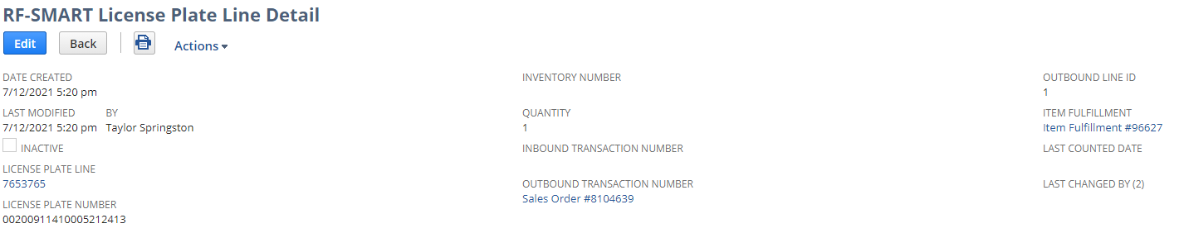
What is the structure of a License Plate

Slide 56
What is the structure of a License Plate
SO#

Slide 57
What is the structure of a License Plate
SO Line #
SO#

Slide 58
What is the structure of a License Plate
SO Line #
IF #
SO#

Slide 59
What is the structure of a License Plate
Structure:
  Pallet License Plate Header (optional)
    Carton License Plate Header
      License Plate Line
        License Plate Line Detail

Slide 60
2.0 Training: License Plates
What is a License Plate
Why are license plates used
What is the structure of a license plate

Slide 61
2.0 Training: License Plates
Additional Questions?

