Slide 1

2.0 Training:
Locations & Bins
March 2, 2021

Slide 2
2.0 Training: Locations & Bins
Locations: Binned vs Unbinned
Sub-Locations
Location Group Name
Bins
Location vs Bin Inventory Availability

Slide 3
2.0 Training: Locations & Bins
Locations: Binned vs Unbinned
Sub-Locations
Location Group Name
Bins
Location vs Bin Inventory Availability

Slide 4
Locations: Binned vs Unbinned

Slide 5
Locations: Binned vs Unbinned
Binned Locations: Inventory resides in and moves between bins
  We do not ever want inventory outside of a bin and in the Location itself
  Inventory management reviews this regularly to keep inventory in the bin (sometimes users make errors)
Unbinned Locations: Inventory does not reside in or move between bins

Slide 6
Locations: Binned vs Unbinned
Binned Locations
  12th
  Shawland
  PBG
Unbinned Locations
  Creative Images
  Direct Import
  Outside Domestic
  Outside International
  Etc

Slide 7
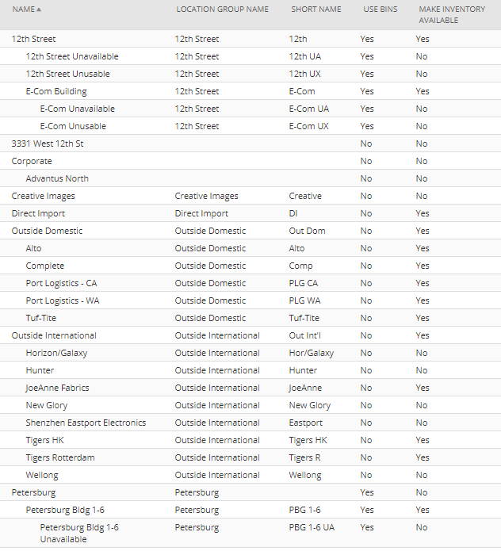
Locations: Binned vs Unbinned
(Screenshot is not
complete list of locations)

Slide 8
Locations: Binned vs Unbinned

Slide 9
Locations: Binned vs Unbinned
Questions?

Slide 10
2.0 Training: Locations & Bins
Locations: Binned vs Unbinned
Sub-Locations
Location Group Name
Bins
Location vs Bin Inventory Availability

Slide 11
2.0 Training: Locations & Bins
Locations: Binned vs Unbinned
Sub-Locations
Location Group Name
Bins
Location vs Bin Inventory Availability

Slide 12
Sub Locations

Slide 13
Sub-Locations

Slide 14
Sub-Locations
Locations/Sub-locations Example
  12th Street
    12th E-com Building
      12th E-Com Unavailable
      12th E-Com Unusable
    12th Unavailable
    12th Unusable

Slide 15
Sub-Locations
Locations/Sub-locations Example
  Shawland
    Shawland H-I
      Shawland H-I Unavailable
      Shawland H-I Unusable
    Shawland K
      Shawland K Unavailable
      Shawland K Unusable
    Shawland L
      Shawland L Unavailable
      Shawland L Unusable

Slide 16
Sub-Locations
Locations/Sub-locations Example
  Petersburg
    Petersburg 1-6
      Petersburg 1-6 Unavailable
      Petersburg 1-6 Unusable
    Petersburg 7-8
      Petersburg 7-8 Unavailable
      Petersburg 7-8 Unusable

Slide 17
Sub-Locations
Locations/Sub-locations Example
  12th Street
    12th E-com Building
      12th E-Com Unavailable
      12th E-Com Unusable
    12th Unavailable
    12th Unusable

Slide 18
Sub-Locations
Locations/Sub-locations Example
  Shawland
    Shawland H-I
      Shawland H-I Unavailable
      Shawland H-I Unusable
    Shawland K
      Shawland K Unavailable
      Shawland K Unusable
    Shawland L
      Shawland L Unavailable
      Shawland L Unusable

Slide 19
Sub-Locations
Locations/Sub-locations Example
  Shawland
    Shawland H-I
      Shawland H-I Unavailable
      Shawland H-I Unusable
    Shawland K
      Shawland K Unavailable
      Shawland K Unusable
    Shawland L
      Shawland L Unavailable
      Shawland L Unusable
X
NO
Inventory Should be Here

Slide 20
Sub-Locations
Locations/Sub-locations Example
  Petersburg
    Petersburg 1-6
      Petersburg 1-6 Unavailable
      Petersburg 1-6 Unusable
    Petersburg 7-8
      Petersburg 7-8 Unavailable
      Petersburg 7-8 Unusable

Slide 21
Sub-Locations
Locations/Sub-locations Example
  Petersburg
    Petersburg 1-6
      Petersburg 1-6 Unavailable
      Petersburg 1-6 Unusable
    Petersburg 7-8
      Petersburg 7-8 Unavailable
      Petersburg 7-8 Unusable
X
NO
Inventory Should be Here

Slide 22
Sub-Locations
Questions?

Slide 23
2.0 Training: Locations & Bins
Locations: Binned vs Unbinned
Sub-Locations
Location Group Name
Bins
Location vs Bin Inventory Availability

Slide 24
2.0 Training: Locations & Bins
Locations: Binned vs Unbinned
Sub-Locations
Location Group Name
Bins
Location vs Bin Inventory Availability

Slide 25
Location Group Name

Slide 26
Location Group Name
Custom field to allow us to more simply report/review data across locations/sub-locations

Slide 27
Location Group Name

Slide 28
Location Group Name

Slide 29
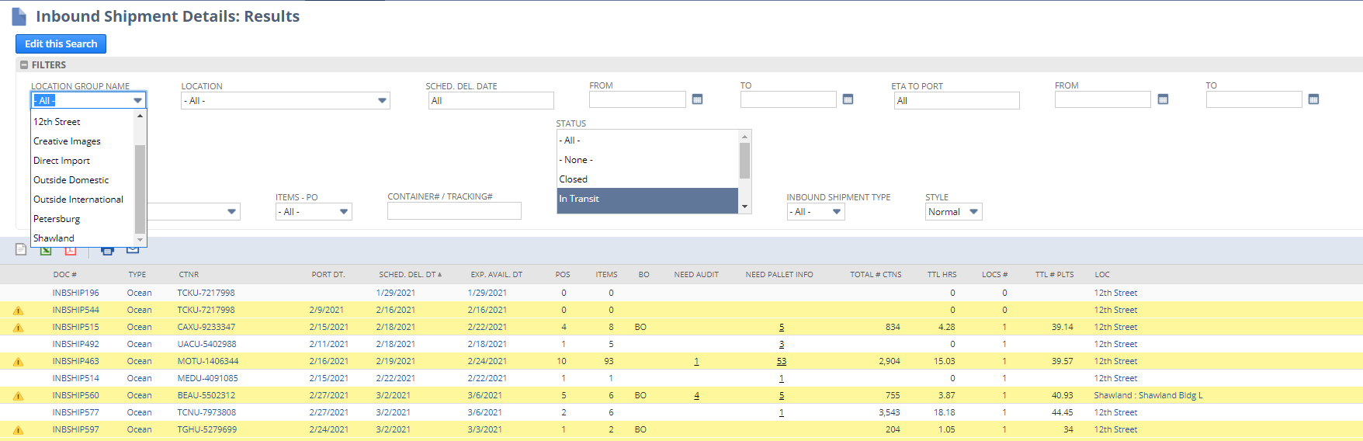
Location Group Name

Slide 30
Location Group Name
Added a few weeks ago (relatively recently)
Not available for all reports/searches, but request if you would like it added and we can see

Slide 31
Location Group Name
Questions?

Slide 32
2.0 Training: Locations & Bins
Locations: Binned vs Unbinned
Sub-Locations
Location Group Name
Bins
Location vs Bin Inventory Availability

Slide 33
2.0 Training: Locations & Bins
Locations: Binned vs Unbinned
Sub-Locations
Location Group Name
Bins
Location vs Bin Inventory Availability

Slide 34
Bins

Slide 35
Bins
Lots of types of bins

Slide 36
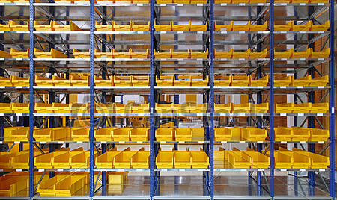
Bins
Bin (Pick bin)

Slide 37
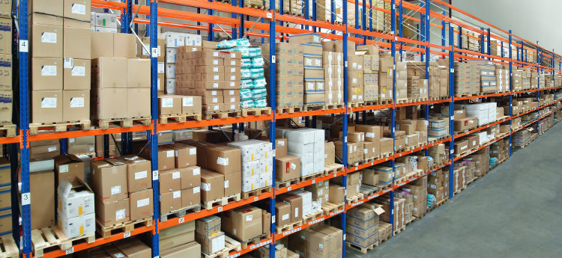
Bins
Bin (Pallet position)

Slide 38

Bins
Bin (Aisle)

Slide 39
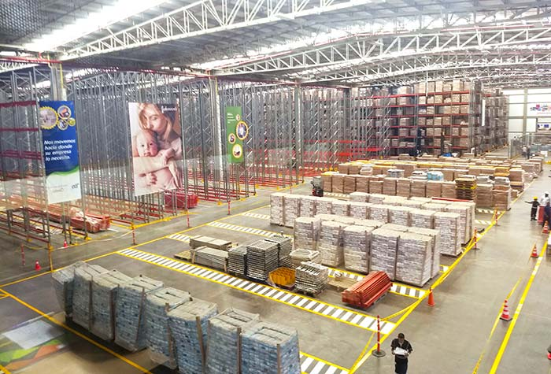
Bins
Bin (Staging area)

Slide 40
Bins
Lots of types of bins
Bins can be found under Lists > Supply Chain (or Items) > Bins

Slide 41
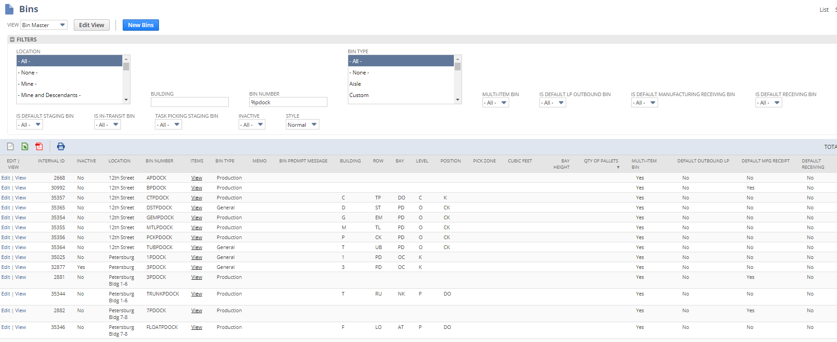
Bins

Slide 42
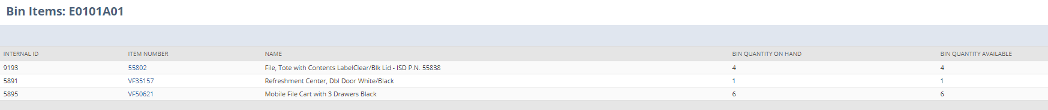
Bins

Slide 43
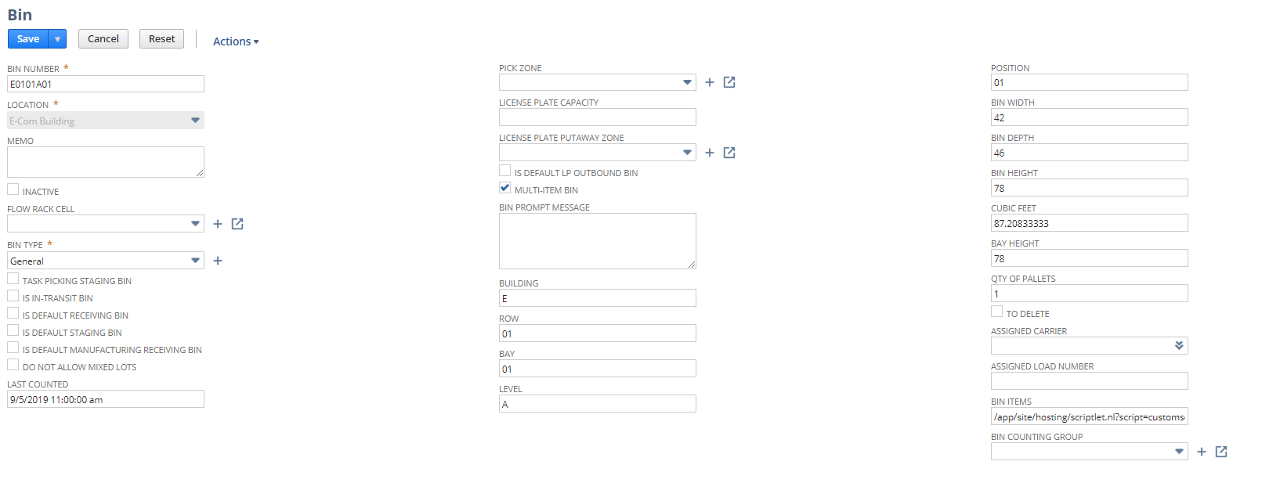
Bins

Slide 44
Bins

Slide 45
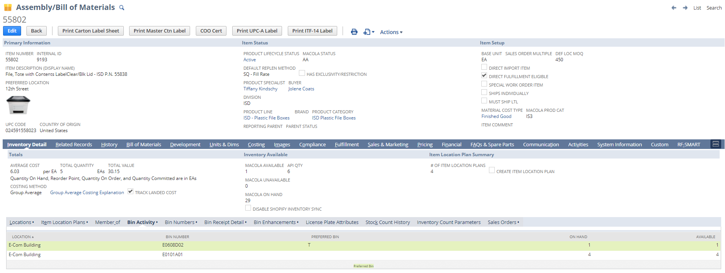
Bins
Bin Activity = Bins where item is currently

Slide 46
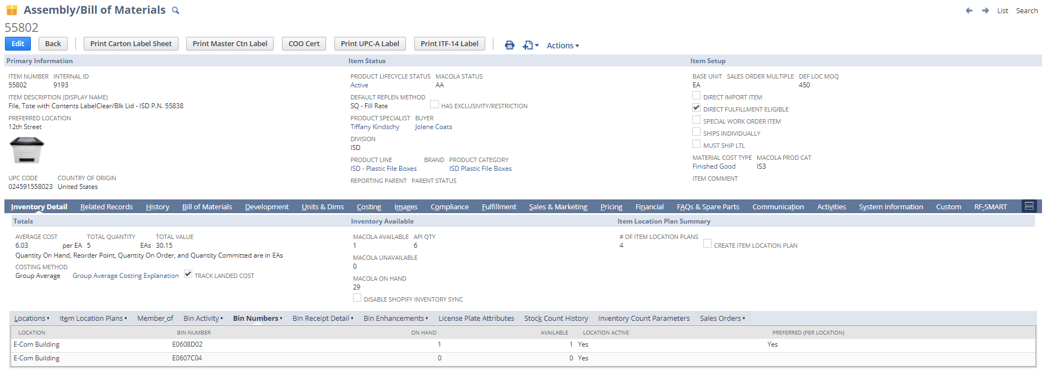
Bins
Bin Numbers = Bin records that are/were preferred at some point

Slide 47
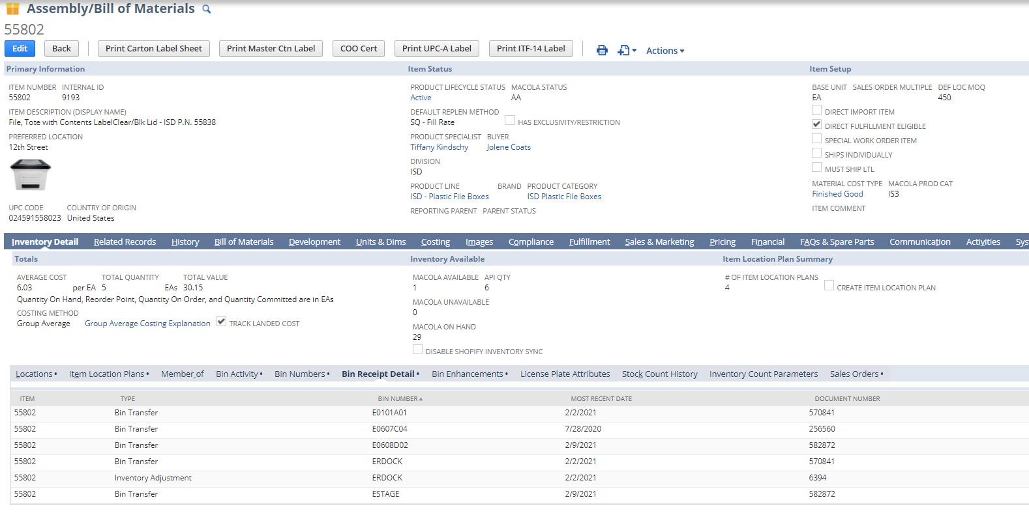
Bins
Bin Receipt Detail = Bin transfer/adjustment/receipt activity/dates

Slide 48
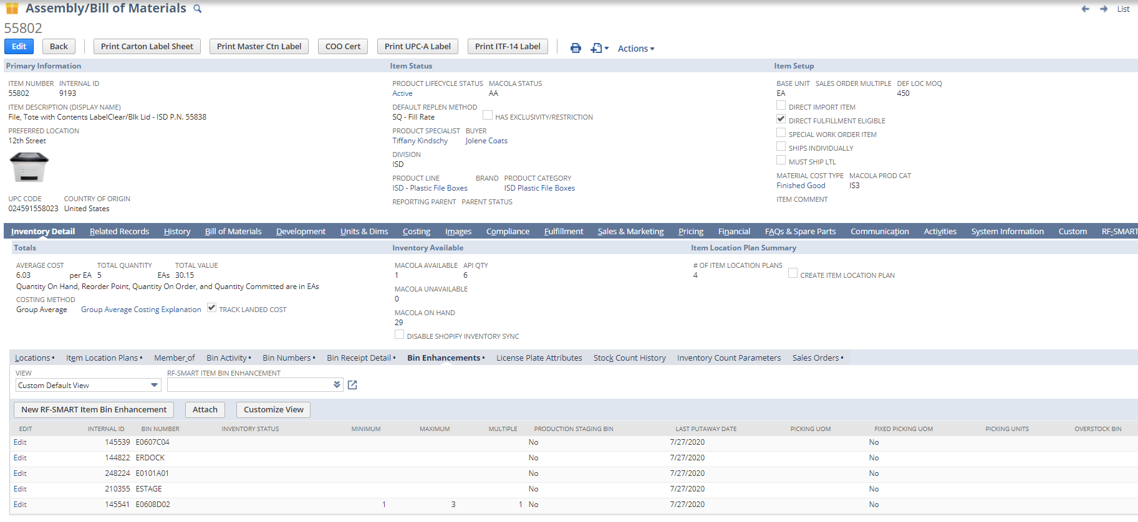
Bins
Bin Enhancements = Preferred bin, min/max settings

Slide 49
Bins
Lots of types of bins
Bins can be found under Lists > Supply Chain (or Items) > Bins
If a location is binned, inventory MUST be in a bin at all times. Inventory transactions must specify the bin.

Slide 50
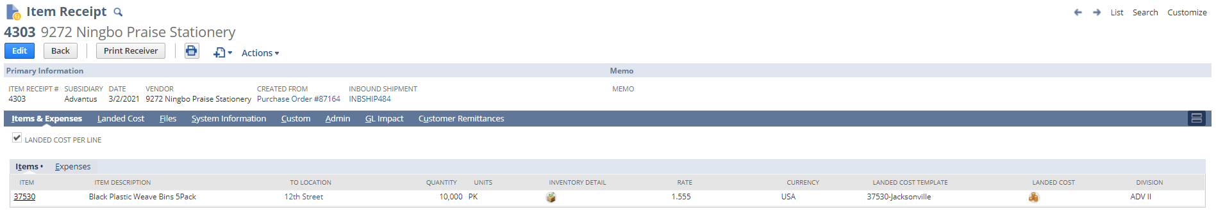
Bins

Slide 51
Bins

Slide 52
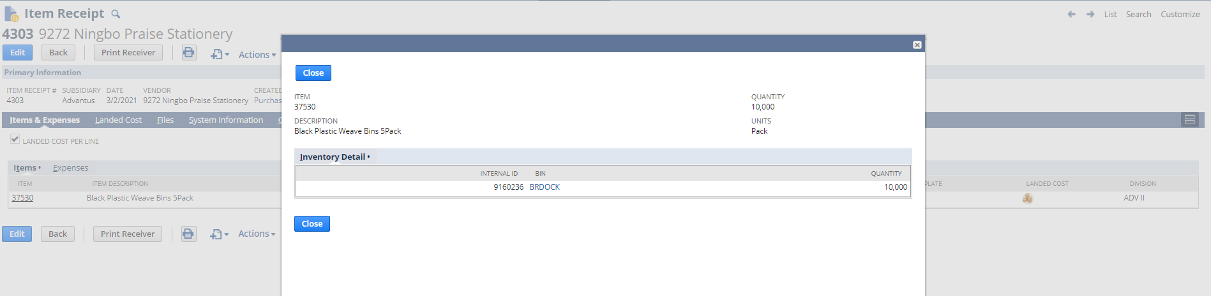
Bins

Slide 53
Bins

Slide 54
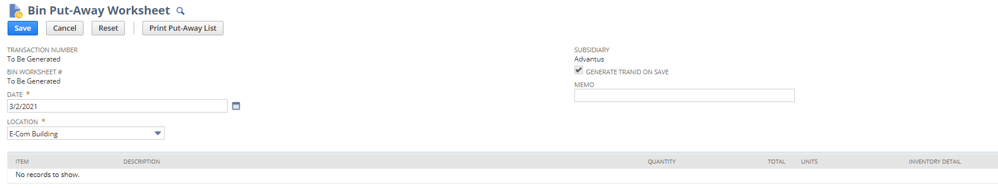
Bins

Slide 55
Bins
Lots of types of bins
Bins can be found under Lists > Supply Chain (or Items) > Bins
If a location is binned, inventory MUST be in a bin at all times. Inventory transactions must specify the bin.
Non-binned locations will not have inventory detail.

Slide 56
Bins
Questions?

Slide 57
2.0 Training: Locations & Bins
Locations: Binned vs Unbinned
Sub-Locations
Location Group Name
Bins
Location vs Bin Inventory Availability

Slide 58
2.0 Training: Locations & Bins
Locations: Binned vs Unbinned
Sub-Locations
Location Group Name
Bins
Location vs Bin Inventory Availability

Slide 59
Inventory Availability

Slide 60
Inventory Availability
Location Inventory Availability <> Bin Inventory Availability

Slide 61
Inventory Availability
Location Inventory Availability <> Bin Inventory Availability
  Location Inventory Availability
    Is this inventory allocated/committed to a transaction?
    Can I allocate/commit this inventory to a transaction?
  Bin Inventory Availability
    Can I move this inventory between bins within the warehouse?

Slide 62
Inventory Availability

Slide 63
Inventory Availability

Slide 64
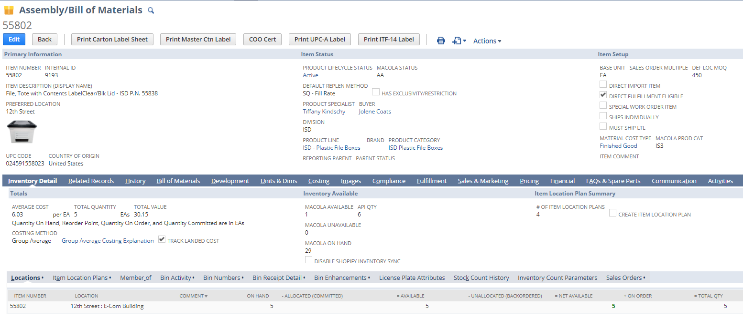
Inventory Availability

Slide 65
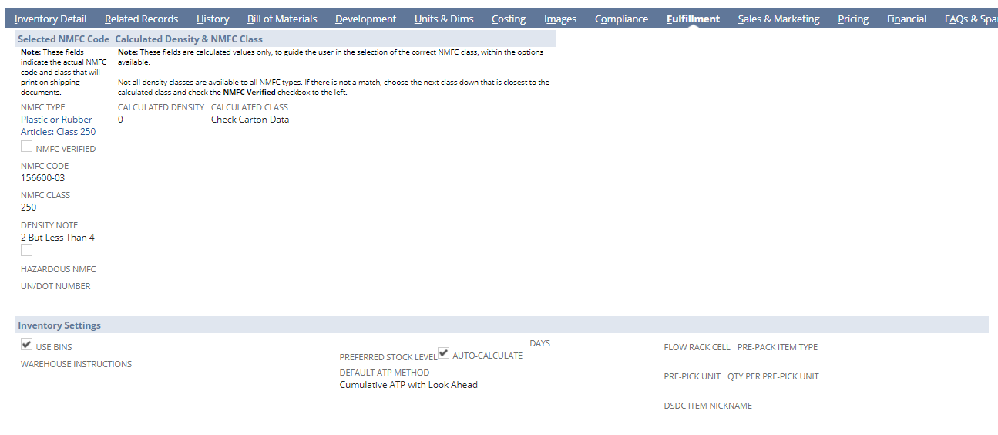
Inventory Availability

Slide 66
Inventory Availability

Slide 67
Inventory Availability
On Hand = What is physically in the location
Allocated/Committed = What is committed/”locked” to an order
Available = On Hand – Allocated/Committed
Unallocated/Backordered = What is on open orders but not committed or backordered
Net Available = Available – Unallocated/Backordered
On Order = What is on open/released POs/WOs
Total Qty = Net Available + On Order

Slide 68
Inventory Availability
Inventory gets committed to Sales Orders, Work Orders, Transfer Orders
Once committed, it “sticks” with that order and is not available for other orders unless it is re-allocated
Meaning, the same inventory cannot be committed/allocated to two different sales orders = no risk of double-dipping. Inventory must be re-allocated/”freed up” to commit to another transaction

Slide 69
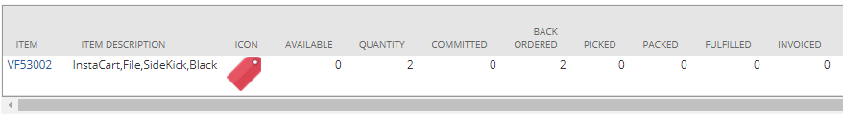

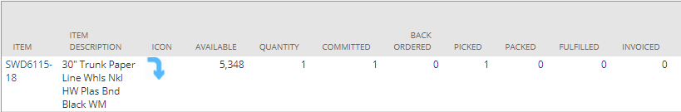
Inventory Availability
8045329
8044632
8045323

Slide 70
Inventory Availability
Location Inventory Availability <> Bin Inventory Availability
  Location Inventory Availability
    Is this inventory allocated/committed to a transaction?
    Can I allocate/commit this inventory to a transaction?
  Bin Inventory Availability
    Can I move this inventory between bins within the warehouse?

Slide 71
Inventory Availability
8045329
8044632
8045323

Slide 72
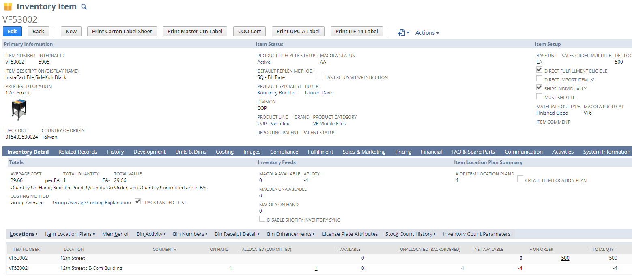
Inventory Availability

Slide 73
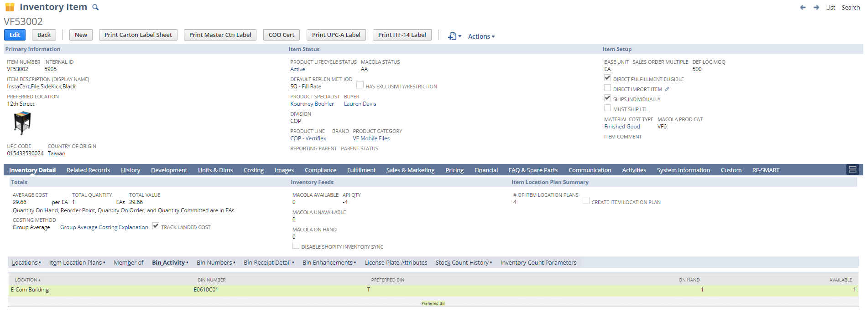
Inventory Availability

Slide 74
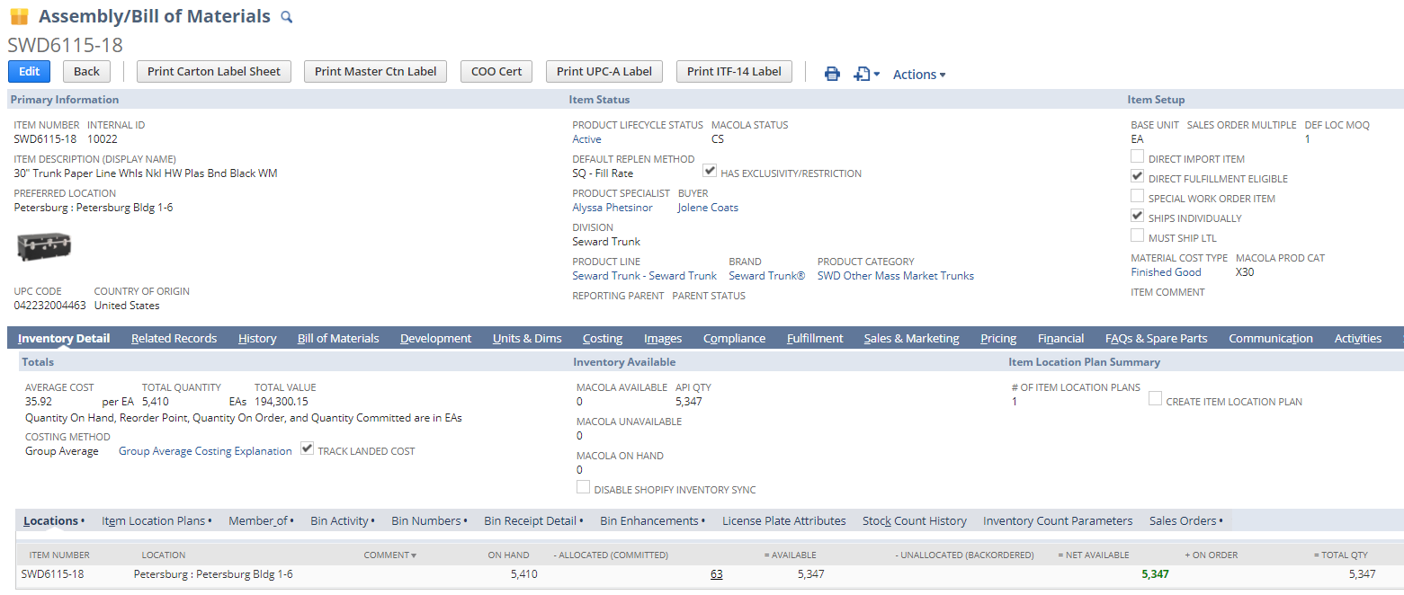
Inventory Availability

Slide 75
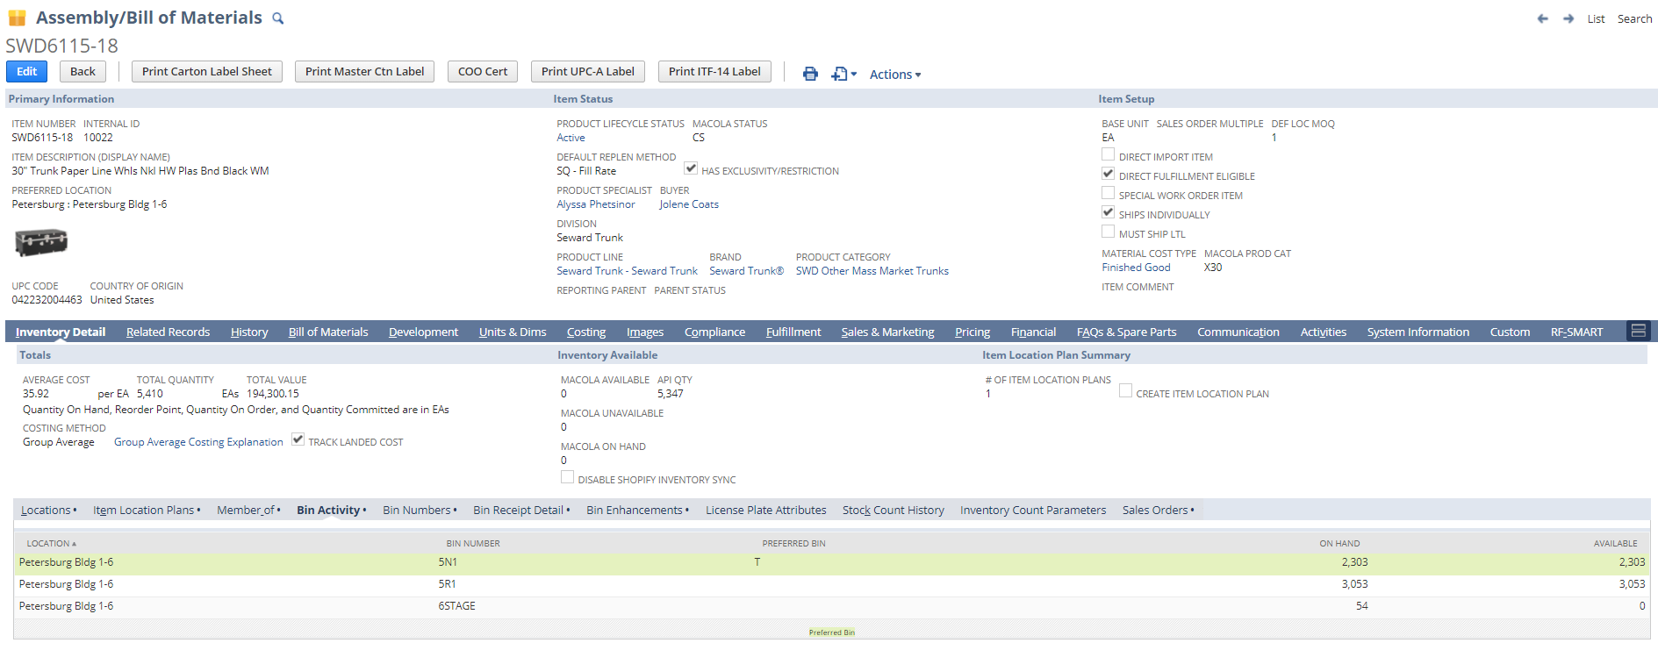
Inventory Availability

Slide 76
Inventory Availability
Location Inventory Availability <> Bin Inventory Availability
  Location Inventory Availability
    Is this inventory allocated/committed to a transaction?
    Can I allocate/commit this inventory to a transaction?
  Bin Inventory Availability
    Can I move this inventory between bins within the warehouse?

Slide 77
Inventory Availability
If Bin Quantity Available < Bin Quantity On Hand, this means that some portion of that quantity in the bin is tied to an Item Fulfillment and cannot be transferred/moved
Because inventory is normally moved to a staging bin at the end of a pick, inventory in a staging bin is almost always not available.
This means staging bins should usually have 0 for Bin Quantity Available

Slide 78
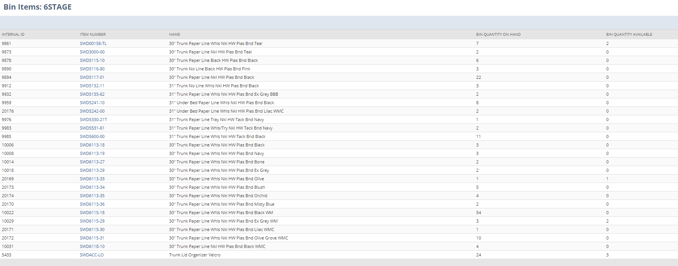
Inventory Availability

Slide 79
Inventory Availability

Slide 80
Inventory Availability

Slide 81
Inventory Availability
Questions

Slide 82
2.0 Training: Locations & Bins
Locations: Binned vs Unbinned
Sub-Locations
Location Group Name
Bins
Location vs Bin Inventory Availability

