Slide 1

NetSuite EDI Processes
Kevin Kazimir
December 1st, 2020

Slide 2
Agenda
What is EDI
Advantus EDI Platforms (1.0, 1.5, 2.0)
Journey of an EDI Order through NetSuite
Common EDI Misconceptions / Misunderstandings
Understanding an EDI Purchase Order / 850
Advantus EDI Tools for Your Enjoyment
Questions?

Slide 3
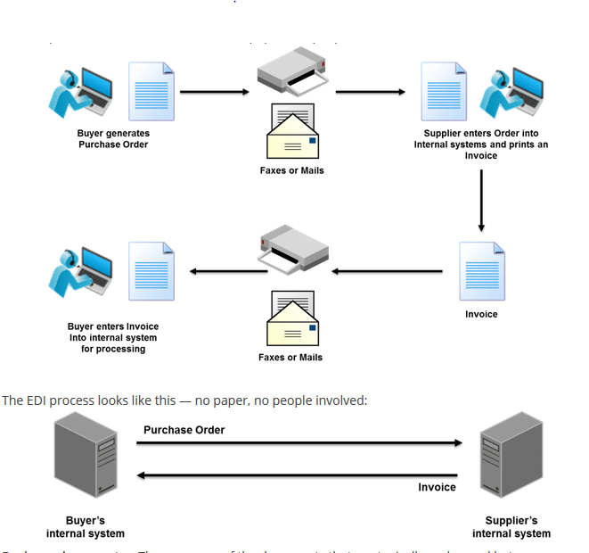
What is EDI
EDI = Electronic Data Interchange
Send business documents electronically
  Inbound
    EDI 850 = Customer Purchase Order (Advantus Sales Order)
    EDI 860 = Purchase Order Change Request
  Outbound
    EDI 810 = Advantus Invoice
    EDI 856 = ASN (Advance Shipping Notice)
    EDI 855 = PO Acknowledgment
    EDI 846 = Inventory Inquiry (aka Inventory Feed)
  Inbound –and- Outbound
    EDI 997 = Functional Acknowledgment

Slide 4
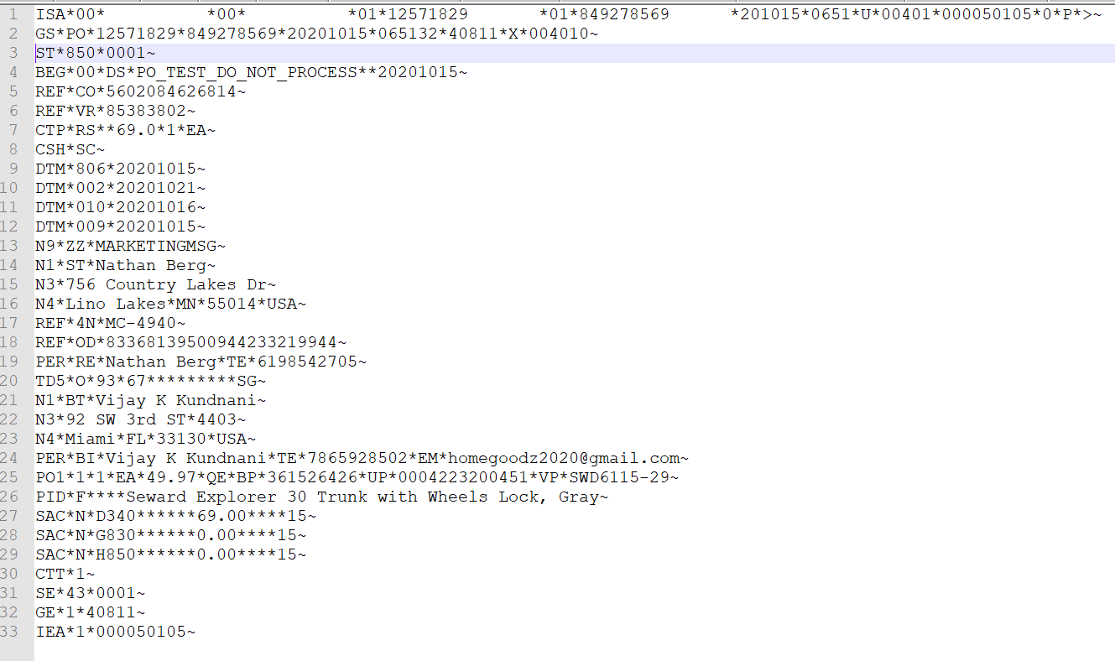
What is EDI
EDI anatomy
  EDI Standards – ANSI X12, EDIFACT
  EDI Transports
    AS2
    VAN (Value Added Network)
    FTP (File Transfer Protocol) or SFTP (Secure FTP)
  EDI Document basics
    Identification / GS Version (Lines 1 - 2 in example)
    Header (Lines 3 – 24 in example)
    Detail (Lines 25 – 29 in example)
    Summary (Lines 30 – 33 in example)
    Segments
    Elements

Slide 5
Advantus EDI Platforms
Advantus EDI 1.0
  Managed by software called “Vantage Point” developed by a company named “Data Masons”
  We need one EDI map per document type. EDI maps are developed by Vantage Point (~$500 / map)
  Software called “Cleo” running on a server at Corporate HQ listens for connections from our trading partners and sends documents
  Compatible with Macola only
Advantus EDI 1.5
  Continue to use Vantage Point, but selectively duplicate documents for NetSuite customers
  Use Dell Boomi to make an FTP connection to EDI server at Corporate and “read-in” EDI documents
  Use Dell Boomi to query NetSuite, build outbound EDI documents, and place on EDI server at Corporate for sending

Slide 6
Advantus EDI Platforms
Advantus EDI 2.0
  Use Dell Boomi exclusively
  Have our customers start sending their documents directly to the “Boomi Cloud”
  Customer must fully be on NetSuite in order for us to do this
  At the end of the day, our objective was/is to change systems without our customers noticing so that their buying habits would not need to change.

Slide 7
EDI Journey through NetSuite
Customer
Advantus
Receive Doc
NS Sales Order
PO (850)
Receive Doc
Functional Ack (997)
Receive Doc
PO Ack (855)
Pick/Pack
Functional Ack (997)
Receive Doc
NS Outbound Shipment
Receive Doc
ASN (856)
“Shipped” / Picked Up by Carrier
Functional Ack (997)
Receive Doc
Invoice (810)
NS Invoice
Receive Doc
Functional Ack (997)
Receive Doc

Slide 8
EDI Timing / Schedule
Purchase Orders (850) – Every hour
Invoices (810) – Every 6 hours
ASNs (856) – Every 2 hours after a shipment is in “Shipped” status
Inventory Feeds (846) – Once per day (however, we can do more often)
Because Boomi limits how many processes we can have running at once, we do NOT run every customer’s processes at the same hour marker (e.g. we don’t integrate 850s for every customer at 2:00 PM, 3:00 PM, 4:00 PM, etc.)

Slide 9
Common EDI Issues / Misconceptions
MYTH – There are “stuck” or “hidden” purchase orders
FACT – The EDI PO Lookup tool is a window into PO activity. 99.99% of the time, if we receive a PO, it’s integrated
MYTH – The customer has an “ASN issue”
FACT – The majority of the time, customers refer to over/short issues as ASN issues (e.g. the quantity or items they received does not match the quantities and items we said we shipped on our ASN)
MYTH - We acknowledge every PO
FACT – We FUNCTIONALLY ACKNOWLEDGE every PO, but we do not send out a formal, PO acknowledgement for every PO. The functional acknowledgement just confirms we received the PO systematically. It is not an acceptance of the terms of the PO

Slide 10
Common EDI Issues / Misconceptions
MYTH – Every PO has an address we should ship to
FACT – Many big customers use location codes (e.g. location code 0001 corresponds to a physical distribution center in Jacksonville, FL)
MYTH – EDI is always more cost effective over manual data entry and we should always do it
FACT – Even when we start building out our own EDI maps, Boomi Trading Partner licenses cost $450 / year plus the labor to build and maintain those maps. If order volume is low, we should push for manual data entry.
MYTH – Our EDI map is wrong
FACT – Most commonly, EDI problems are caused by bad data in our system – not mapping issues
MYTH – All inventory feeds are EDI
FACT – Some, but not all, inventory feeds are EDI. Many customers of ours get their inventory feed as a CSV/Excel file that’s emailed to them.

Slide 11
Customers, Trading Partners, Accounts
Customers != Trading Partners != Netsuite Accounts != Fulfillment Locations
Scenario #1 – Customer: Walmart
  2 Trading Partners = 1 for Walmart DSV (dropship), 1 for Walmart
  3 Accounts in NetSuite
  2 Fulfillment Locations
Scenario #2 – Customer: Wayfair
  1 Trading Partner
  2 Accounts in NetSuite
  2 Fulfillment Locations
Scenario #3 – Customer: Home Depot
  2 Trading Partners = 1 for HomeDepot.com (dropship), 1 for Home Depot stores
  Several accounts in NetSuite
  3 Fulfillment Locations
Scenario #4 – Customer: 123Stores
  1 Trading Partner
  1 Account in NetSuite
  3 Fulfillment Locations

Slide 12
Understanding an EDI 850
Reminder – Segments vs. Elements
The ST segment
The BEG segment
DTM codes – see: https://ediacademy.com/blog/x12-date-time-qualifiers/
The N1*ST and N1*BT segments
The PO1 segment

Slide 13
Advantus EDI Tools
Dell Boomi demo
  What does a map look like
  How do we monitor processes and errors

Slide 14
Advantus EDI Tools
View EDI850 Button on Sales Orders –https://newton.advantus.com/EDIPOLookup/
Resend EDI810 on Invoice record
Resend EDI846 Inventory Feed on Customer record
Lots of other “IT only” tools to help us manage
  EDI Score
  Hybrid PO Verifier – Checks to see if every PO we receive is either in NetSuite or Macola
  Hybrid EDI log – Logs every EDI document that passes through our “hybrid” system
  Resend EDI856 ASN on Shipment record

Slide 15
Questions
  Ask away!

