Slide 1
Inventory: Bins, Stock Counts, Adjustments & Transfers
NetSuite Inventory Flow

Slide 2
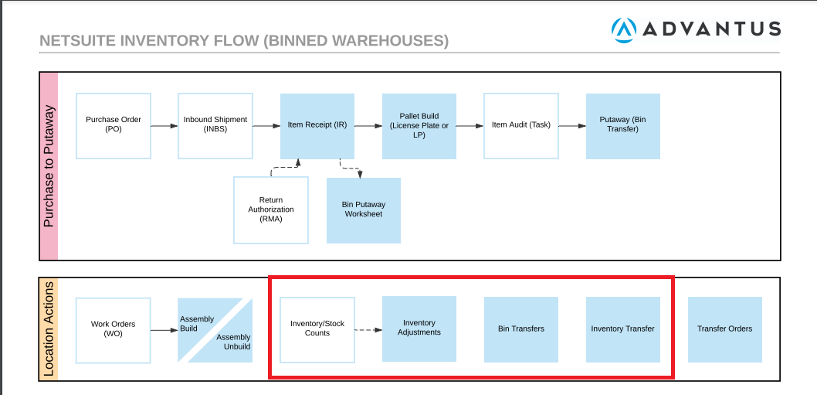
Process Overview
*Inventory Flow job aid is available on Wiki Job Aids page.

Slide 3
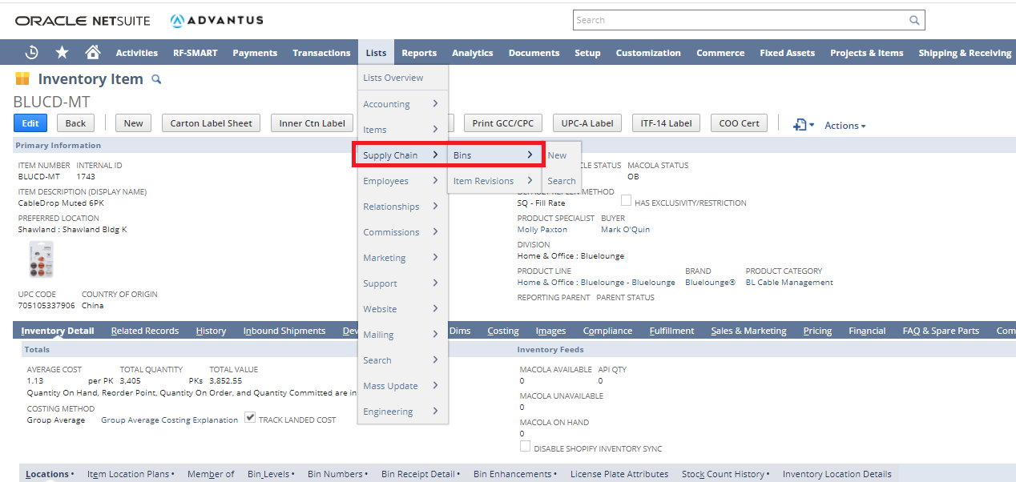
Inventory: Bins

Slide 4
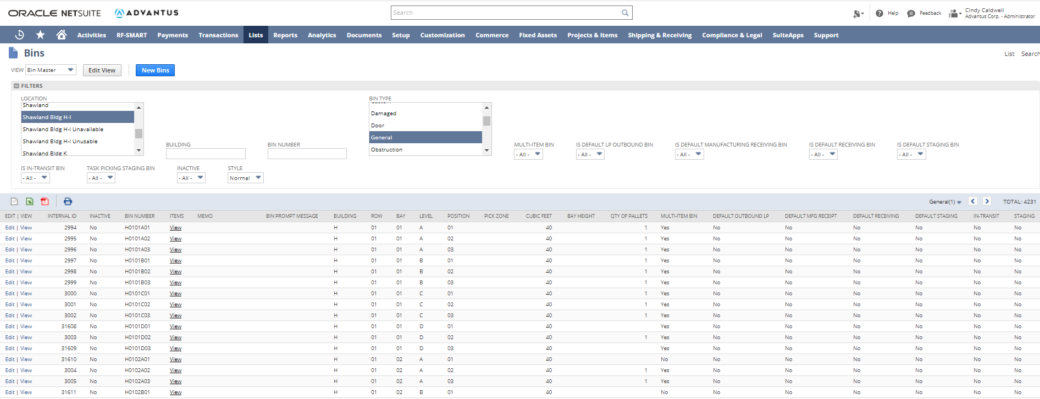
Inventory: Bins

Slide 5
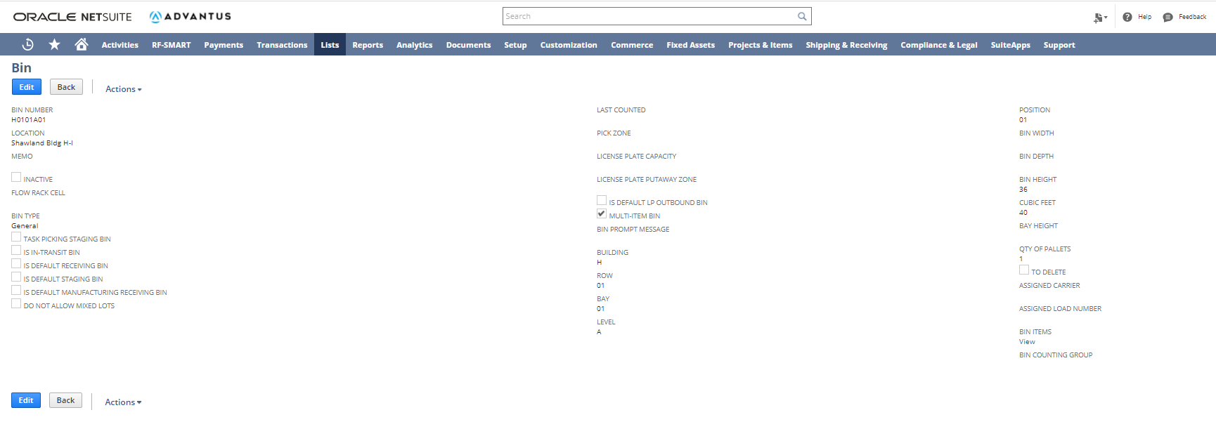
Inventory: Bins

Slide 6
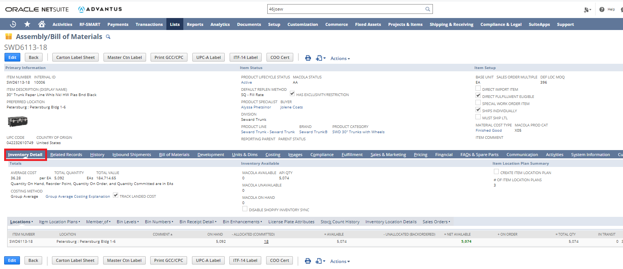
Inventory: Bins

Slide 7
Inventory: Bins

Slide 8
Inventory: Bins

Slide 9
Inventory: Bins

Slide 10
Inventory: Stock Counts
Scheduled off item classification
Class A: count interval is set for 90 days
Class B: count interval is set for 180 days
Class C: count interval is set for 360 days
On demand

Slide 11
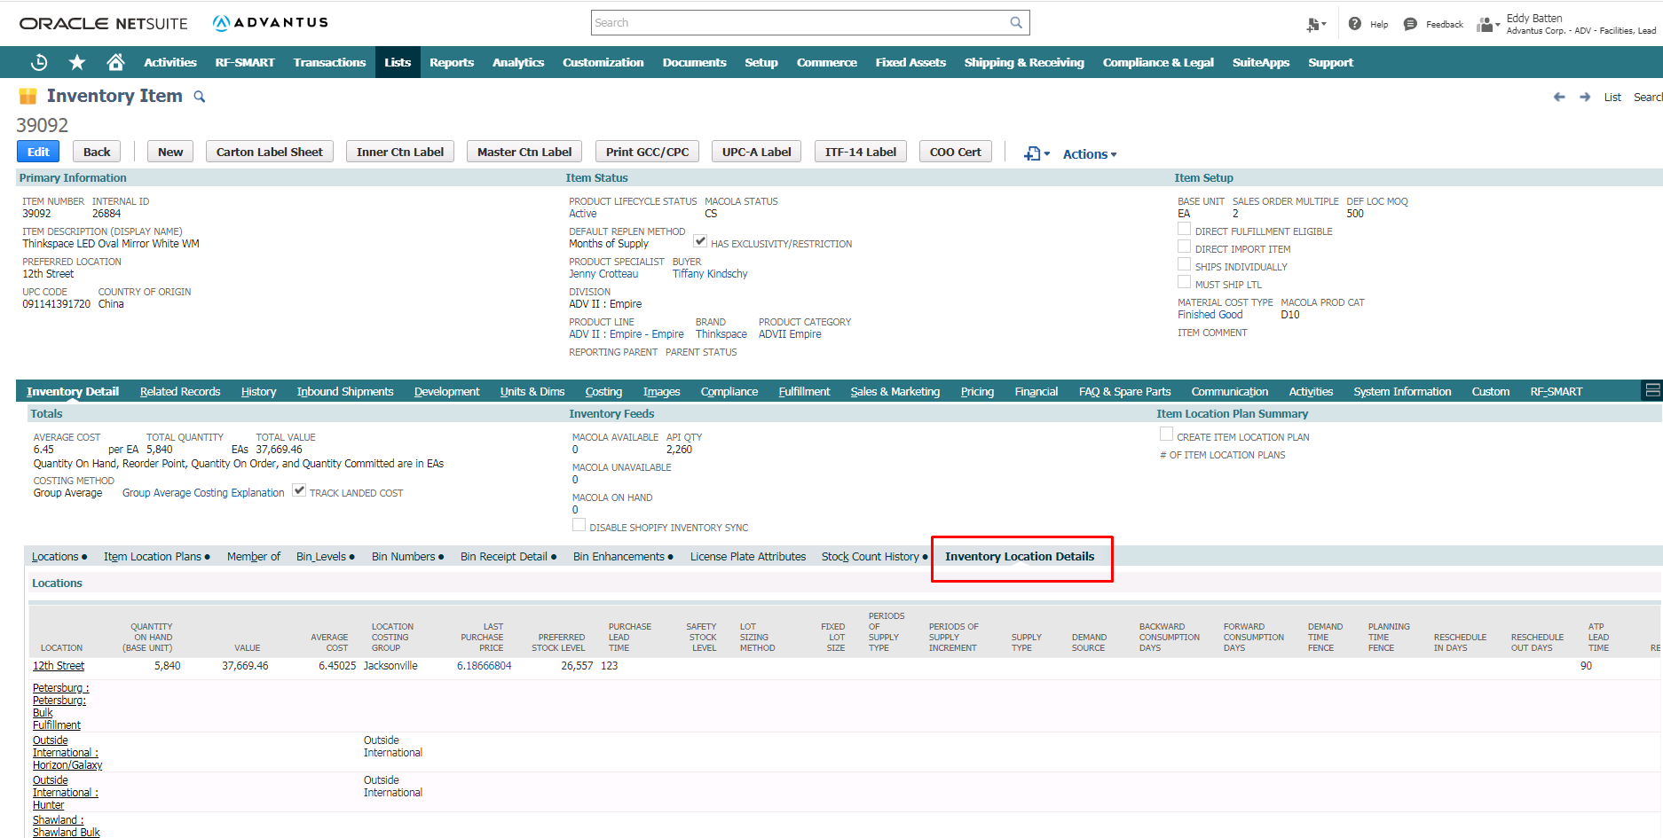
Inventory: Stock Counts

Slide 12
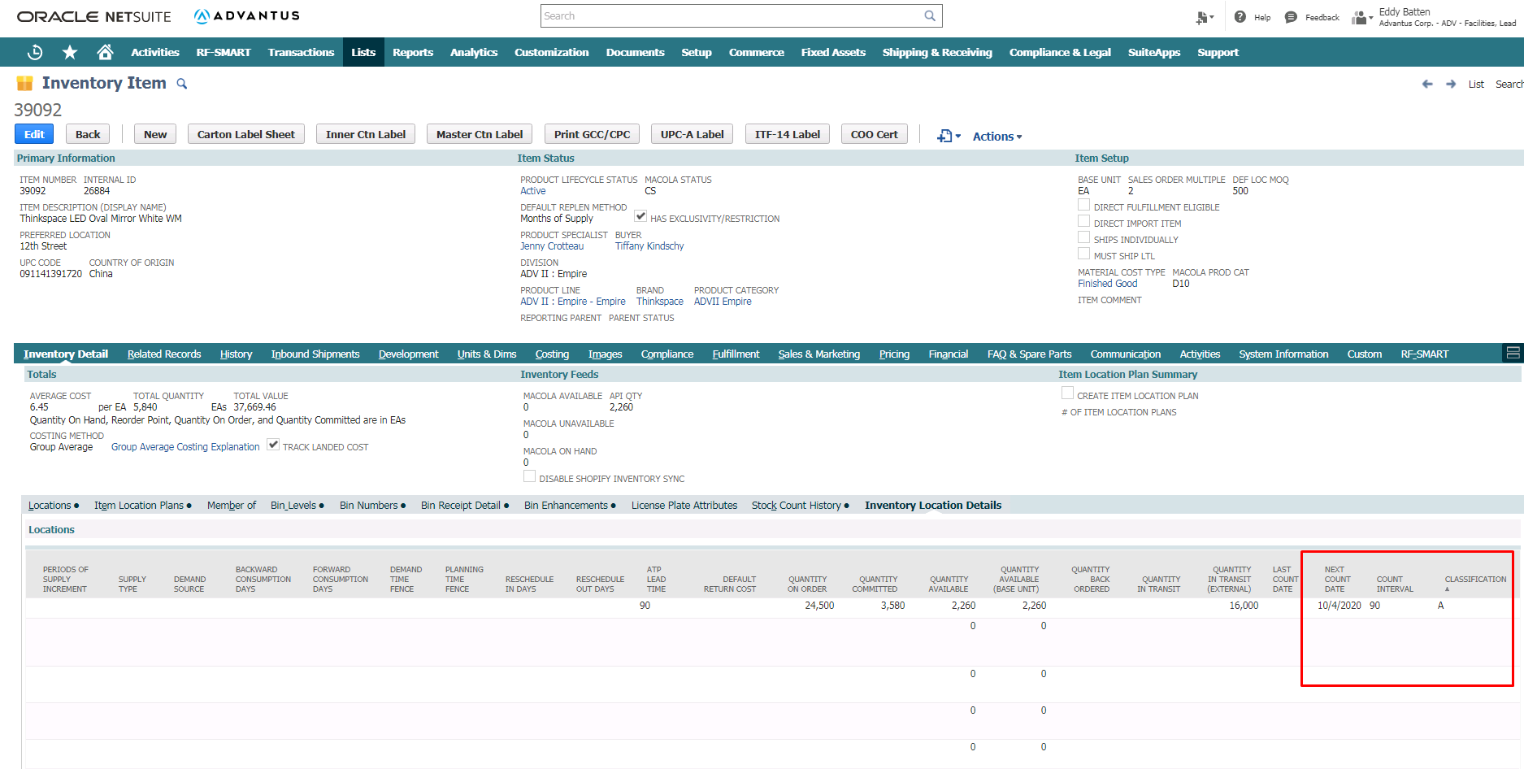
Inventory: Stock Counts

Slide 13
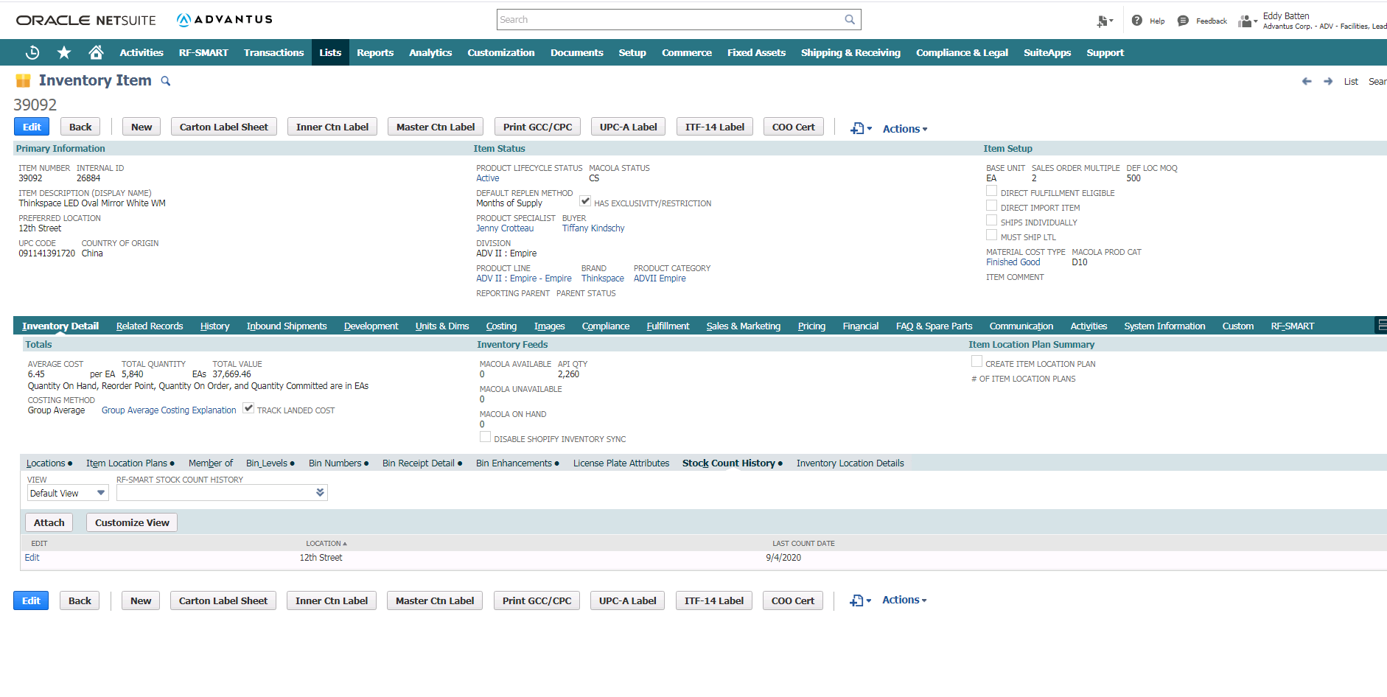
Inventory: Stock Counts

Slide 14
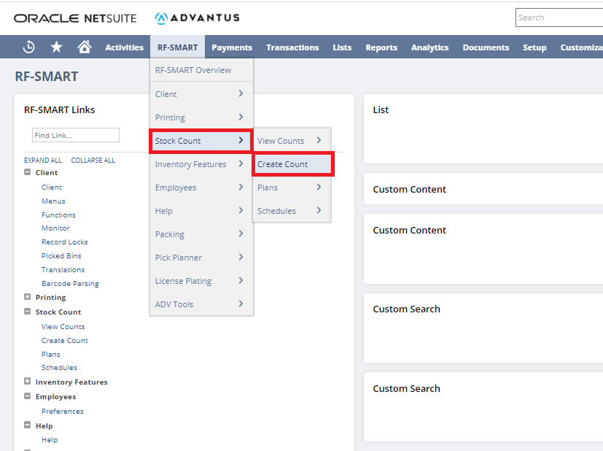
Inventory: Stock Counts

Slide 15
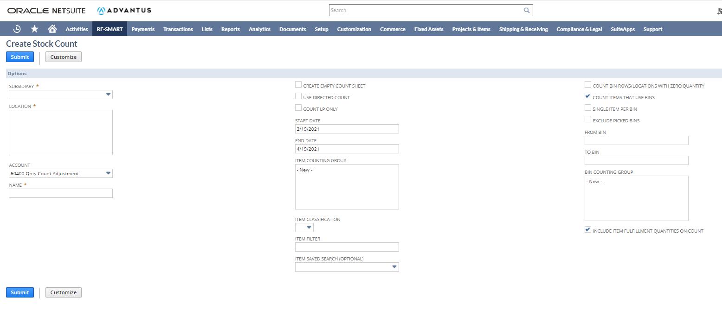
Inventory: Stock Counts

Slide 16
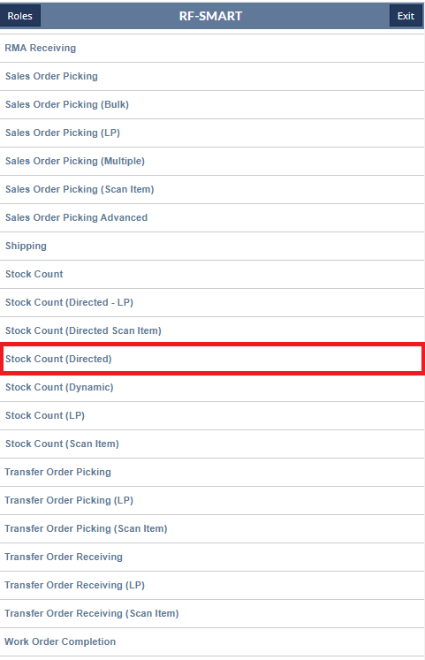
Inventory: Stock Counts

Slide 17
Inventory: Stock Counts

Slide 18
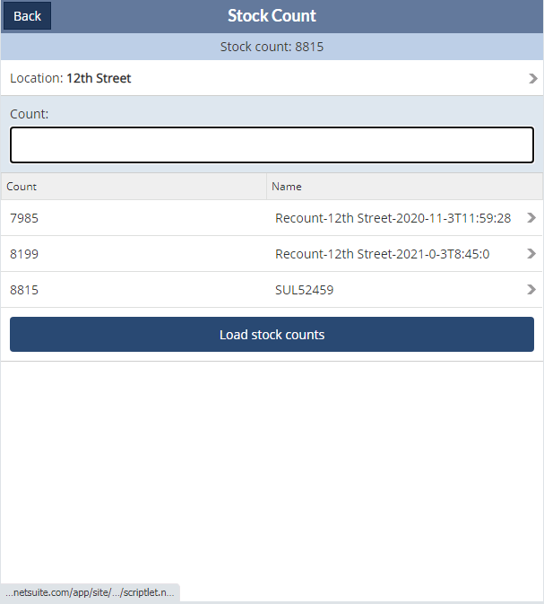
Inventory: Stock Counts

Slide 19
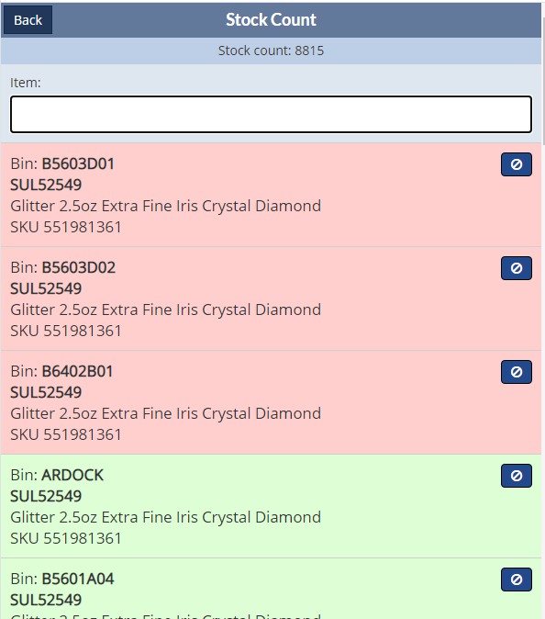
Inventory: Stock Counts

Slide 20
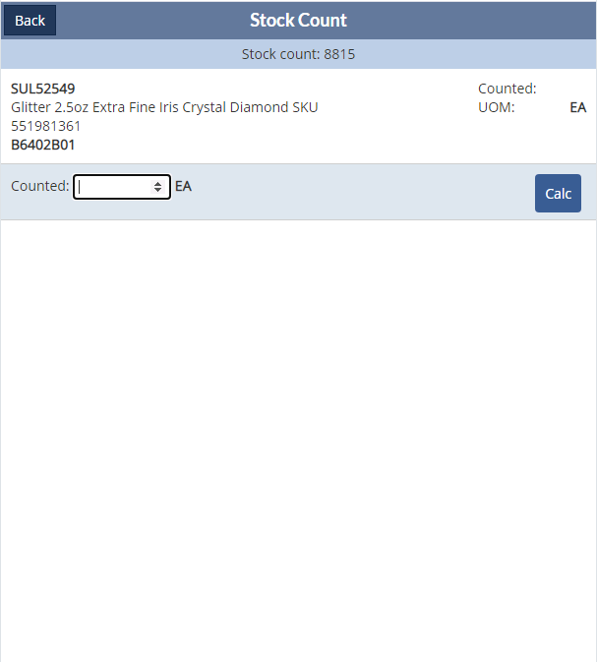
Inventory: Stock Counts

Slide 21
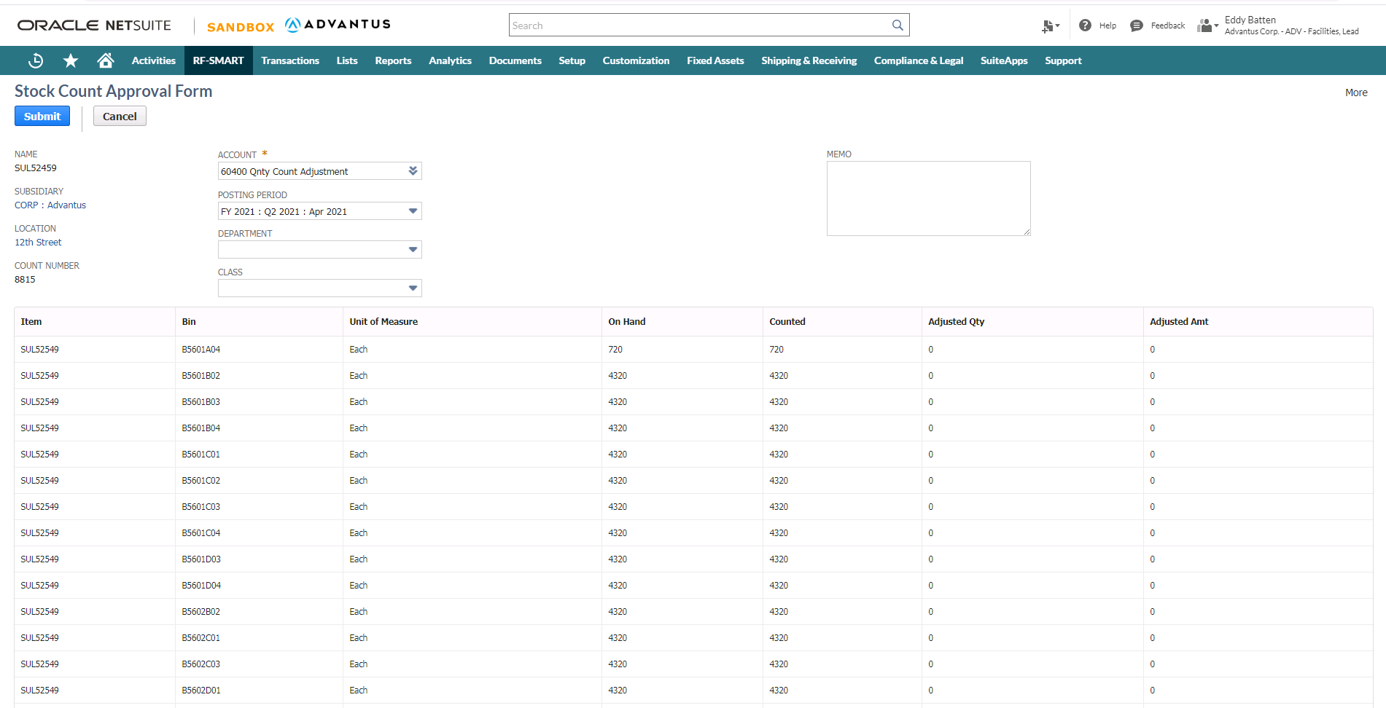
Inventory: Stock Counts

Slide 22
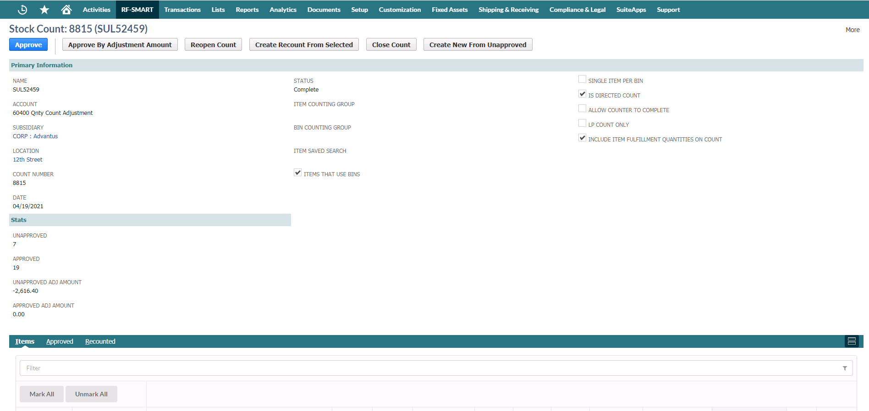
Inventory: Stock Counts

Slide 23
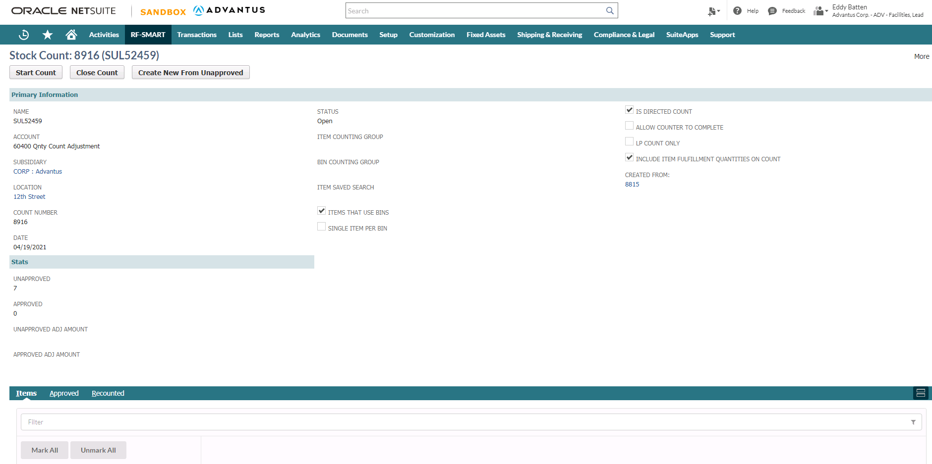
Inventory: Stock Counts

Slide 24
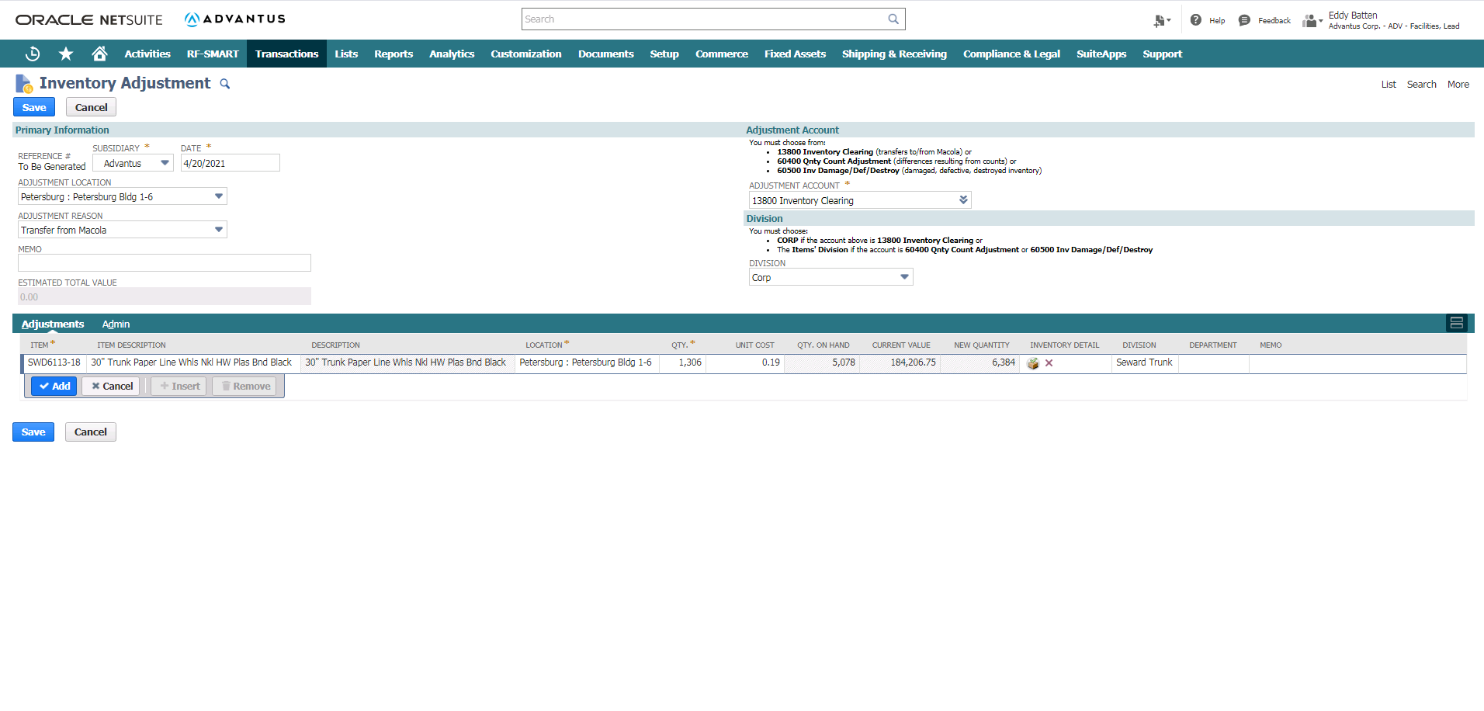
Inventory: Adjustments
Inbound Shipment Details-Inbound Shipment record

Slide 25
Inventory: Adjustments
Inbound Shipment Details-Inbound Shipment record

Slide 26
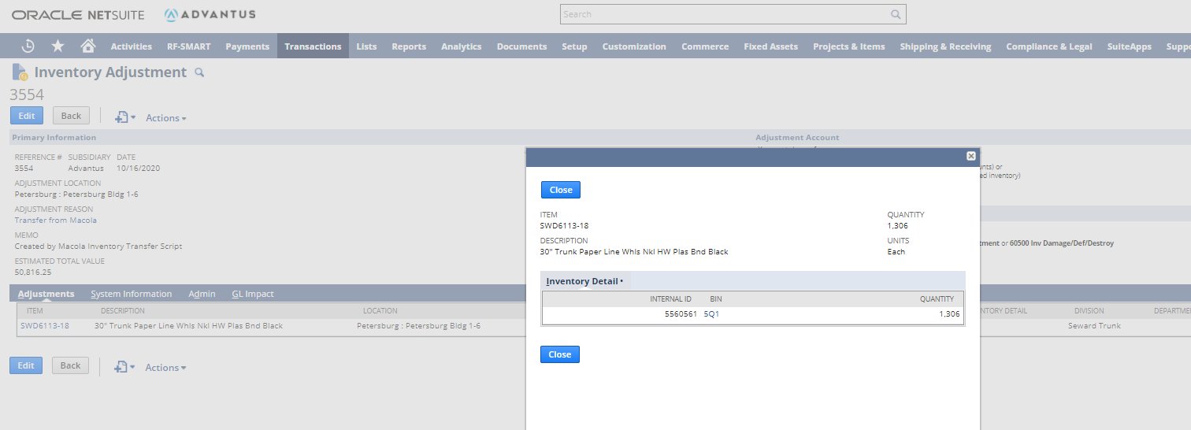
Inventory: Adjustments
Inbound Shipment Details-Inbound Shipment record

Slide 27
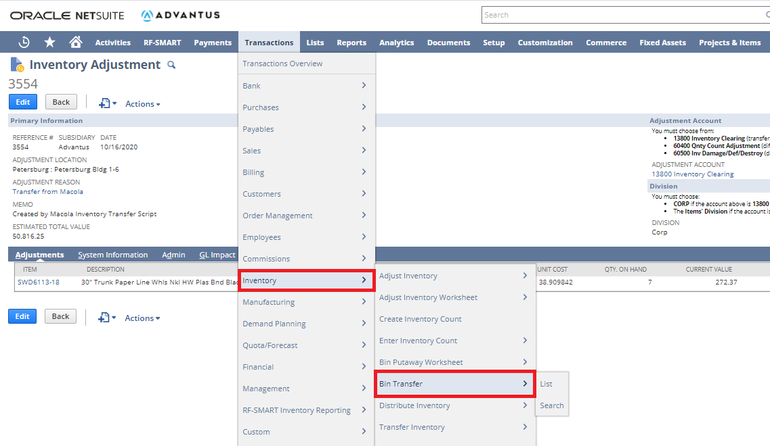
Inventory: Bin Transfers (Native NetSuite)
Inbound Shipment Details-Inbound Shipment record

Slide 28
Inventory: Bin Transfers (Native NetSuite)
Inbound Shipment Details-Inbound Shipment record

Slide 29
Inventory: Bin Transfers (Native NetSuite)
Inbound Shipment Details-Inbound Shipment record

Slide 30
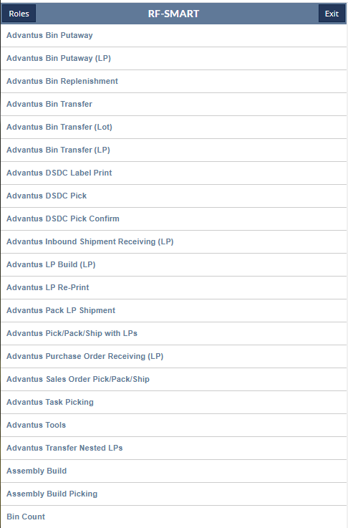
Inventory: Bin Transfers (RF-Smart)
Inbound Shipment Details-Inbound Shipment record

Slide 31
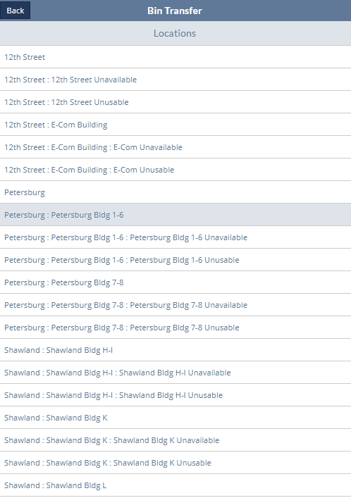
Inventory: Bin Transfers (RF-Smart)
Inbound Shipment Details-Inbound Shipment record

Slide 32
Inventory: Bin Transfers (RF-Smart)
Inbound Shipment Details-Inbound Shipment record

Slide 33
Inventory: Bin Transfers (RF-Smart) Bin to Bin
Inbound Shipment Details-Inbound Shipment record

Slide 34
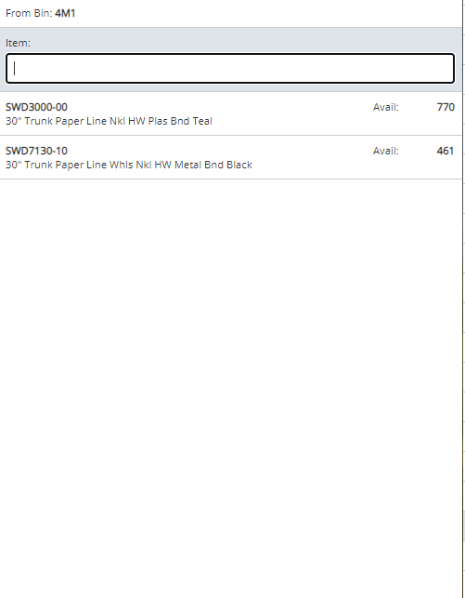
Inventory: Bin Transfers (RF-Smart) Bin to Bin
Inbound Shipment Details-Inbound Shipment record

Slide 35
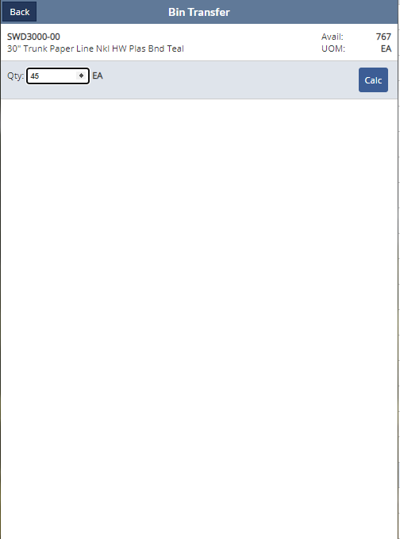
Inventory: Bin Transfers (RF-Smart) Bin to Bin
Inbound Shipment Details-Inbound Shipment record

Slide 36
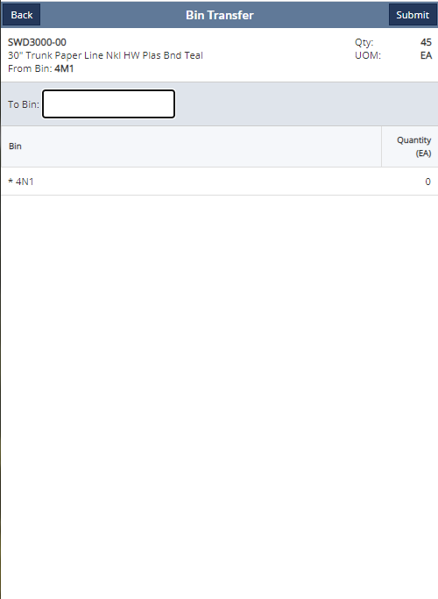
Inventory: Bin Transfers (RF-Smart) Bin to Bin
Inbound Shipment Details-Inbound Shipment record

Slide 37
Inventory: Bin Transfers (RF-Smart) Item
Inbound Shipment Details-Inbound Shipment record

Slide 38
Inventory: Bin Transfers (RF-Smart) Item
Inbound Shipment Details-Inbound Shipment record

Slide 39
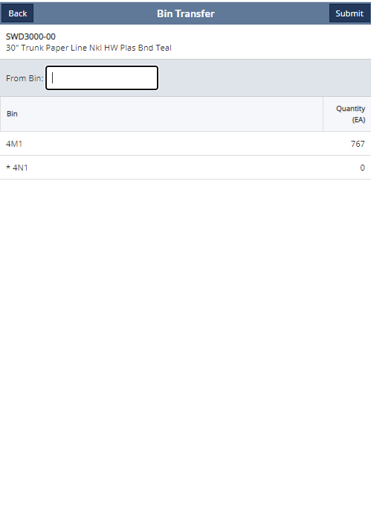
Inventory: Bin Transfers (RF-Smart) Item
Inbound Shipment Details-Inbound Shipment record

Slide 40
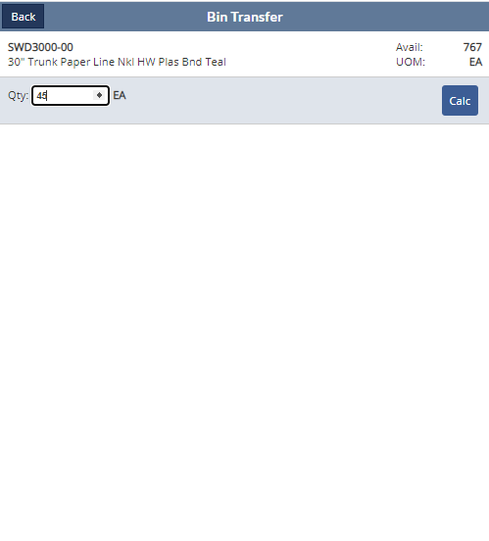
Inventory: Bin Transfers (RF-Smart) Item
Inbound Shipment Details-Inbound Shipment record

Slide 41
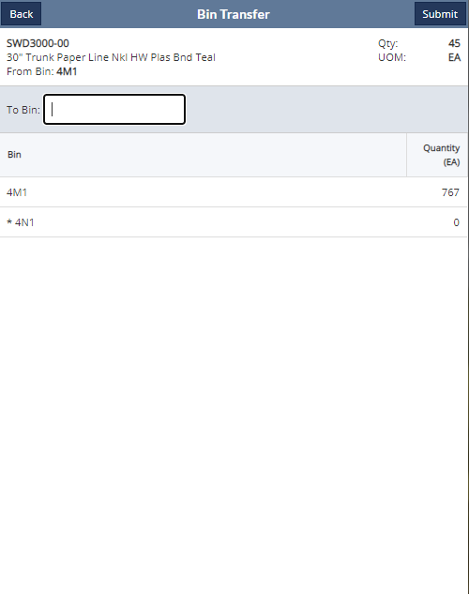
Inventory: Bin Transfers (RF-Smart) Item
Inbound Shipment Details-Inbound Shipment record

Slide 42
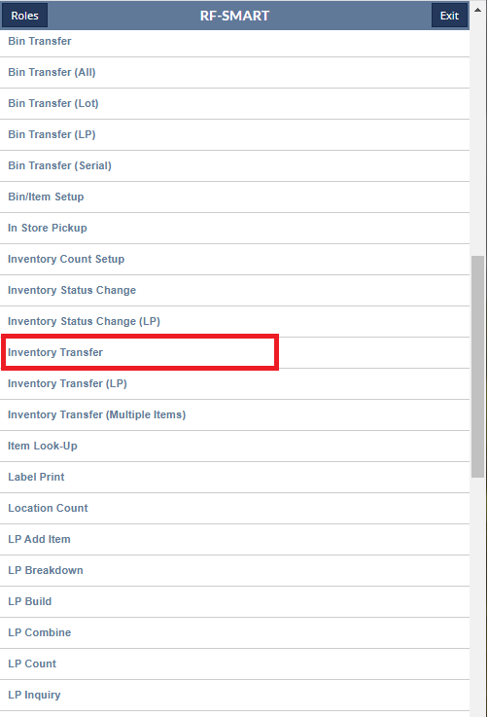
Inventory: Inventory Transfers (RF-Smart)
Inbound Shipment Details-Inbound Shipment record

Slide 43
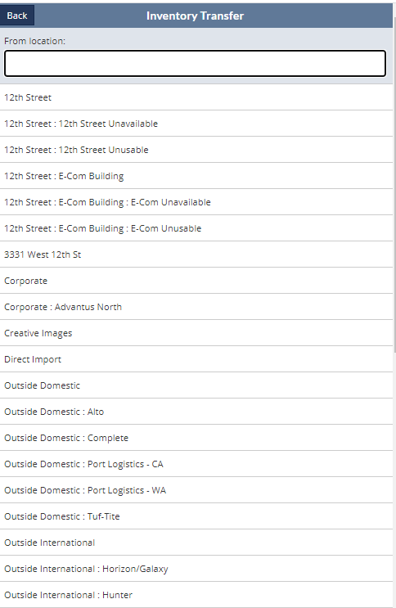
Inventory: Inventory Transfers (RF-Smart)
Inbound Shipment Details-Inbound Shipment record

Slide 44
Inventory: Inventory Transfers (RF-Smart)
Inbound Shipment Details-Inbound Shipment record

Slide 45
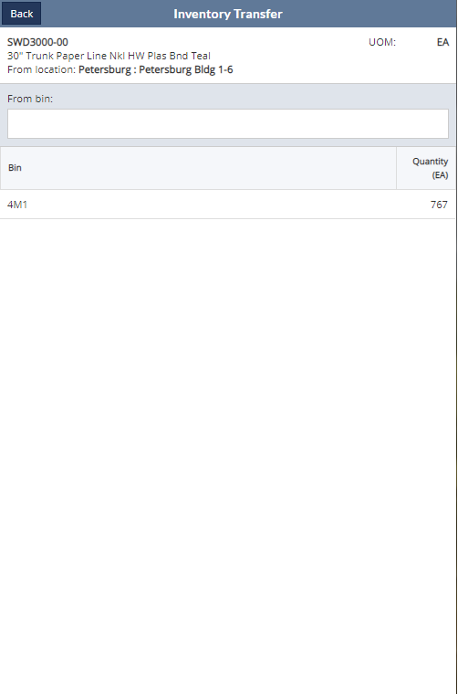
Inventory: Inventory Transfers (RF-Smart)
Inbound Shipment Details-Inbound Shipment record

Slide 46
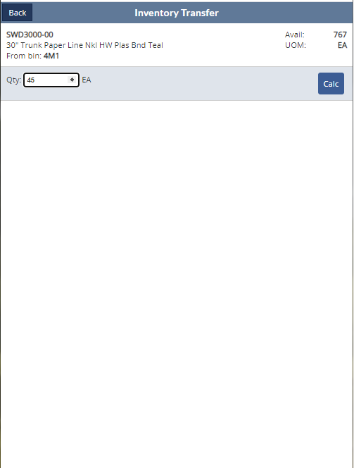
Inventory: Inventory Transfers (RF-Smart)
Inbound Shipment Details-Inbound Shipment record

Slide 47
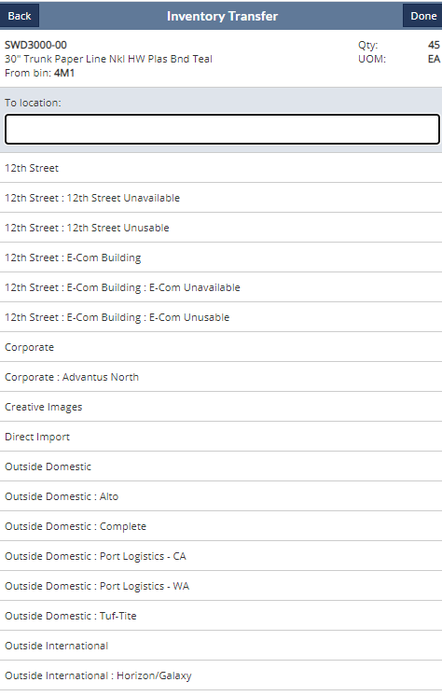
Inventory: Inventory Transfers (RF-Smart)
Inbound Shipment Details-Inbound Shipment record

Slide 48
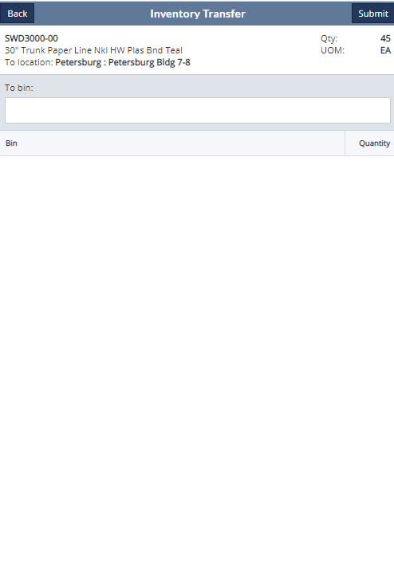
Inventory: Inventory Transfers (RF-Smart)
Inbound Shipment Details-Inbound Shipment record

Slide 49
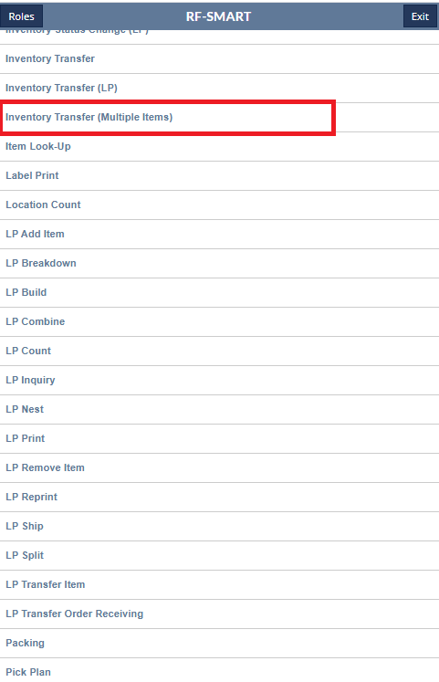
Inventory: Inventory Transfers (RF-Smart) Multiple Items
Inbound Shipment Details-Inbound Shipment record

Slide 50
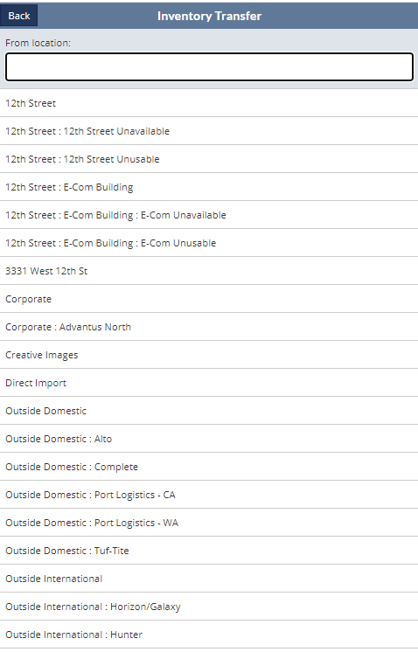
Inventory: Inventory Transfers (RF-Smart)
Inbound Shipment Details-Inbound Shipment record

Slide 51
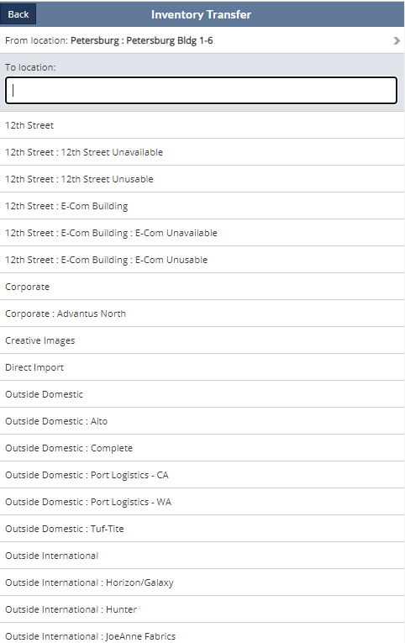
Inventory: Inventory Transfers (RF-Smart) Multiple Items
Inbound Shipment Details-Inbound Shipment record

Slide 52
Inventory: Inventory Transfers (RF-Smart) Multiple Items
Inbound Shipment Details-Inbound Shipment record

Slide 53
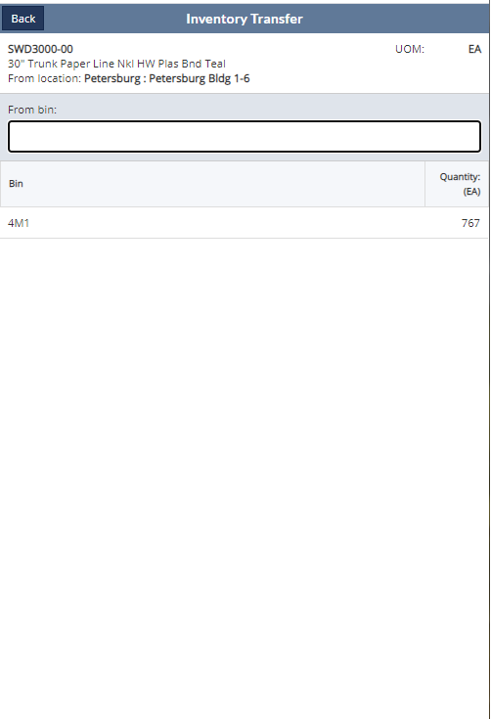
Inventory: Inventory Transfers (RF-Smart) Multiple Items
Inbound Shipment Details-Inbound Shipment record

Slide 54
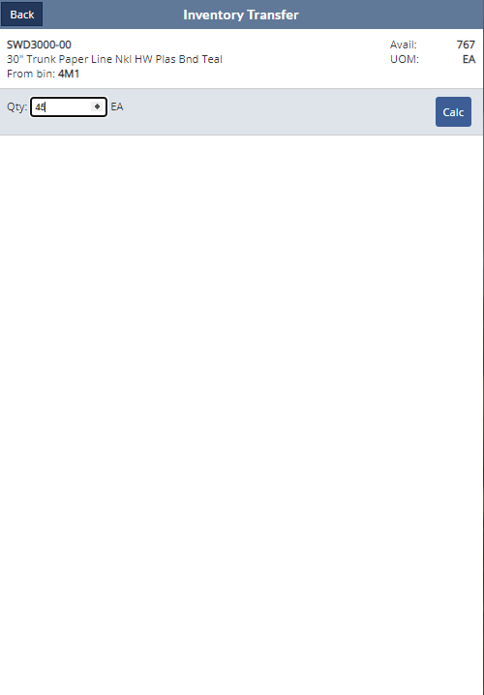
Inventory: Inventory Transfers (RF-Smart) Multiple Items
Inbound Shipment Details-Inbound Shipment record

Slide 55
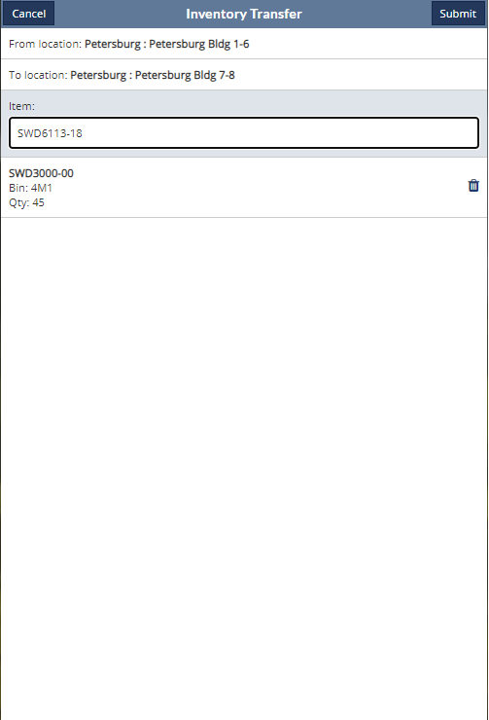
Inventory: Inventory Transfers (RF-Smart) Multiple Items
Inbound Shipment Details-Inbound Shipment record
Repeat for next item

Slide 56
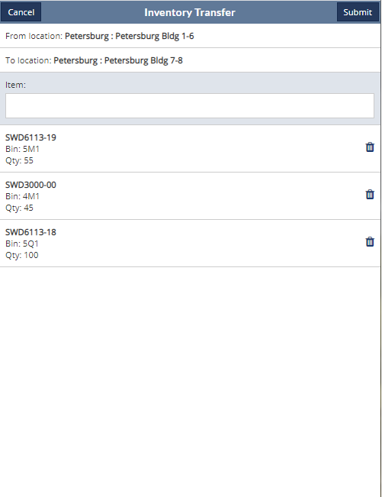
Inventory: Inventory Transfers (RF-Smart) Multiple Items
Inbound Shipment Details-Inbound Shipment record
After all items are added for the location to location transfer, select Submit

Slide 57
Questions?

