Slide 1
Inventory Allocation/Commitment
March 9, 2021

Slide 2
Agenda
Macola vs. NetSuite
Commit Inventory
Reservations
Order Fields
Exceptions

Slide 3
Macola vs. NetSuite

Slide 4
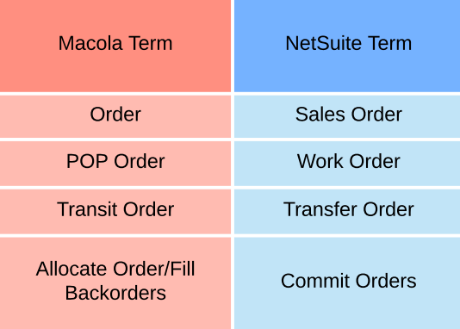
Macola vs. NetSuite: Terminology
Important transaction terms related to allocations/commitment
Allocate/Commit
NetSuite uses these terms
interchangeably
The specific process used/run
does have a different name
Fill Backorders is a custom program. It is
not available in NetSuite
Order: Umbrella terms for all order types
Full job aid: http://wiki.advantus.com/wp-content/uploads/2021/02/Job-Aids-Terminology_-Fields-Labels.pdf

Slide 5
Macola vs. NetSuite: Available/Net Available Calculations
Macola calculation
NetSuite calculation
“Backordered” is different between systems
Macola: since the calculation for Available includes all orders regardless of allocation status, the backordered quantity is an addition to calculate the Net Qty.
NetSuite: since the calculation for Available only includes allocated quantities, the backordered quantity is a subtraction to calculate the Net Available.
The Available Qty in Macola is now the Net Available
The Net Qty in Macola is now the Available Qty
Qty on Hand | - Qty Ordered | = Available | + Backordered | = Net Qty
100 | 80 | 20 | 10 | 30
Qty on Hand | - Allocated (Committed) | = Available | - Unallocated (Backordered) | = Net Available
100 | 70 | 30 | 10 | 20

Slide 6
Macola vs. NetSuite
Questions?

Slide 7
Commit Inventory

Slide 8
Commit Inventory: Current Process
Due to most of the inventory being in Macola, we currently have a setting selected in NetSuite to allocate the inventory after the transaction is saved.
Once the inventory is received or transferred from Macola, the allocation is immediate
If there is more than one order for a given item, it’s first come, first serve.
If sales orders and work orders are backordered for the same item, once the inventory is received, work orders will allocate first.
Example: A work order for MRC9133-BK-CUSTOM and a sales order MRC9133-BK (component/member of MRC9133-BK-CUSTOM)

Slide 9
Commit Inventory: New Process
Commit Orders: Manual
Macola version: Fill Backorders ad hoc
Commit Orders: Schedules
Macola version: Fill Backorders run by assigned C/S rep every hour
Reallocate Items
Macola version: Agility screen Mass Order Lines Update

Slide 10
Commit Inventory: Commit Orders Manually
Transactions -> Inventory -> Commit Orders
Native suitelet
Expected to be used occasionally
No orders will appear on this screen in production right now since commitment is done instantly

Slide 11
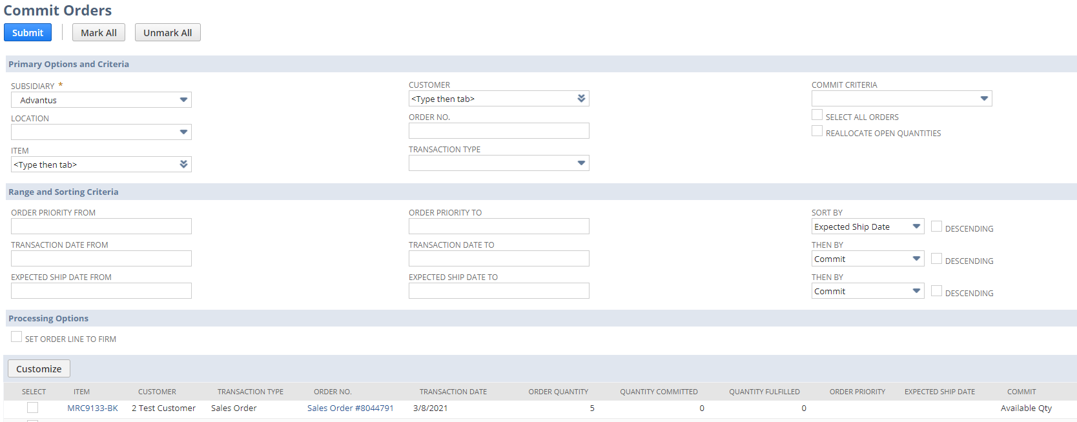
Commit Inventory: Commit Orders Manually

Slide 12
Commit Inventory: Commit Orders via Schedules
Transactions -> Inventory -> Commit Orders -> Schedule
Majority of the orders will be allocated using schedules
Based on saved searches
We currently only have schedules for sales orders
Current schedules are set up to run every 15 minutes

Slide 13
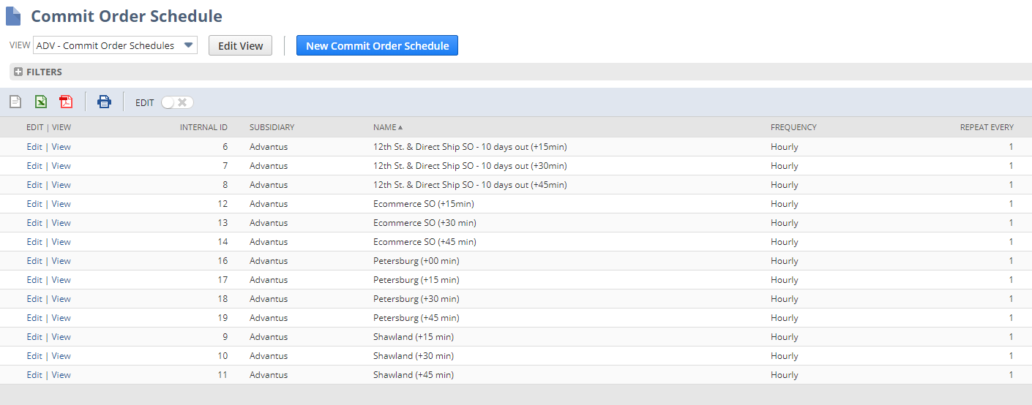
Commit Inventory: Commit Orders via Schedules

Slide 14
Commit Inventory: Reallocate Items
Transactions -> Inventory -> Reallocate Items
Native suitelet
Choose Item and Location
Once selected, adjustments can be done as needed
Once a work order has been released and inventory committed, the quantity cannot be reallocated
Available for use now
Be aware that since we have the setting enabled to allocate immediate, if you are trying to unallocate but the quantity is still available and there are not other orders for the items, the inventory will re-commit.
This will not be an issue once we fully transition to the new process

Slide 15
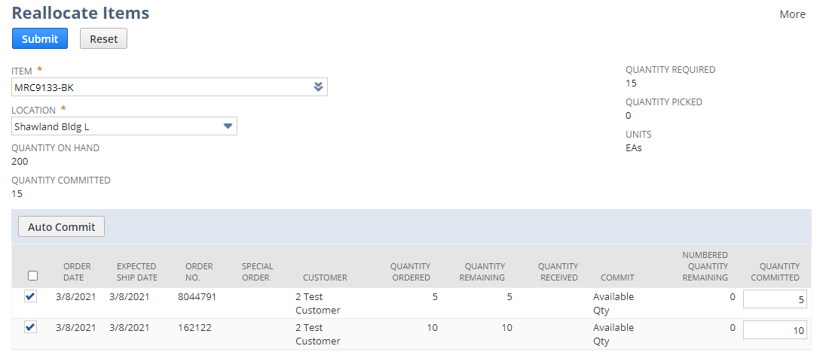
Commit Inventory: Reallocate Items

Slide 16
Commit Inventory: Transition Plan
Why?
Although on the surface it may seem as though we should let the system allocate as soon as inventory is available, we have too many customer requirements and customer-specific processes to allow this.
Switching to NetSuite native processes will allow us to allocate based on the needs of our customer and process
Over the coming weeks, the following actions will be done prior to the switch
Current commit schedules reviewed/modified
Commit schedules will be built for work orders, transfer orders and reservations
Process-specific training with impacted departments

Slide 17
Commit Inventory
For more specifics regarding the filters and this process, there is a process-specific training available on the wiki
Committing Orders
http://wiki.advantus.com/welcome/netsuite-training-sessions

Slide 18
Commit Inventory
Questions?

Slide 19
Reservations

Slide 20
Reservations
In NetSuite, specific Sales Order form is used
The reservation is for the parent customer so that Order Priority is 1 which allows the system to reserve the inventory
Parent customers are the only customers with a set priority at this time
No shipping information on Reservations form
If quantity is on hand, reservation will commit the quantity
If not, reservation will commit quantity once available
Inventory is allocated to the parent customer’s sales order
Based on the reason for the reservation, the reallocation can be done several ways

Slide 21
Reservations
Questions?

Slide 22
Order Fields

Slide 23
Order Fields: Status
The orders must be in the in the following statuses in order to allocation/commit inventory
Sales Orders = Pending Fulfillment
Transfer Orders = Pending Fulfillment
Work Orders = Released

Slide 24
Order Fields: Sales Order Status Icon
Backordered line:
Committed and not fulfilled line:
No icon for fulfilled lines

Slide 25
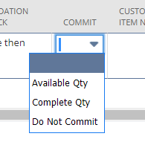
Order Fields: Commit
Field is available on Sales Order and Transfer Order
Drop down field with options based on the need
Available Qty: will allocate as much as available
Default
Complete Qty: will not allocate to the order line unless it can commit the entire quantity
Example: If there is 100 available and we receive an order for 200, the entire 200 will be backordered
Do Not Commit: no qty will allocate

Slide 26
Order Fields: Closed
Field is available on Sales Order and Transfer Order
Checkbox on the far right of the line
If at least one line is closed and the rest are fulfilled or received, the status of the sales order or transfer order will be Closed when it is fully processed

Slide 27
Order Fields
Questions?

Slide 28
Exceptions

Slide 29
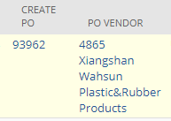
Exceptions: Create WO and Create PO
Used for Direct Import and Custom Dec sales orders
These types of sales order have their own sales order forms
Not visible/usable on other sales order forms
On sales orders, if the Create WO or Create PO checkboxes are checked (edit mode) or there are linked transactions in these fields (view mode), the available quantity on hand will not allocate to these sales orders
A sales order cannot have both Create WO
and Create PO fields populated.
The quantity for the sales order is from the linked transaction

Slide 30
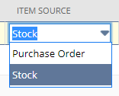
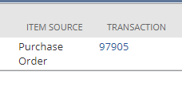
Exceptions: Item Source
On work orders, the item source must be Stock in order for the inventory to allocate to a work order.
If the selection is Purchase Order, the work order will be a linked purchase order

Slide 31
Exceptions: Reallocate Open Quantities and Firmed
Reallocate Open Quantities
NetSuite allows the users the option to reallocate inventory that has not be fulfilled
We will not be using this feature
Firmed
In order to prevent inventory from being reallocated, the Firmed checkbox allows the user to lock the inventory to a particular transaction or transaction line
Since we will not be reallocating open quantities, the Firmed checkbox is not as useful for sales orders and transfer orders
Checkbox is being used for work orders

Slide 32
Exceptions
Questions?

