Slide 1

Inventory Allocation/Commitment
April 22, 2021

Slide 2
Agenda
Why?
Types of orders
Commit Orders: Schedules
Commit Orders: Manual
Reallocate Items
Exceptions

Slide 3
Why?
Although on the surface it may seem as though we should let the system allocate as soon as inventory is available, we have too many customer requirements and customer-specific processes to allow this.
Switching to NetSuite native processes will allow us to allocate based on the needs of our customer and process

Slide 4
Types of Orders

Slide 5
Types of Orders
Sales Orders
Work Orders
Transfer Orders
Order: Umbrella terms for all order types

Slide 6
Commit Orders: Schedules

Slide 7
Commit Orders: Schedules
Transactions -> Order Management -> Commit Orders -> Schedule
Majority of the orders will be allocated using schedules
Based on saved searches
Current schedules are set up to run every 15 minutes
  4 schedules for each group
List view includes the 3 order types
List shows last time executed and next time

Slide 8
Commit Orders: Schedules
Sales Orders
  Will allocate if:
    Commit field is not set to Do No Commit
    Ship Via is not Billing only
    Status is Partially Fulfilled OR Pending Fulfillment
    Order Release Status is Hold
    Quantity Backordered doesn’t equal zero
    Within a set number of days in the future
      12th St & Direct Ship: 10 days
      Petersburg: 30 days
      Shawland: 5 days
  Reservations are included

Slide 9
Commit Orders: Schedules
Transfer Orders
  Will allocate if:
    Commit field is not set to Do No Commit
    Status is Partially Fulfilled OR Pending Fulfillment
    Quantity Backordered doesn’t equal zero
Work Orders
  Will allocate if:
    Commit field is not set to Do No Commit
    Status is Released
    Quantity Backordered doesn’t equal zero
  Order Line will be set to Firmed

Slide 10
Commit Orders: Schedules
Status page
  Transactions -> Order Management -> Commit Orders -> Status
  Allows the user to see
    Status of each schedule
    Orders allocated (select Complete)
    Errors

Slide 11
Commit Orders: Manually

Slide 12
Commit Inventory: Commit Orders Manually
Transactions -> Order Management -> Commit Orders
Expected to be used occasionally
Important filters
  Subsidiary
    Should default to Advantus until we allow access to other subsidiaries
  Transaction Type
    Choose between sales order, transfer order or work order
Only shows orders that can be allocated
Can’t allocate partial quantities

Slide 13
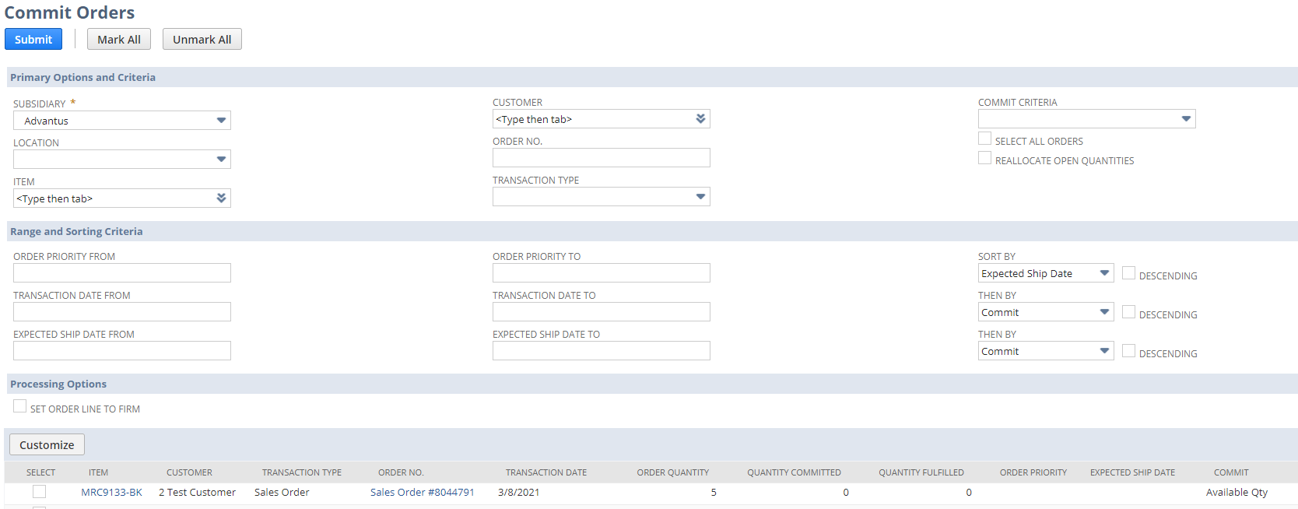
Commit Inventory: Commit Orders Manually

Slide 14
Reallocate Items

Slide 15
Commit Inventory: Reallocate Items
Transactions -> Order Management -> Reallocate Items
Choose Item and Location
Once selected, adjustments can be done as needed
Once a work order has been released and inventory committed, the quantity cannot be reallocated (firmed)
Can allocate partial quantities

Slide 16
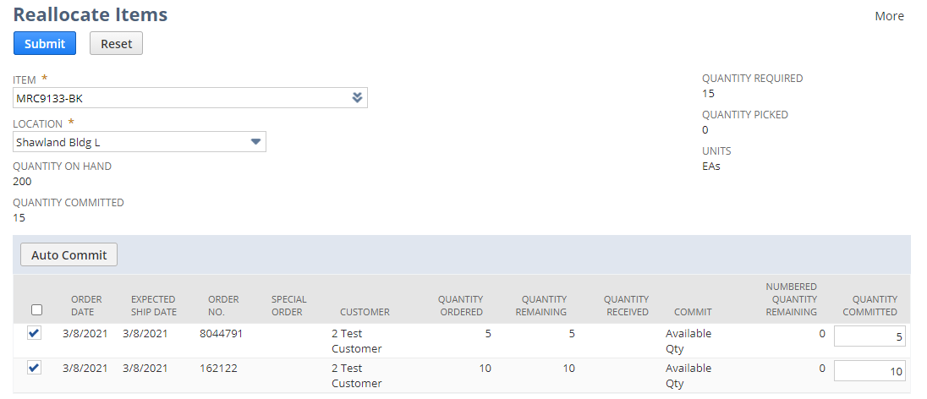
Commit Inventory: Reallocate Items

Slide 17
Exceptions

Slide 18
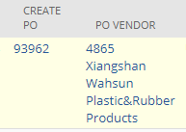

Exceptions: Create WO and Create PO
Used for Direct Import and Custom Dec sales orders
  These types of sales order have their own sales order forms
Not visible/usable on other sales order forms
On sales orders, if the Create WO or Create PO checkboxes are checked (edit mode) or there are linked transactions in these fields (view mode), the available quantity on hand will not allocate to these sales orders
  A sales order cannot have both Create WO
  and Create PO fields populated.
The quantity for the sales order is from the linked transaction

Slide 19
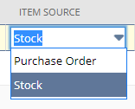
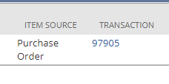
Exceptions: Item Source
  On work orders, the item source must be Stock in order for the inventory to allocate to a work order.
    If the selection is Purchase Order, the work order will be a linked purchase order

Slide 20
Questions?

