Slide 1

Direct Import Process in NetSuite
January 4, 2021

Slide 2
Shipment Methods
Direct Import
  Shipment from an overseas supplier direct to our customer overseas
  Customer pays the freight and duty
  Unlike Macola, we have only one Location for Direct Import orders
Direct Delivery
  Shipment from an overseas supplier direct to our customer’s door or agreed upon location
  Advantus pays the freight and duty

Slide 3
Shared Services/Department Responsibilities
Marketing/Graphics: pricing, sales presentations, customer item detail records, packaging, etc.
Product & Sourcing: item setup, sourcing, project management, etc.
Compliance: Review/approval of customer documents, product testing, customer fines tracking, etc.
Sales: Customer management, presenting new items, etc.
IT: EDI activity, customer item detail records, document creation, etc.
SCM: Sales Order, Purchase Order and Work Order creation and management
Accounting: Vendor bill processing, sending customer documents, collection activity, etc.

Slide 4
Overview of Order Process
Customer issues purchase order
Advantus enters sales order
NetSuite automatically creates purchase orders or work orders
  Linking the transactions
Purchase orders are sent to the supplier
Supplier produces product and schedules the shipment
Advantus sends documents to the customer or assigned agent
Advantus pays the vendor for the purchase orders
Advantus requests payment from the customer
Full flowchart: http://wiki.advantus.com/cross-functional-processes/direct-import-process-flowchart
Every customer’s process is different

Slide 5
Important Terms
Cargo Ready Date (CRD)
  Date we expect to have the product ready for pickup/delivery
  Direct Delivery shipments: date the shipment is delivered to our customer’s door or picked up from agreed up location
    Port of Entry (POE)
      A specific US port may be used for direct delivery shipments as the point of handoff
  NetSuite field: Planned Ship Date
Forwarder’s Cargo Receipt (FCR)
  Since Advantus does not own the goods while on the water, the forwarder cannot provide us with a bill of lading. Instead, they give us an FCR for proof we delivered the product to the port.
  This does not apply to direct delivery shipments
  This document is used to present to the customer or customer’s bank in order to receive payment

Slide 6

Sales Order Quantities
The status of individual items can still be found on the sales order lines
Lines with linked purchase orders will not commit/allocate since it’s using the purchase order quantity to fulfill the sales order.
Lines with linked work orders will commit/allocate once the work order is built.
Quantity descriptions
  Picked = documents sent or uploaded to portal
  Packed = documents confirmed
  Fulfilled = cargo ready date has arrived and documents are complete
  Invoiced = customer has been billed

Slide 7
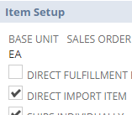
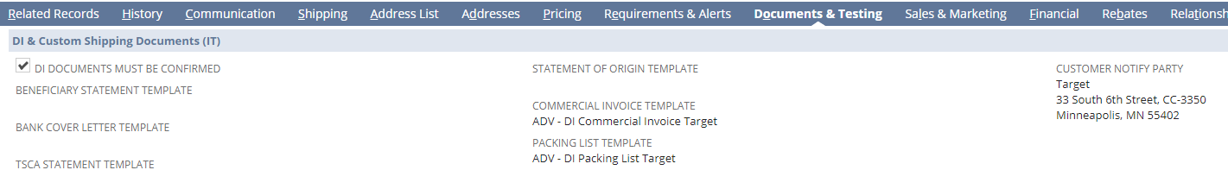
Setup
Item
  If an item is ONLY shipped via Direct Import (DI), the Direct Import Item checkbox on the item record is checked.
  Note: we can still ship an item via DI even if this checkbox is not checked. The intention of the checkbox is to streamline the process and easily report on DI-only items.
Customer Record
  Documents & Testing subtab
    Similar to the other shipments, templates of the documents are saved for reference
    Other information is saved on this subtab that is unique to that customer

Slide 8
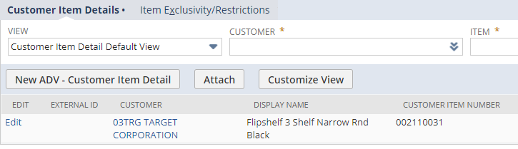
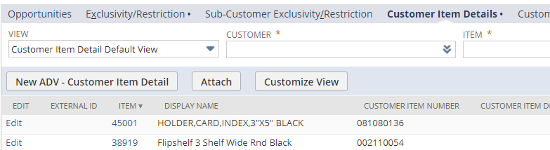
Setup
Customer Item Detail (CID)
  Custom record used to store all the customer-specific item information
  Used for DI and non-DI shipments
  These records can be accessed from the item record or the customer record
    Sales & Marketing subtab on both records
  IT owns the CID records for EDI customers and Marketing owns them for non-EDI customers

Slide 9
NetSuite Demo
Sales Order
Purchase Order
Item Fulfillment
Customer Item Details

Slide 10
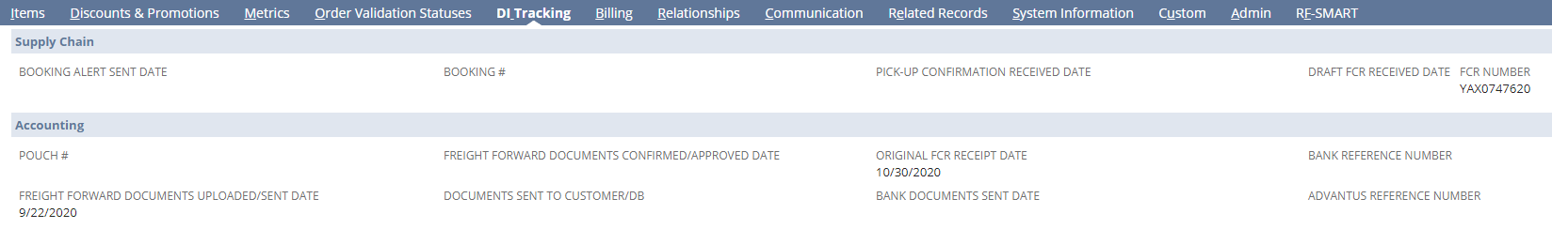
Tracking
The activity is tracked on the sales order using custom fields. All of these fields can be found on the DI Tracking subtab.
Although the fields can be found on the sales order, a couple of saved searches are used a majority of the time to view and update the orders.

Slide 11
Tracking Saved Searches
There are two main searches used to update DI sales orders.
  Direct Import Tracking, Open
    Used by Supply Chain and Accounting to update sales orders from the creation of the sales order to when the sales order is billed.
  Direct Import Tracking, Billed not Presented
    Used by Accounting to update sales orders after the sales order is billed to when the documents are presented for payment.

Slide 12
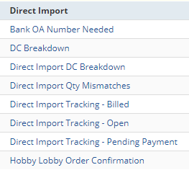
Misc Saved Searches
There are several additional saved searches used for various purposes throughout the process
  Saved Searches in Quick Links
  There is also a variety of saved searches used as reminders to catch possible issues

Slide 13
Questions?

