Slide 1

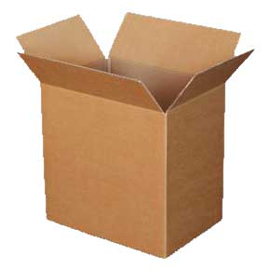
“Corrugated Cartons 101”

Slide 2
What this document will help you do
Understand what corrugated cartons are made of and how their characteristics are measured
Identify the basic types of corrugated cartons and types of corrugated carton components
Determine what type of carton to specify based on the size and weight of your product
Understand the options available to you for printing on cartons
Accurately measure the dimensions of a carton based on corrugated carton industry standards

Slide 3
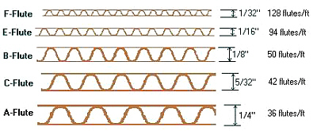
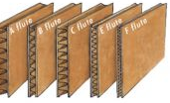
Basics of Corrugated
Understanding the fundamentals of corrugated cartons will allow you to use the right type of box to minimize the cost associated with losing products to damage. (Fact: “Corrugate” is a verb and does not mean a corrugated carton. You can’t say “I need a larger corrugate.” You can say, “I need a larger corrugated carton.”)
Corrugated material is comprised of two main components: (1) a liner; and (2) a wavy, fluted material. The fluted material is inserted between two liners and gives the material its strength, similar to the way arches provide strength to a bridge. The liners and fluted material are then glued, pressed, cut and scored on a machine called a corrugator.
The most common flute types are A, B, C and E (F is uncommon)
  C is the most common and it represents 80% of all corrugated cartons

Slide 4
Corrugated Materials
Although most corrugated cartons are made from kraft paper and are brown in color, there are other options. Included below are options for creating color cartons either by printing directly on cartons or by attaching a four color printed sheet to cartons. Once you know the quantity and quality of cartons that you need, you can determine the best choice of material from the list below:
  Kraft — Naturally brown in color. The most commonly used and least expensive liner.
    What we use when we are doing commercial items with just a barcode label on the outside.
    Also used for master cartons that do not need to be displayed in a retail setting.
  #3 White — Mottled white, with underlying kraft showing through. Provides a cleaner look and better printability than kraft.
    Cheapest grade of white box.
  #1 White — Bleached bright white. Offers very good printability, but easily soils during transit.
    More expensive than #3 White but cheaper than Premium Grade.
  Premium Grade — Surface has a bright white clay coating, minimizing porosity(soaking in of ink) so printing inks sit up on the surface.
    Gives excellent printability as colors are more vibrant.
    Because ink sits on surface of clay, ink rub can be a problem.
  All the above grades can be printed directly on the liner. This is done before the liner goes into the corrugater machine. The printing process for printing on liner is called Flexographic Printing and involves a process similar to using a rubber stamp on paper. It can achieve very good quality but the best printing quality comes from offset lithography (a/k/a normal offset printing—”Litho printed”—see below).
  Litho-printed outer liner, meaning liner is offset printed and integrated into the construction of the box. The liner is the offset printed sheet.
  Litho-printed labels adhered onto corrugated cartons after the box is made.

Slide 5
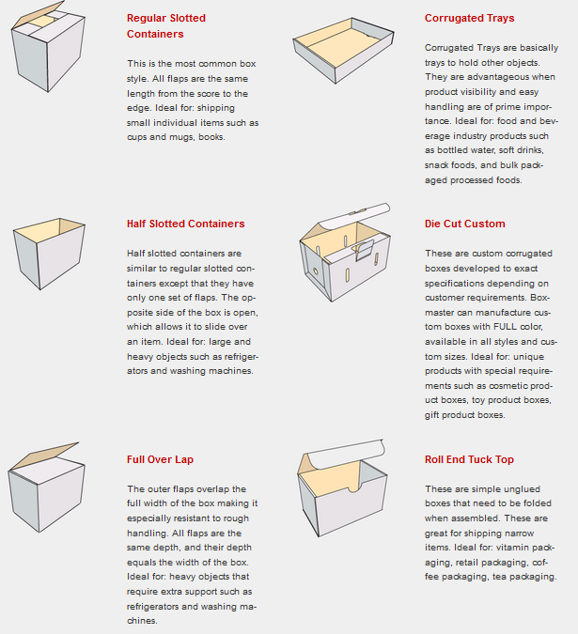
Basic Styles of Corrugated Cartons

Slide 6
Most Common Advantus Cartons
Most cartons Advantus purchases domestically and overseas are RSC (Regular Slotted Carton) and are made of kraft liners.
In an RSC carton, all flaps are the same depth, and the two outer flaps (normally the lengthwise longer flaps) are one-half the container’s width, so that they meet at the center of the box when folded and are usually taped along that meeting edge.
An RSC is the most economical carton because it uses the corrugated material in the most efficient manner.
When designing a corrugated carton, remember that a rectangular shape carton is less expensive for the same given volume than a square shape carton because it uses the corrugated material more efficiently.
An FOL, Full Overlap carton, is used when the contents are very heavy or you need 100% certainty that someone cutting a box open will not cut the contents. It is much more expensive than an RSC because it uses corrugated material much less efficiently.
Die Cut Custom cartons are normally designed to be used as display cartons at retail. Using this type of carton allows the shipping carton to be dual purposed as a store display. Most Die Cut Custom cartons are packed inside an outer protective carton.

Slide 7
Determining What Board Strength You Need
Board strength involves all the factors, other than carton type, that define how strong the carton should be. There are a number of questions you must have answers to before you can accurately assess how strong a particular carton should be including:
  The nature of the products being packaged.
  The total weight of the contents of the carton.
  The size of the carton (see Measuring a Carton below).
  How the carton will be stacked, stored, and transported.
A corrugated carton expert is best suited to determine the exact specifications of the carton you need. This document can get you very close to the ideal carton type and specification. Every corrugated carton supplier has an expert (engineer) at their factory to help with this task.
If you are designing or ordering cartons you should spend time with the expert to learn how to effectively design and buy cartons.

Slide 8
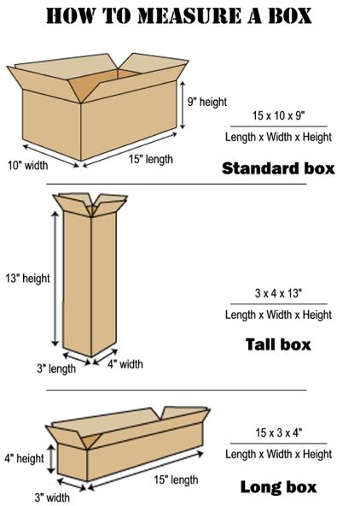
Measuring a Carton
Dimensions of a corrugated carton are always inside dimensions. Keep this in mind when ordering from, or being quoted by, a corrugated manufacturer.
  This has nothing to do with entering product dimensions in Macola or any other information sheet. This solely applies to communicating with corrugated manufacturers and reading the quotations they provide back.
Dimensions are always described in this order, Length (L), Width (W), and then Height (H) (sometimes Height is called Depth or Inner Height).
The longest dimension of the base of the carton is called its Length. The only time the Length will not be the largest overall dimension is if you have a “Tall box” (see picture below).
The Width (W) is the dimension that intersects the Length on the plane of the base.
The Height (H) is the vertical dimension when the opening is facing upwards.

Slide 9
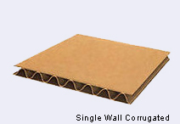
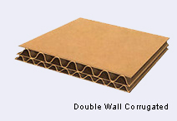
Board Styles of Corrugated Cartons
Single Wall Corrugated— A corrugated medium (flutes) with a linerboard facing adhered to both sides. It is also referred to as “Double Face”. This popular and versatile 3-ply construction is converted into a wide variety of containers and packaging components. Virtually all of our corrugated cartons are Single Wall. Due to the choices in liners and flutes, you can achieve an amazingly wide range of strengths using this type of carton.
Double Wall Corrugated—Two corrugated mediums (flutes) with a linerboard facing adhered between them and to both sides. This 5-ply construction is most applicable for packing extremely heavy items where high rigidity and protection is required. It is made up of B and C Flutes. Double Wall cartons feature extra padding and strength and are great for stacking heavy items. We use this type of carton for packing some of our heavier industrial items.

Slide 10
Measurements of Carton Strength
Carton strength is measured in two different ways.
  Mullen Test—The Mullen Test measures resistance to rupture in pounds per square inch (psi). This was how corrugated was measured up until about 10 years ago. People would say, “I need a 250 lb. test carton”. However, this test was designed when most freight was shipped by rail. In today’s environment of package and truck shipping, a better indicator of strength was needed; however, the Mullen Test is still often referred to.
  Edge Crush Test—”ECT” or “Edge Crush” as it is commonly known was developed to be a more realistic indicator of box strength and performance. The tests are related somewhat but their scales are totally different. The ECT measures the ability of combined board to sustain a top-to-bottom load. The strength is directly related to the compression strength of both the liners and medium.
Often, our customers will have specifications for the ECT of cartons they purchase based on the size of a carton and the weight of the carton’s contents.
Standard industry rules of thumb for single wall cartons require the following numbers for either test.
Carton Contents Maximum Weight (Lbs.) | Mullen Test (Lbs. per square inch) | ECT (Lbs. per inch width)
20 | 125 | 23
35 | 150 | 26
50 | 175 | 29
65 | 200 | 32
80 | 250 | 40
95 | 275 | 44
120 | 350 | 55

Slide 11
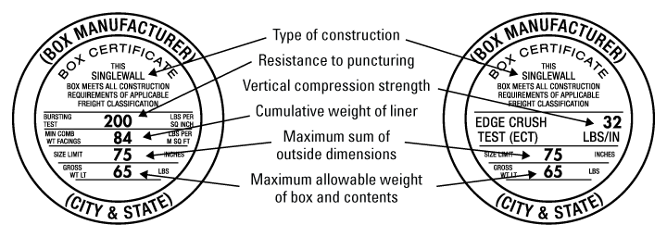
Box Manufacturer Certificates
In the past, all corrugated cartons needed BMC’s, Box Manufacturer Certificates, to legally be shipped in the USA. This requirement is almost totally gone now.
UPS and FedEx don’t even put BMC’s on their cartons.
Some of our customers require cartons shipped to them to be certified. When a box has a certificate stamp on it any misrepresentation is considered fraud and violators can be prosecuted.
Foreign suppliers are able to get certificates put on cartons from their corrugated carton suppliers.
The certificate format is slightly different for the Mullen and the ECT. See examples below. (Mullen is on left, ECT is on right)
Where it says (BOX MANUFACTURER) you would normally see the name of the actual corrugated carton manufacturer. Because of corrugated cartons’ relatively low cost and widespread availability, it is rare to see a company in the USA purchase cartons that are manufactured more than 100 miles from where they are used. This is an excellent way to see where goods are actually manufactured versus where they are shipped from.

Slide 12
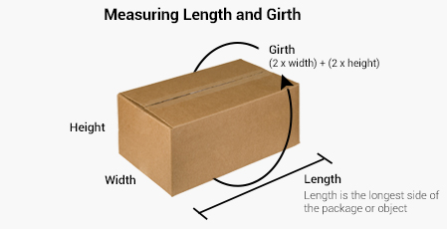
Purchasing Basics for Corrugated Cartons
The larger the quantity of cartons you purchase the lower the per unit price will be. Short runs are quantities below 1000 and are very expensive.
RSC cartons do not require a die. A die is a type of mold that cuts out specialty shape cartons. RSC cartons are made by the machine operator simply setting the L, W & H of the carton on the corrugated carton assembly machine.
Die cut cartons – Die charge should be paid for only once. When you place repeat orders you do not pay the die charge again. When getting a quote for die cut carton make sure the die cost is separated out of the per piece cost. By doing this, you will avoid paying for the die every time you order.
When designing a large corrugated carton, attention should be paid to the oversize rules of FedEx and UPS. No carton should be designed that is over 130” in Length plus Girth.
  Length is defined (only for UPS and FedEx) as the largest dimension of the carton.
  Girth is defined as two times the sum of the other two dimensions of the carton.
  Example: If a carton is 36”x18”x12” its Length is 36 (largest package dimension). Its Girth is 2 X (18 + 12) = 60.
  The Length plus Girth equals a total of 96.

Slide 13
Purchasing Basics for Corrugated Cartons Continued
Corrugated usually arrives bundled in 25’s, 50’s or 100’s depending on the size of the carton.
Advantus tries to name corrugated cartons with a name that has some meaning and usually starts with the 3 letter prefix “COR”.
Cartons are usually sealed with either clear plastic tape or kraft colored gummed tape.
Cartons typically have the box manufacturer certificates and our item numbers printed on the bottom in black ink at no extra cost. Often, warnings can be printed on cartons at no charge such as: “DO NOT USE A KNIFE TO OPEN” which is on all Floating Luxuries cartons. Usually, there is an initial printing plate one time cost (plate should be quoted separately so that future orders do not have to pay the plate charge again).

Slide 14
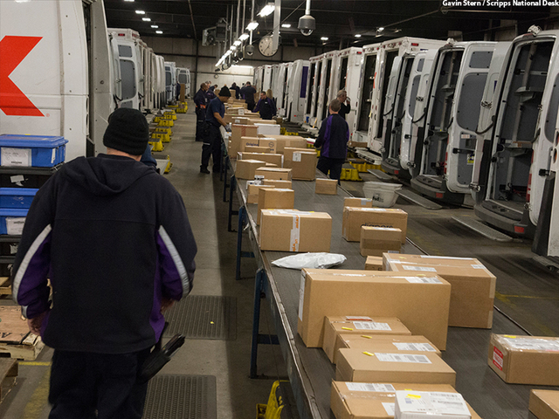
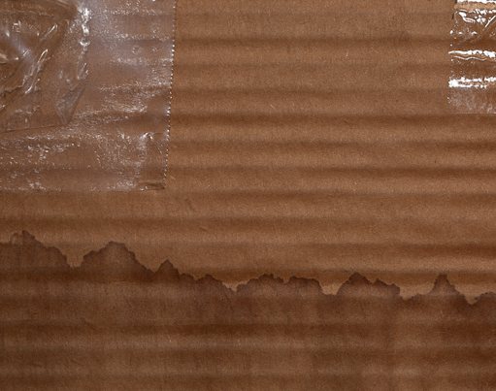
Properties of Corrugated to be Aware of
White boxes don’t fare well on the black rubber belting of a FedEx or UPS handling facility. White boxes also do not fare well in delivery trucks.
Water is a true enemy of corrugated cartons. Wet boxes often fall apart and often lose their structural integrity. This integrity does not come back just because the box is allowed to dry. Wet cartons are ruined cartons.
Corrugated has a shelf life and stock needs to be rotated. Heat, moisture and time eventually ruin a corrugated carton. Corrugated shelf life for maximum strength is usually up to a year. After that time the integrity of the cartons cannot be guaranteed.
FedEx Facility rubber belts Water damaged corrugated

