Slide 1

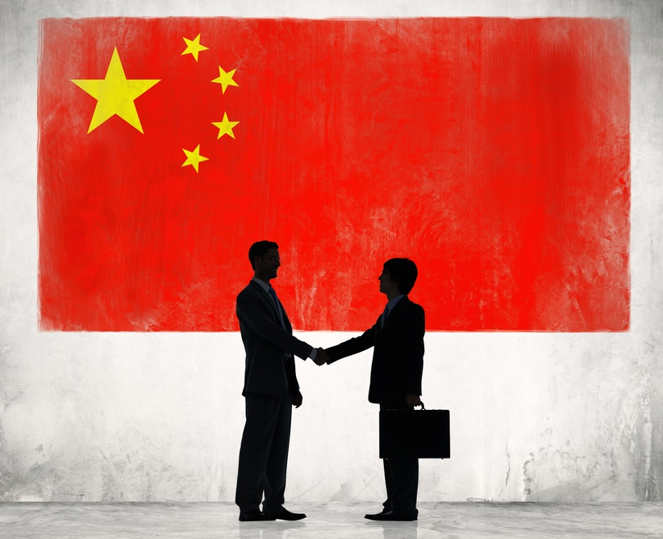
“China 101”

Slide 2
China Overview
China is a country with a proud history and a culture that influences how they do business and interact with the outside world
Understanding some of the cultural differences can make your dealings with Chinese vendors more efficient and productive
China is usually 12 hours ahead of USA East Coast time. So for much of the year it is the exact same time as it is in Jacksonville but just PM instead of AM or vice versa.
China is roughly 20 hours away by air from Jacksonville and almost all the folks we deal with in China have never been to the USA

Slide 3
Cultural Differences
Americans quickly establish business relationships but our relationships are typically more shallow and not long lasting. Throughout the Orient it takes more time to develop relationships and they tend to last a longer time.
  Having a good working relationship on a personal level over a long time period is very valuable with Chinese vendors.
Chinese companies often are surprised when people switch jobs so easily in our companies. Chinese positions tend to last longer.
Chinese believe that personal qualities are much important to business relationships than Americans do. Americans think expertise and knowledge are more important than the way the relationship is handled.

Slide 4
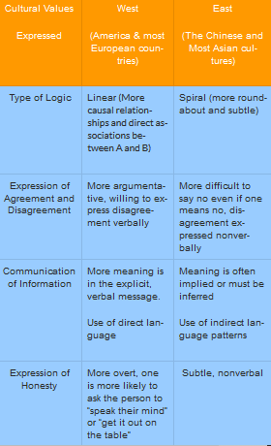
Cultural Differences

Slide 5
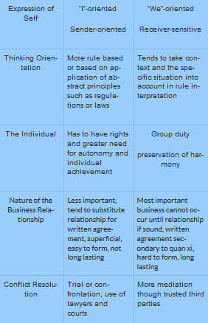
Cultural Differences

Slide 6
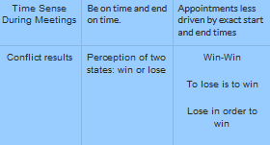
Cultural Differences

Slide 7
Face
In the USA, we don’t like to be embarrassed when we make a mistake, especially in front of our boss
In China the concept of “face”, as in “saving face and giving face” is critical to understand because you need to allow the person you are working with in China to save face or you really can’t work with them going forward. You give face when you show respect and don’t give negative replies directly.
  When there is a problem try not to use techniques that would embarrass them
    Like cc’ing everyone on earth on an email
    CC’ing can be a good tool when you can’t get any reply, but using it all the time ruins the relationship
    Everyone knows why you copy someone’s boss on an email
      Two reasons
        To make sure it will get done
        To inform the boss that the issue is out there
        Try to avoid this if you haven’t had a problem with the person previously

Slide 8
Chinese Names
Remember that in China and most nations in the Orient the first name is the family name. So for example, Mr. Fang Chu Yiu, is known as Mr. Fang (Fang is the family name and comes first). See email tips for how to address folks in China. In general use Mr/Mrs/Ms _______ if they signed their email that way. If they signed their email with their “English name”, then you may address them with that name but put a salutation in the email like Dear Jenny, or Dear Snowy. Do not email with words like Hi— or Hello—. It is simply not proper (not in emails to American either).
Names are much more important in the Orient than they are in the West. In the Orient people spend a great amount of time in not just picking the name, but the characters that are used to spell the name, these characters can show the qualities that are desired in the person, not just how to pronounce the name. Remember that characters in the Orient are not phonetic, they are picture symbols, so how you spell a name has great significance.
Chinese people treat their business cards very seriously and one should never take notes on someone’s business card as it is disrespectful

Slide 9
Chinese Time Horizons and Country
In the USA everything is quick. We invented drive-throughs, 24 hr everything, microwave meals, etc. In the Orient meals, relationships, and other parts of life are given more time.
China has roughly 4x the number of citizens as the USA. It is huge. Every major city has a dialect of its language but all are now uniting under the Mandarin(official) dialect.
Beijing is capital, Shanghai is largest and most Western city in appearance.

Slide 10
Things to Remember
Maintain your composure when replying to folks in China. Try not to add emotion as this is counter-productive.
Don’t use a strong negative statement. Negative answers are considered impolite, so find alternatives. You can say “I’ll think about it” rather than “NO!”.
Similarly if a Chinese counterpart says “Not a big issue” or “The problem is not serious” they usually mean that there are still problems or that the problems are serious. Remember that they are answering in their cultural norm, not yours.
Do not make fun of people, although funny in western culture, it is inappropriate in Chinese culture
Spend a little extra time proof reading your emails and be complete, concise and accurate. With a 12 hour time difference every misunderstanding will end up costing you a full day to get it straightened out.
Chinese people are much more interested in the group “we” than Americans who are all aobut “I”. So don’t say things like “I need you to answer this immediately”. Say something like “Advantus would appreciate the answer as soon as possible from ABC Co.”.
  Chinese people are much more team/group/organization focused than folks in the West.

Slide 11
Things to Remember
When negotiating don’t talk about your needs. As in, “I need $.18 or we can’t do business”. Better to say “$.18 would be a price that would allow Advantus to grow the mutually beneficial relationship for the future” or “$.18 is a price that would be much better for our market and allow us to increase sales of the product”
The reputation of Advantus in China and the Orient has been groomed for 30 years. It is a reputation of trustworthiness, honesty, and integrity. Everything we do should always aim to strengthen that reputation. Warren Buffet said a “reputation takes a lifetime to achieve but five minutes to ruin.” Our reputation benefits us in so many ways, each interaction with a Chinese vendor adds to that reputation if we are doing it right, don’t subtract from the reputation.
Almost all our relationships are based on handshakes, not a massive legal system. We try to settle differences without threatening legal action or taking legal action. It is incredibly expensive and not successful usually.
We never share customer information with our Chinese (or any other vendors). We are the customer to the vendor, they don’t truly care who we sell to and we should never tell them. That is TMI and hurts Advantus.

