Slide 1

Consignment Process
International

Slide 2
Agenda
Overview
Setups
Processes
  General
  Staples Canada

Slide 3
Agenda
Overview
Setups
Processes
  General
  Staples Canada

Slide 4
Overview
Why?
  Required by the customer
Domestic consignment is handled by OP Products
International consignment is handled by Advantus
  Example: Canada
Advantus holds ownership of consignment inventory until product is sold to end user
Artistic acquisition includes consignment inventory with Staples

Slide 5
Agenda
Overview
Setups
Processes
  General
  Staples Canada

Slide 6
Agenda
Overview
Setups
Processes
  General
  Staples Canada

Slide 7
Setups
Some records have differences from our normal process
  Locations
  Customers
  Pricing

Slide 8
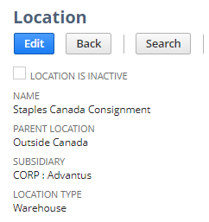
Setups: Locations
A location is setup for every consignment customer
The location holds the inventory until the product is sold to the end user
  Typically reported/relived weekly
We still own the inventory in the consignment location, even though physically it is at our customer’s location(s)
Staples: We have one location for consignment in Canada

Slide 9
Setups: Customers
For every customer, we have at least 2 customer records
  One for the shipping process (receives POs from customer, physically ships to customer)
  One for the sales/billing process (invoices/receives payment from customer)
Staples: since they have retail and contract businesses, we have 4 total customers for consignment in Canada
  01STBDART: fulfills retail orders
  01TBDART: weekly sales for retail
  01STADVART: fulfills contract orders
  01STINVART: weekly sales for contract
 | Retail | Contract
Shipping | 01STBDART | 01STADVART
Sales | 01TBDART | 01STINVART

Slide 10
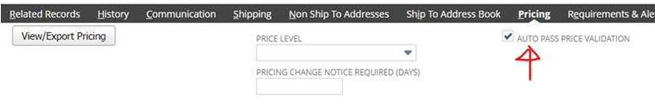
Setups: Pricing
Pricing
  Pricing is set on the both customers
    Shipping customer: zero for all items
      Check the “Auto Pass Price Validation” box on pricing tab of this customer record
    Sales customer: price issued to customer
Staples:
  01STBDART: zero
  01TBDART: Staples price
  01STADVART: zero
  01STINVART: Staples price

Slide 11
Agenda
Overview
Setups
Processes
  General
  Staples Canada

Slide 12
Agenda
Overview
Setups
Processes
  General
  Staples Canada

Slide 13
Agenda
Overview
Setups
Processes
  General
  Staples Canada

Slide 14
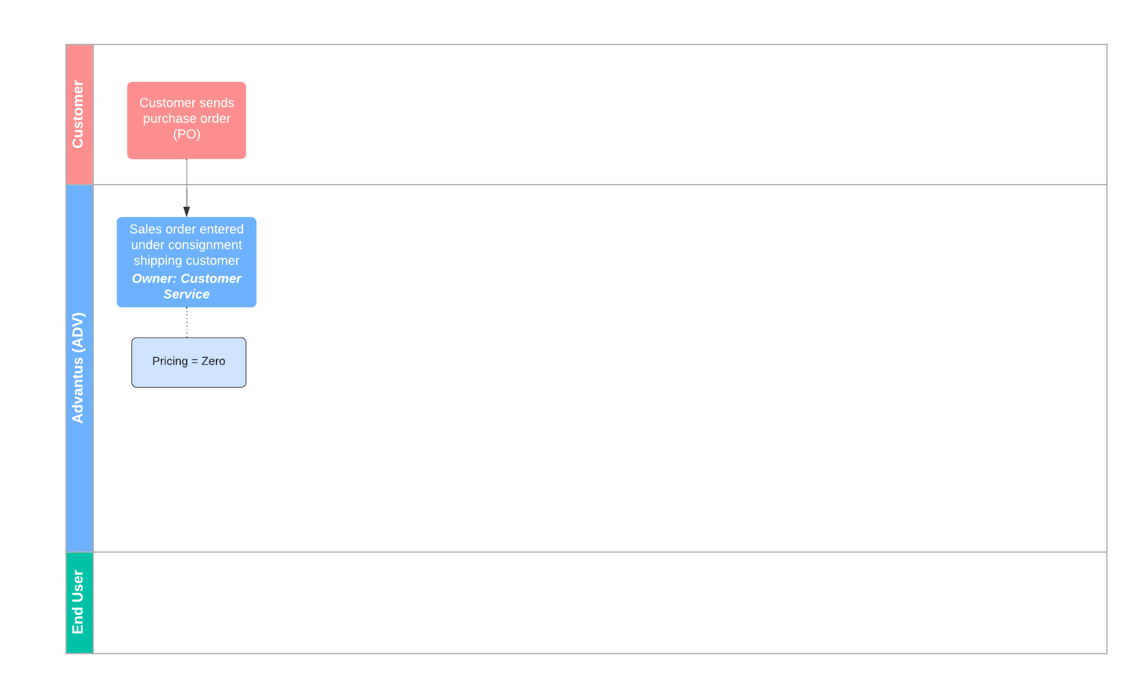
Consignment Process: General

Slide 15
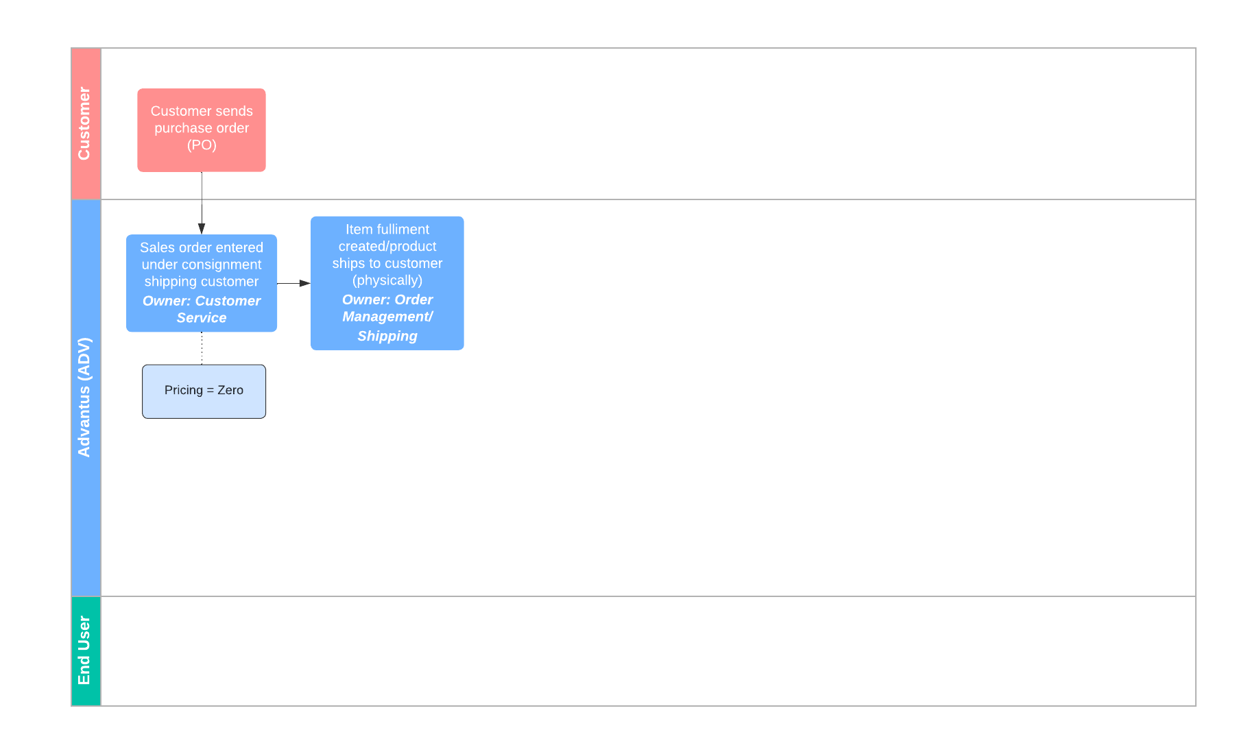
Consignment Process: General

Slide 16
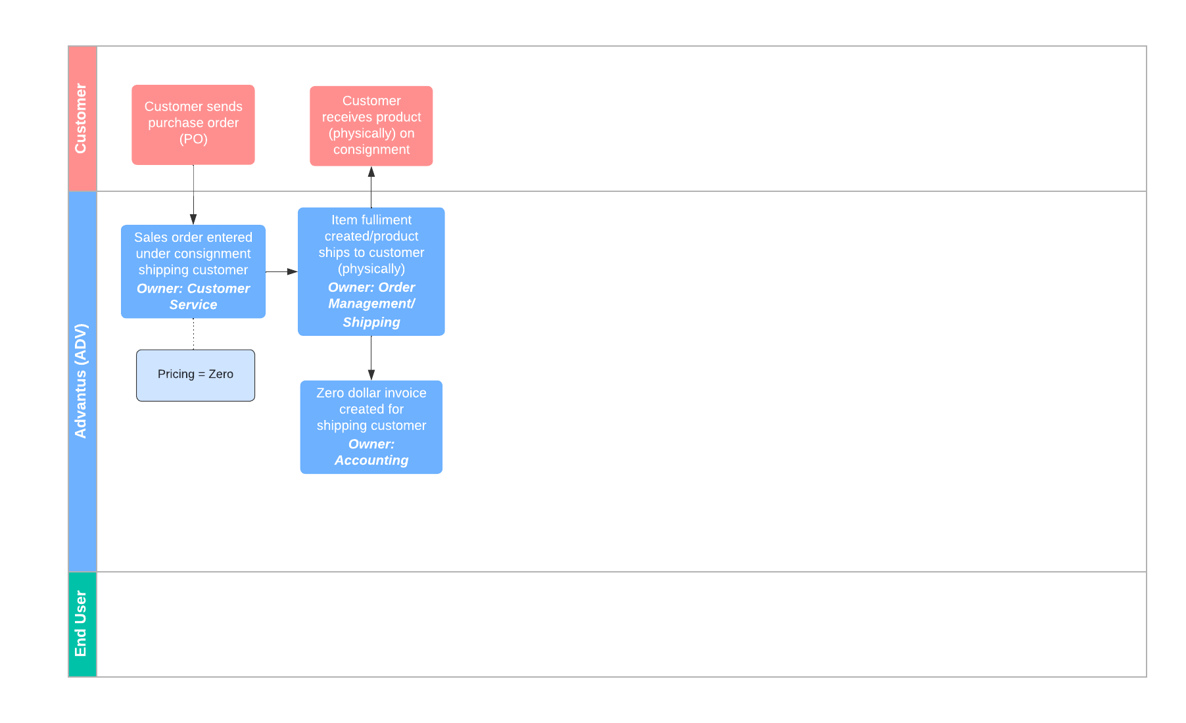
Consignment Process: General

Slide 17
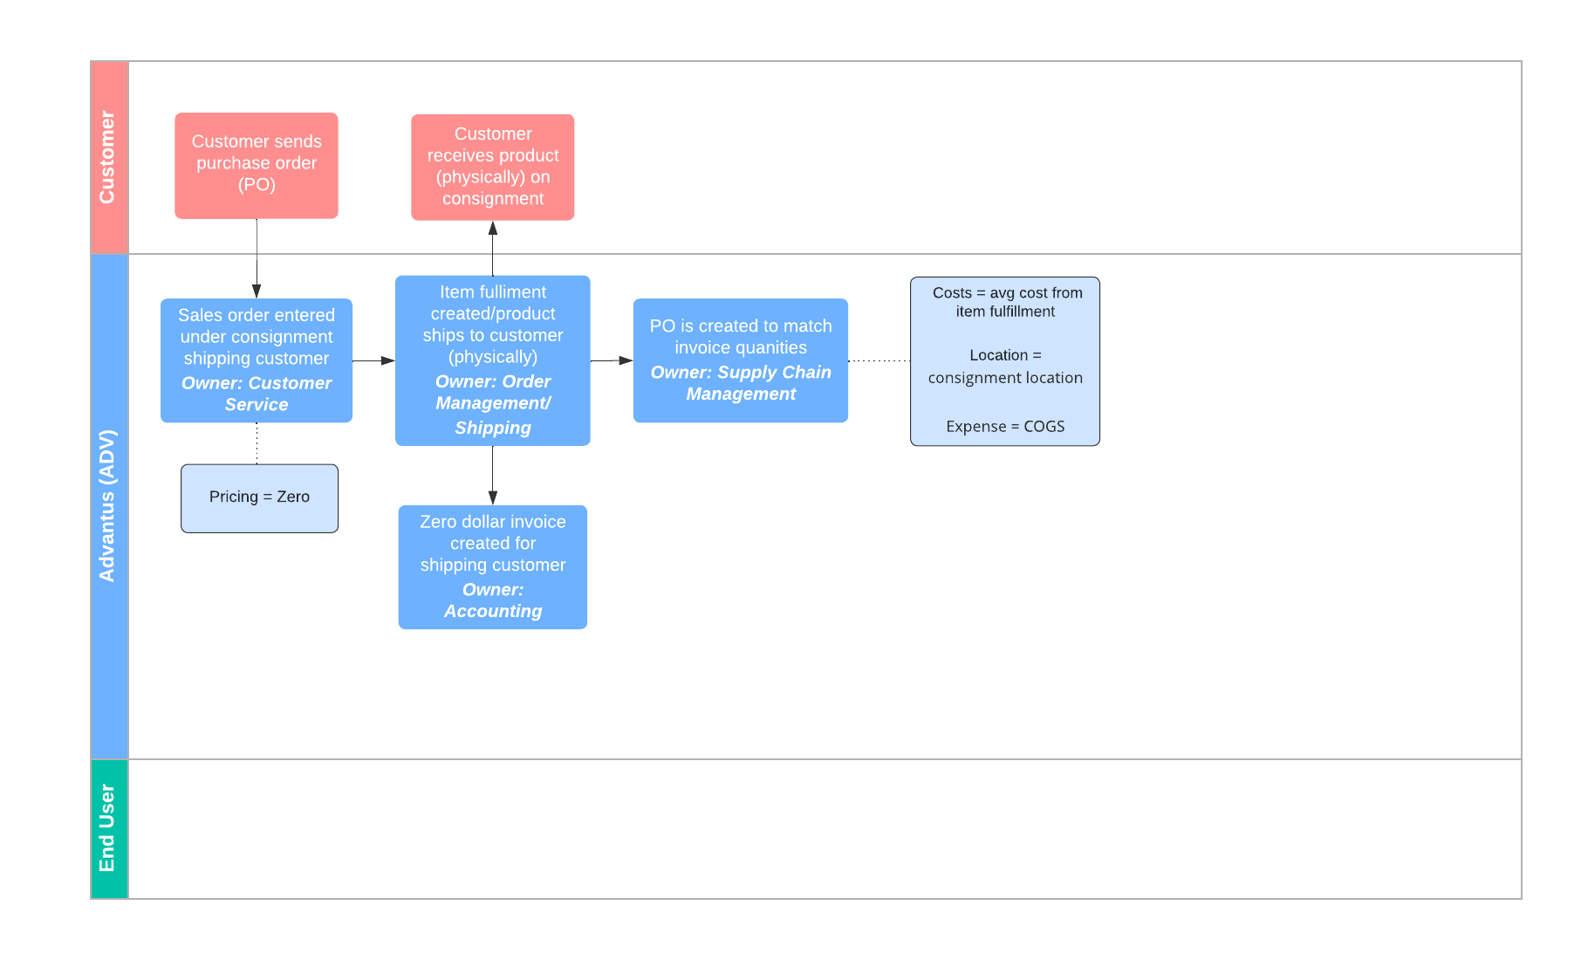
Consignment Process: General

Slide 18
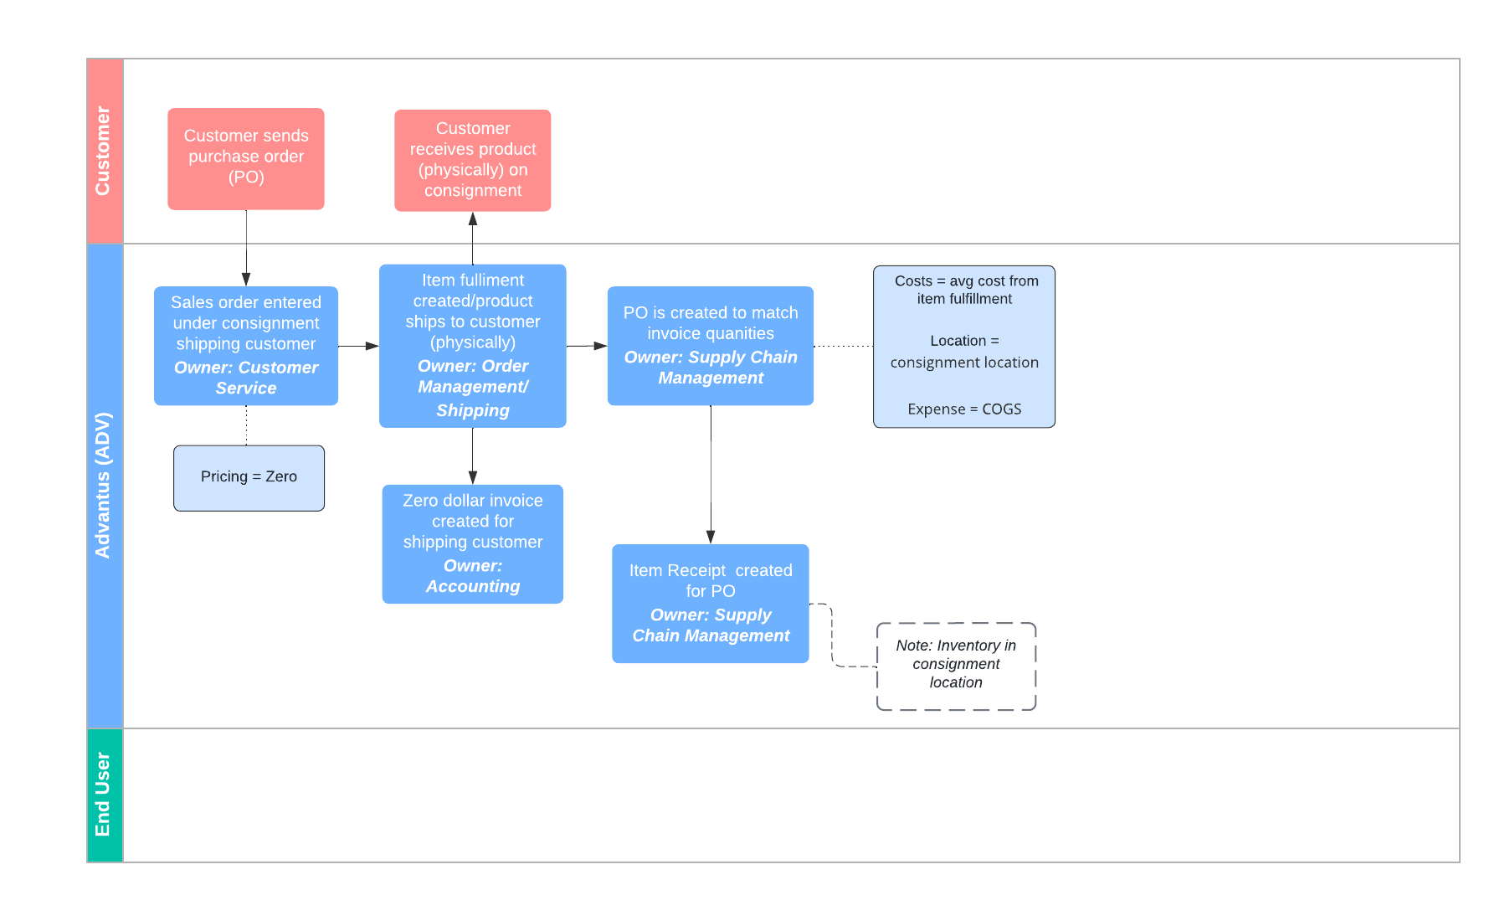
Consignment Process: General

Slide 19
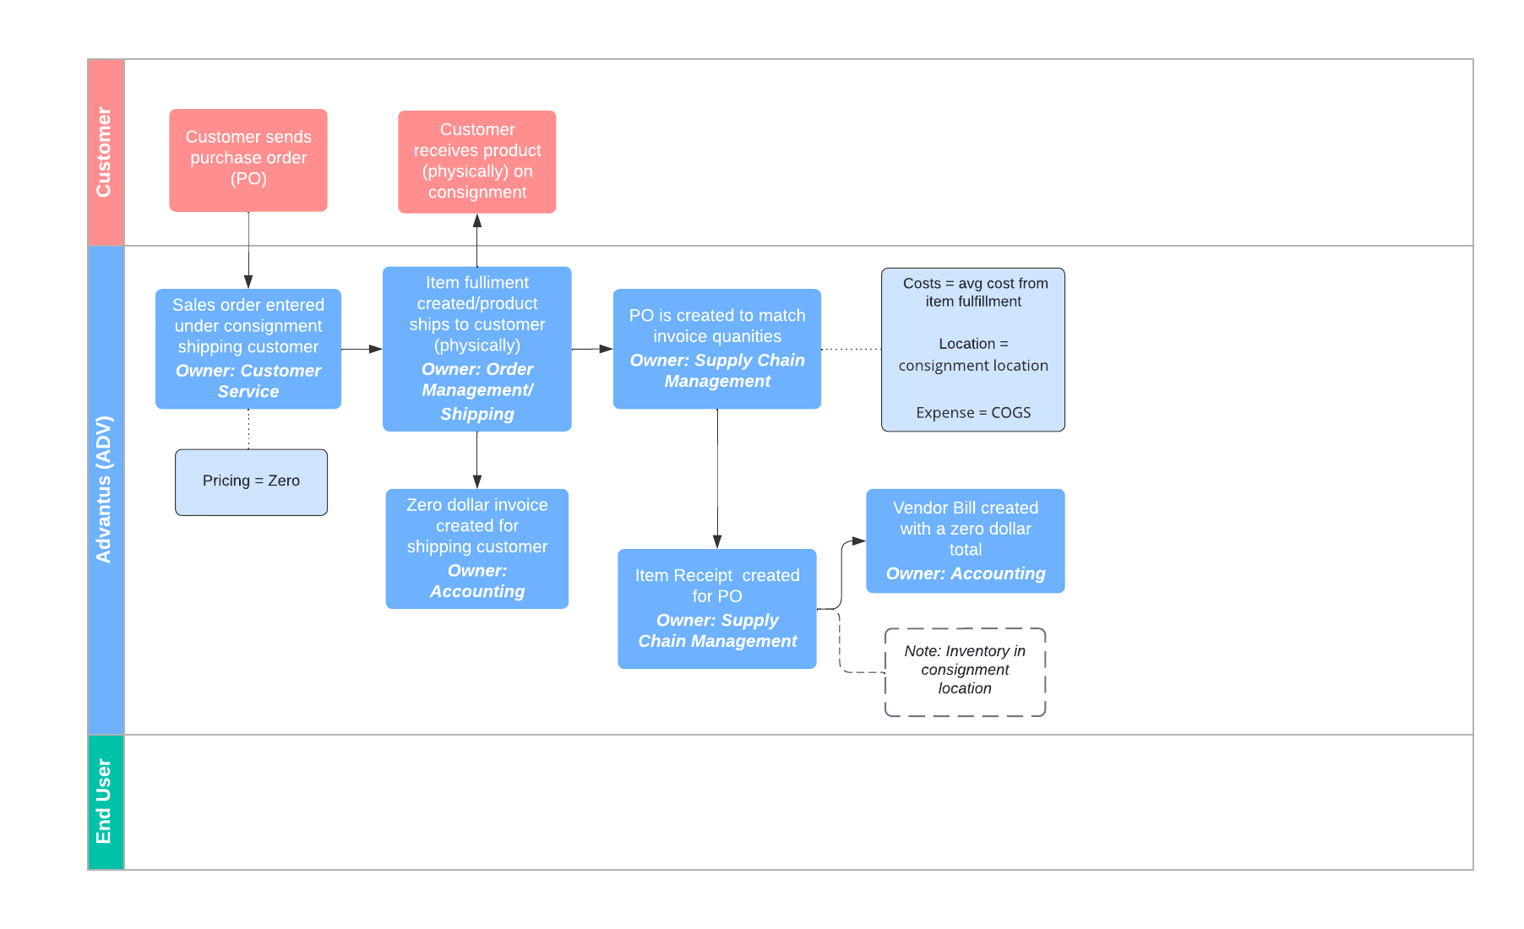
Consignment Process: General

Slide 20
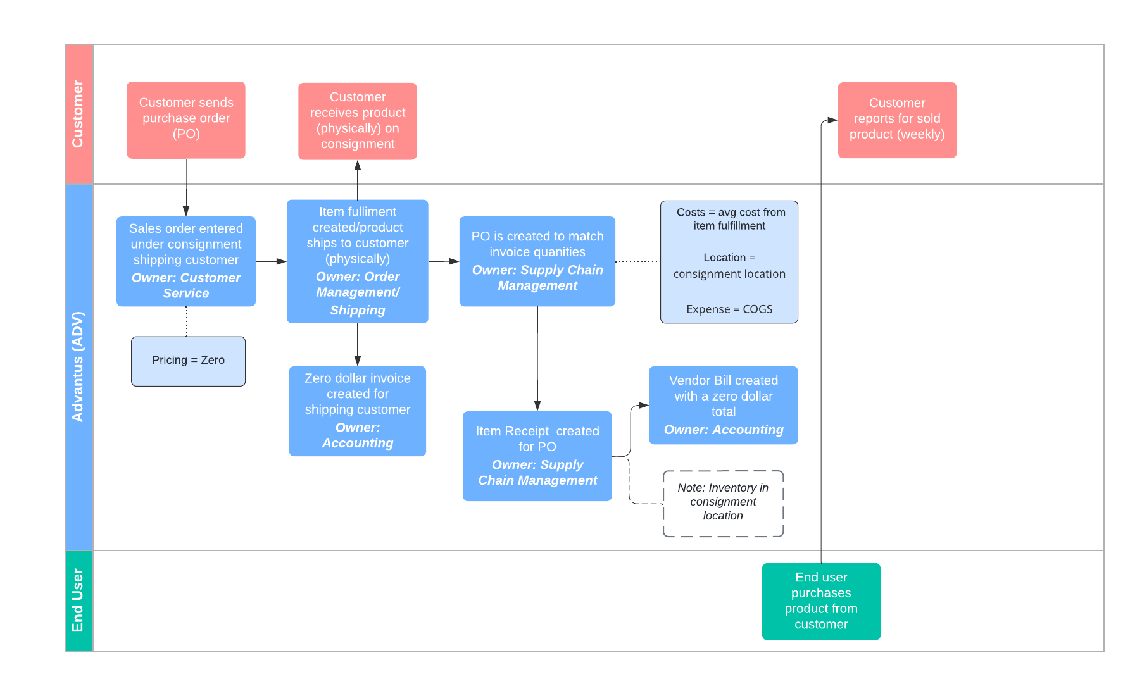
Consignment Process: General

Slide 21
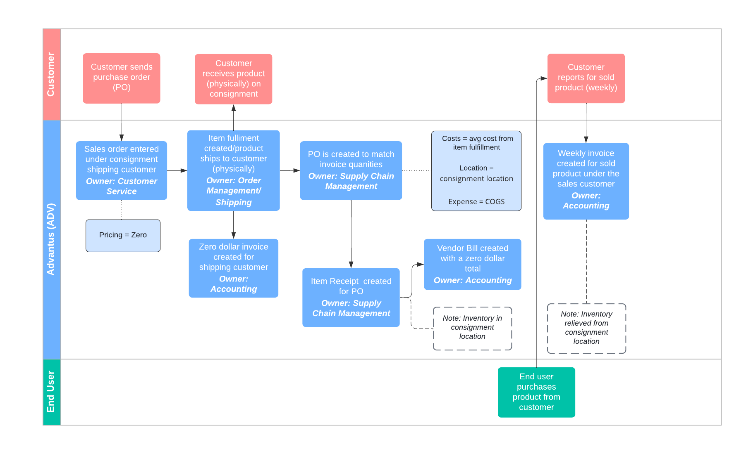
Consignment Process: General

Slide 22
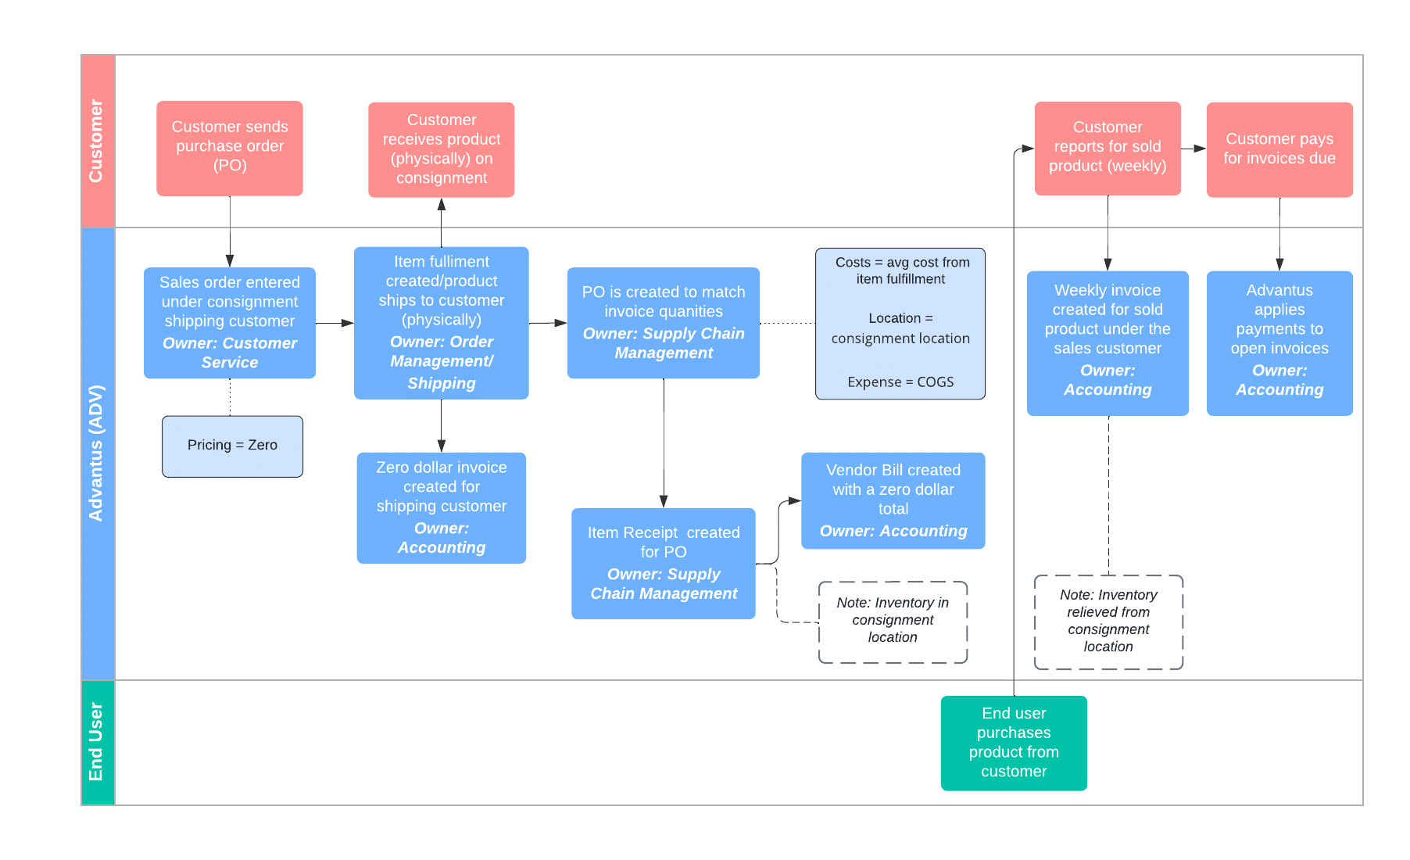
Consignment Process: General

Slide 23
Agenda
Overview
Setups
Processes
  General
  Staples Canada

Slide 24
Agenda
Overview
Setups
Processes
  General
  Staples Canada

Slide 25
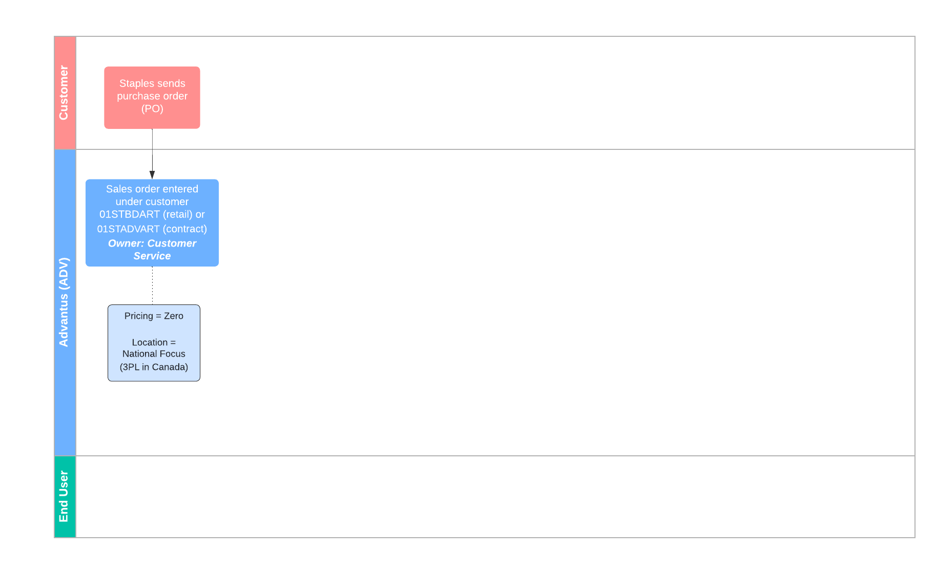
Consignment Process: Staples Canada

Slide 26
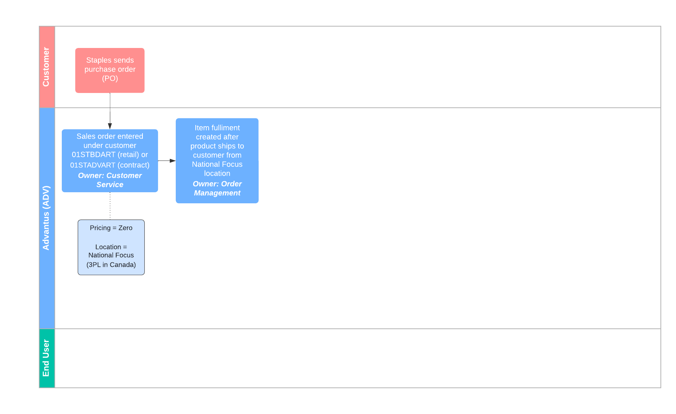
Consignment Process: Staples Canada

Slide 27
Consignment Process: Staples Canada

Slide 28
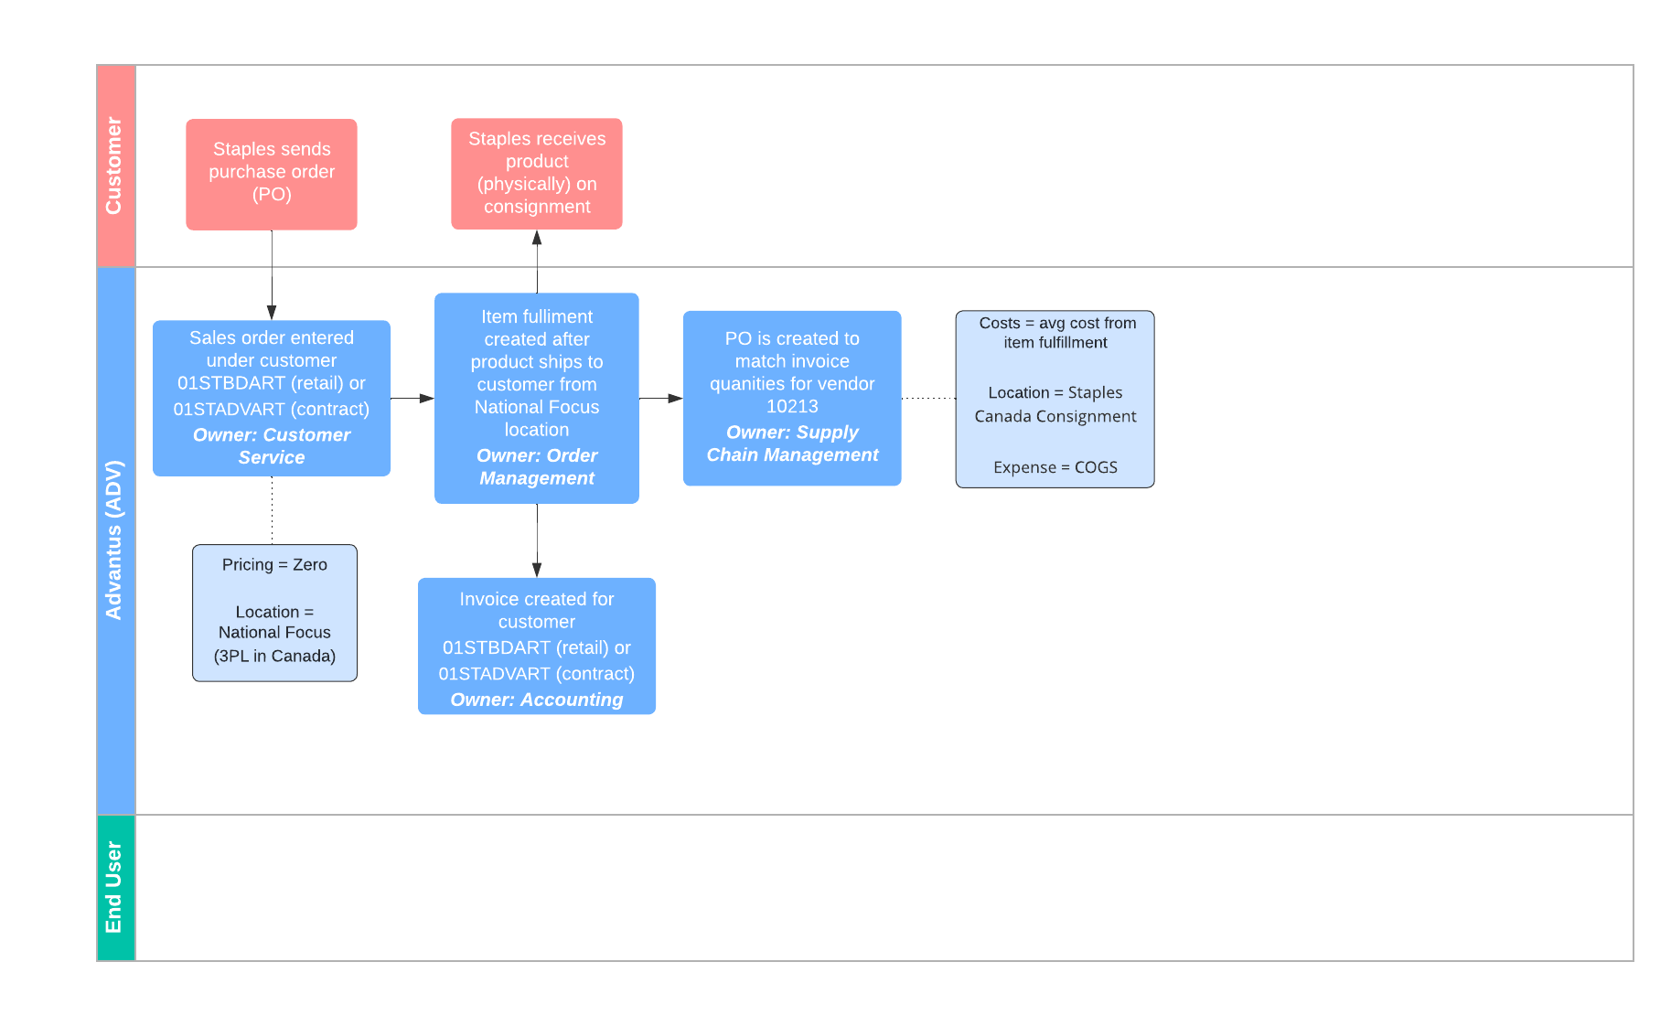
Consignment Process: Staples Canada

Slide 29
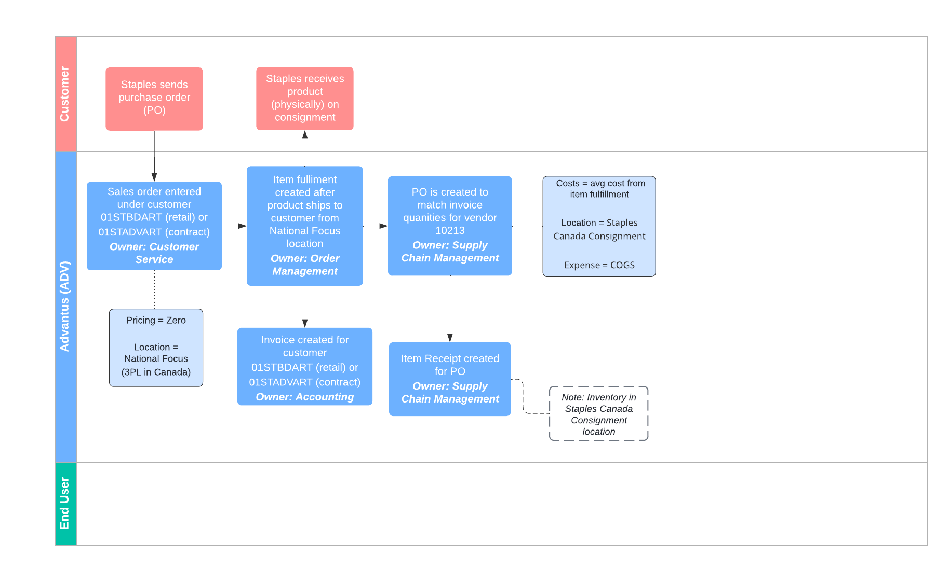
Consignment Process: Staples Canada

Slide 30
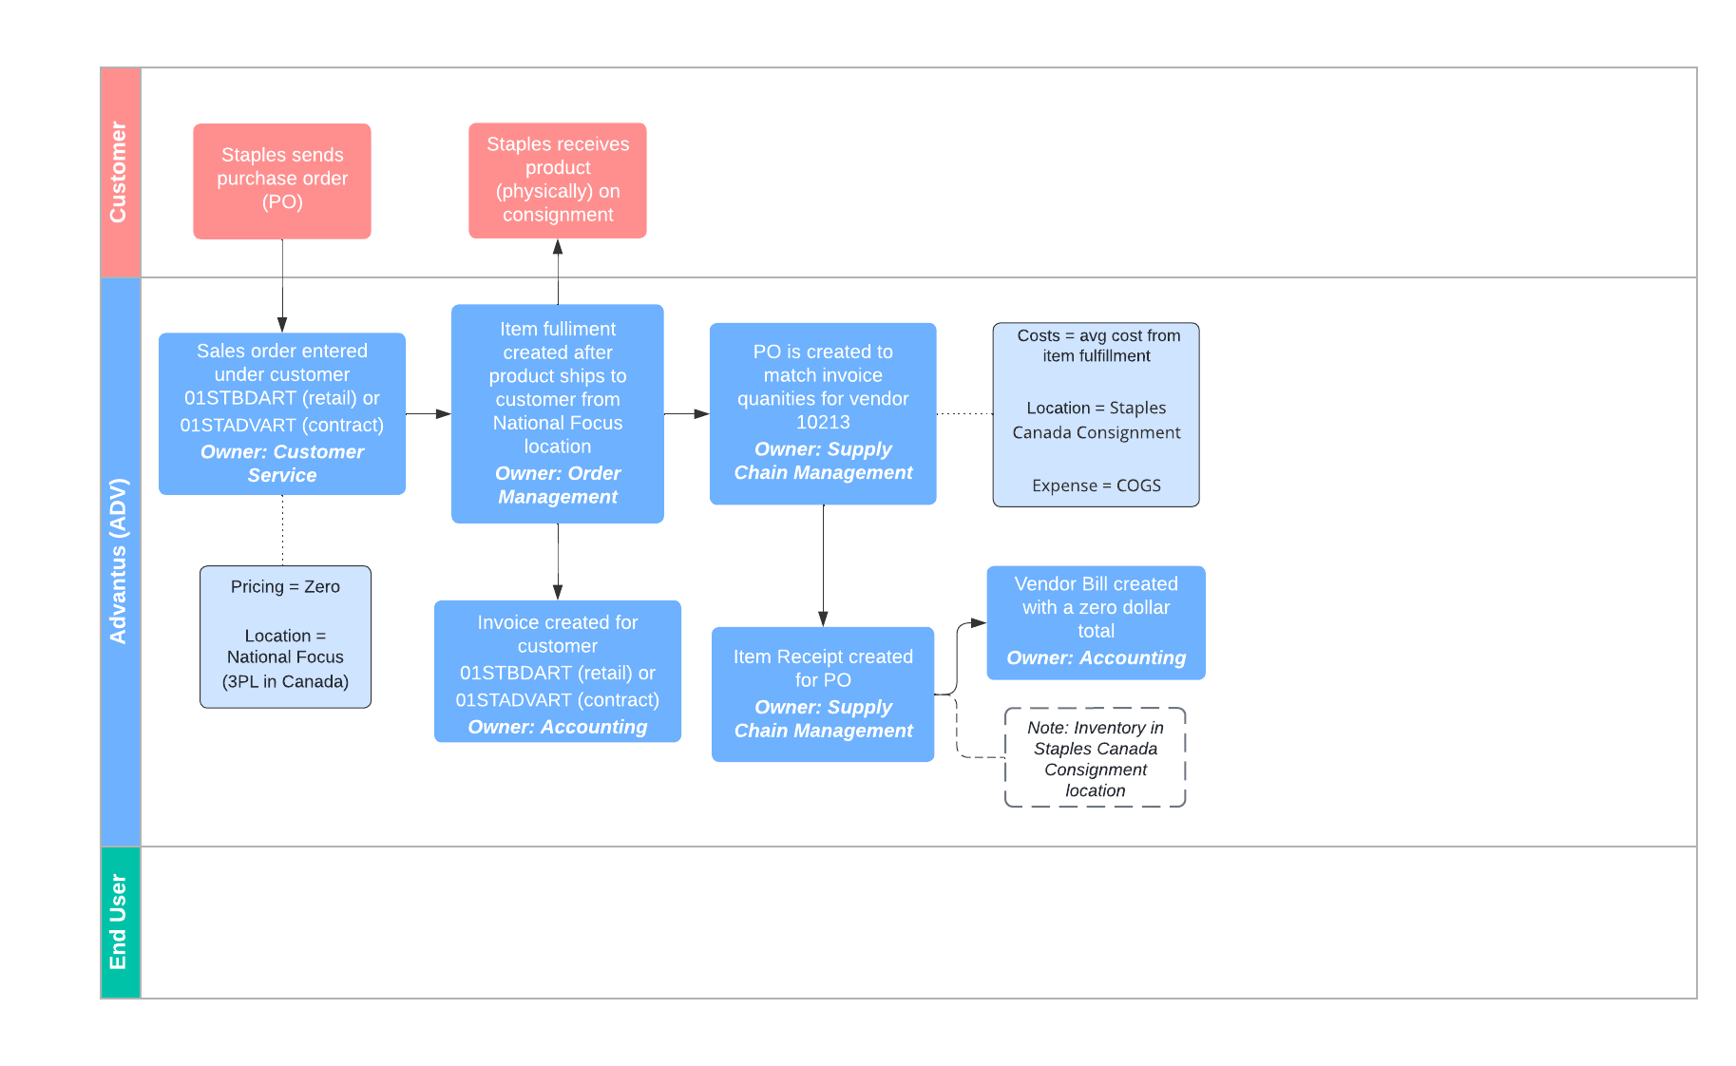
Consignment Process: Staples Canada

Slide 31
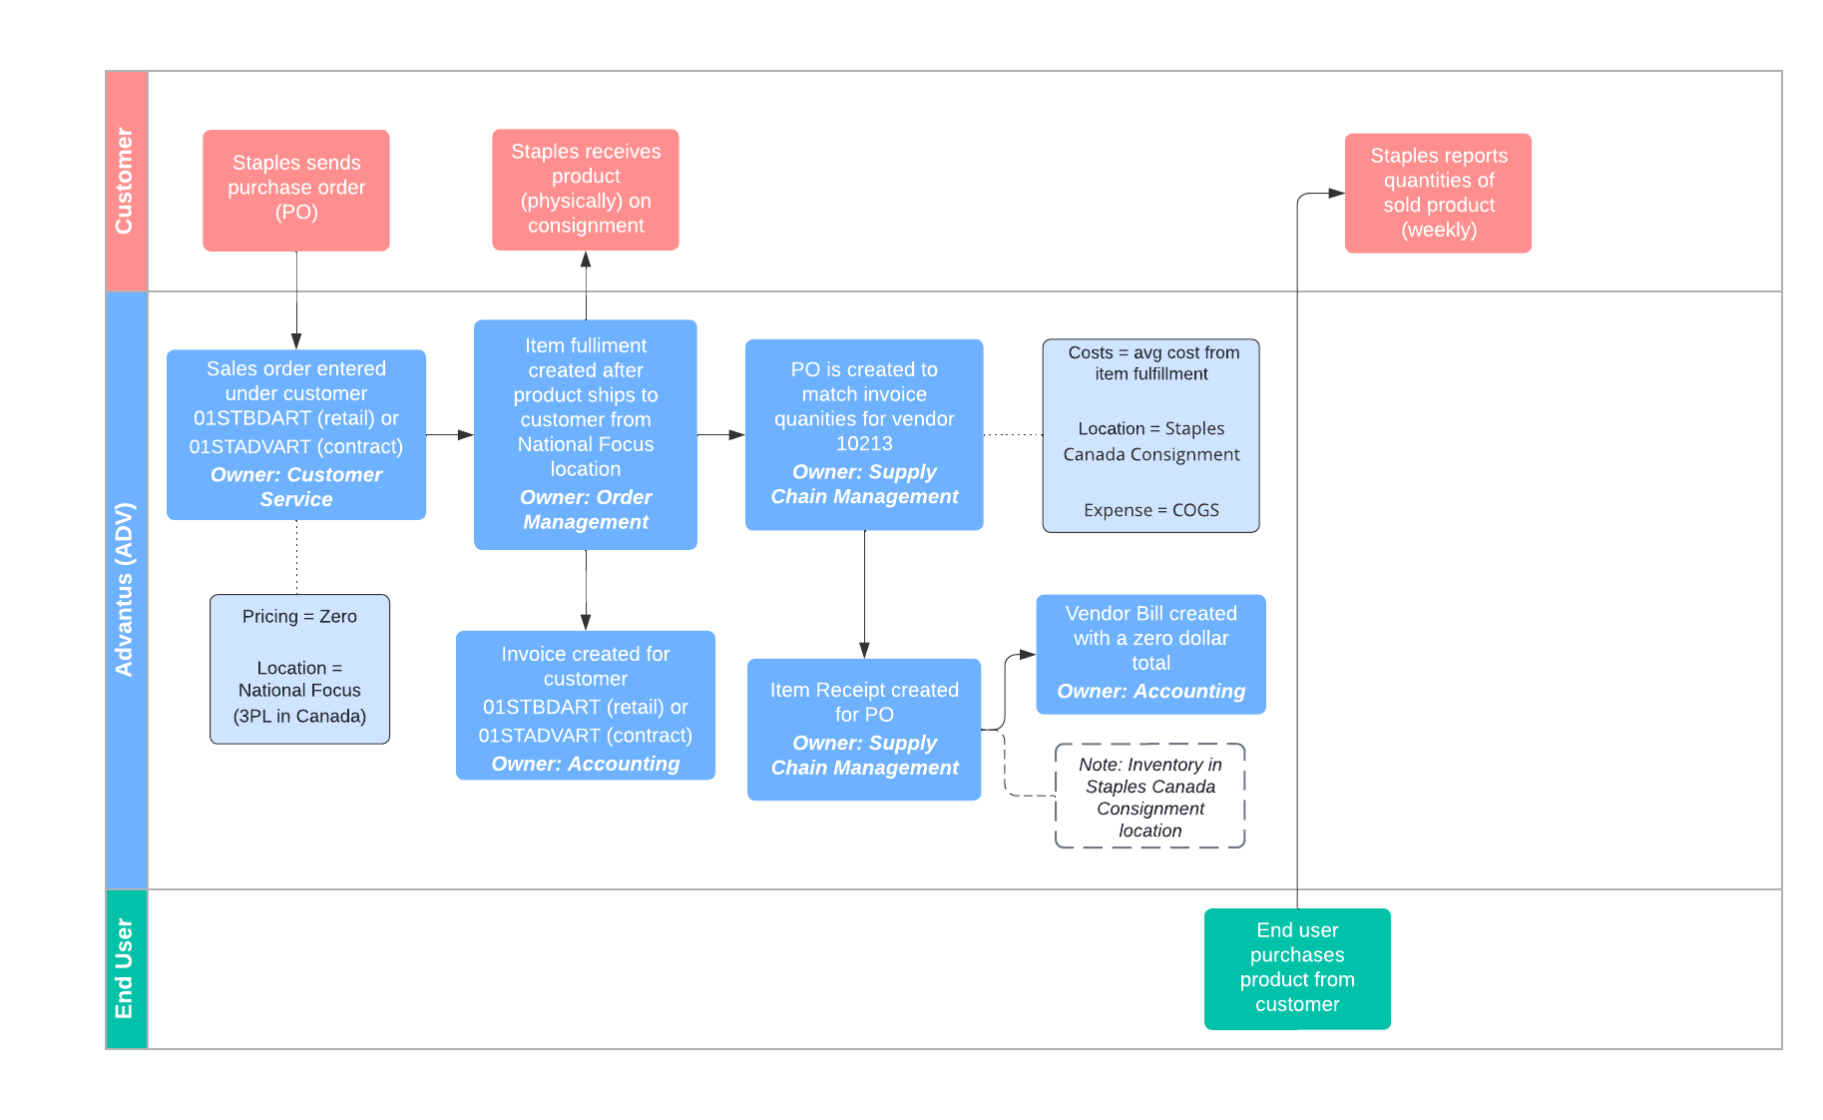
Consignment Process: Staples Canada

Slide 32
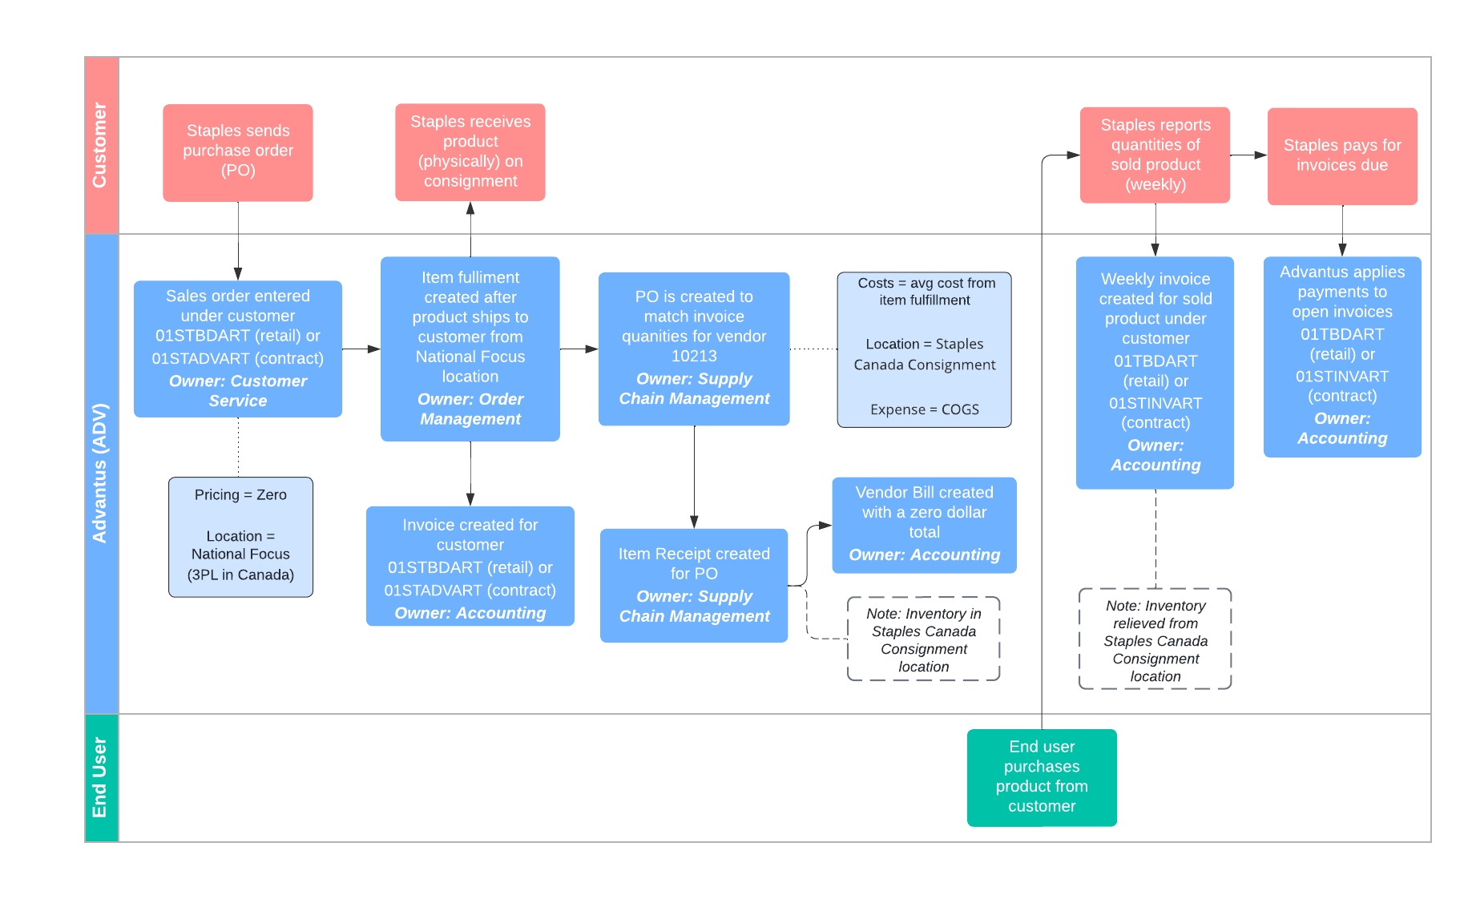
Consignment Process: Staples Canada

Slide 33
Consignment Process: Staples Canada

Slide 34
Agenda
Overview
Setups
Processes
  General
  Staples Canada

Slide 35
Agenda
Overview
Setups
Processes
  General
  Staples Canada

Slide 36

Questions?

