Slide 1
A guide to web scrubs

Slide 2
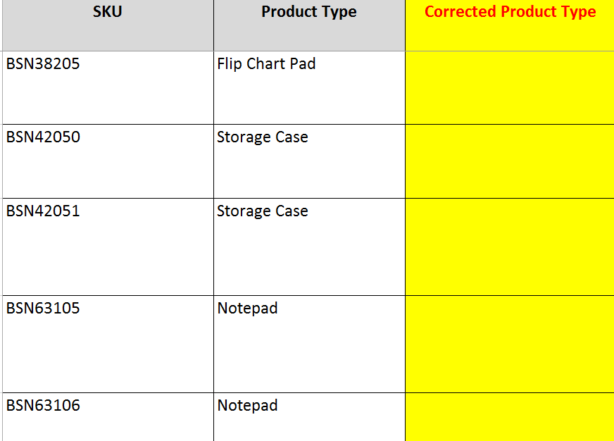
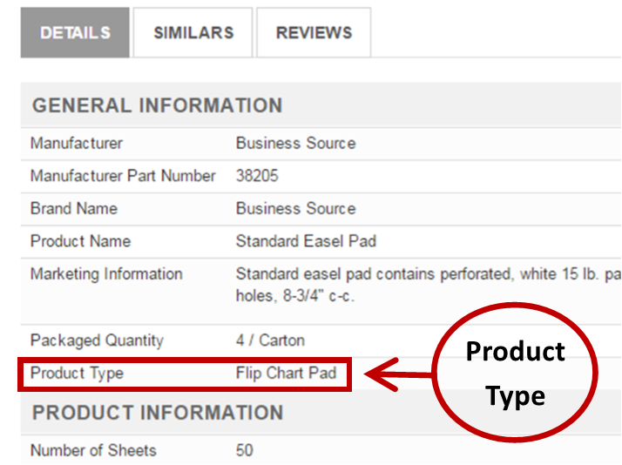
PRODUCT TYPE
Web Scrub
Enhanced Content

Slide 3
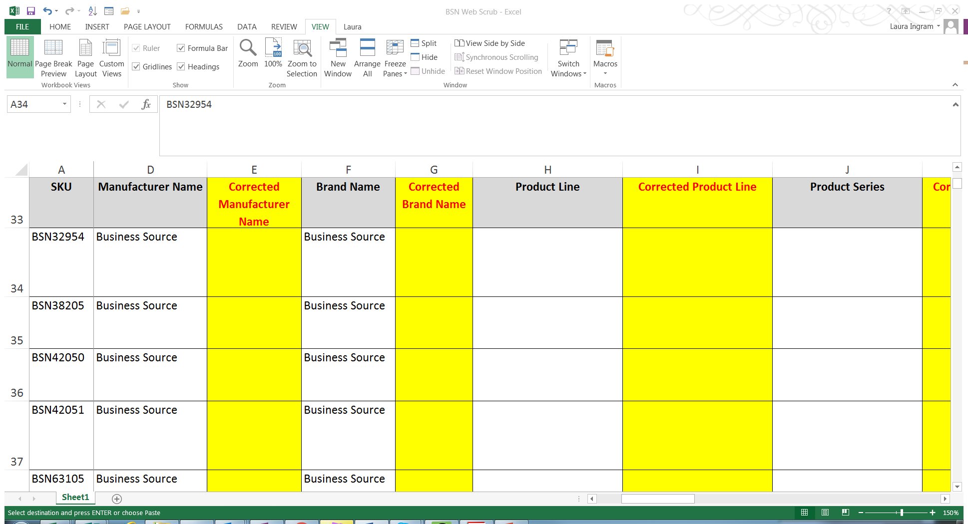
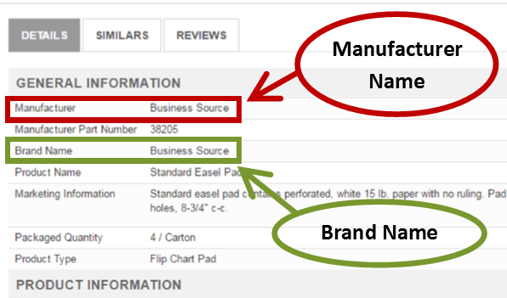
Manufacturer and Brand name
Web Scrub
Enhanced Content

Slide 4
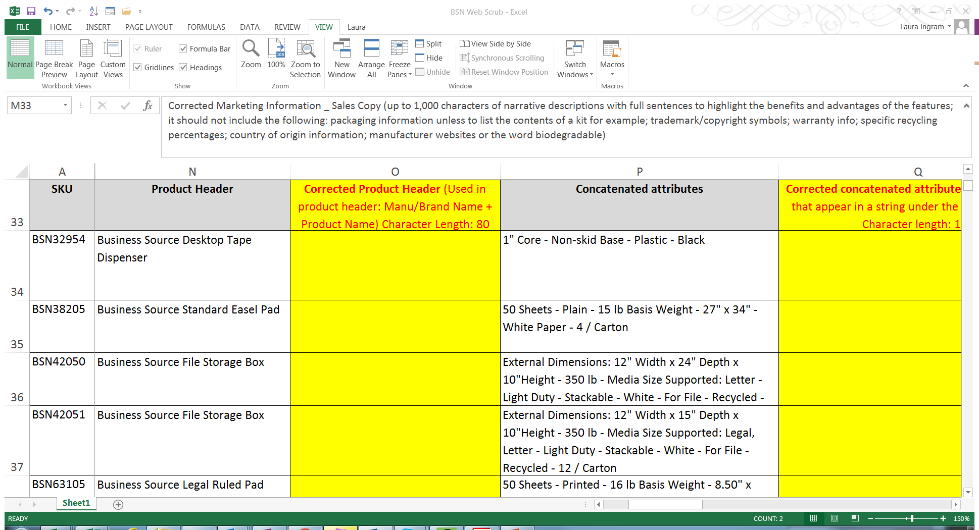
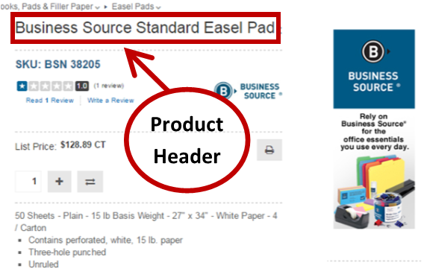
Product Header
Combines Brand Name + Product Name
Web Scrub
Enhanced Content

Slide 5
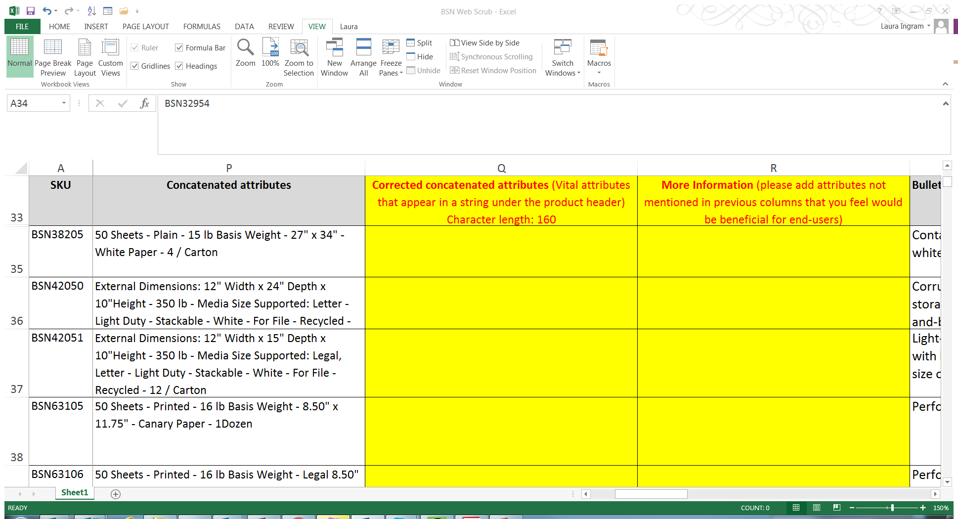
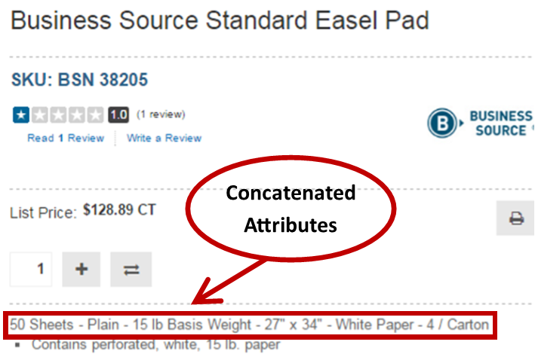
Concatenated Attributes
Vital features pulled from attribute listing, but not all attributes are listed here
Add only the attribute you want corrected: 16 lb. Basis Weight for example
Web Scrub
Enhanced Content

Slide 6
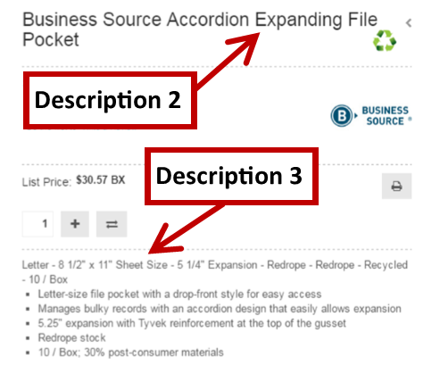
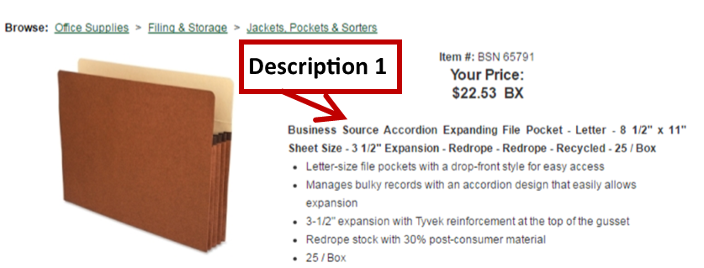
Side note: Description 1
Not included in the Web Scrub
Description 1 = Product Header (Desc. 2) + Concatenated Attributes (Desc. 3)
Description 1 = Another option for dealers
to describe products

Slide 7
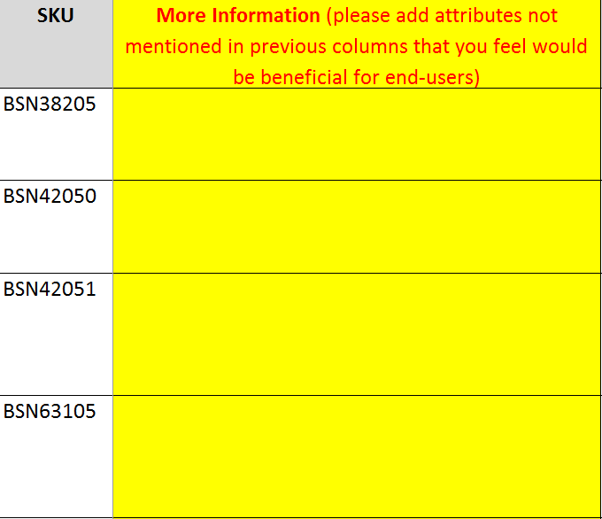
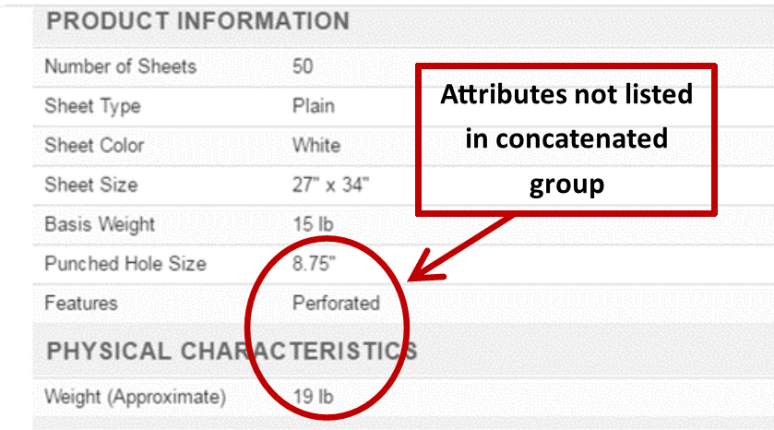
More information
Add any detail you want included that doesn’t appear in Product Header or Concatenated Attributes (which doesn’t include all attributes)
Web Scrub
Enhanced Content

Slide 8
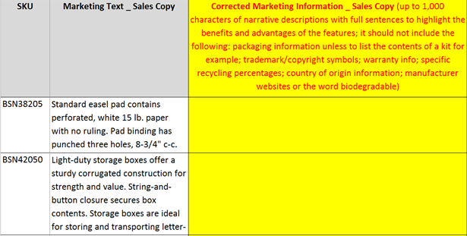
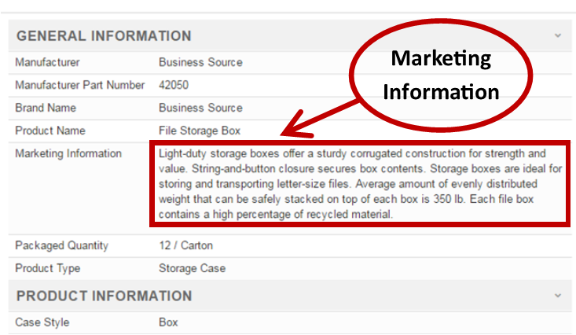
Marketing Information
Web Scrub
Enhanced Content

Slide 9
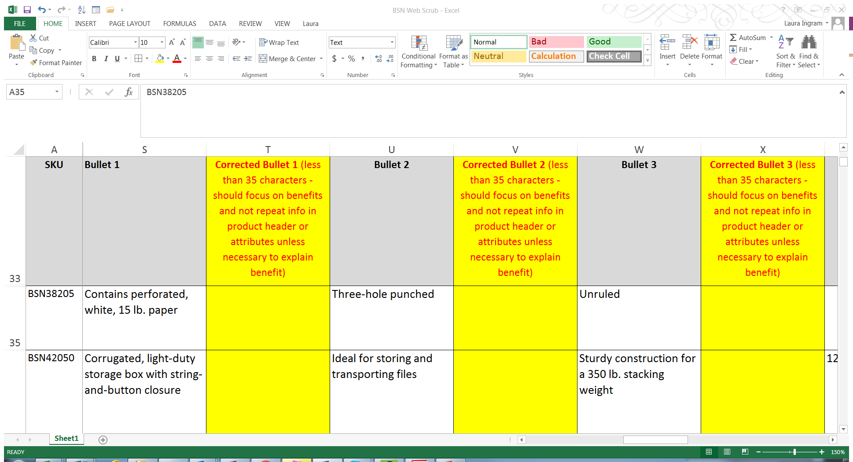
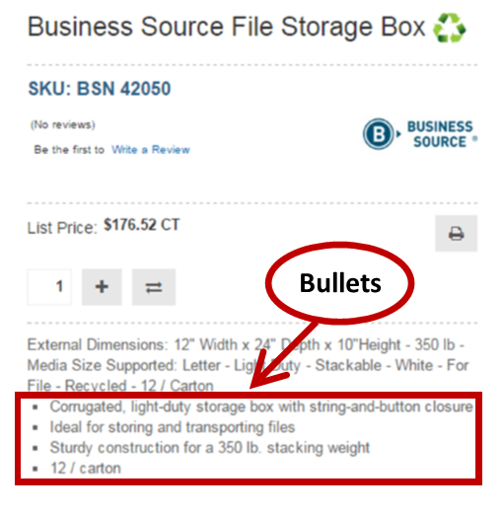
Bullets
Selling points packed with benefits of features, not features (attributes) already stated in the product header and concatenated attributes
Web Scrub
Enhanced Content

Slide 10
For questions or concerns
Contact Laura Ingram
Laura_ingram@sprich.com
770-779-4492

