Slide 1
Measuring Guide for Mercury Tactical Bags

Slide 2
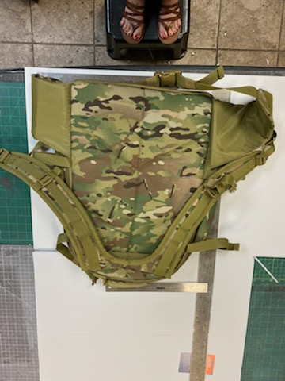
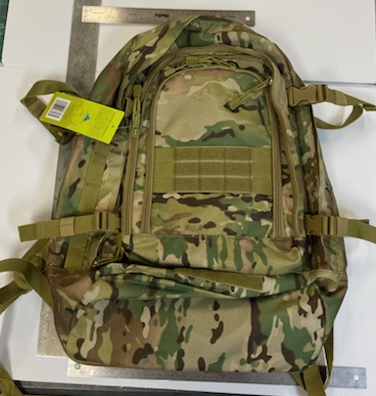
How to measure a backpack
Width
Height
Measure the width along the widest part of the bag
For backpacks, this will be at the bottom of the bag
Lay flat and measure
Include the top handle for bags with a structured handle

Slide 3
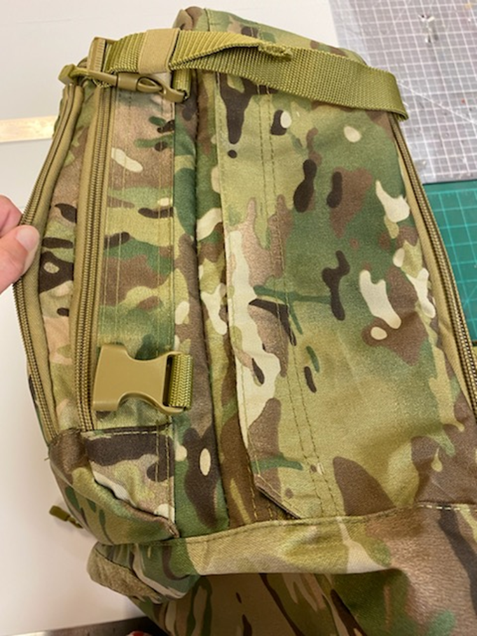
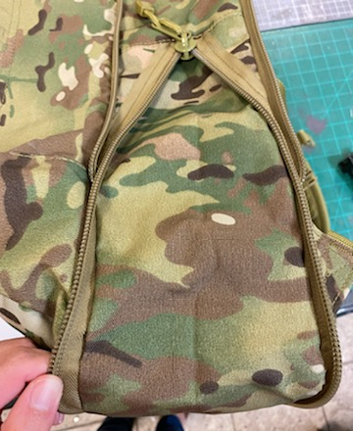
How to measure a backpack cont’d
Depth
Expansion
Holding the bag on it’s side, stretch taut, and measure from the back seam to the seam of the front pocket
Unzip the expansion, hold the bag on it’s side, stretch taut, and measure from the front seam to the back seam

Slide 4
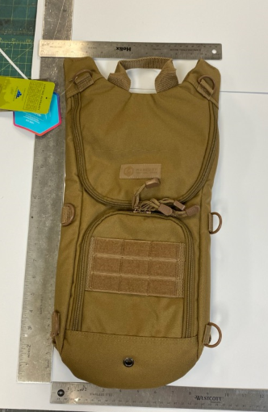
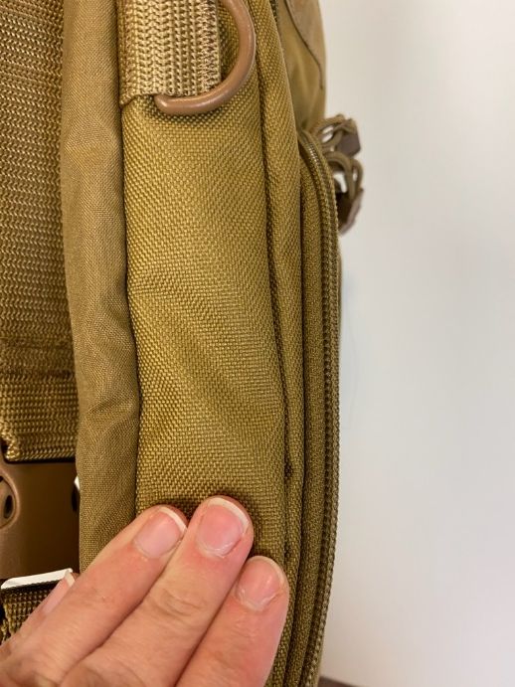
How to measure a Hydration Pack
Height
Depth
Measure flat
Measure from the bottom of the bag to the top of the structured backpack straps
Holding the bag on it’s side, stretch taut, and measure from the back seam to the seam of the front pocket

Slide 5
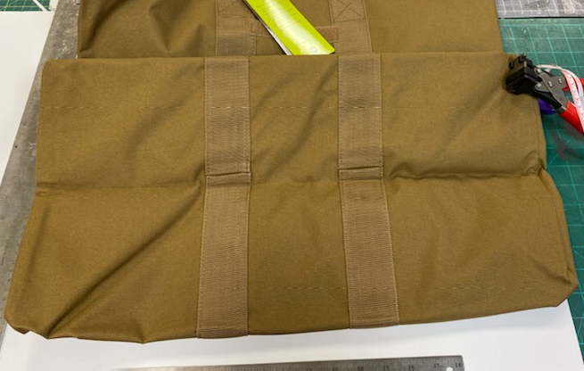
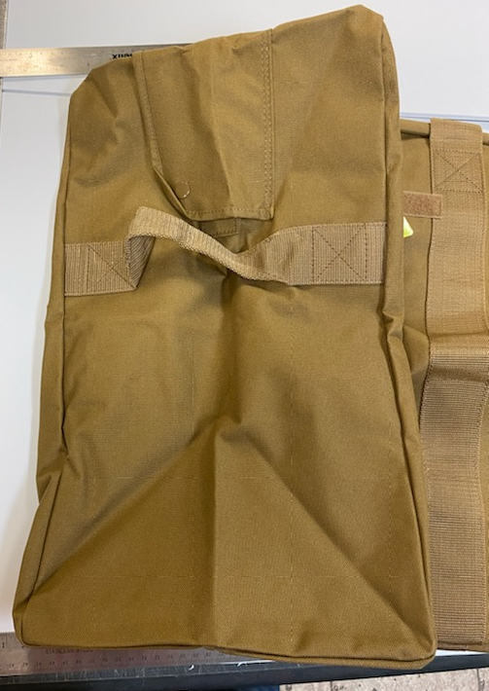
How to measure unstructured bags- Square
Square and rectangular bags should be measured flat.
Examples:
  Kit Bag
  War Bag
Depth
Height
Stretch taut and measure seam to seam
Stretch taut and measure seam to seam
Width
Stretch taut and measure the width along the bottom of the bag

Slide 6
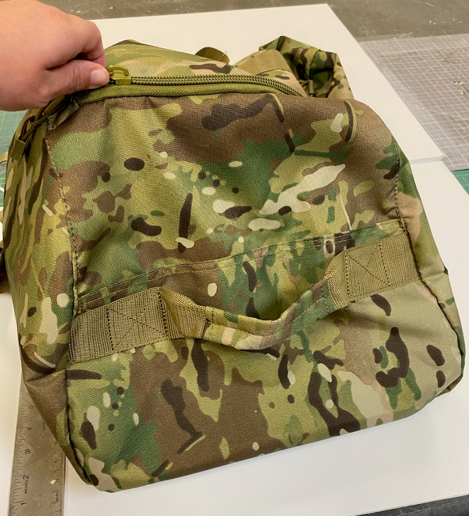
How to measure unstructured bags- Other shapes
On bags that are not square or rectangle follow these guidelines.
Examples:
  Giant Duffel Backpack
Depth
Height
Stretch taut and measure seam to seam
Stretch taut and measure seam to seam
Width
Lay flat, stretch taut, and measure the width along the bottom of the bag

Slide 7
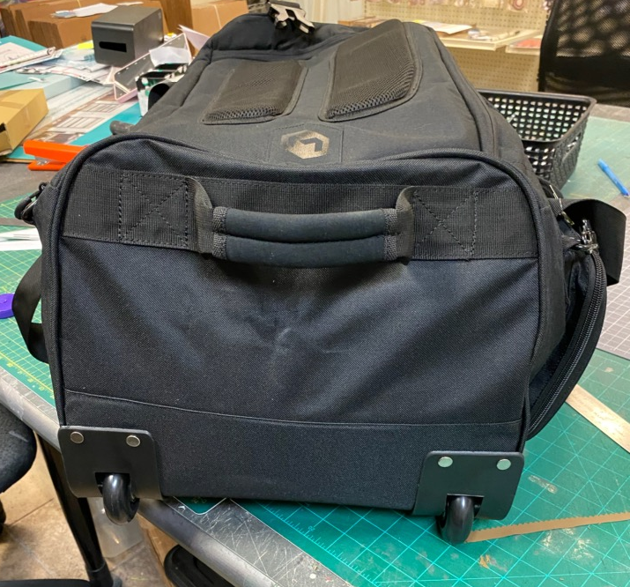
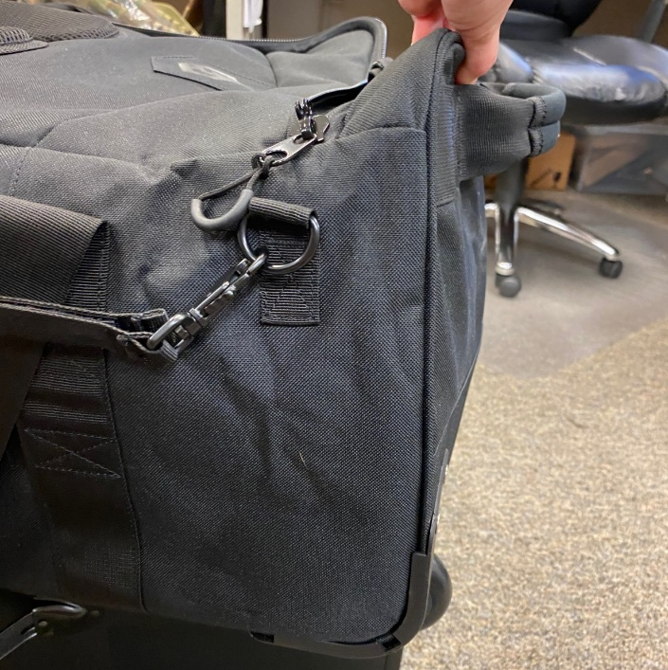
How to measure a structured duffel
  If bag has dividers, put them in place to help hold the shape of the bag
  Examples:
  Mini Monster
  Monster
  Campaign Deployment Pack
Instead, hold the bag taut, and measure from the bottom seem to the top seam
Height
For bags with wheels, do not measure height from the side with the wheels.

Slide 8
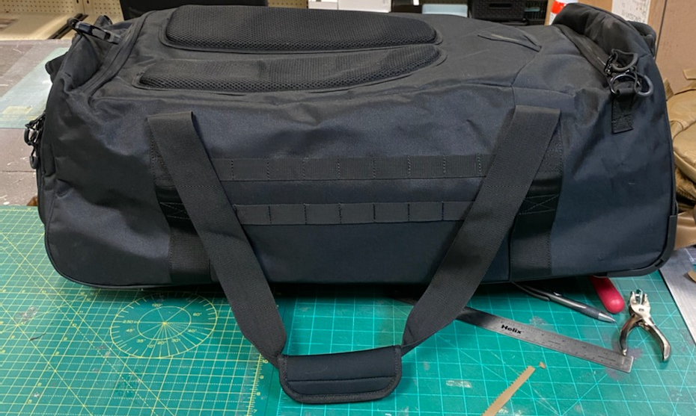
How to measure a structured duffel cont’d
Depth
Stretch taut and measure seam to seam
Width
Stretch taut and measure the width along the widest part of the bag
Add one inch to each end with a handle to include the handle

